Slide 1
Keep the customers most likely to leave
A low-cost, handset-age-targeted retention test for Company A, proven in a pilot before any rollout
39.5% → 59.3%
churn rate before vs after a handset passes 300 days
0.693 vs 0.500
model ROC-AUC vs no-skill baseline (test set)
6.4%
GCI World 2026 Final Assignment: Data Science and Business Consulting
SunilMandloi
of would-be churners the nudge must save to break even

Slide 2
Executive summary: a cheap, targeted nudge is worth testing, but it only pays above a break-even save rate
PROBLEM
EVIDENCE
US postpaid carriers lose about 0.9-1.0% of customers every month [1-3], roughly 11% a year.
Company A needs to decide whom to contact before they leave, and how much each contact may cost.
Handset age is the clearest warning sign: churn is 39.5% up to 300 days and 59.3% from 301 to 400 days.
A gradient-boosting model ranks risk with ROC-AUC 0.693 (no-skill = 0.500). At a realistic 1% base rate, its top 5% are 5.3x as likely to churn as average.
ACTION
IMPACT (CONDITIONAL)
Score customers monthly, then contact the top ~5% with a handset-upgrade or plan-review message costing about $0.75 or less.
Hold back a random half of the list so the true effect can be measured.
Break-even needs the nudge to save 6.4% of would-be churners. Base case is just below break-even before fixed costs; a $20 credit would need 32%.
Decision: approve a capped pilot (about $4,815 of contact cost), not a rollout.
Source: Company A dataset (100,000 customers); author analysis in SunilMandloi.ipynb. External churn: references [1]-[3].
2

Slide 3
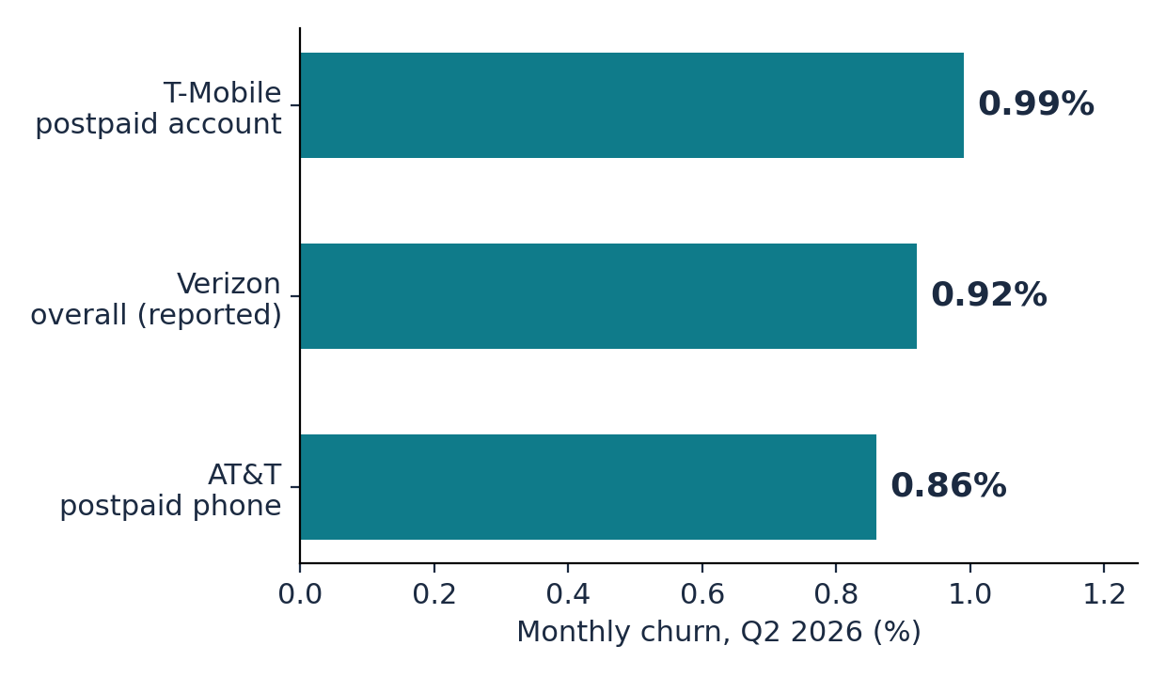
US carriers lose about 1% of customers a month, so a retention model has to work at a very low base rate
Retention is a growth lever.
Verizon says lower churn is its path to growing the customer base [2]; T-Mobile reports churn every quarter alongside ARPA [1].
The compounding is large.
At 0.99% a month, about 11.3% of customers leave within a year (author calculation, assuming a constant rate).
Implication for this project.
Company A's file shows 49.6% churn, far above the market, so it is enriched with churners. Rankings carry over; precision and counts must be rescaled to about 1%, which this deck does.
Churn rates are reported on different bases (accounts vs phone lines), so they are an order-of-magnitude anchor, not a like-for-like benchmark.
Sources: [1] T-Mobile Q2 2026 release (account churn); [2] Verizon Q2 2026 call (overall churn 0.92% as reported; consumer postpaid phone 0.84%); [3] AT&T Q2 2026 results as reported. Definitions differ across carriers.
3

Slide 4
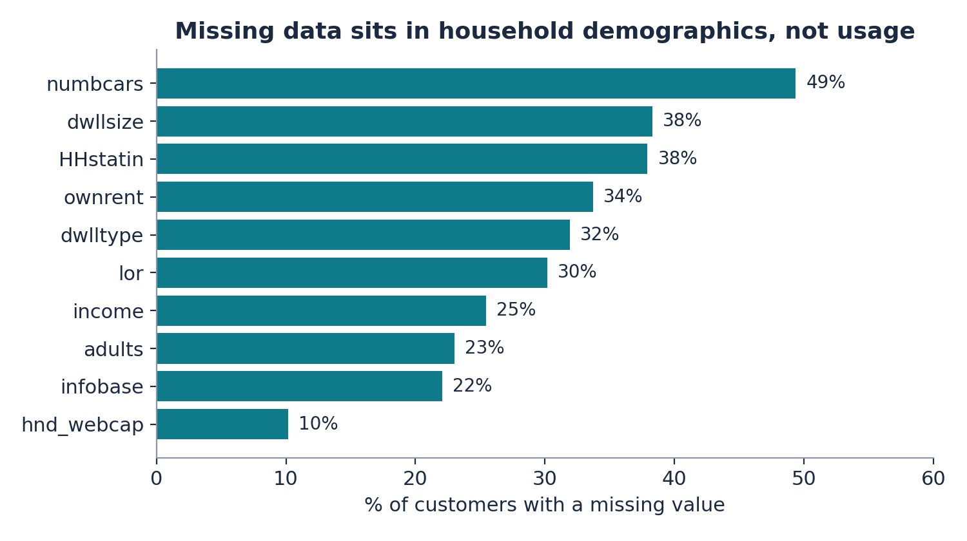
The data is clean and joins one-to-one, but it is enriched with churners and has no dates
Item | What we found
Files | Client.csv 100,000 x 50; Record.csv 100,000 x 51
Join on Customer_ID | 1:1; no missing or duplicate IDs; 0 unmatched; merged 100,000 x 100
Target | churn = left 31-60 days after the observation date (binary)
Class balance | 49.6% churned vs about 1% per month at US carriers [1-3]
Missing values | 43 of 100 columns; highest in household fields (up to 49%)
Model inputs | 97 features; Customer_ID and ethnic excluded (fairness)
Limits | No timestamps (no time-based test); currency not stated (USD assumed); regions anonymised
Why it matters
Missing demographics are imputed inside the model pipeline, with a flag so missingness can carry signal.
No single feature is suspiciously strong (best single-variable AUC 0.574), so we found no sign of target leakage.
Source: Company A dataset (100,000 customers); author analysis in SunilMandloi.ipynb.
4

Slide 5
Churn retention is the only direction with a labelled outcome, enough data and a clear action
Candidate problem | Business value | Data suitability | Model feasibility | Actionability | Evidence quality | Verdict
Churn retention targeting | H | H | H | M-H | M | Selected
Customer value segmentation | M | H | M | M | L | No outcome to validate
Usage decline / engagement | M | M | L-M | M | L | Only 3-6 month averages
Customer-service burden | L-M | L | L | L | L | No cost or outcome data
Business problem
Which customers should Company A contact before they leave, and how much can it afford to spend on each contact?
Task: binary classification of the supplied churn label. We show an association, not a cause: whether contacting a customer reduces churn is unknown until a controlled test measures it.
Ratings are the author's assessment after inspecting the files (H = high, M = medium, L = low). Selected option highlighted.
5

Slide 6
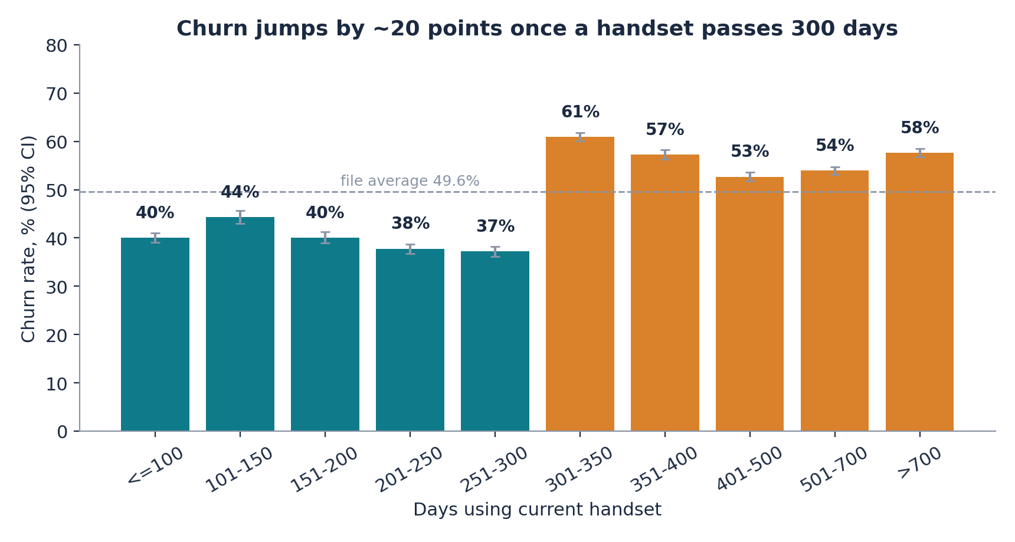
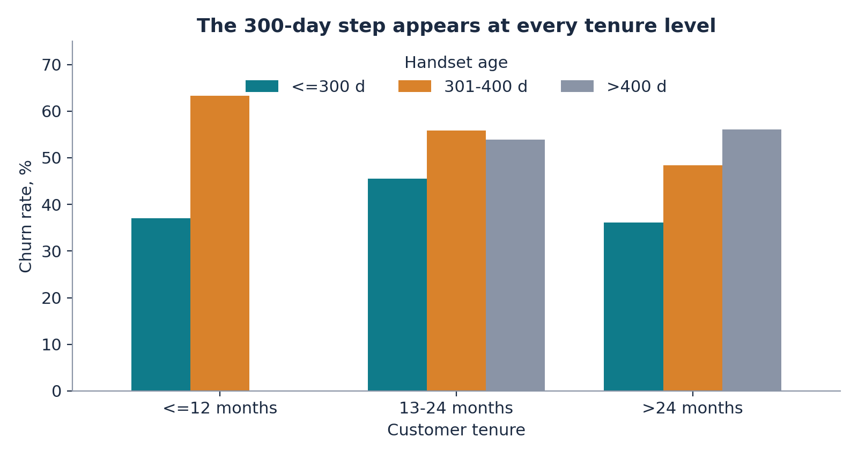
Churn jumps about 20 points once a handset passes 300 days, and it happens at every tenure level
What it shows. Churn is 39.5% for handsets up to 300 days old (n = 40,088) and 59.3% for 301-400 days (n = 20,866); p < 0.001.
Why it matters. A fixed date to act on: contact customers as they approach 300 days, before the jump.
But not enough alone. That group is 20.9% of customers yet holds only 25.0% of churners.
Robustness. Within every tenure group the step is there: 37% to 63% (up to 12 months), 46% to 56% (13-24), 36% to 48% (over 24).
What matters less. Revenue, usage trend and care calls move churn by at most about 8 points across their groups.
Source: Company A dataset (100,000 customers); author analysis in SunilMandloi.ipynb. Bars: churn rate with 95% confidence interval. Association, not proof of cause.
6

Slide 7
We tested four models on a held-back 20% of customers, choosing the winner before looking at it
Design choice | What we did
Target | churn (1 = left within 31-60 days)
Inputs | 97 usage, billing, handset and demographic fields (ethnic excluded)
Split | 80% train / 20% untouched test, stratified, seed 42
Tuning | 3-fold cross-validation on the training data only
No leakage | Imputing and scaling are fitted on training folds only
Models | Dummy baseline; logistic regression; random forest; gradient boosting (scikit-learn)
Main metric | ROC-AUC (ranking quality), plus PR-AUC, precision, recall, F1
Probabilities | Calibrated, then rescaled to a 1% monthly base rate
In plain language
ROC-AUC: the chance that a randomly chosen churner is ranked above a randomly chosen loyal customer. 0.5 is a coin flip; 1.0 is perfect.
Gradient boosting: many small decision trees built one after another, each correcting the last. It can learn a step such as the 300-day jump.
Calibration: turning scores into honest probabilities, so a 5% score means about 5%.
Hold-out test: customers the model never saw, so the scores are not flattering.
Source: Company A dataset (100,000 customers); author analysis in SunilMandloi.ipynb. Full protocol in notebook sections 6-10.
7

Slide 8
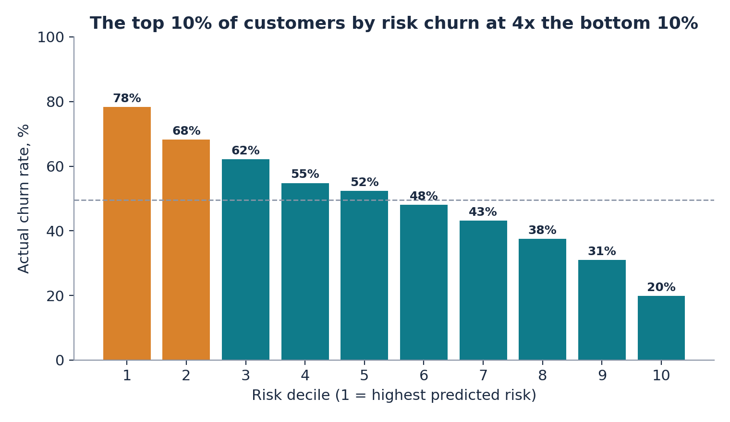
Gradient boosting ranks churn risk well above chance: ROC-AUC 0.693 against 0.500 for the baseline
Model | CV ROC-AUC | Test ROC-AUC | Test PR-AUC | Accuracy | Precision | Recall | F1
Dummy (prior) | 0.500 | 0.500 | 0.496 | 0.504 | 0.000 | 0.000 | 0.000
Logistic regression | 0.641 | 0.644 | 0.630 | 0.607 | 0.609 | 0.580 | 0.594
Random forest | 0.673 | 0.675 | 0.658 | 0.623 | 0.614 | 0.645 | 0.629
Gradient boosting (selected) | 0.689 | 0.693 | 0.681 | 0.636 | 0.630 | 0.645 | 0.638
Selected: gradient boosting. Test ROC-AUC 0.693 (95% bootstrap interval 0.687-0.701) vs 0.500 for the baseline; PR-AUC 0.681.
Honest reading. Churn is moderately predictable, not predictable person by person. The value is in ranking: it tells us whom to contact first.
Accuracy of 63.6% is not the headline. A 50/50 file makes accuracy a weak guide to how the model works at about 1% real churn.
Top 10% of customers by predicted risk: 78% actually churned. Bottom 10%: 20%.
Ranking quality is similar across areas (AUC 0.64-0.73) but stronger for first-year customers (about 0.75) than for 13-24 month customers (about 0.65).
Source: Company A dataset (100,000 customers); author analysis in SunilMandloi.ipynb. Test set = 20,000 customers; accuracy is shown with caution because the file is almost 50/50.
8

Slide 9
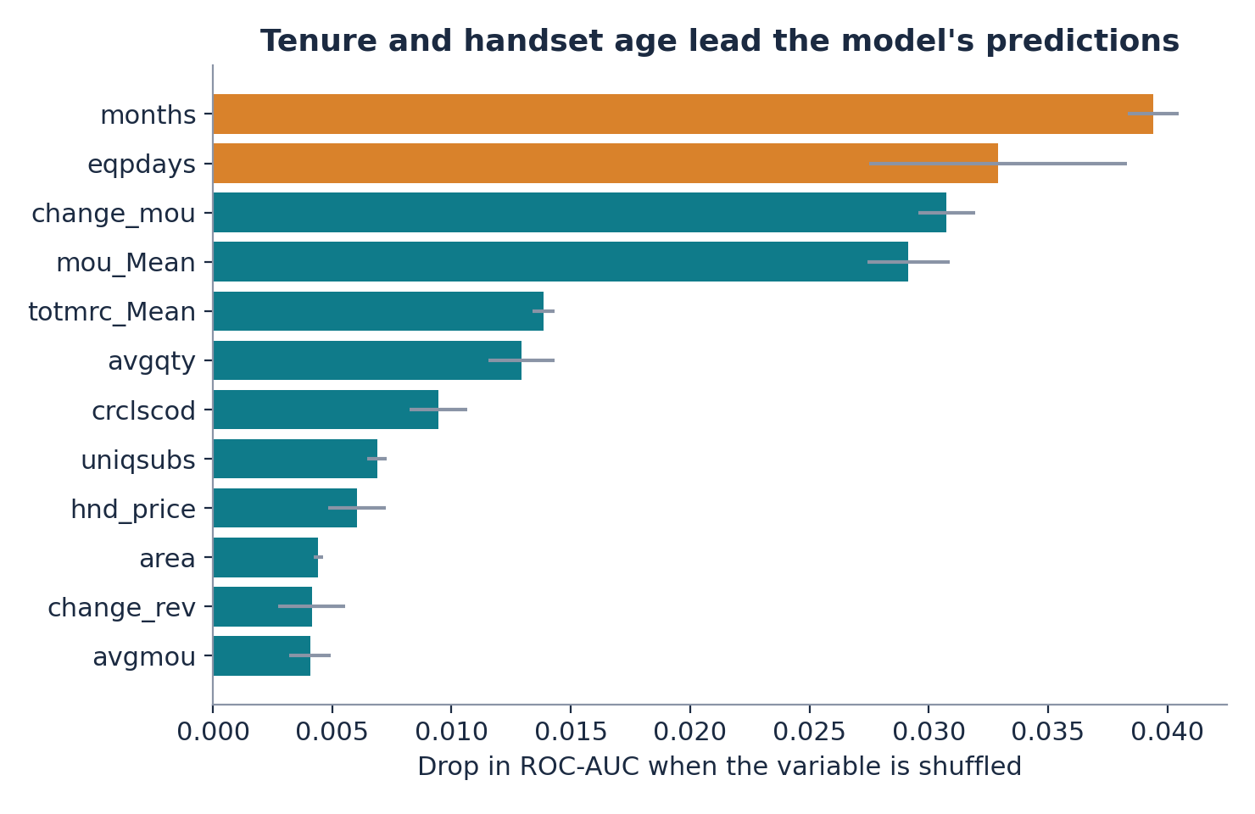
Tenure and handset age drive the model, and it beats a simple handset-age rule, but most contacts would have stayed anyway
Contact | Churn rate in file | Precision at 1% base rate | Lift at 1% base rate
Model: top 5% | 84.6% | 5.3% | 5.3x
Model: top 10% | 78.3% | 3.6% | 3.6x
Model: top 20% | 73.3% | 2.7% | 2.7x
Rule: handset 301-400 days | 59.8% | 1.5% | 1.5x
So what. At a realistic base rate, about 95% of the top-5% contacts would have stayed anyway.
The model adds real value over the rule: 5.3x lift for the top 5% vs 1.5x for the handset-age rule.
Therefore each contact must be cheap, and its effect must be measured, not assumed.
Tenure (months) and handset age (eqpdays) lead, followed by the change in minutes of use and total minutes. Only the first two are things Company A can plan an offer around. Predictive importance does not mean changing a variable changes behaviour.
Source: Company A dataset (100,000 customers); author analysis in SunilMandloi.ipynb. Importance = drop in test ROC-AUC when a variable is shuffled (predictive, not causal). 1% base rate = assumption anchored on [1]-[3].
9

Slide 10
Proposed solution: a monthly risk list, a cheap nudge, and a hold-out group that proves whether it works
1 Data
2 Risk score
3 Target list
4 Nudge
5 Measure
Billing, usage and handset age already held in Company A systems
Model scores every customer monthly (probability of leaving in 31-60 days)
Top ~5% by risk; half are randomly held back (no contact)
SMS, app or email: handset-upgrade eligibility, plan review (about $0.75 or less)
Compare churn in contacted vs held-back customers each month
Team | Responsibility | Output / KPI
Data and analytics | Run monthly scoring; monitor ROC-AUC and calibration by tenure group | Ranked list; AUC and calibration report
CRM and marketing | Send the nudge; keep the hold-out untouched | Contact rate; opt-out rate
Finance | Own margin, cost and fixed-cost inputs | Net benefit per wave; ROI
Legal and compliance | Consent, privacy and fairness review (ethnic not used) | Sign-off before launch
Conceptual workflow; PoC uses existing CRM and campaign tools plus one scheduled scoring job. No new platform is needed to test the idea.
10

Slide 11
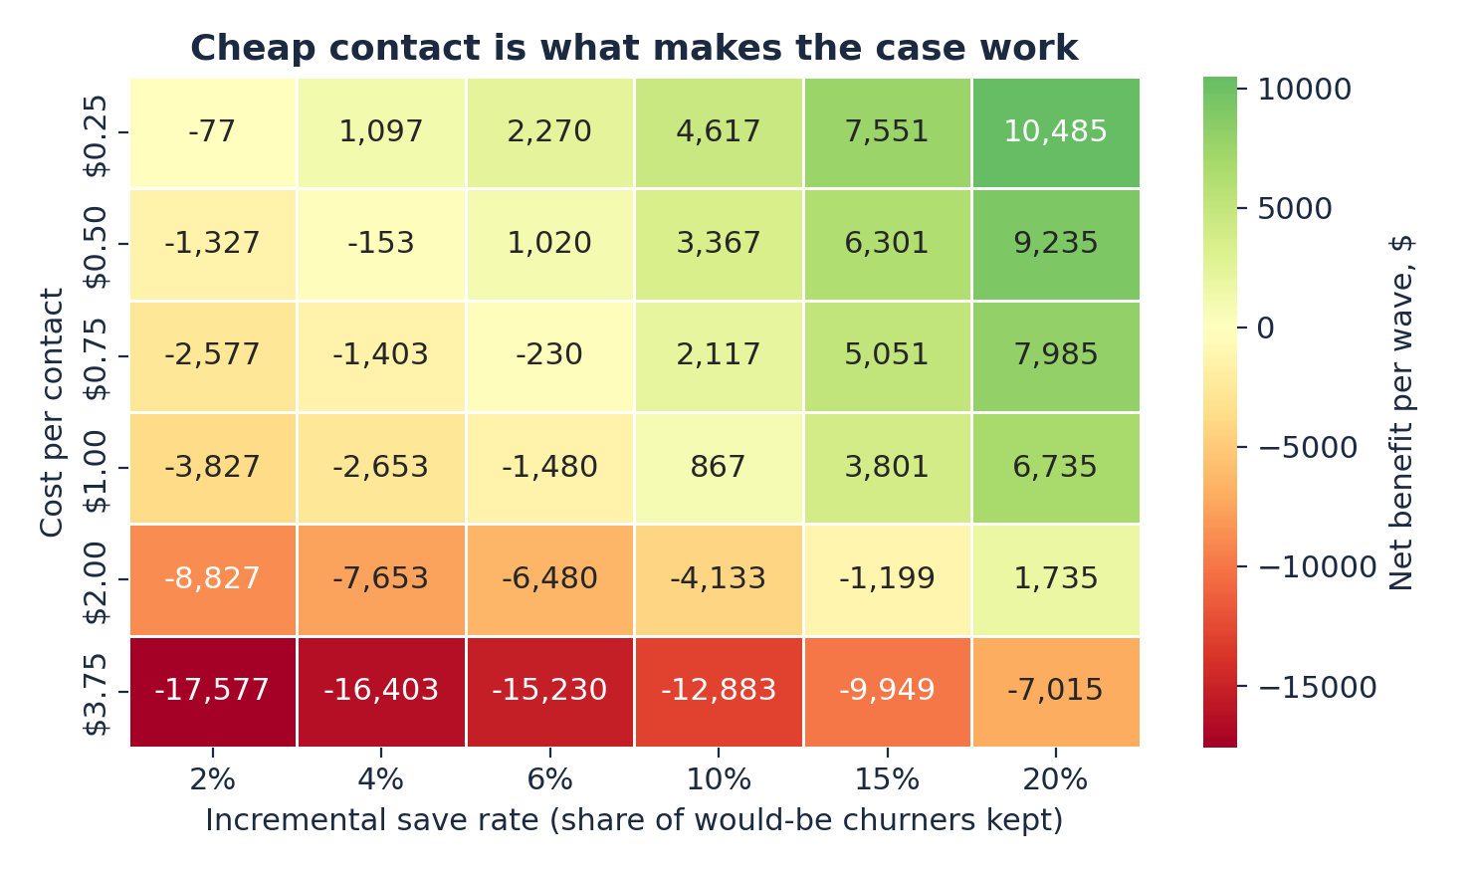
The business case is conditional: it pays only if the nudge saves at least 6.4% of would-be churners at $0.75 or less
Scenario | Save rate | Saved / yr | Gross benefit | Contact cost | Net after fixed cost | ROI
Conservative (0.86% churn, 30% margin, 6 mo, $1.00) | 3% | 83 | $6,931 | $60,000 | -$113,069 | -94%
Base (0.99%, 40%, 12 mo, $0.75) | 6% | 189 | $42,246 | $45,000 | -$62,754 | -60%
Upside (1.04%, 50%, 12 mo, $0.50) | 10% | 329 | $92,203 | $30,000 | $2,203 | 2%
Formula. Contacted x would-be churners x save rate x value per save = gross benefit; minus contact cost and fixed cost.
Value per save = average monthly revenue ($47) x margin x months retained = $224 in the base case.
Break-even save rate: 6.4% for a $0.75 nudge; 32% for a $20 credit accepted by 15% (so no blanket incentives).
Only the upside covers fixed cost for a 100,000-customer book (break-even book about 96,459). The top-10% upside nets $38,925; its base case is negative.
Biggest swing factors (annual net variable benefit): save rate (swing about $49k), cost per contact ($30k), margin and months retained ($21k each).
Cheap contact is what makes the case work.
Per 100,000 customers, annual (12 monthly waves), top 5% contacted. USD, margins, costs and save rates are ASSUMPTIONS to be replaced by Company A data; fixed cost $60,000/yr is a placeholder. Notebook section 14.
11

Slide 12
Roadmap: measure the save rate first, then scale only if the break-even test is passed
Weeks 0-4
Prepare
Weeks 4-8
Design
Weeks 8-20
Pilot
Week 20
Decision gate
After gate
Scale and monitor
Replace placeholder inputs with Company A's churn rate, margin, contact cost
Check when each column is recorded (leakage)
Re-calibrate model on Company A's real base rate
Monthly scoring job and hold-out rule
Compliance review: consent, opt-out, fairness
Pick pilot footprint
At least 6,420 contacted and 6,420 held back per arm to detect a 20% relative drop in churn
Pool several monthly waves if the footprint is small
Smaller effects need more: 27,033 per arm for a 10% effect
Nudge only; no credits
Scale only if measured save rate is at least 6.4% at about $0.75 per contact
Otherwise stop and keep the learning
Roll out to more areas
Monthly AUC and calibration by tenure
Retrain on drift; test a small credit only after a positive result
PoC success criteria: (1) measured save rate at or above 6.4% with a confidence interval that excludes zero; (2) cost per contact at or below $0.75; (3) ROC-AUC of at least 0.65 and sound calibration on Company A's own data; (4) opt-out and complaint rates within limits set with compliance.
Timeline is a proposal. Sample size: 80% power, 5% two-sided test, churn probability in the top-5% slice 5.2% (notebook section 14.3).
12

Slide 13
The main risks are an unknown save rate, a mismatched base rate and thin margins, and each has a control
Risk | Why it matters | Mitigation
Save rate unknown | The model measures risk, not who responds to an offer | Randomised hold-out; decision gate at break-even
Base-rate mismatch | File is 49.6% churn vs about 1% in the market [1-3]; precision overstated | Rescaled here; re-calibrate on Company A's real data
Data timing | No timestamps, so a column recorded after the outcome cannot be ruled out | Confirm recording dates; test on a time-based split
Thin economics | About 95% of contacts would have stayed; costs eat the benefit | Cheap channels only; stop rule; no blanket credits
Fairness and privacy | Demographic fields may act as proxies; customer contact needs consent | ethnic excluded; review income, marital; opt-out; compliance sign-off
Model drift and uneven quality | AUC is about 0.75 in year one but 0.65 for 13-24 months | Monthly monitoring by tenure group; retrain on drift
Assumed inputs | Margin, costs, currency (USD assumed) and fixed cost are placeholders | Finance replaces them before the decision gate
Source: Company A dataset (100,000 customers); author analysis in SunilMandloi.ipynb.
13

Slide 14
Decision requested: approve a capped measurement pilot in New York City, not a full rollout
We ask management to
1. Approve the pilot in the New York City area, the largest segment and one that churns at the company average. Contact cost for the treated arm is about $4,815 (at 6,420 customers and $0.75 each).
2. Provide four inputs: the true monthly churn rate, contribution margin, cost per contact, and New York subscriber count.
3. Commit to the rule: scale only if the measured save rate reaches 6.4% at about $0.75 per contact; otherwise stop.
A decision to stop is a valid and cheap outcome.
KPI | Target
Measured save rate (treated vs held back) | at least 6.4%, interval above zero
Cost per contact | about $0.75 or less
Model ROC-AUC on Company A data | at least 0.65
Calibration (predicted vs actual churn) | close, checked by tenure group
Opt-out and complaint rates | limits set with compliance
Net benefit per wave | positive after contact cost
New York City Area = 11,098 of 100,000 customers (11.1%), churn 50.0% vs 49.6% overall; Company A's real New York subscriber count is needed to confirm the pilot is large enough.
14

Slide 15
References
[1] T-Mobile US, Inc. (22 July 2026). T-Mobile Delivers Continued Strong Account Growth, Translating into Industry-Leading Service Revenue Growth Driven by Widening Differentiation (Q2 2026 results). Business Wire. Postpaid account churn 0.99% (Q2 2026), 1.04% (Q1 2026). https://www.businesswire.com/news/home/20260722580890/en/
[2] Customer Experience Dive (July 2026). Verizon Q2 2026 earnings call coverage: overall churn 0.92%. https://www.customerexperiencedive.com/news/verizon-fight-churn-cx-investments/826174/ ; Nasdaq (July 2026). Verizon Q2 earnings call highlights: consumer postpaid phone churn 0.84%. https://www.nasdaq.com/articles/verizon-communications-q2-earnings-call-highlights
[3] The Desk (July 2026). AT&T improves wireless churn in Q2: postpaid phone churn 0.86%. https://thedesk.net/2026/07/att-q2-2026-earnings-report-fiber-buildout/ ; PhoneArena (July 2026). https://www.phonearena.com/news/at-t-adds-more-postpaid-phone-subscribers-during-q2_id182058
[4] Company A dataset: Client.csv and Record.csv, supplied with the GCI World 2026 Final Assignment (100,000 customers). Analysis: SunilMandloi.ipynb.
[5] Pedregosa, F. et al. (2011). Scikit-learn: Machine Learning in Python. Journal of Machine Learning Research, 12, 2825-2830.
[6] ChatGPT conversation used in preparing the assignment: https://chatgpt.com/share/6acccf90-6cd0-83ec-84bf-165da7064fe2
[7] Claude (Anthropic) assisted with the analysis code, notebook and slides; all reported figures are produced by the notebook.
All external figures accessed October 2026. Churn definitions differ across carriers.
15

