Slide 1

Internet Basics, Browsers, Full-Stack Overview & Cloud

Slide 2

Learning Objectives
Today you will learn:
Internet as global network
IP vs domain names
Role of DNS
Understand request–response model
HTTP vs HTTPS basics
Browser request and display
Frontend vs backend roles
Cloud as rented computing
Purpose of code editors

Slide 3
Internet

Slide 4

What is Internet ?
The Internet is a global network of connected computers
Millions of computers around the world are linked together
These computers:
Share information
Send and receive data
Communicate using common rules
👉 Internet = Computers talking to each other globally

Slide 5
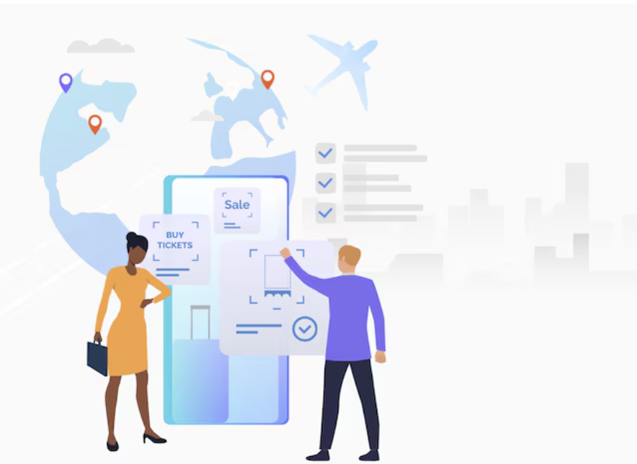
How Data Travels?
When you open a website:
You type a website address
Your computer sends a message
Another computer sends data back
The page appears on your screen
Data is constantly moving between computers
👉 Opening a website = sending and receiving data

Slide 6
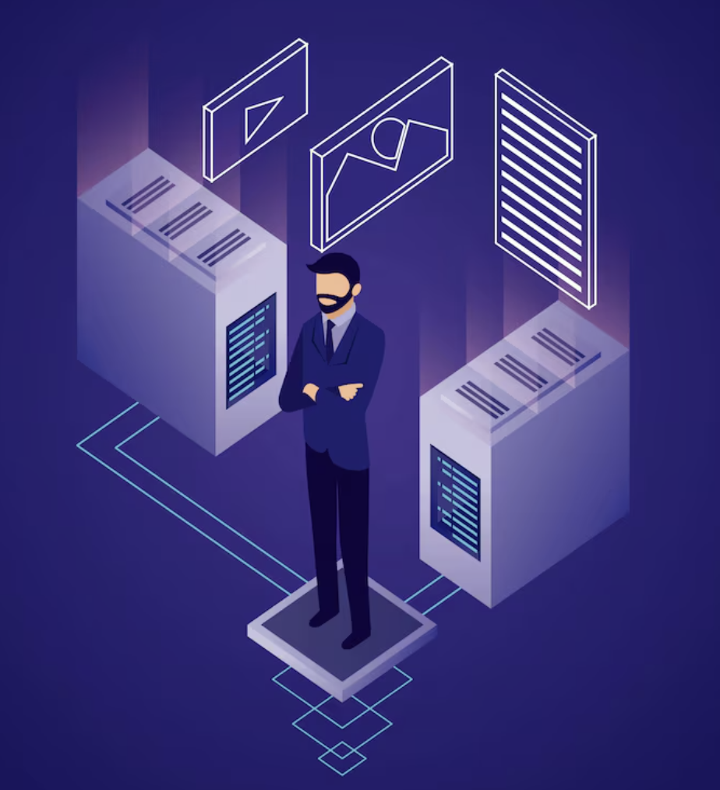
Client–Server Model
Most internet communication follows this model:
Client
Your browser or app
Makes a request
Server
A powerful computer
Stores website or application data
Sends back a response
👉 Client asks → Server responds

Slide 7
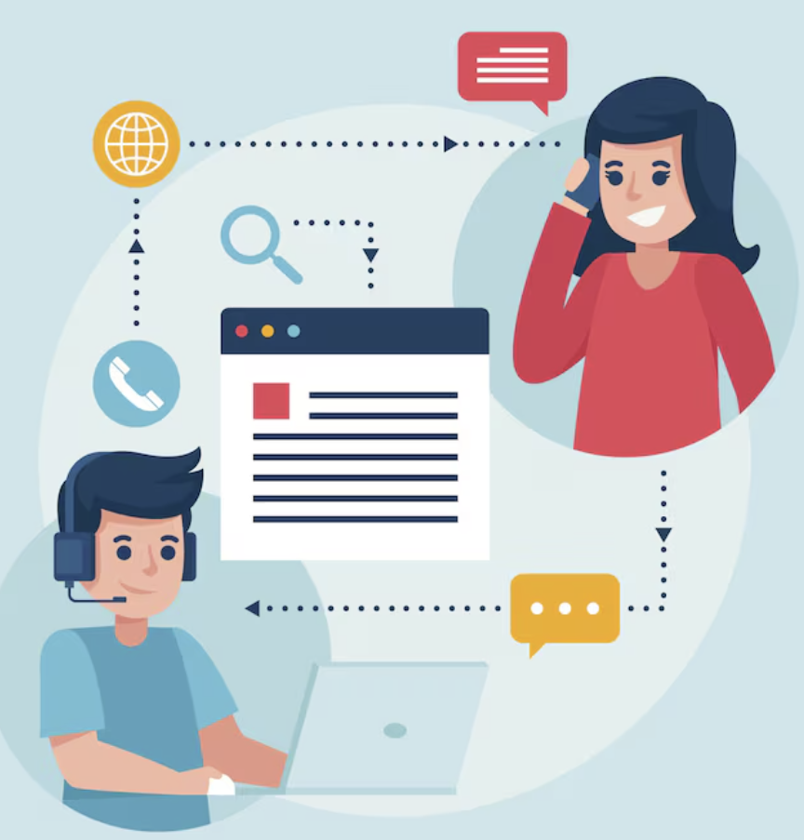
Request–Response
Example: You click “Login”
Request: “Check my username and password”
Server processes it Response: “Access granted” or “Invalid password”
No guessing, no magic Just structured request and response
👉 Internet communication is a continuous question–answer system

Slide 8
Pop Quiz
Q. In the client–server model, what does the client do?
A
Stores all website data permanently
B
Sends a request to another computer

Slide 9
Pop Quiz
Q. In the client–server model, what does the client do?
A
Stores all website data permanently
B
Sends a request to another computer

Slide 10
Addresses on Internet

Slide 11

IP Address: The Numeric Address
Every computer connected to the internet has a unique number called an IP address
Example:
192.168.1.1
Analogy:
🏠 A house address for a computer
It tells other computers:
“Where to send the data”
👉 IP address = exact numeric location of a server

Slide 12
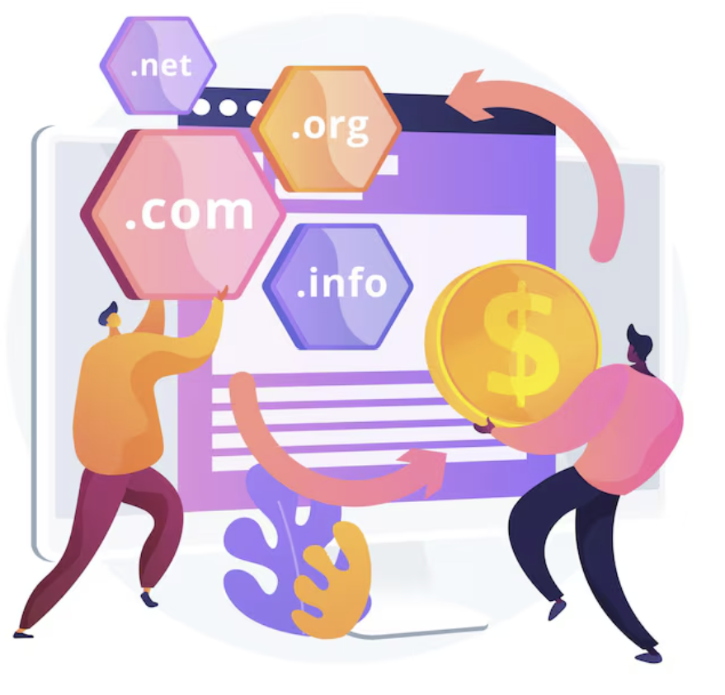
Domain Name: Human-Friendly Address
Numbers are hard to remember
So we use domain names instead:
google.com
amazon.com
example.org
A domain name is just a readable name for an IP address
👉 Domain name = easy name for humans
👉 IP address = real address for computers

Slide 13

DNS: The Internet’s Phonebook
DNS = Domain Name System
It works like a phonebook:
Know the name → It gives the number
You type:
google.com
DNS finds:
The correct IP address behind it
👉 DNS translates names into numbers

Slide 14
What Happens When You Type a Website?
You type a domain name in the browser
DNS finds the matching IP address
Browser connects to that IP (server)
Server sends back the website
Domain → DNS → IP → Server → Website loads
👉 The process happens in seconds, but follows clear steps

Slide 15
Pop Quiz
Q. What is the main job of DNS?
A
To store website content
B
To translate domain names into IP addresses

Slide 16
Pop Quiz
Q. What is the main job of DNS?
A
To store website content
B
To translate domain names into IP addresses

Slide 17
HTTP vs HTTPS

Slide 18
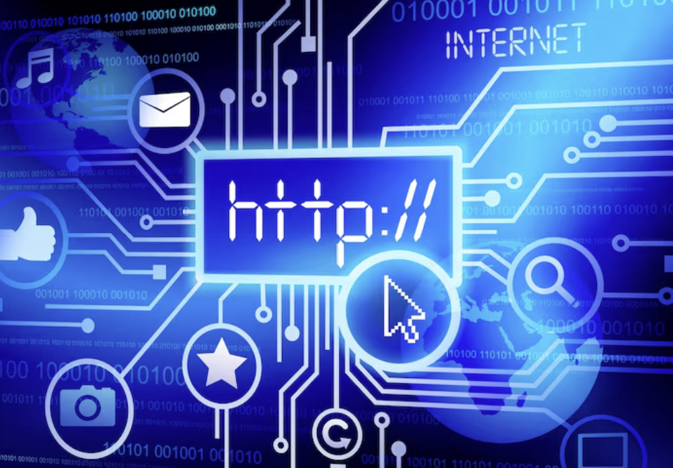
What is HTTP?
HTTP = HyperText Transfer Protocol
It is the basic method used by browsers and servers to communicate
When you:
Open a website
Submit a form
Click a link
Your browser sends an HTTP request
The server sends an HTTP response
👉 HTTP = Rulebook for sending and receiving web data

Slide 19
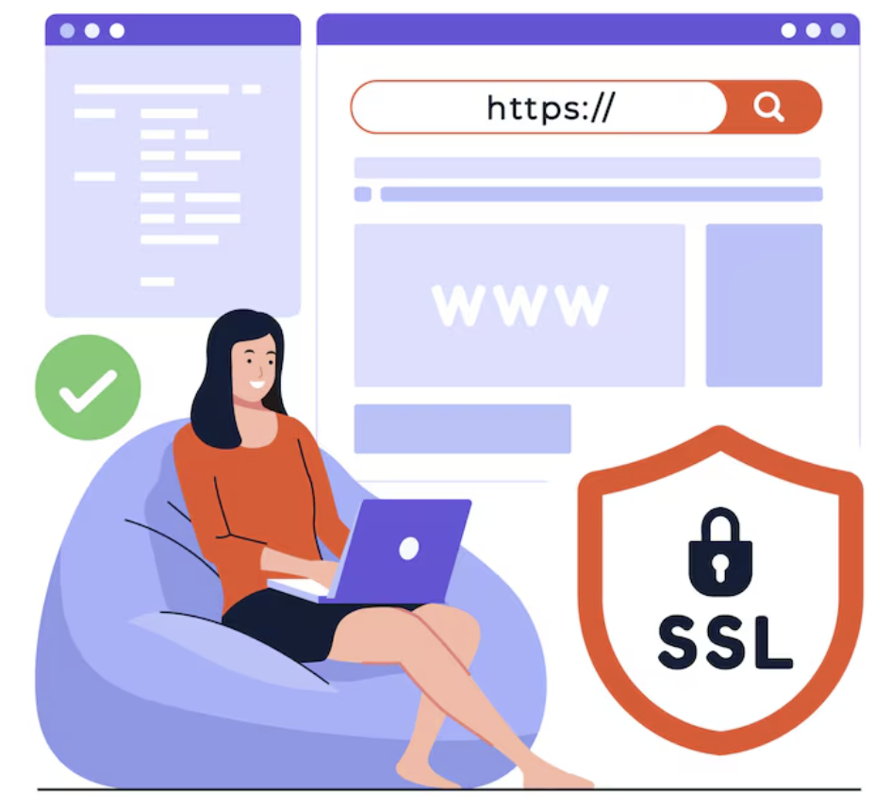
What is HTTPS?
HTTPS = Secure HTTP
It is HTTP with:
🔒 Encryption (data is scrambled)
✅ Trust (you are connected to the real server)
This means:
Even if someone intercepts the data, they cannot read it easily
👉 HTTPS protects sensitive information

Slide 20

When to use HTTP Vs HTTPS?
If a website involves:
Login
Passwords
Payments
Personal information
👉 It must use HTTPS
Today, most modern websites use HTTPS by default
HTTP = Communication
HTTPS = Secure communication

Slide 21
Pop Quiz
Q. When should HTTPS be used?
A
Only for entertainment websites
B
Whenever sensitive data like passwords or payments are involved

Slide 22
Pop Quiz
Q. When should HTTPS be used?
A
Only for entertainment websites
B
Whenever sensitive data like passwords or payments are involved

Slide 23
Web Browser

Slide 24
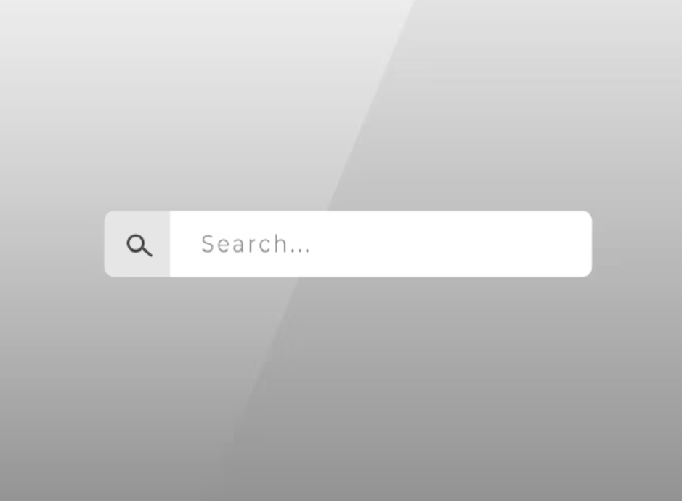
What is a Web Browser ?
A software tool that requests and displays web pages
Examples:
Chrome
Edge
Firefox
When you open a website, the browser:
Connects to a server
Retrieves website data
Shows it in a readable format
👉 Browser = Gateway between you and the internet

Slide 25

What Does a Browser Do ?
Step 1: Makes a Request
You type a website → Browser sends a request to a server
Step 2: Receives a Response
Server sends back website data
Step 3: Displays the Page
Browser converts that data into text, images, buttons, etc.
👉 Request → Response → Display

Slide 26
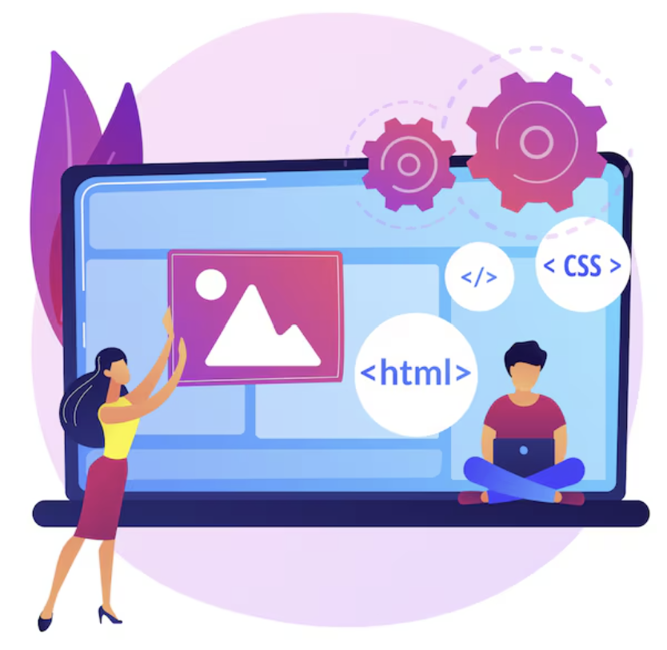
How Web Pages Are Built ?
Web pages are built using:
HTML → Structure (the skeleton of the page)
CSS → Styling (colors, layout, design)
JavaScript → Interaction (clicks, animations, dynamic updates)
The browser creates something called the DOM
👉 The page’s structure that JavaScript can work with
Together, these create interactive web experiences

Slide 27
Pop Quiz
Q. What is the primary role of a web browser?
A
To store all website data permanently
B
To request web pages and display them to users

Slide 28
Pop Quiz
Q. What is the primary role of a web browser?
A
To store all website data permanently
B
To request web pages and display them to users

Slide 29
Take A 5-Minute Break!
Stretch and relax
Hydrate
Clear your mind
Be back in 5 minutes

Slide 30
Full Stack Development

Slide 31
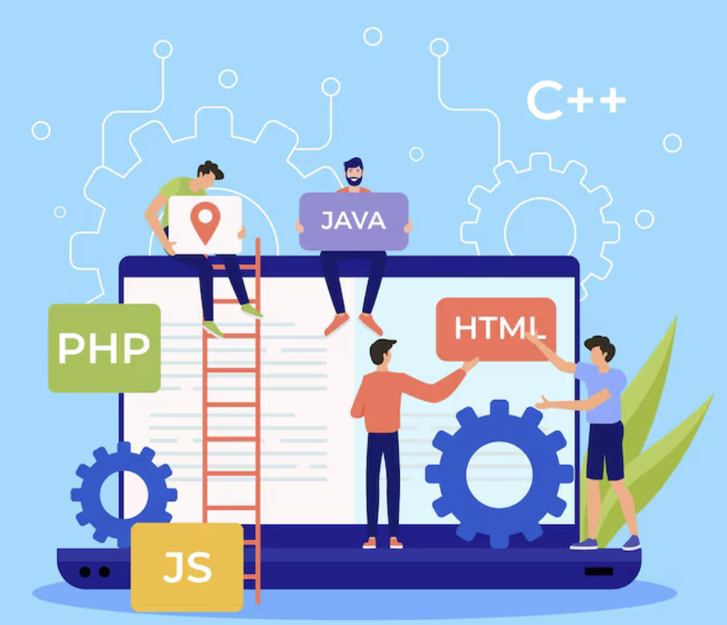
What is Full-Stack Development?
Full-Stack Development means building both parts of an application:
Frontend
What users see and interact with
Backend
The logic, data, and processing happening behind the scenes
👉 A full-stack developer understands the complete flow of an application

Slide 32
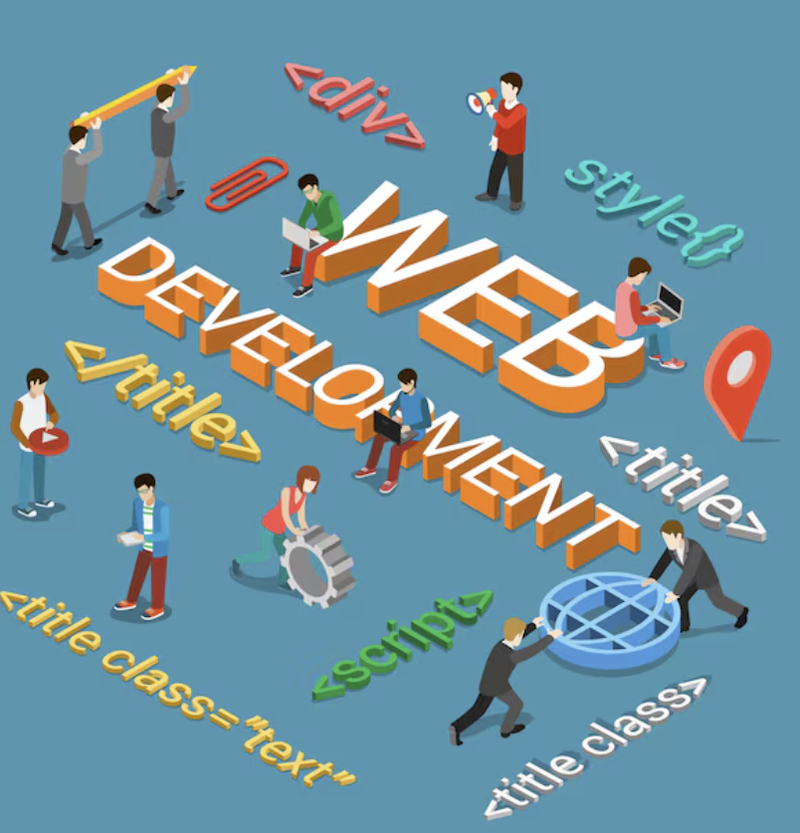
Frontend - USER Side
Frontend is responsible for:
UI screens (buttons, forms, layouts)
User interactions (clicks, typing)
Form validations (checking empty fields)
Displaying messages and results
It focuses on:
👉 How the application looks and feels
Users directly interact with the frontend

Slide 33
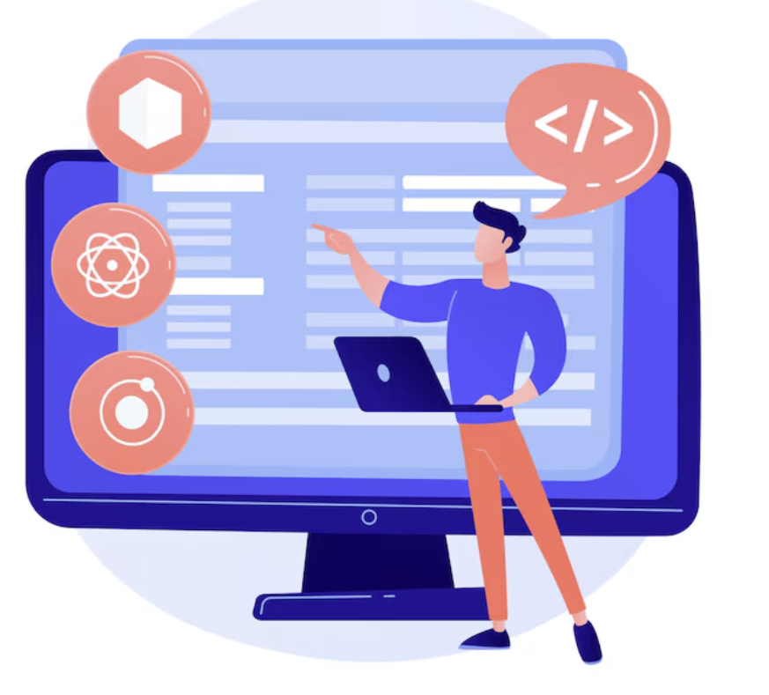
Backend - SERVER Side
Backend handles:
Authentication (checking login details)
Data storage (saving information in database)
APIs (sending/receiving data)
Business rules (application logic)
It focuses on:
👉 How the application works internally
Users don’t see backend, but everything depends on it

Slide 34
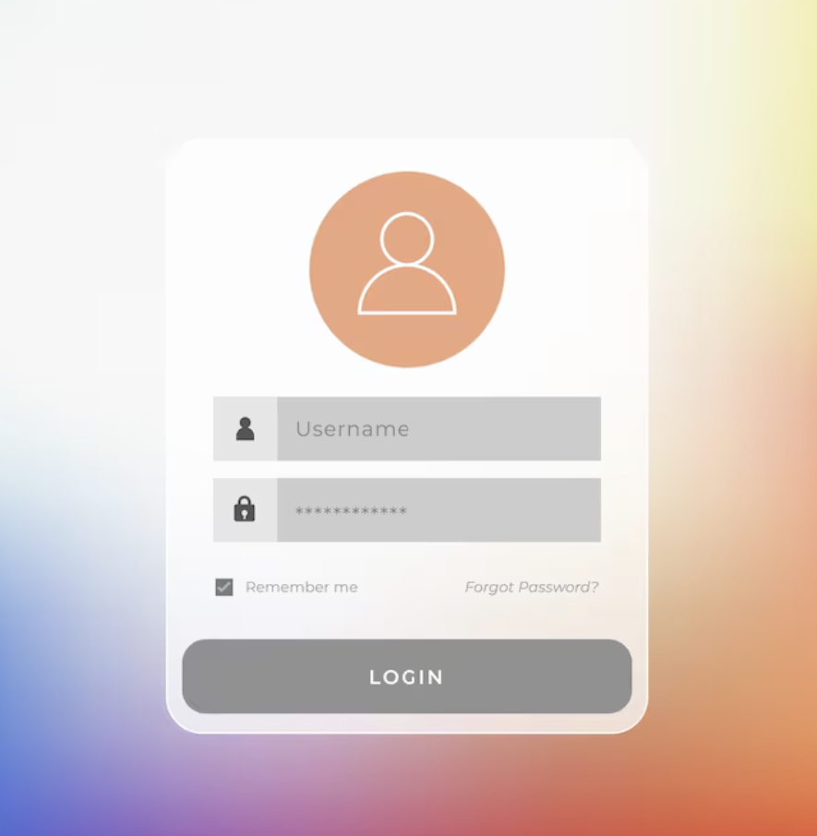
Example - Login Page
User enters username & password (Frontend)
Frontend sends data to backend
Backend verifies credentials
Database checks stored data
Backend sends response
Frontend shows:
“Login successful”
OR
“Invalid password”
👉 Full-stack = Understanding this complete journey

Slide 35
Pop Quiz
Q. What does a full-stack developer work on?
A
Only designing screens
B
Both user interface and backend logic

Slide 36
Pop Quiz
Q. What does a full-stack developer work on?
A
Only designing screens
B
Both user interface and backend logic

Slide 37
A Sneak Peek to Cloud Computing

Slide 38
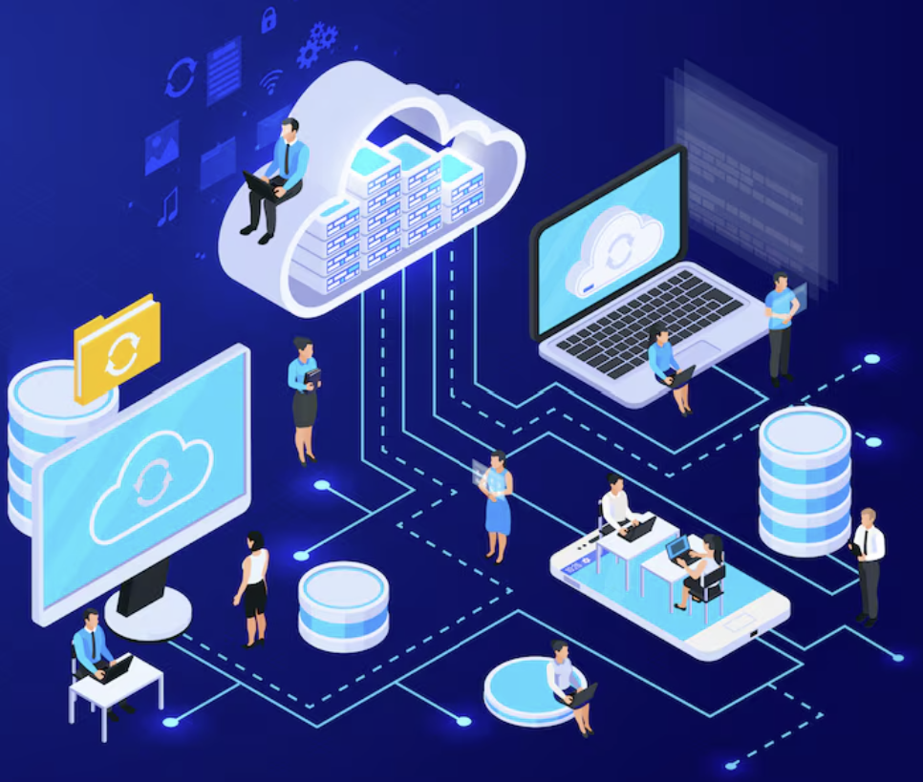
What is Cloud Computing?
👉 Renting computing resources over the internet
Instead of buying physical servers, companies rent:
Storage
Computing power
Databases
Software
You use it when needed and pay for what you use
Think of it like:
Electricity — you don’t build a power plant, you just use power

Slide 39

Why is Cloud Used?
Cloud is popular because it is:
Scalable
Increase or decrease resources easily
Accessible
Access from anywhere via internet
Cost-Efficient
No need to buy expensive hardware upfront
This is especially useful for:
Startups
Growing applications
Online products

Slide 40
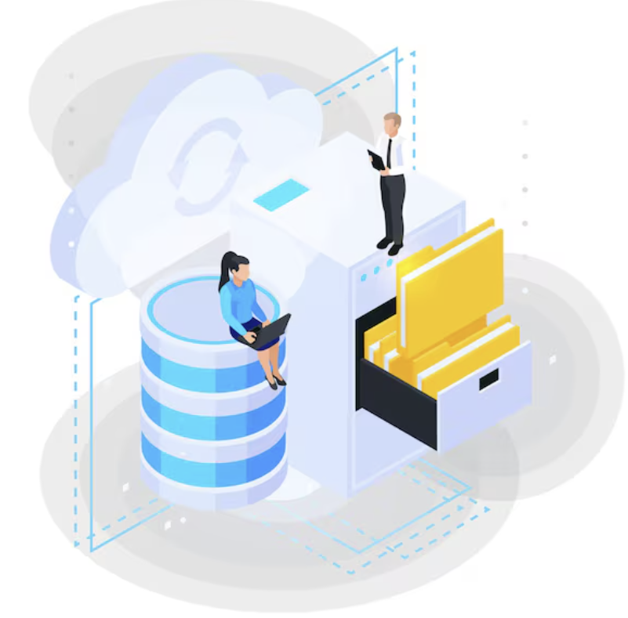
Types of Cloud Services
IaaS — Infrastructure as a Service
Rent virtual machines (computers)
PaaS — Platform as a Service
Rent a ready environment to build and deploy apps
SaaS — Software as a Service
Use software directly via internet (no installation)
👉 More convenience → Less control

Slide 41


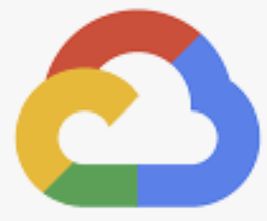
Cloud Providers
Some major cloud providers:
AWS
Microsoft Azure
Google Cloud (GCP)
They provide:
Servers, storage, databases, and tools online

Slide 42
Pop Quiz
Q. What does cloud computing mainly mean?
A
Buying and maintaining your own physical servers
B
Renting computing resources over the internet

Slide 43
Pop Quiz
Q. What does cloud computing mainly mean?
A
Buying and maintaining your own physical servers
B
Renting computing resources over the internet

Slide 44
VS Code Setup

Slide 45
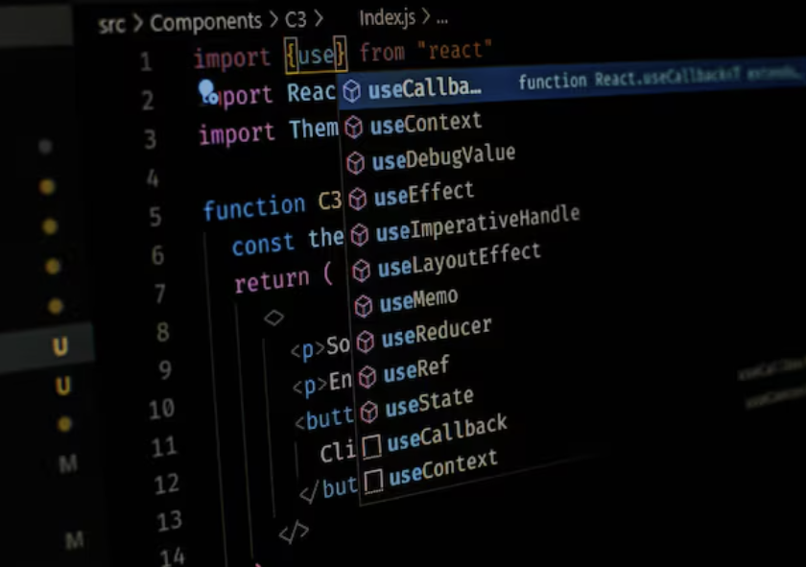
What is a Code Editor?
Tool used to write and edit programming code
It helps developers:
Write code clearly
Organize files
Spot errors quickly
Improve productivity
👉 Think of it as a smart notebook designed for coding

Slide 46
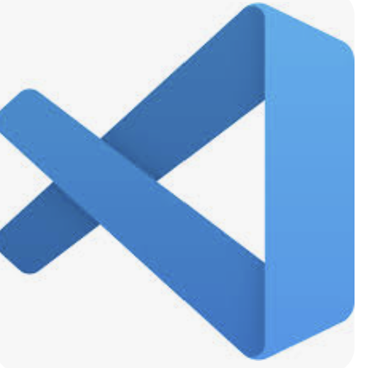
Why VS Code is Commonly Used ?
Visual Studio Code (VS Code) is popular because it:
Is free and lightweight
Supports many programming languages
Offers helpful extensions (plugins)
Provides built-in debugging tools
Has a clean and simple interface
👉 It balances simplicity and powerful features, making it beginner-friendly and professional-ready

Slide 47
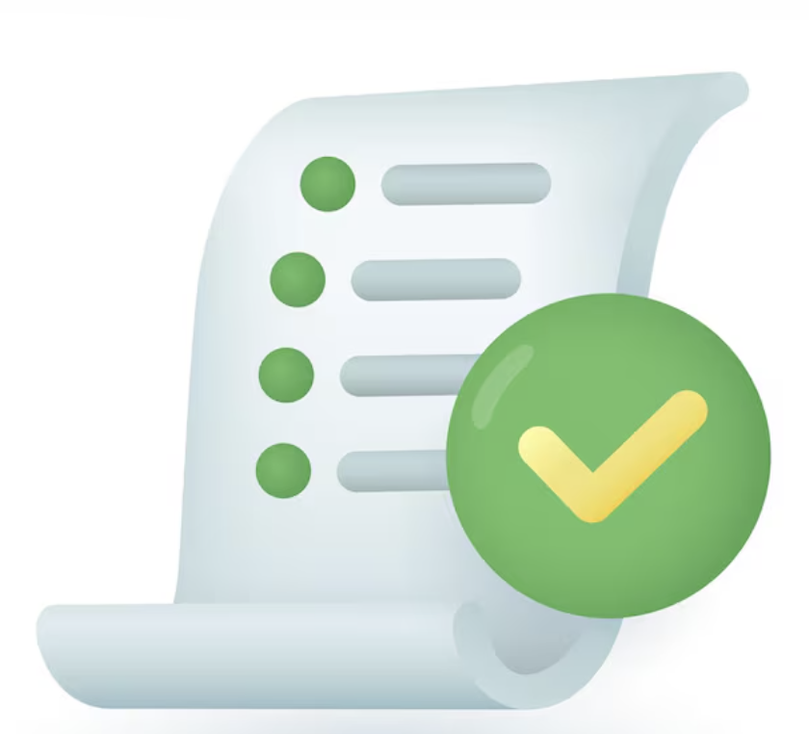
Summary
In this lecture, we have covered:
Internet as global network
IP vs domain names
Role of DNS
Understand request–response model
HTTP vs HTTPS basics
Browser request and display
Frontend vs backend roles
Cloud as rented computing
Purpose of code editors

Slide 48

DOUBT RESOLUTION

Slide 49
Important
Complete the post-class assessment
Complete assignments (if any)
Practice the concepts and techniques taught in this session
Review your lecture notes
Note down questions and queries regarding this session and consult the teaching assistants.

Slide 50
THANK YOU

