Slide 1
DBx Migration Suite

Slide 2
Medallion Architecture
 | BRONZE | SILVER | GOLD | PLATINUM
Purpose | Ingest | Cleanse | Transform | Consolidate
Role | Auditable Source | The Clean Mirror | The Integration Hub | The Presentation Mart
Data Engineers | Ingestion & Audit | Ingestion & Archiving | Transformation & Quality | Define, Build, Optimize & Deliver Models, Visuals & Prompt Response
Data Scientists | Deep Forensic Investigation | Exploratory Data Analysis | Exploration & Feature Engineering | Model Training & Business Consumption
AI Engineers | Not usable | Deep Data Discovery | Building Training Datasets | Enable AI, PBI, ML use cases
Report Engineers | Not usable | Not usable | Query | Build dashboards & visuals
Business Analysis | Not usable | Not usable | Diagnostic analysis, why something happened | Proactive, predictive, automated decision making & forecasting

Slide 3
Reference Architecture -- SQL Server to Databricks Unity Catalog | Metadata-Driven Medallion
Azure SQL Server
Flask AI Workflow Mgr
Databricks Unity Catalog
REST API
dev_volumes
bronze
silver
gold (future)
HR Database
-------------------
DimDepartment
DimEmployee
DimJobRole
DimLocation
DimDate
Metadata pipeline config
SP to PySpark (AI)
Notebook gen & deploy
Databricks job submit
Background run polling
Self-healing recovery
UC Volumes (Landing)
Bronze (Raw + Audit)
Silver (Cleansed)
Gold (Business KPIs)
/Volumes/dev_volumes/
hr/landing/{table}
Format: Parquet
bronze.hr.{table}
Delta Tables
+ __src_file, __load_ts
+ __batch_id
silver.hr.{table}
Delta Tables
Dedup + null handling
Type cast + DQ checks
Aggregated datasets
BI-ready views
Power BI / Tableau
Metadata Delta Tables (Unity Catalog) + Reconciliation & Logging Catalogs
wf_pipeline_metadata
wf_job_metadata
wf_run_history
wf_watermark_metadata
wf_source_tables
reconciliation.*
loggingdetails.*
Auto-Generated Metadata Notebooks (Standard PySpark + DLT Mode)
00_Orchestrator
01_Extract
02_Bronze / DLT
03_Silver
04_Reconciliation
05_ExecutionLog
Chains all stages
Breaks on FAILED
DLT or Spark mode
JDBC to Azure SQL
Watermark filtering
Parquet → Volumes
Landing → Bronze
Audit cols + DQ
DLT Auto Loader opt.
Bronze → Silver
Dedup + cleanse
7-check DQ scoring
Source vs Bronze
SUM per num col
PASS/WARN/FAIL
Audit trail
Per-job results
Logging catalog
Deploy Infrastructure
Security
Governance
Reliability
Scalability
AutoInfraCreation (Azure SDK)
1. Storage Acct + ADLS Gen2
2. Access Connector + RBAC
3. Storage Credential (UC)
4. External Locations
5. Catalogs + MANAGED LOC
6. UC Volumes (landing)
PAT tokens for API auth
Encrypted JDBC (TLS)
UC RBAC per catalog
MANAGED LOCATION per catalog
Reconciliation catalog
Execution logging catalog
Delta versioning
deployconfig.json driven
Per-stage rerun on fail
Self-healing bot
7-check DQ scoring
Incremental watermarks
Metadata-driven config
DLT + Standard PySpark
Multi-catalog arch
Extensible to Gold
Technology Stack
End-to-End Data Flow
AI SP Converter
Stages & Rerun
Azure SQL Server
HR source database (5 dimension tables)
Azure SQL
JDBC Extract
UC Volumes Landing
Bronze Delta
Recon Validation
Silver Delta
Exec Log
OpenAI/Gemini/Claude
SP → PySpark code
DLT(2)/Spark(3) stages
Per-job rerun
Python / Flask
Web UI: pipeline config, deploy, monitor, rerun
Databricks REST API
Job submit + polling + notebook deploy
UC Volumes + Delta
Landing (Parquet) → Bronze/Silver (Delta)
Future Roadmap
Delta Live Tables
Optional DLT mode: Auto Loader + expectations
Gold Layer: aggregated KPIs for BI dashboards (Power BI / Tableau)
Reconciliation
Source vs Bronze aggregate validation per column
Secret Mgmt: Databricks Secrets / Azure Key Vault (replace PAT tokens)
deployconfig.json
Auto-loads catalogs, locations, storage config
CI/CD: Azure DevOps / GitHub Actions for notebook deploy & pipeline promotion
Incremental Refresh: CDC-based streaming with Auto Loader / Change Data Feed
AI Workflow Manager | Metadata-Driven Medallion | Reconciliation + Execution Logging | DLT + PySpark | Per-Stage Rerun | deployconfig.json
Monitoring: Azure Monitor + Databricks SQL Alerts + DQ dashboard

Slide 4
What's New — Features Added Since Initial Release
🚀 Major New Features
🔧 Pipeline & UI Enhancements
🐛 Bug Fixes & Improvements
1. Deploy Infrastructure (AutoInfraCreation)
5. Per-Stage Pipeline Progress Tracking
JDBC ORDER BY Fix
Fully automated Azure + Unity Catalog setup via Azure Python SDK
Step 1: ADLS Gen2 Storage Account + Container + Folders (HNS enabled)
Step 2: Access Connector for Databricks (Managed Identity)
Step 3: RBAC — Storage Blob Data Contributor role assignment
Step 4: Unity Catalog Storage Credential
Step 5: External Locations (landing + managed root)
Step 6: Catalogs with MANAGED LOCATION (dev_volumes, bronze, silver)
Step 7: UC Volumes for landing zone (Parquet staging)
Stage progress bar with arrows in Pipeline Studio cards
DLT mode: 2 stages (Extract → DLT Bronze+Silver)
Standard mode: 3 stages (Extract → Bronze → Silver)
Stage-specific status icons: ✅ success / ❌ failed / ⏳ running
Removed ORDER BY ORDINAL_POSITION from JDBC subquery
SQL Server forbids ORDER BY in derived tables without TOP/OFFSET
Reconciliation col_query no longer causes SQLServerException
6. Per-Job Rerun on Failure
Multi-Catalog Validation
🔄 Rerun button on each failed stage in Pipeline Studio cards
🔄 Rerun Job button in Pipeline Logs panel per failed run
Reruns from the first failed stage forward (preserves earlier stages)
Volumes, Bronze, Silver catalogs must exist before pipeline run
Notebooks run CREATE SCHEMA IF NOT EXISTS (auto-creates schemas)
But CATALOG must already exist — validated in documentation
2. Reconciliation & Execution Logging Notebooks
04_Meta_Reconciliation — Source vs Bronze aggregate validation
• Identifies all numeric columns via INFORMATION_SCHEMA
• Computes SUM per column (JDBC + Delta) → PASS / WARN / FAIL
• Saves to dedicated reconciliation catalog + Delta table
05_Meta_ExecutionLog — Full audit trail per pipeline run
• Per-job results saved to loggingdetails.hr.ExecutionLog
7. Data Quality Framework (Bronze + Silver)
Frontend → Backend Param Fixes
Bronze: 5 DQ checks — empty file, null-key, duplicate, schema drift, quarantine
Silver: 7 DQ checks — quarantine filter, null removal, high-null cols,
dedup, string trim, empty→NULL, row count anomaly detection
DQ Score: % of checks passed → saved to __dq_metrics Delta table
Per-row __dq_status (passed/warn) + __is_quarantined flags
recon_location / log_location sent in deploy & run-databricks payloads
pipeline_mode sent from UI when creating pipelines (single + bulk)
DLT stage filter added to Job Manager dropdown
3. Delta Live Tables (DLT) Pipeline Mode
New pipeline_mode: 'dlt' alongside 'standard' PySpark
02_Meta_DLT_Pipeline — Auto Loader + DLT expectations
DLT Orchestrator — Extract → DLT pipeline trigger (2 stages)
Standard PySpark remains 3 stages: Extract → Bronze → Silver
8. MANAGED LOCATION for CREATE CATALOG
Fixed AnalysisException: Metastore storage root URL does not exist
recon_location / log_location threaded through entire stack
Backend → metadata_notebooks → workflow_manager → app → frontend
4. deployconfig.json — Centralized Configuration
Auto-loads catalogs, storage paths, reconciliation & logging config
metadata_notebooks.py reads defaults from deployconfig at import
Eliminates hardcoded values — all infra params in one JSON file
Before vs After
Feature
Before
After
Notebooks
4 notebooks
6 notebooks (+Recon, +ExecLog)
Pipeline Modes
Standard only
Standard + DLT
Stages Visible
None
Per-stage progress bars
Rerun
Full rerun only
Per-job rerun from failure
Infra Setup
Manual
Automated (AutoInfraCreation)
SQL to Databricks Migration | What's New — All changes since initial architecture release
Config
Hardcoded defaults
deployconfig.json driven
DQ Checks
Basic
12 checks + DQ Score + metrics

Slide 5
Reference Architecture -- SQL Server to Databricks Unity Catalog | Metadata-Driven Medallion
Databricks Unity Catalog
Azure SQL Server
Flask AI Workflow Mgr
dev_volumes
bronze
silver
gold (future)
HR Database
-------------------
DimDepartment
DimEmployee
DimJobRole
DimLocation
DimDate
Metadata pipeline config
SP to PySpark (AI)
Notebook gen & deploy
Databricks job submit
Background run polling
Self-healing recovery
UC Volumes (Landing)
Bronze (Raw + Audit)
Silver (Cleansed)
Gold (Business KPIs)
REST API
/Volumes/dev_volumes/
hr/landing/{table}
Format: Parquet
bronze.hr.{table}
Delta Tables
+ __src_file, __load_ts
+ __batch_id
silver.hr.{table}
Delta Tables
Dedup + null handling
Type cast + DQ checks
Aggregated datasets
BI-ready views
Power BI / Tableau
Metadata Delta Tables (Unity Catalog)
wf_pipeline_metadata
wf_job_metadata
wf_run_history
wf_watermark_metadata
wf_source_tables
Auto-Generated Metadata Notebooks
00_Meta_Orchestrator
01_Meta_Extract
02_Meta_Bronze
03_Meta_Silver
Reads pipeline metadata
Runs E>B>S per table
Breaks on FAILED
JDBC to Azure SQL
Watermark filtering
Write Parquet to Volumes
Read landing Parquet
Add audit columns
MERGE to bronze Delta
Read bronze Delta
Dedup + cleanse
MERGE to silver Delta
AI SP to PySpark Converter
Security
Governance
Reliability
Scalability
OpenAI / Gemini / Claude
Auto-converts SQL SPs
Generates PySpark code
PAT tokens for API auth
ODBC-escaped credentials
Encrypted JDBC (TLS)
UC RBAC per catalog
Unity Catalog metadata
Catalog-level isolation
Delta versioning
Full audit trail
All paths have try/except
Break on first failure
Error payloads captured
Incremental watermarks
Metadata-driven config
Spark distributed proc
Delta MERGE upserts
Extensible to Gold
Self-Healing Bot
Technology Stack
End-to-End Data Flow
Auto-retry failed runs
AI-powered error fixing
Notebook auto-repair
Azure SQL Server
HR source database (5 dimension tables)
Azure SQL
JDBC Extract
UC Volumes Landing
Bronze Delta
Silver Delta
Gold (Future)
Python / Flask
Web UI: pipeline config, deploy, monitor
Databricks REST API
Job submit (runs/submit) + polling (runs/get)
UC Volumes
Landing zone: Parquet via JDBC extract
Future Roadmap
Delta Lake
Bronze & Silver managed tables (MERGE)
Gold Layer: aggregated KPIs for BI dashboards
ODBC Driver 17
Local schema discovery & data preview
Secret Mgmt: Databricks Secrets / Azure Key Vault
OpenAI/Gemini/Claude
SP to PySpark AI conversion engine
CI/CD: Azure DevOps / GitHub Actions notebook deploy
DQ Framework: Great Expectations at Silver layer

Slide 6
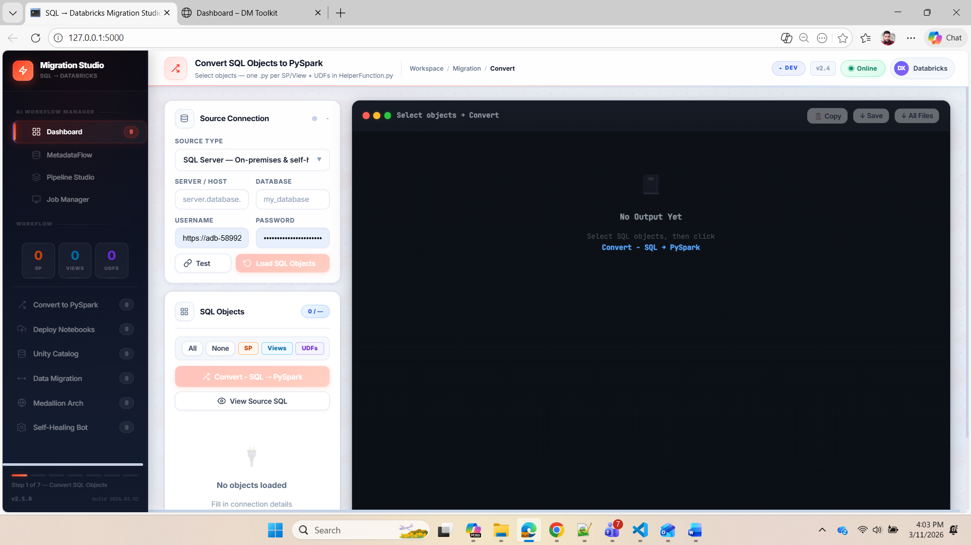

Slide 7
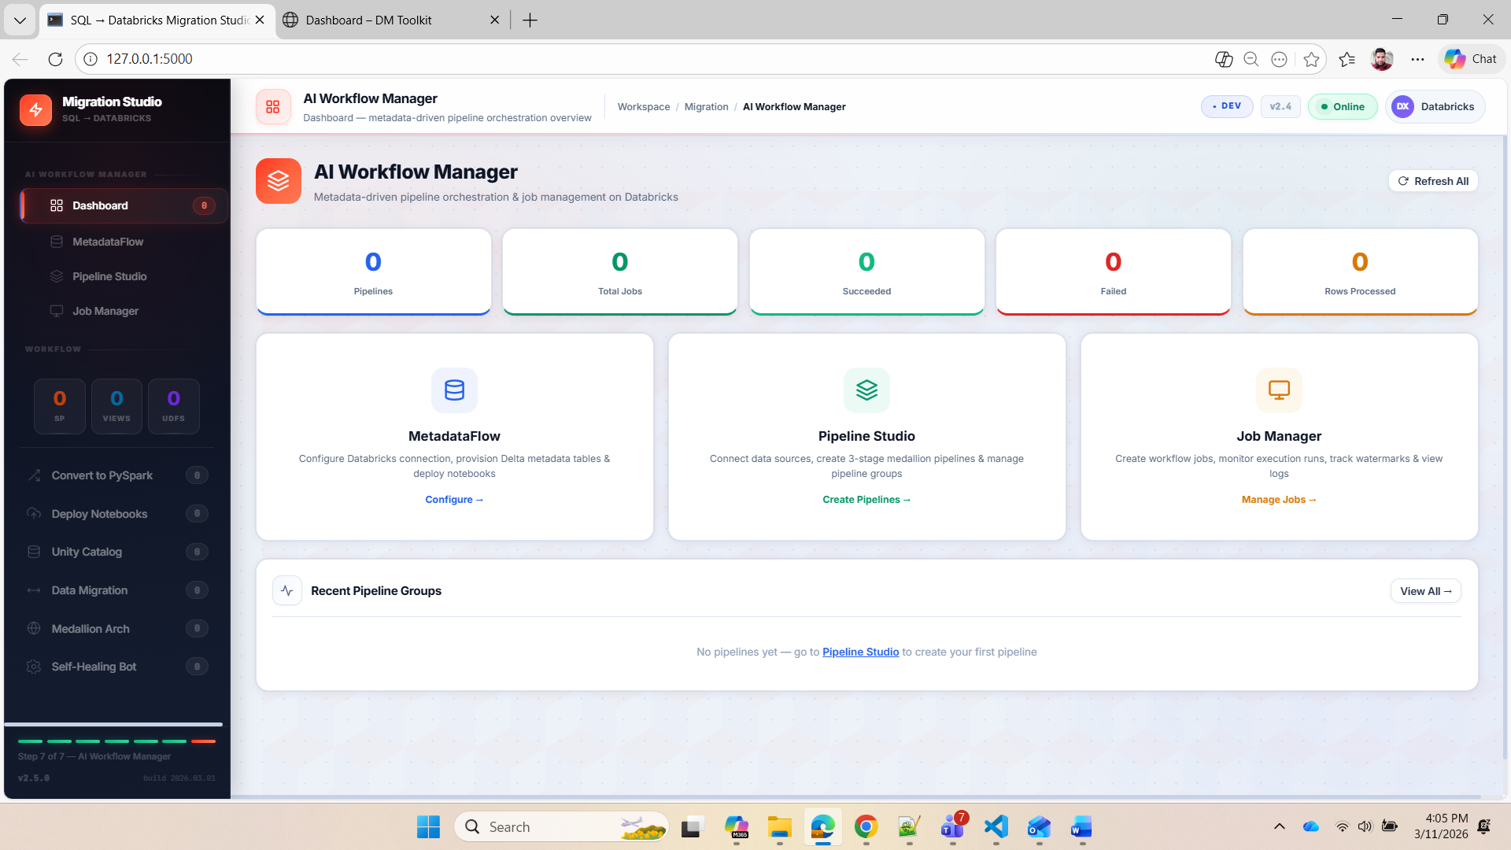
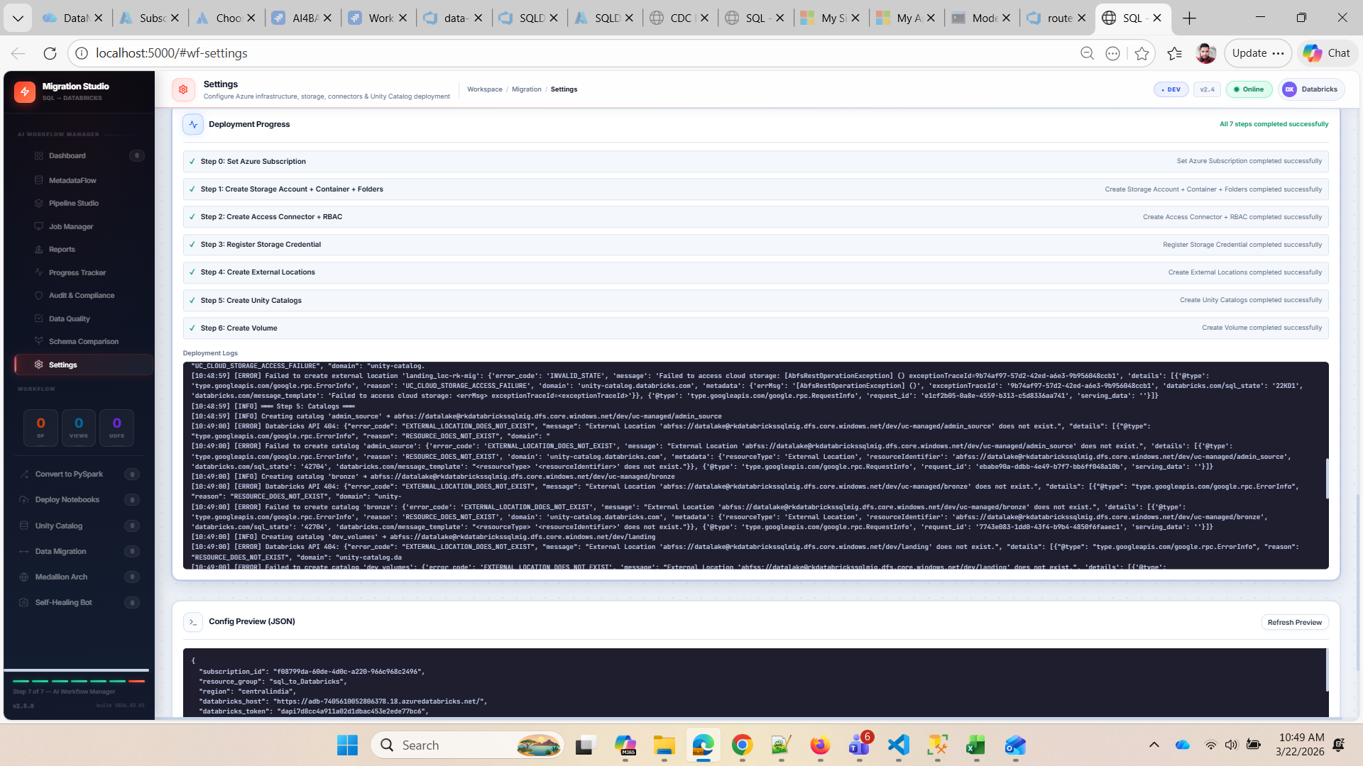

Slide 8
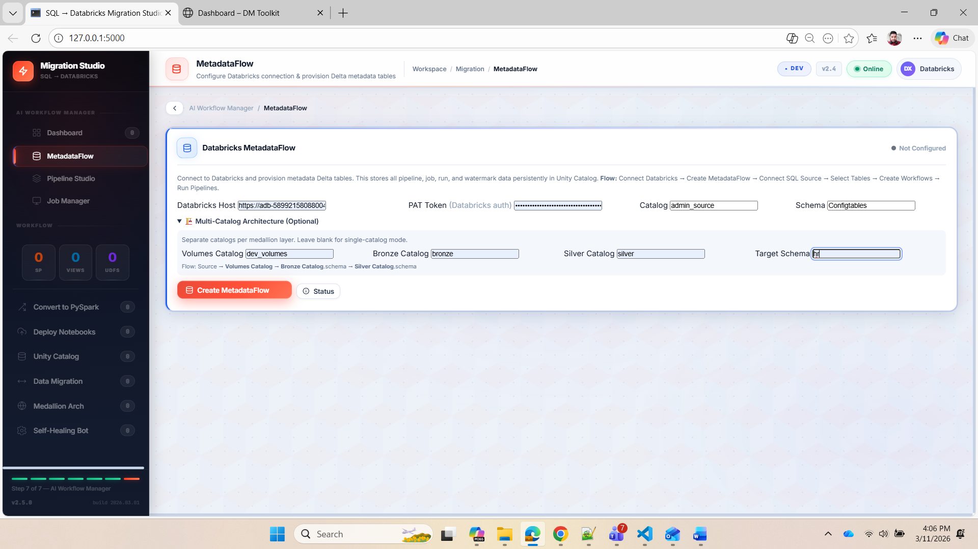

Slide 9
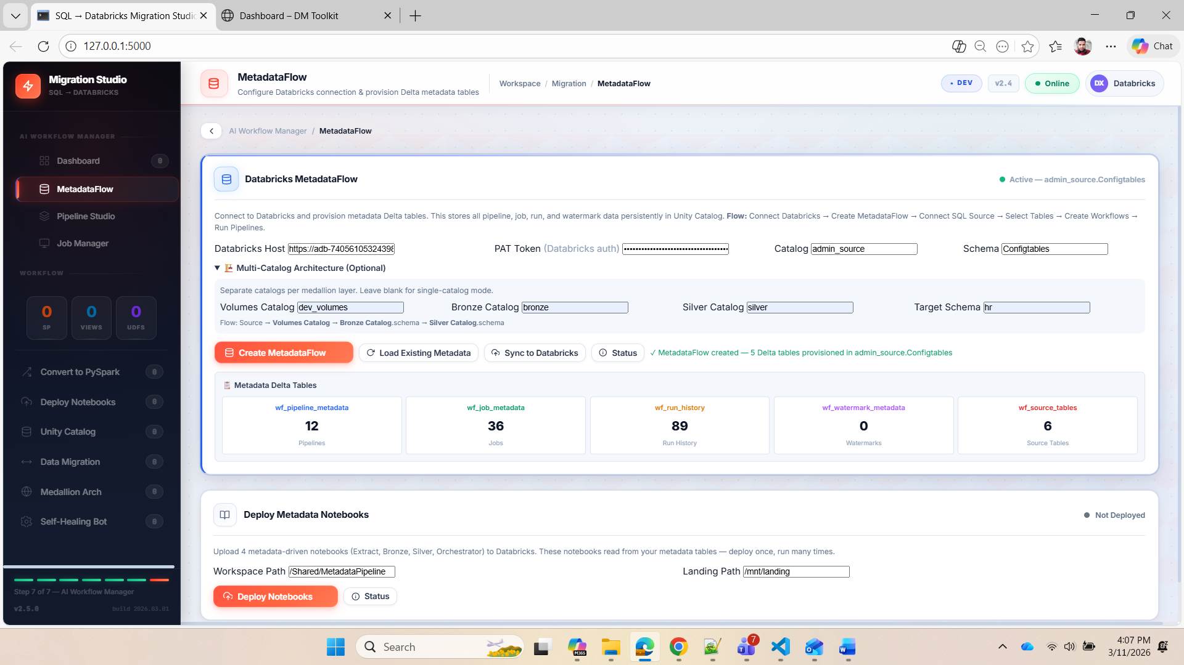

Slide 10
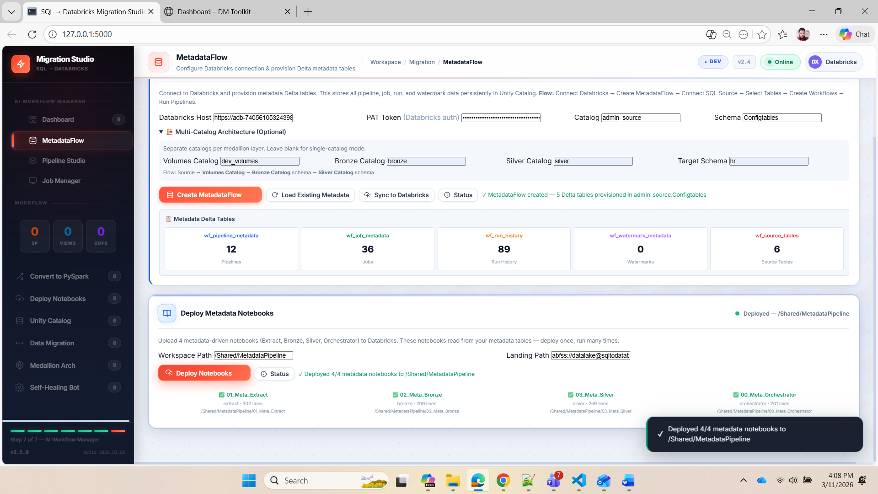

Slide 11
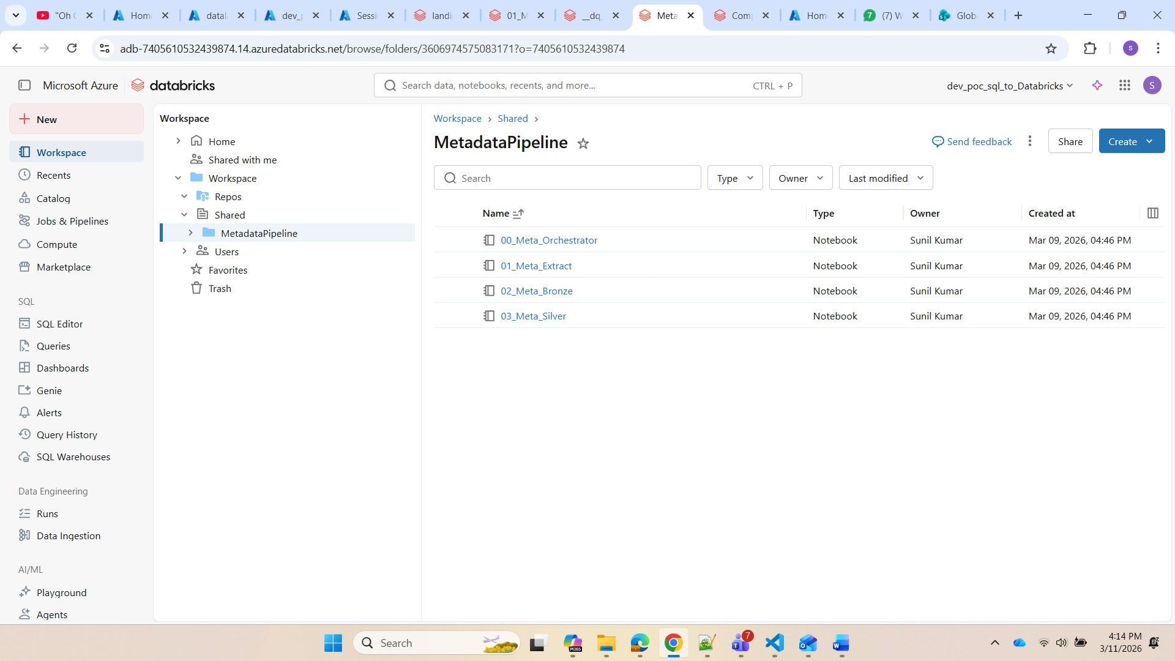

Slide 12
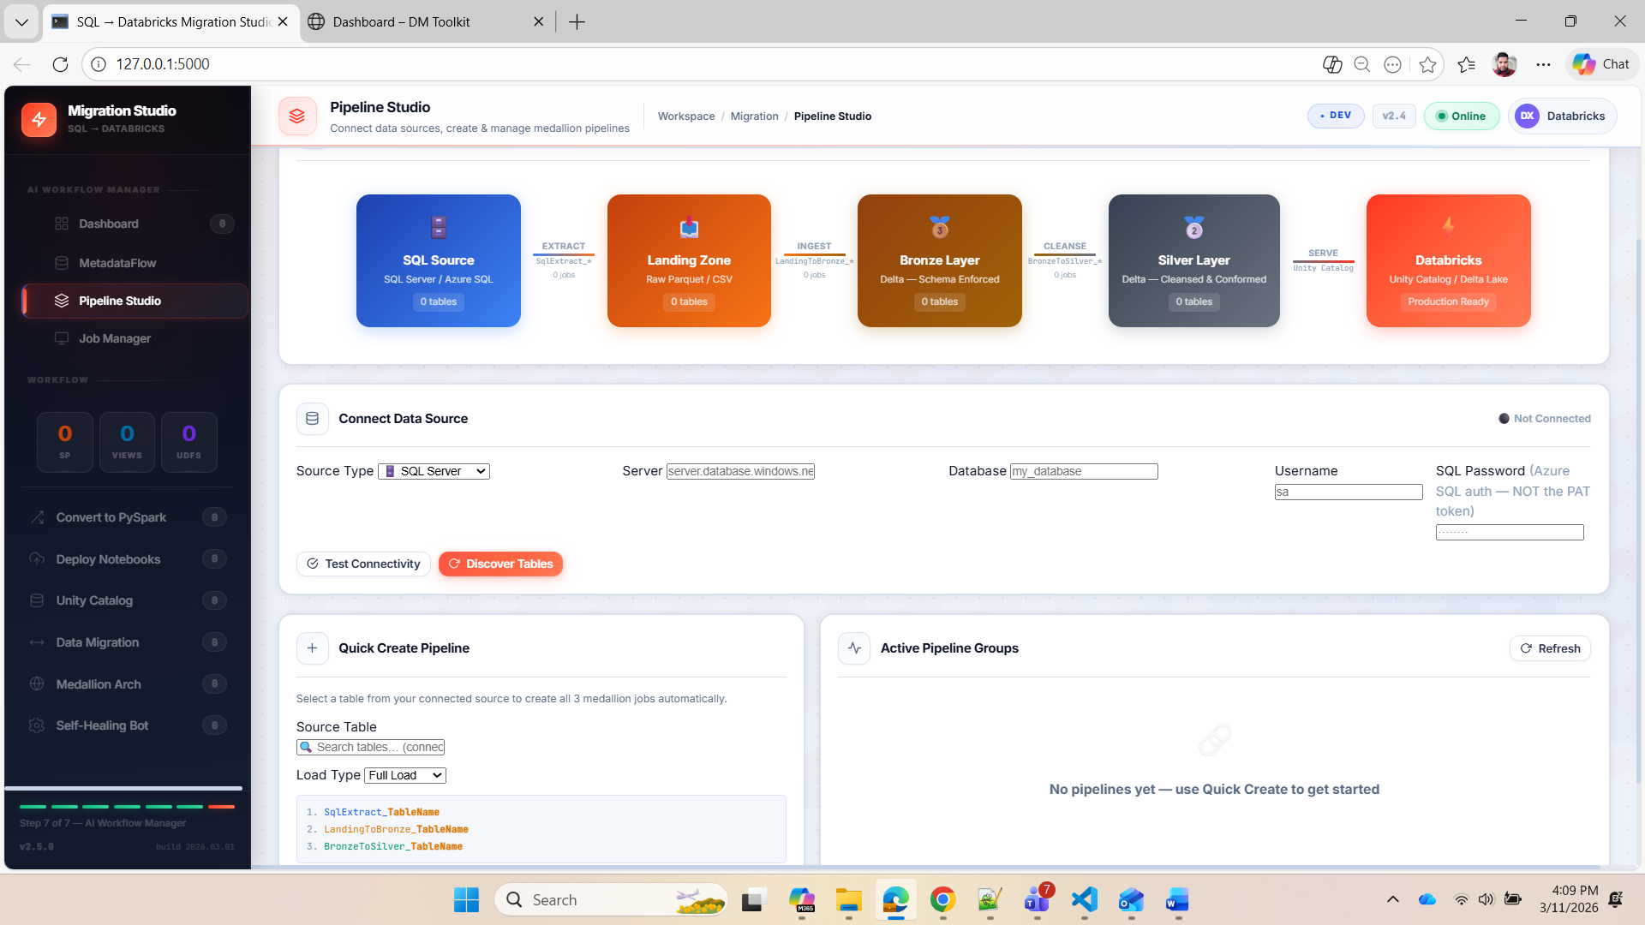

Slide 13
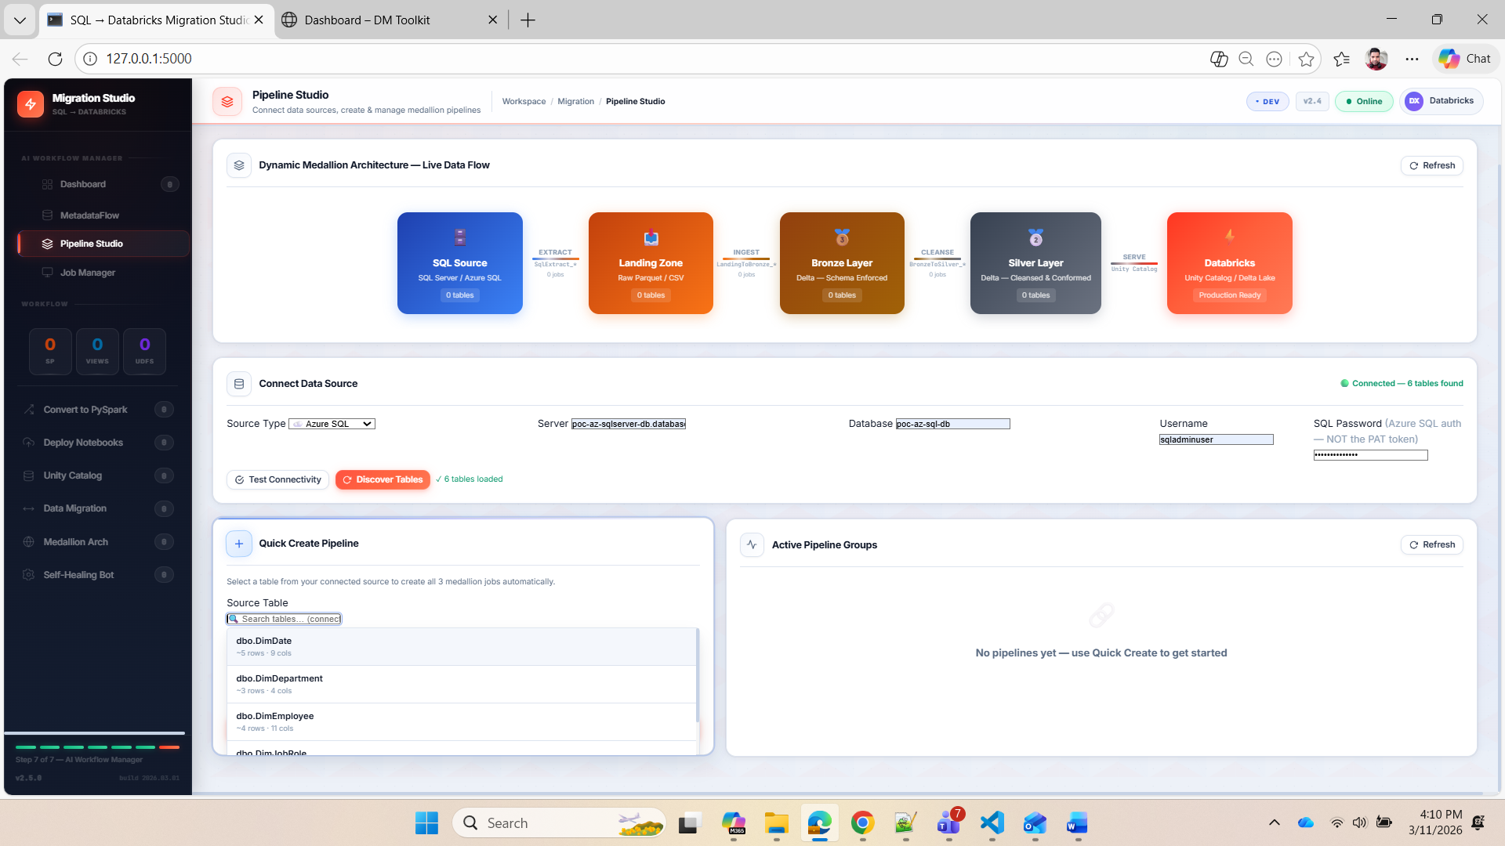

Slide 14
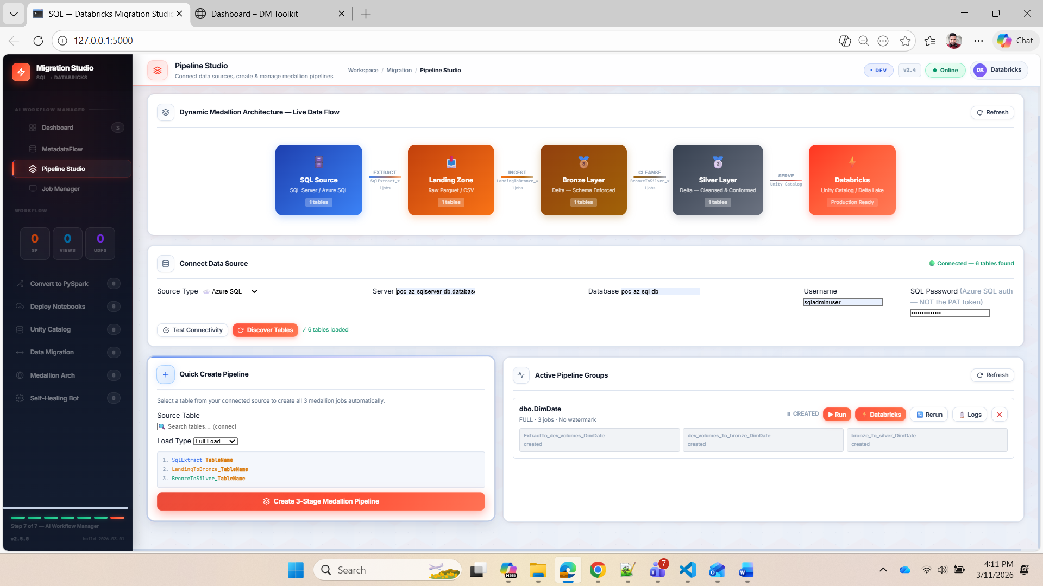

Slide 15
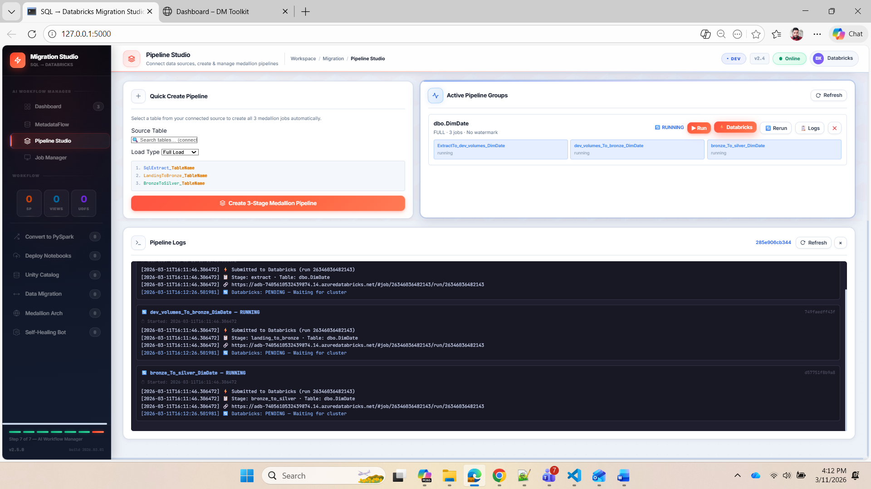

Slide 16
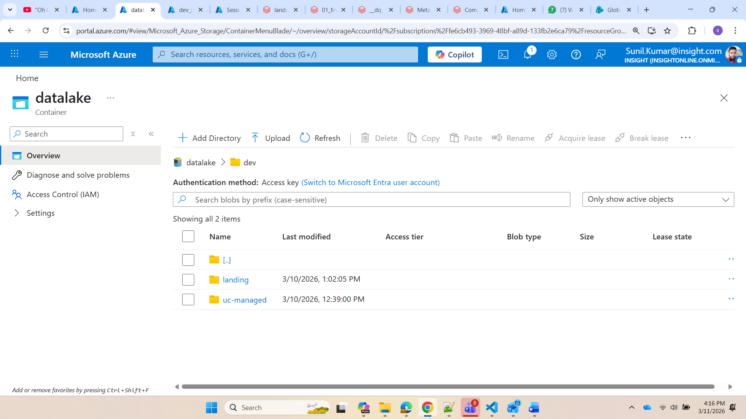

Slide 17
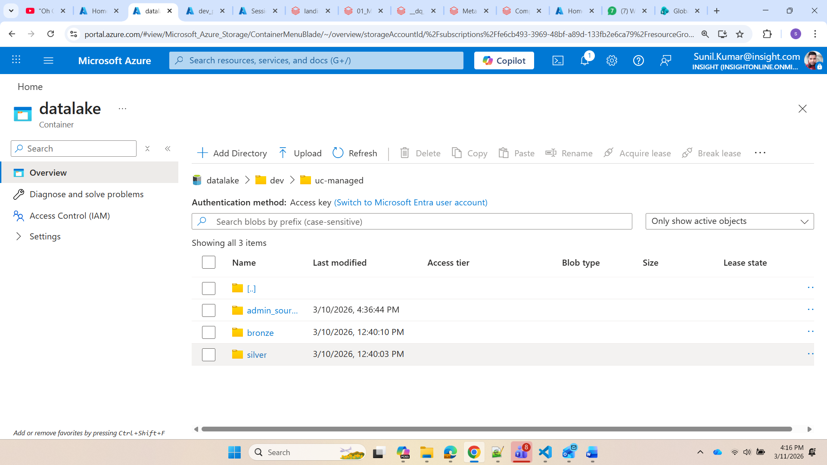

Slide 18
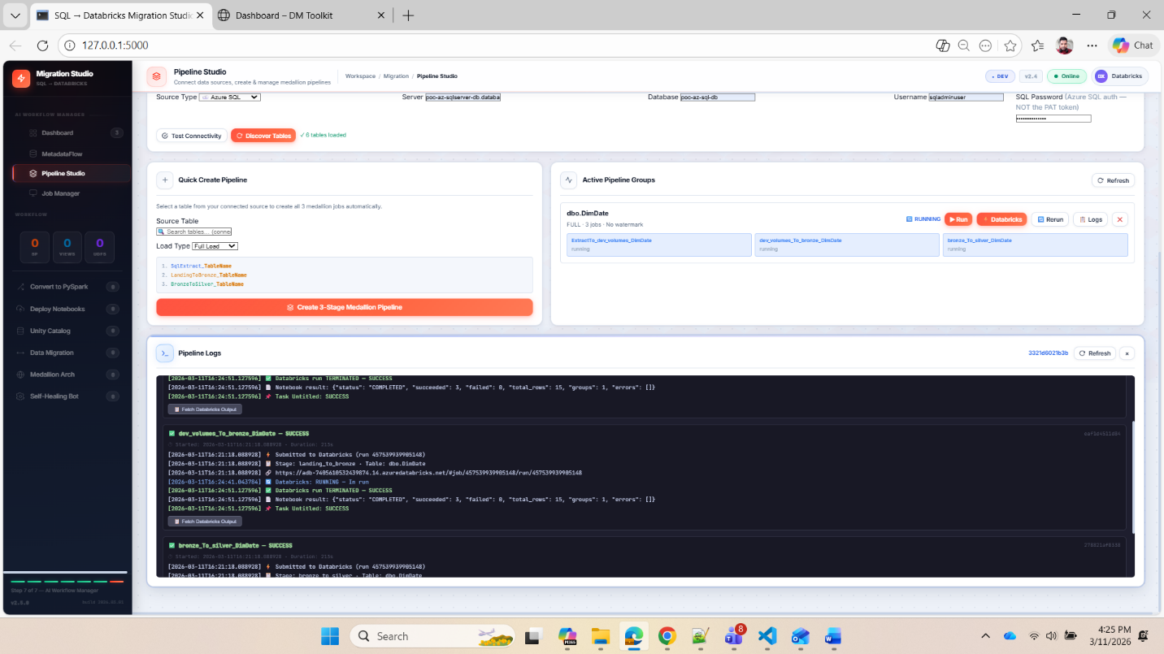
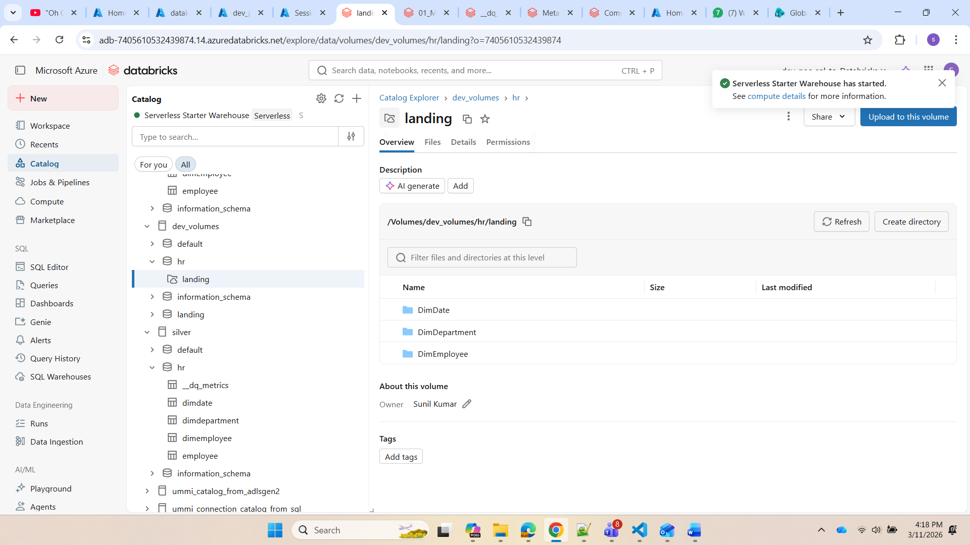

Slide 19
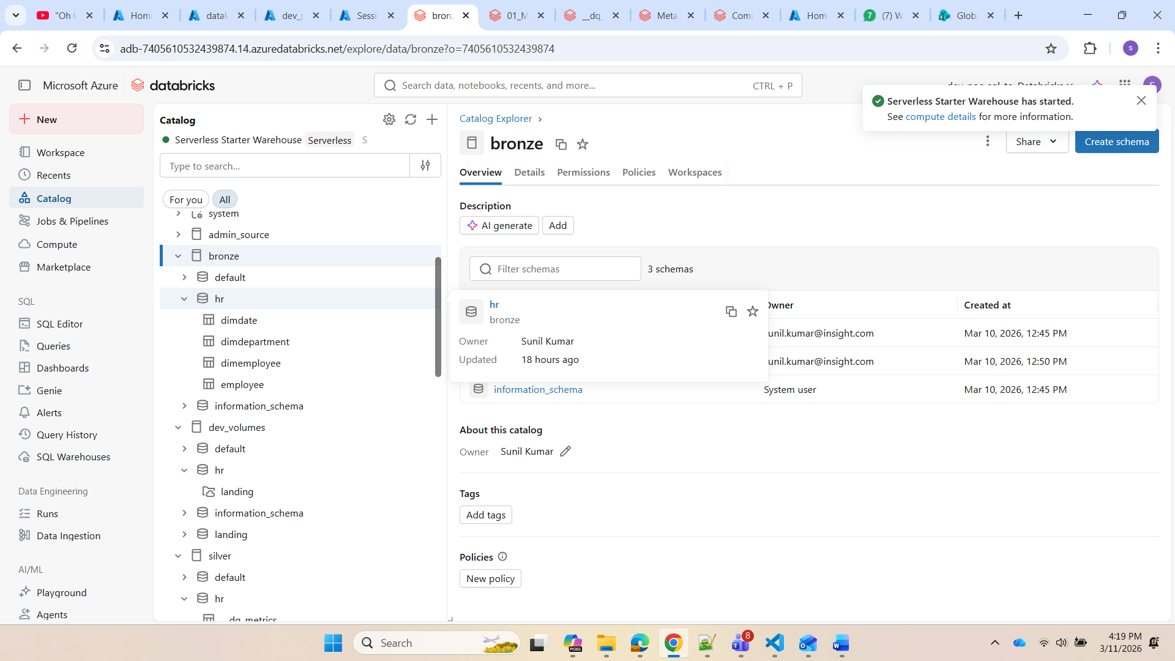

Slide 20
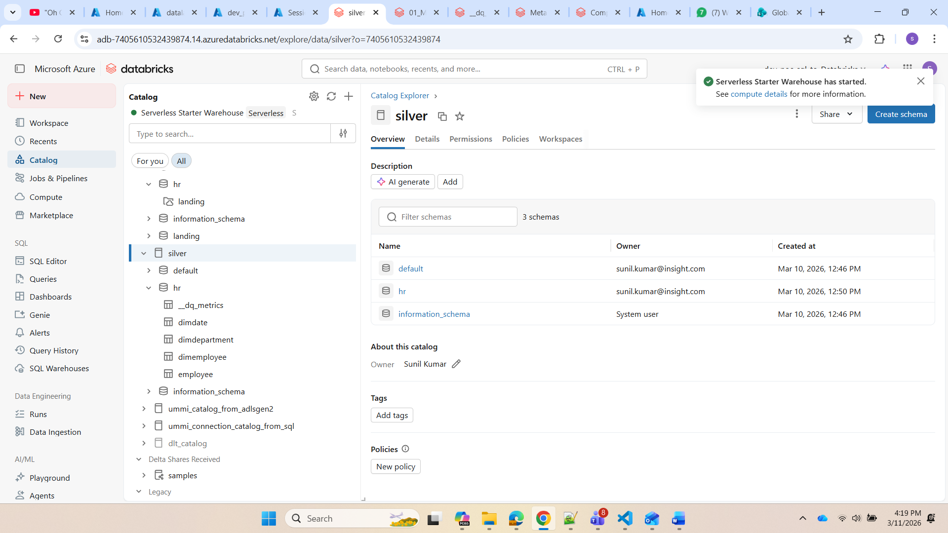

Slide 21
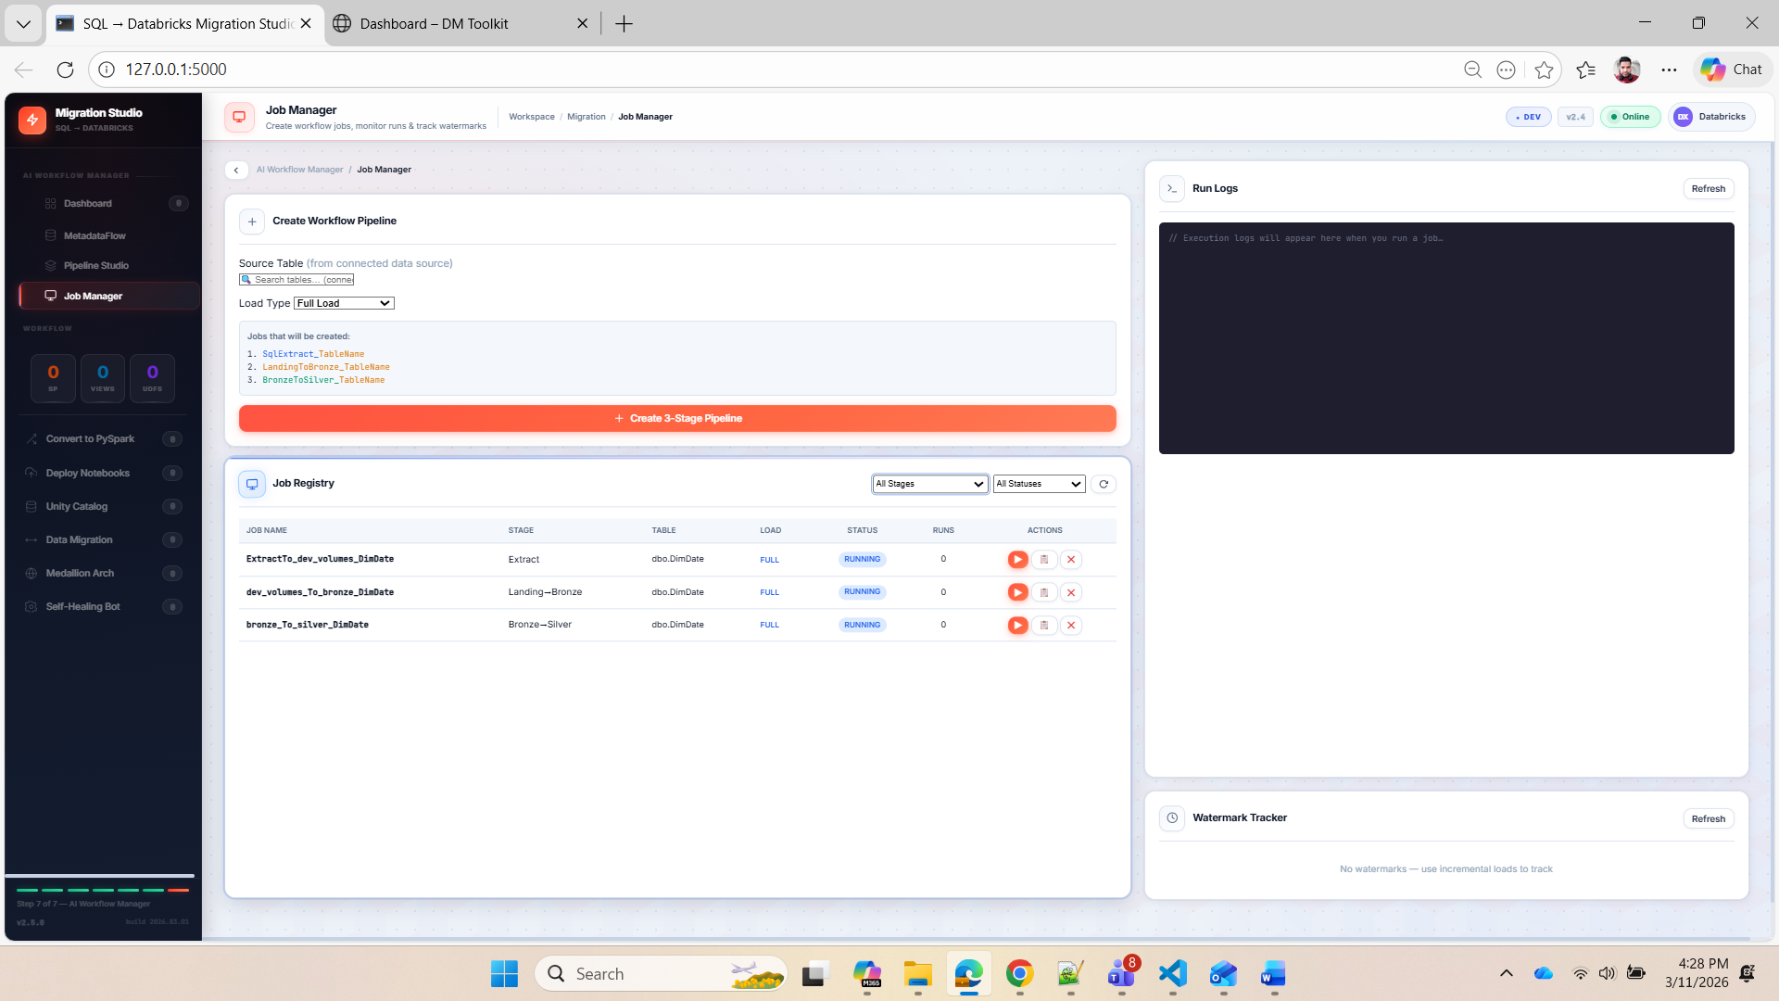

Slide 22
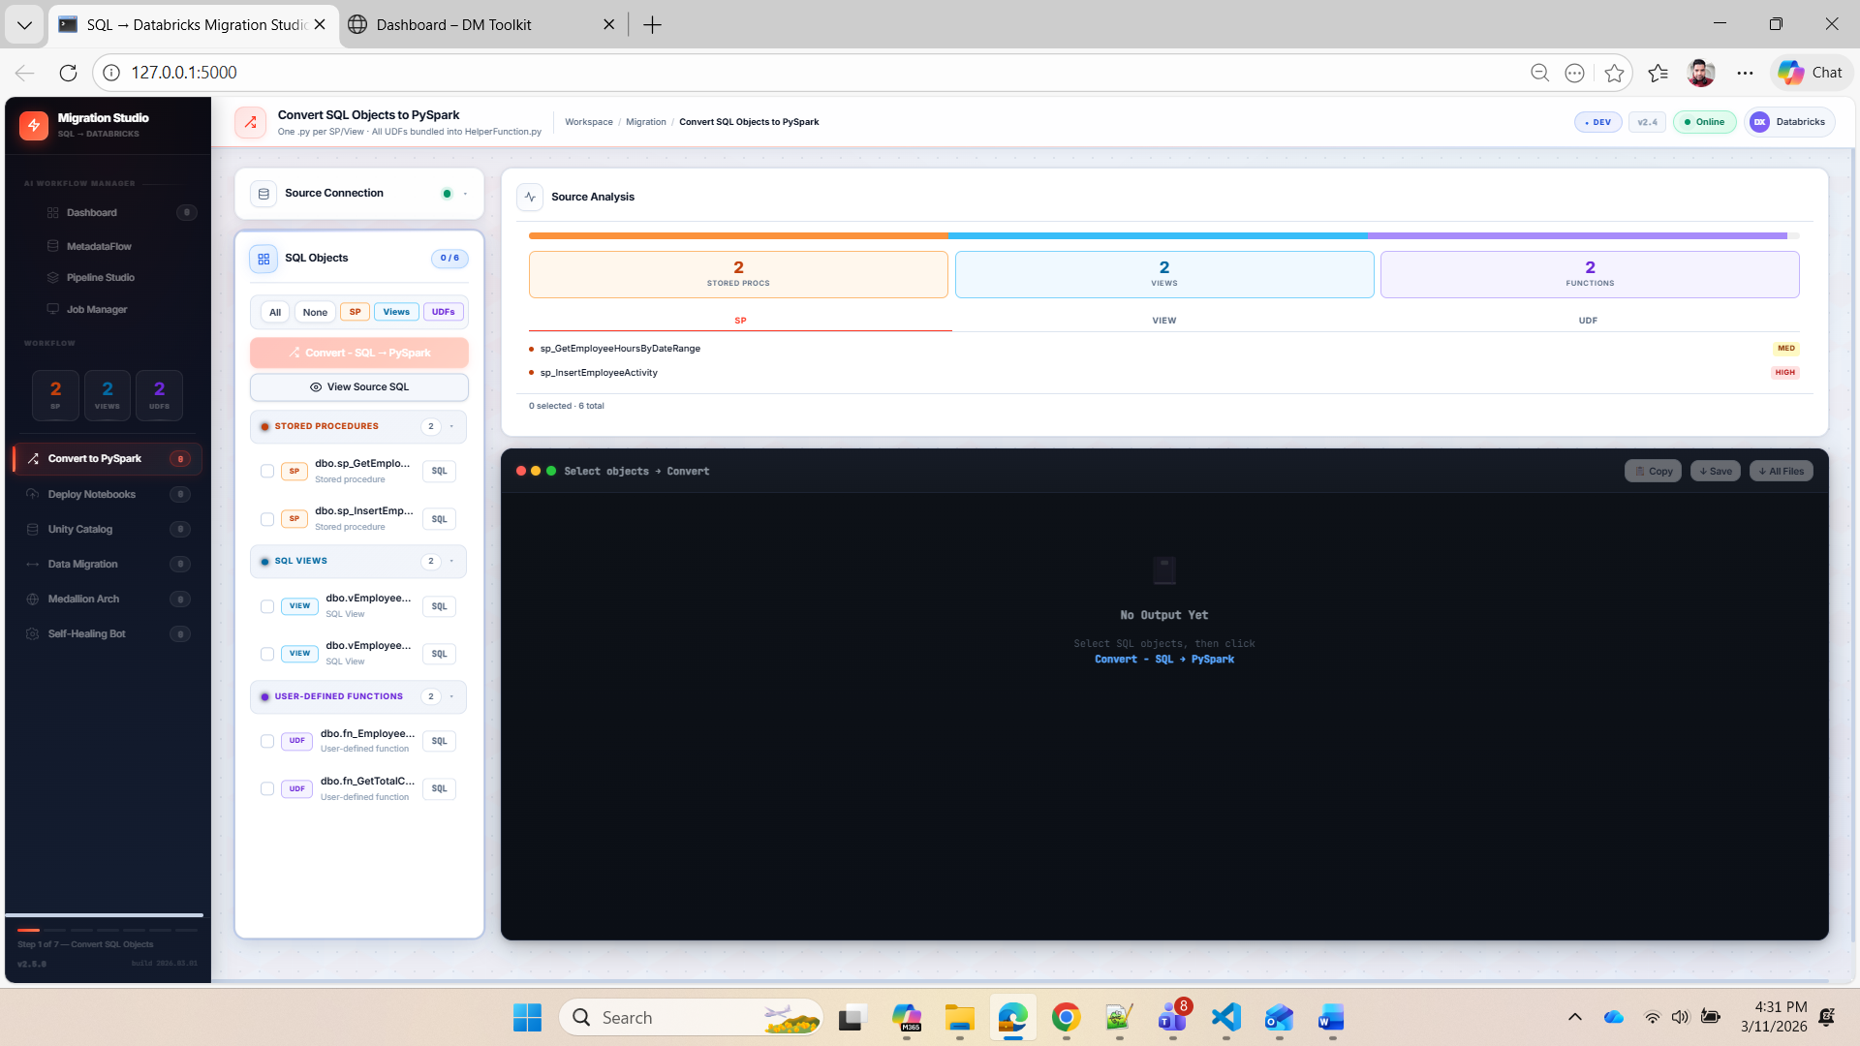

Slide 23
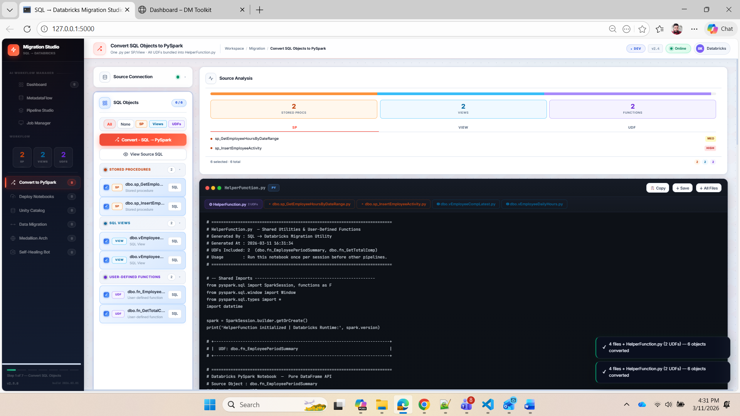

Slide 24
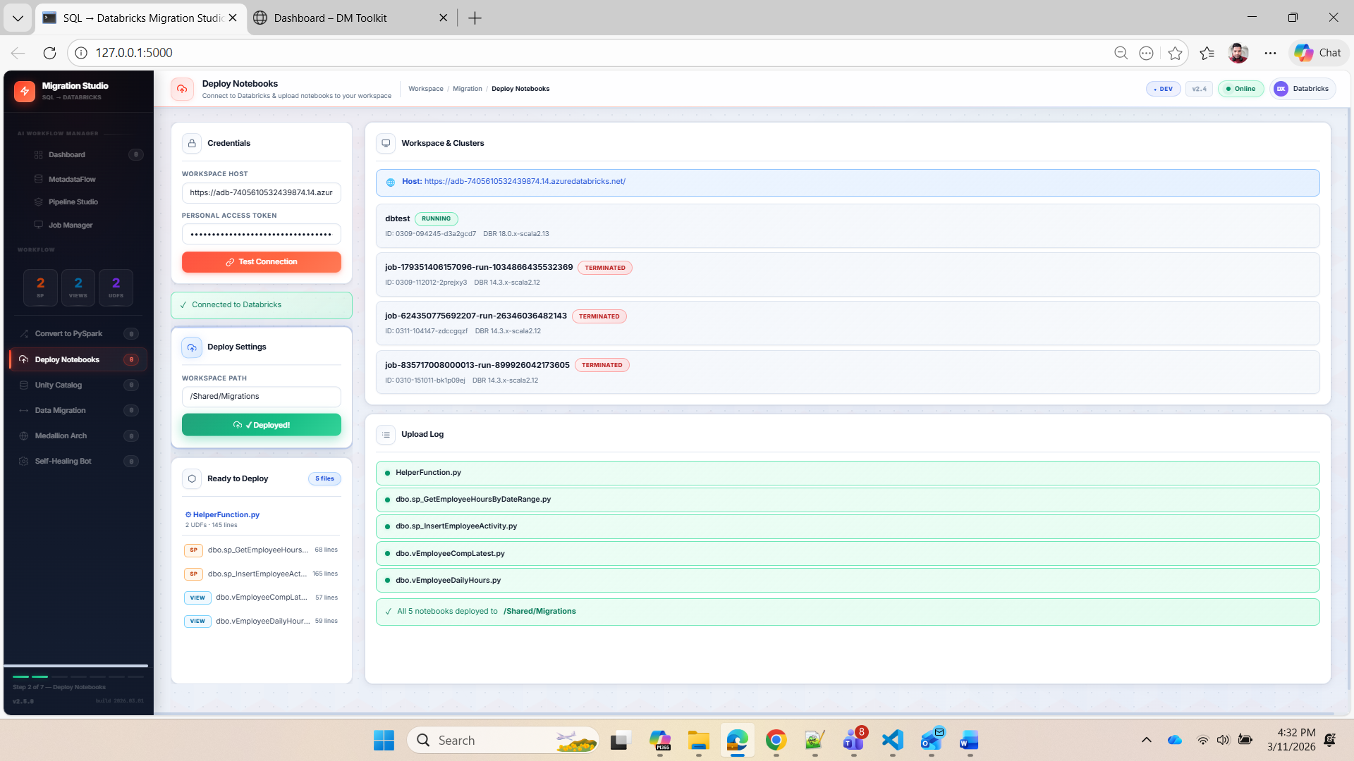

Slide 25
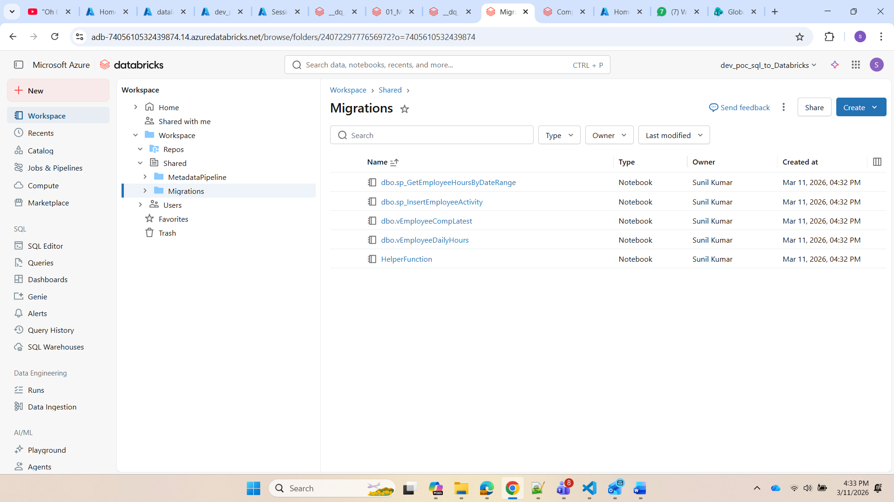

Slide 26
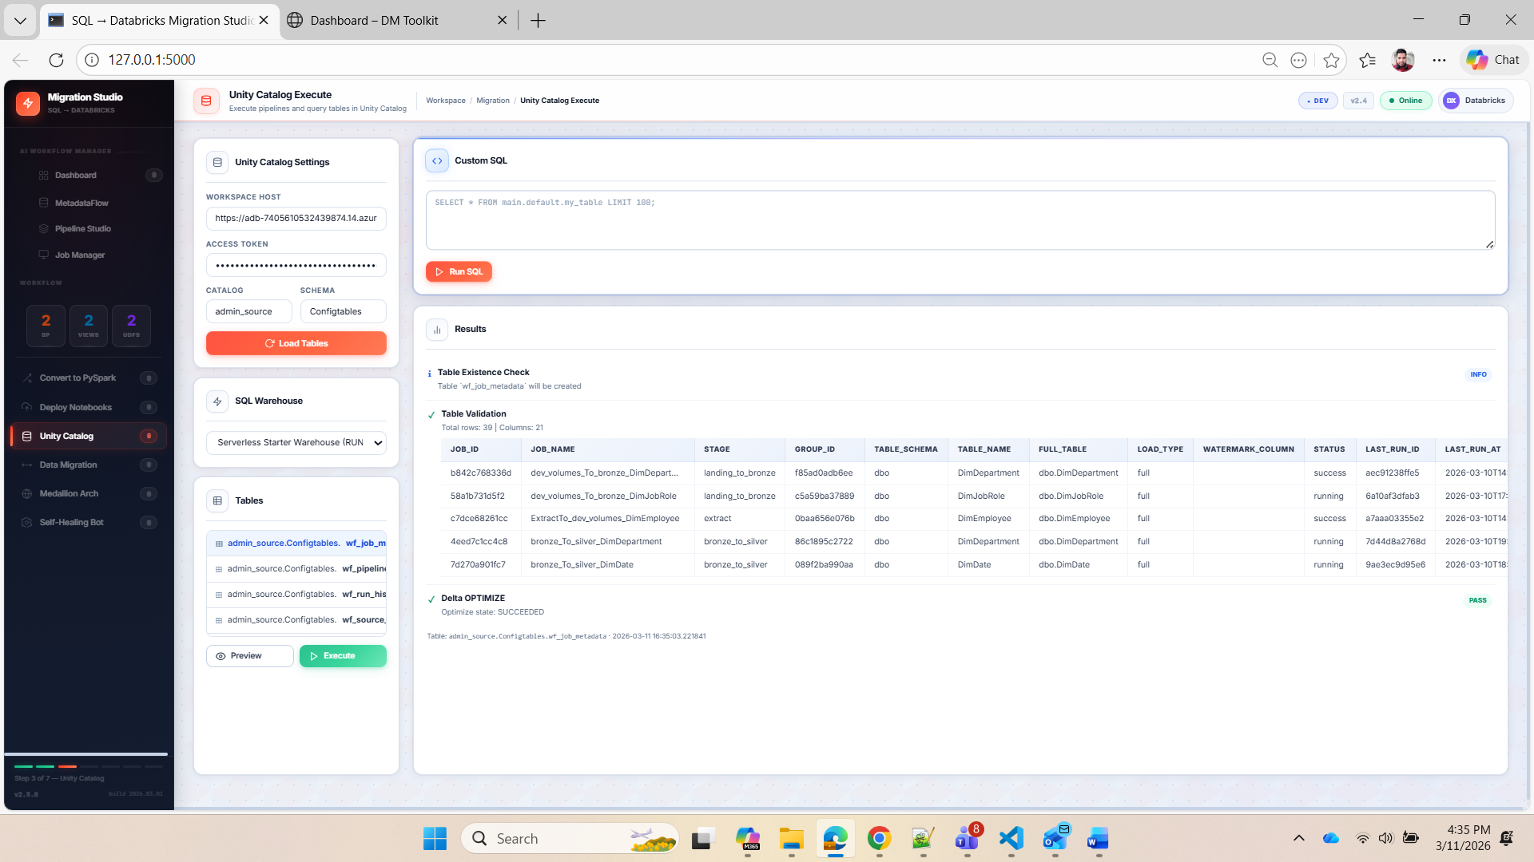

Slide 27
