Slide 1
DBx Migration Suite

Slide 2
Medallion Architecture
 | BRONZE | SILVER | GOLD | PLATINUM
Purpose | Ingest | Cleanse | Transform | Consolidate
Role | Auditable Source | The Clean Mirror | The Integration Hub | The Presentation Mart
Data Engineers | Ingestion & Audit | Ingestion & Archiving | Transformation & Quality | Define, Build, Optimize & Deliver Models, Visuals & Prompt Response
Data Scientists | Deep Forensic Investigation | Exploratory Data Analysis | Exploration & Feature Engineering | Model Training & Business Consumption
AI Engineers | Not usable | Deep Data Discovery | Building Training Datasets | Enable AI, PBI, ML use cases
Report Engineers | Not usable | Not usable | Query | Build dashboards & visuals
Business Analysis | Not usable | Not usable | Diagnostic analysis, why something happened | Proactive, predictive, automated decision making & forecasting

Slide 3
Reference Architecture -- SQL Server to Databricks Unity Catalog | Metadata-Driven Medallion
Databricks Unity Catalog
Azure SQL Server
Flask AI Workflow Mgr
dev_volumes
bronze
silver
gold (future)
HR Database
-------------------
DimDepartment
DimEmployee
DimJobRole
DimLocation
DimDate
Metadata pipeline config
SP to PySpark (AI)
Notebook gen & deploy
Databricks job submit
Background run polling
Self-healing recovery
UC Volumes (Landing)
Bronze (Raw + Audit)
Silver (Cleansed)
Gold (Business KPIs)
REST API
/Volumes/dev_volumes/
hr/landing/{table}
Format: Parquet
bronze.hr.{table}
Delta Tables
+ __src_file, __load_ts
+ __batch_id
silver.hr.{table}
Delta Tables
Dedup + null handling
Type cast + DQ checks
Aggregated datasets
BI-ready views
Power BI / Tableau
Metadata Delta Tables (Unity Catalog)
wf_pipeline_metadata
wf_job_metadata
wf_run_history
wf_watermark_metadata
wf_source_tables
Auto-Generated Metadata Notebooks
00_Meta_Orchestrator
01_Meta_Extract
02_Meta_Bronze
03_Meta_Silver
Reads pipeline metadata
Runs E>B>S per table
Breaks on FAILED
JDBC to Azure SQL
Watermark filtering
Write Parquet to Volumes
Read landing Parquet
Add audit columns
MERGE to bronze Delta
Read bronze Delta
Dedup + cleanse
MERGE to silver Delta
AI SP to PySpark Converter
Security
Governance
Reliability
Scalability
OpenAI / Gemini / Claude
Auto-converts SQL SPs
Generates PySpark code
PAT tokens for API auth
ODBC-escaped credentials
Encrypted JDBC (TLS)
UC RBAC per catalog
Unity Catalog metadata
Catalog-level isolation
Delta versioning
Full audit trail
All paths have try/except
Break on first failure
Error payloads captured
Incremental watermarks
Metadata-driven config
Spark distributed proc
Delta MERGE upserts
Extensible to Gold
Self-Healing Bot
Technology Stack
End-to-End Data Flow
Auto-retry failed runs
AI-powered error fixing
Notebook auto-repair
Azure SQL Server
HR source database (5 dimension tables)
Azure SQL
JDBC Extract
UC Volumes Landing
Bronze Delta
Silver Delta
Gold (Future)
Python / Flask
Web UI: pipeline config, deploy, monitor
Databricks REST API
Job submit (runs/submit) + polling (runs/get)
UC Volumes
Landing zone: Parquet via JDBC extract
Future Roadmap
Delta Lake
Bronze & Silver managed tables (MERGE)
Gold Layer: aggregated KPIs for BI dashboards
ODBC Driver 17
Local schema discovery & data preview
Secret Mgmt: Databricks Secrets / Azure Key Vault
OpenAI/Gemini/Claude
SP to PySpark AI conversion engine
CI/CD: Azure DevOps / GitHub Actions notebook deploy
DQ Framework: Great Expectations at Silver layer

Slide 4
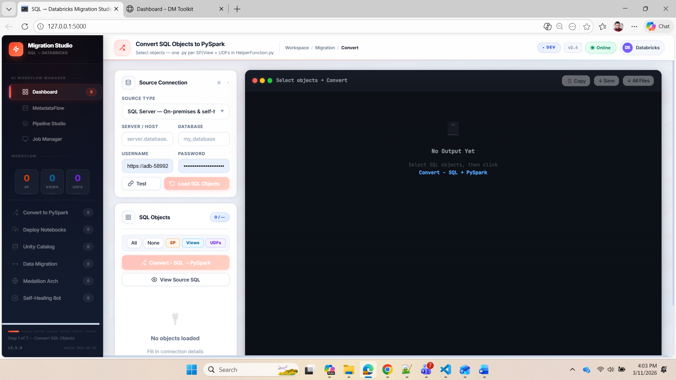

Slide 5
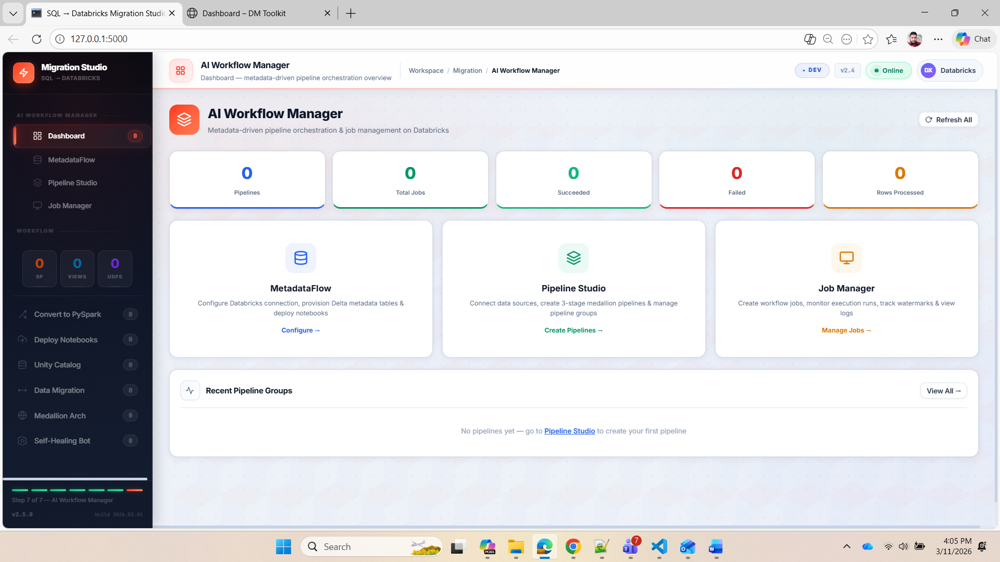

Slide 6
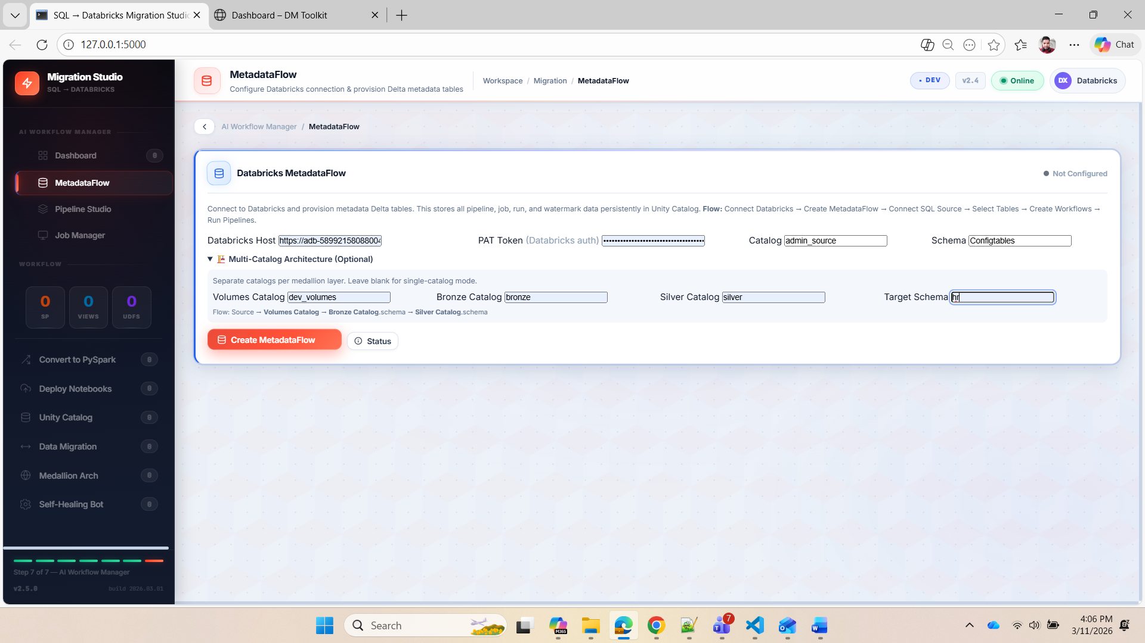

Slide 7
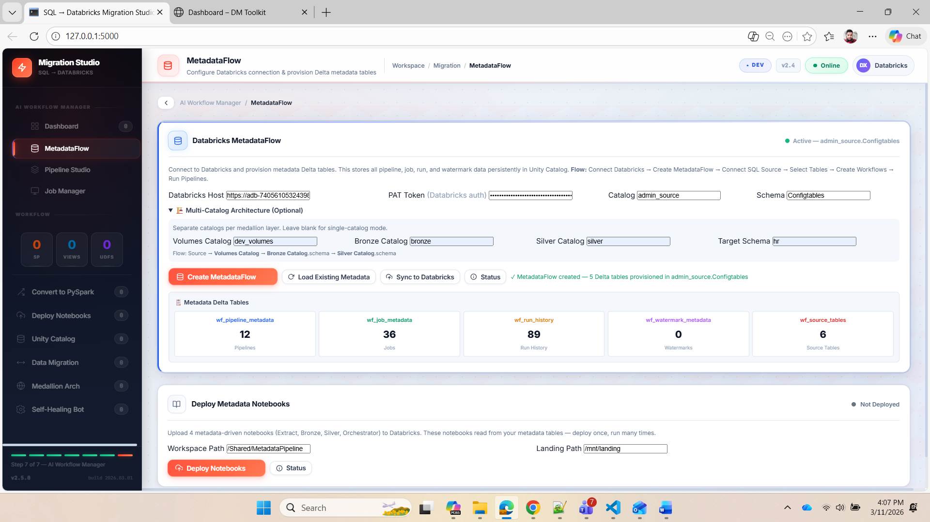

Slide 8
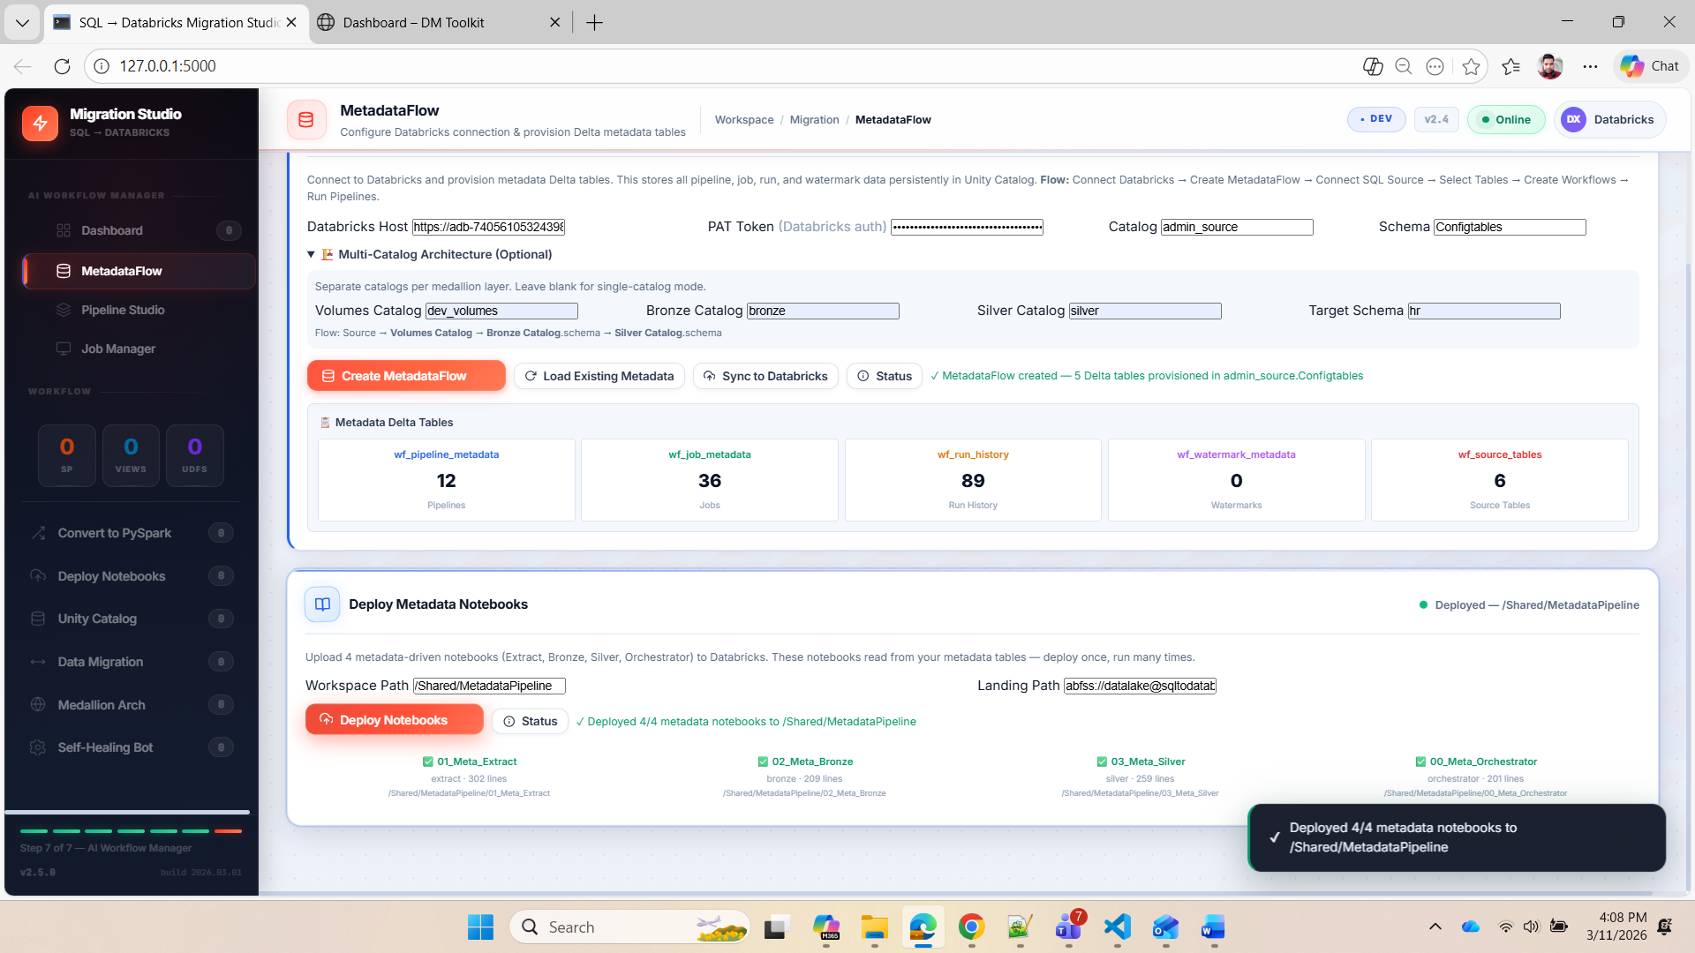

Slide 9
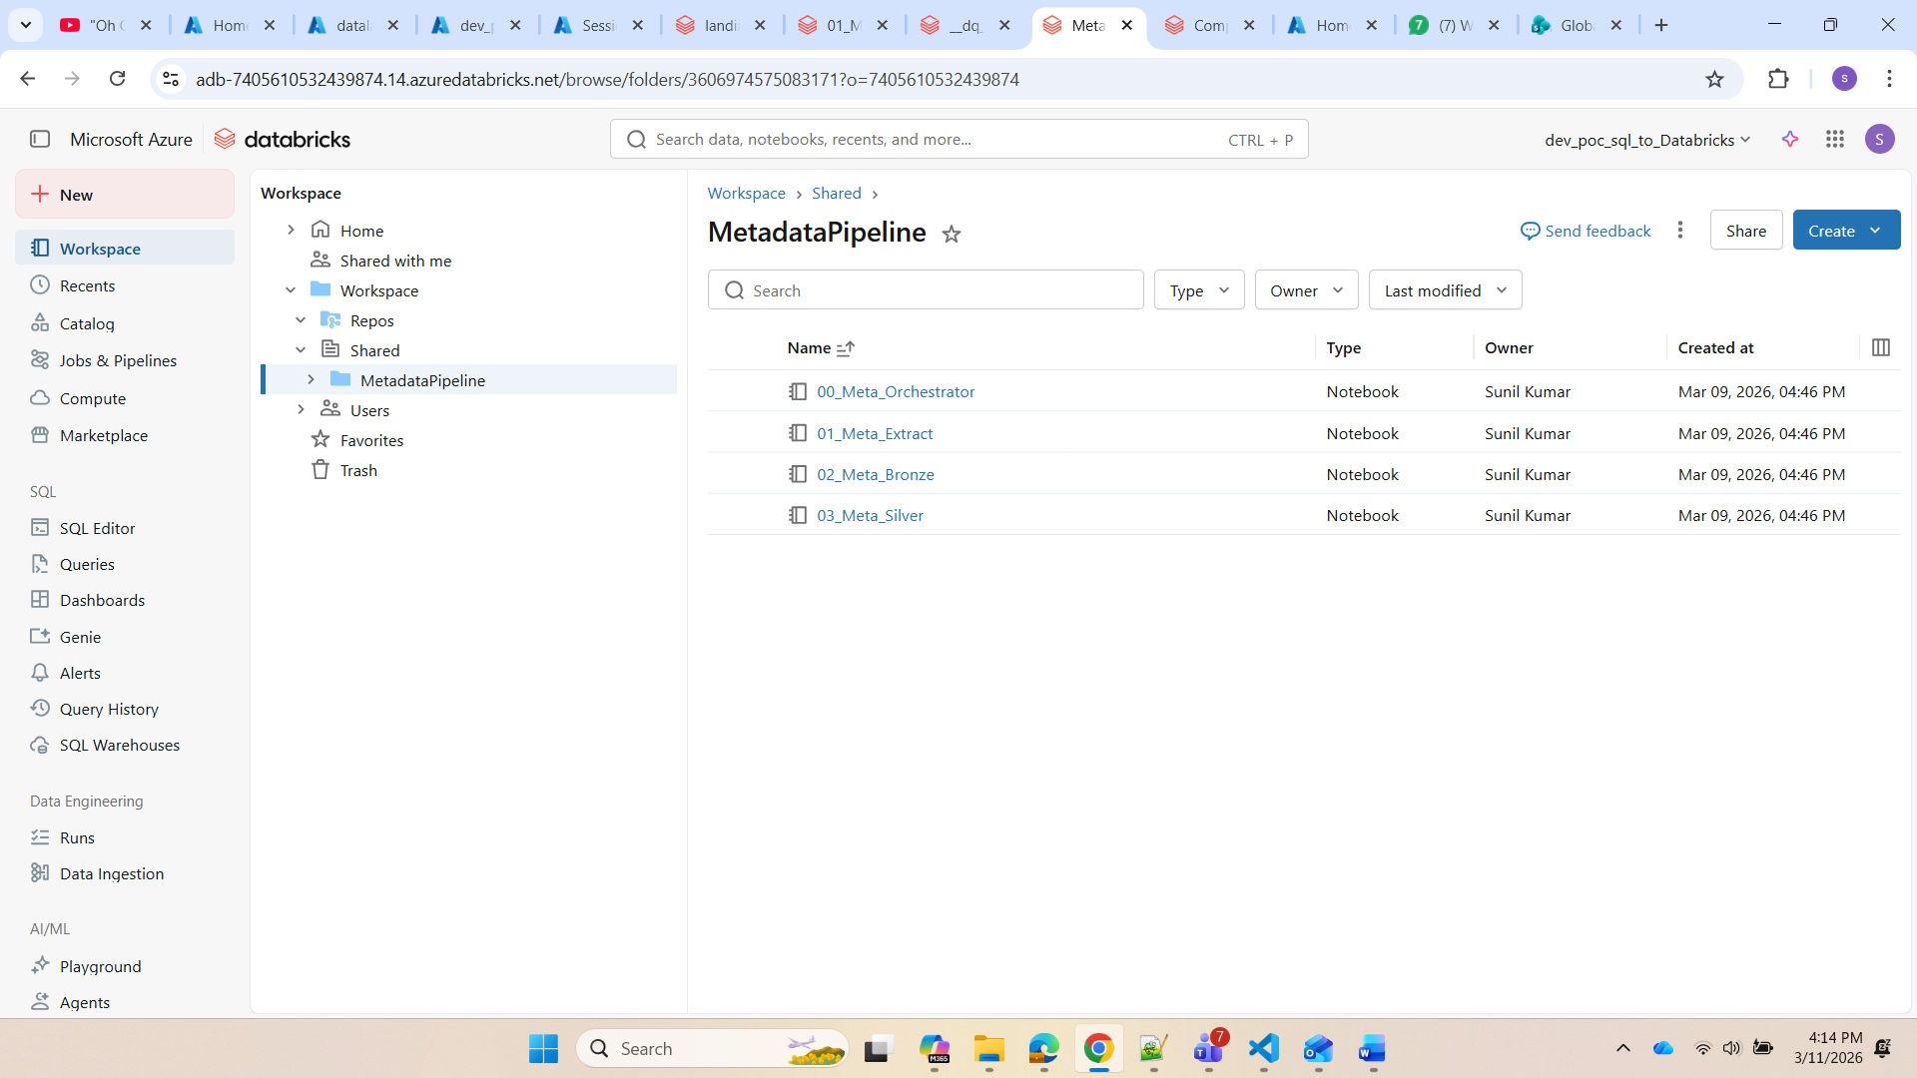

Slide 10
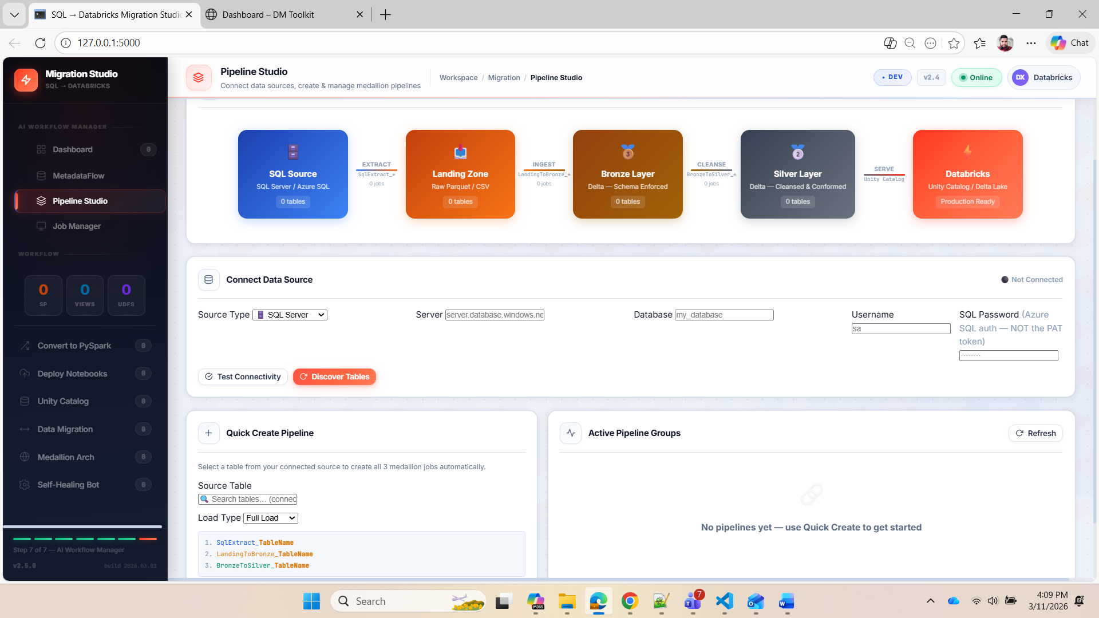

Slide 11
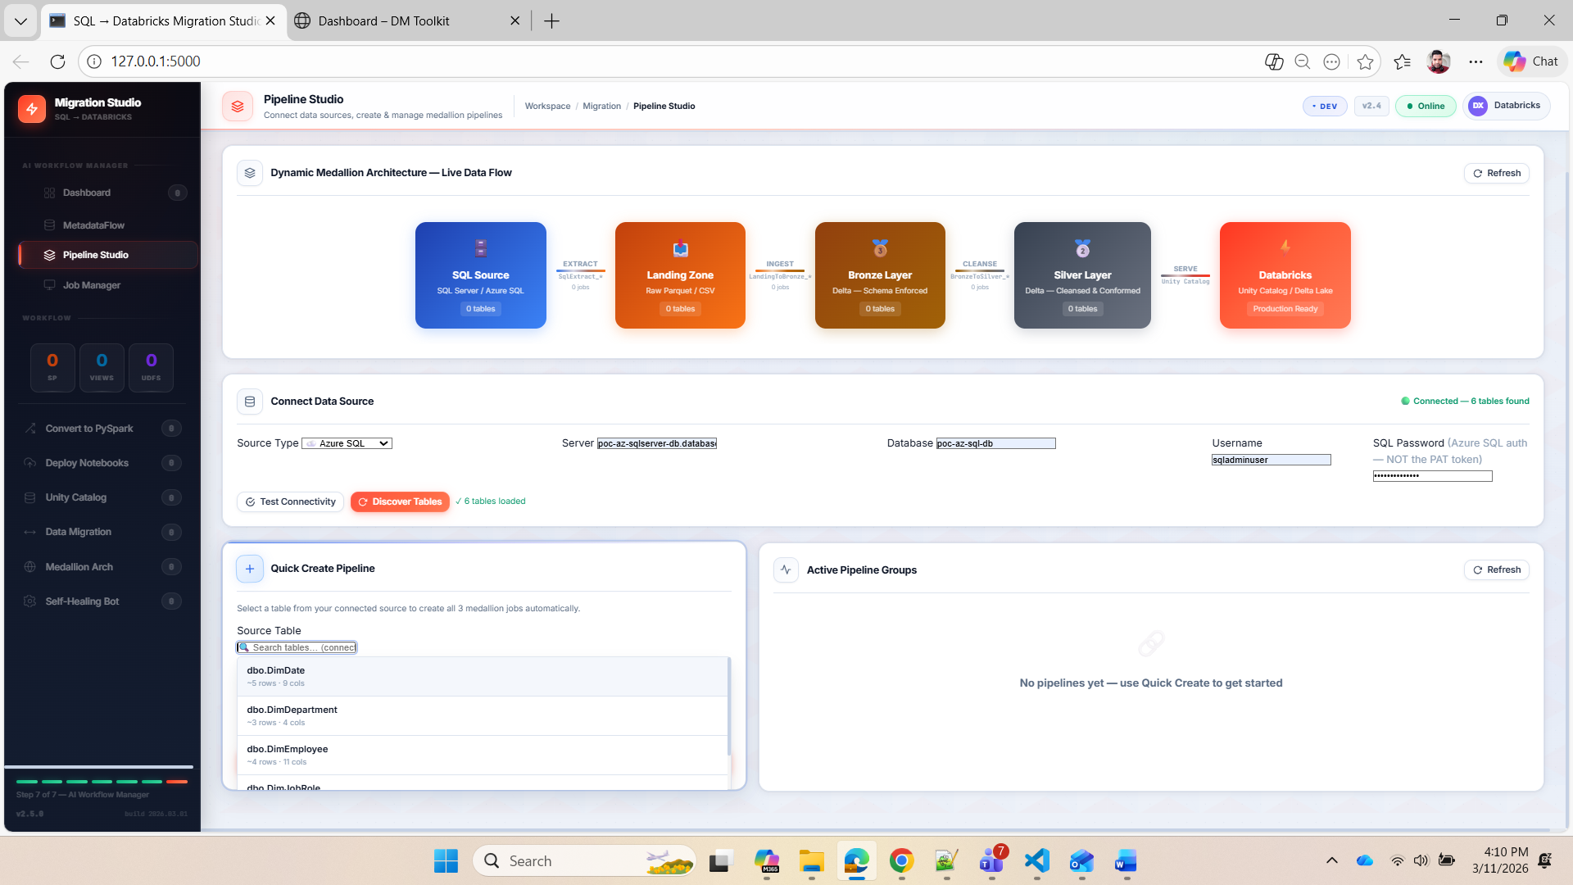

Slide 12
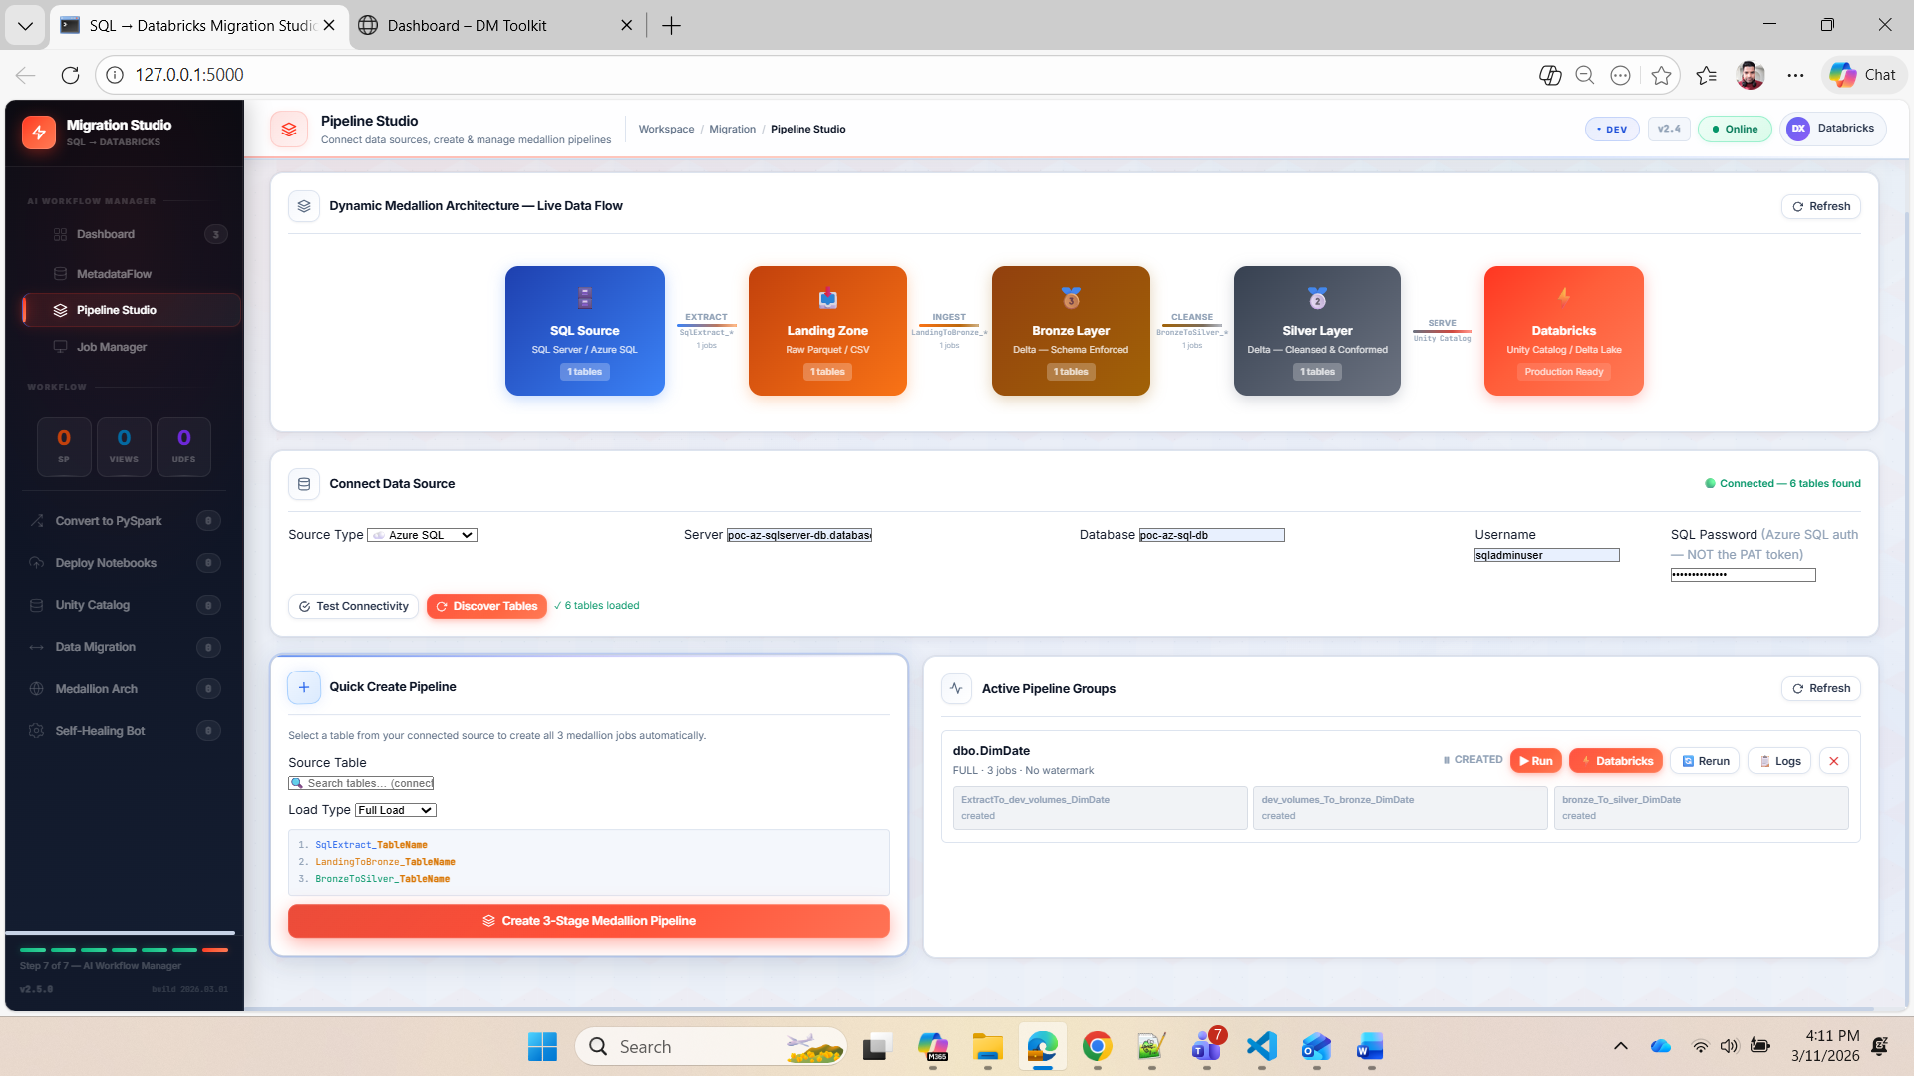

Slide 13
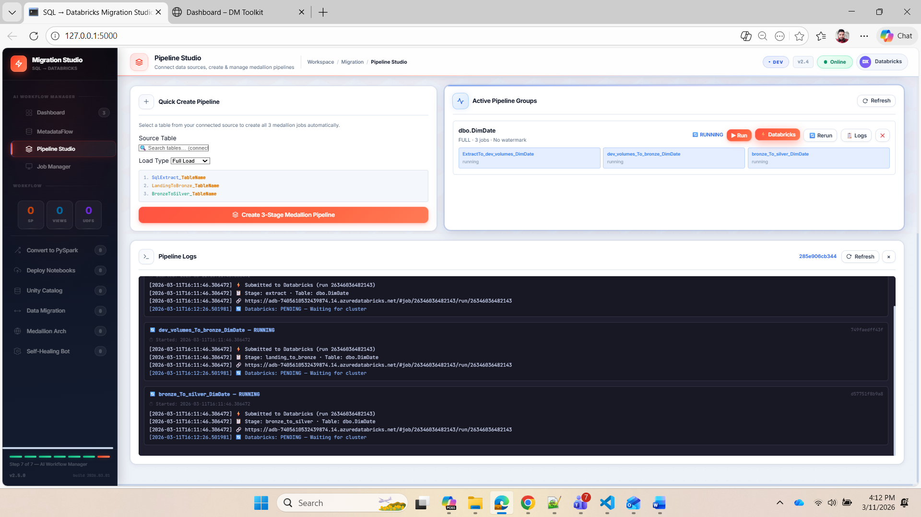

Slide 14
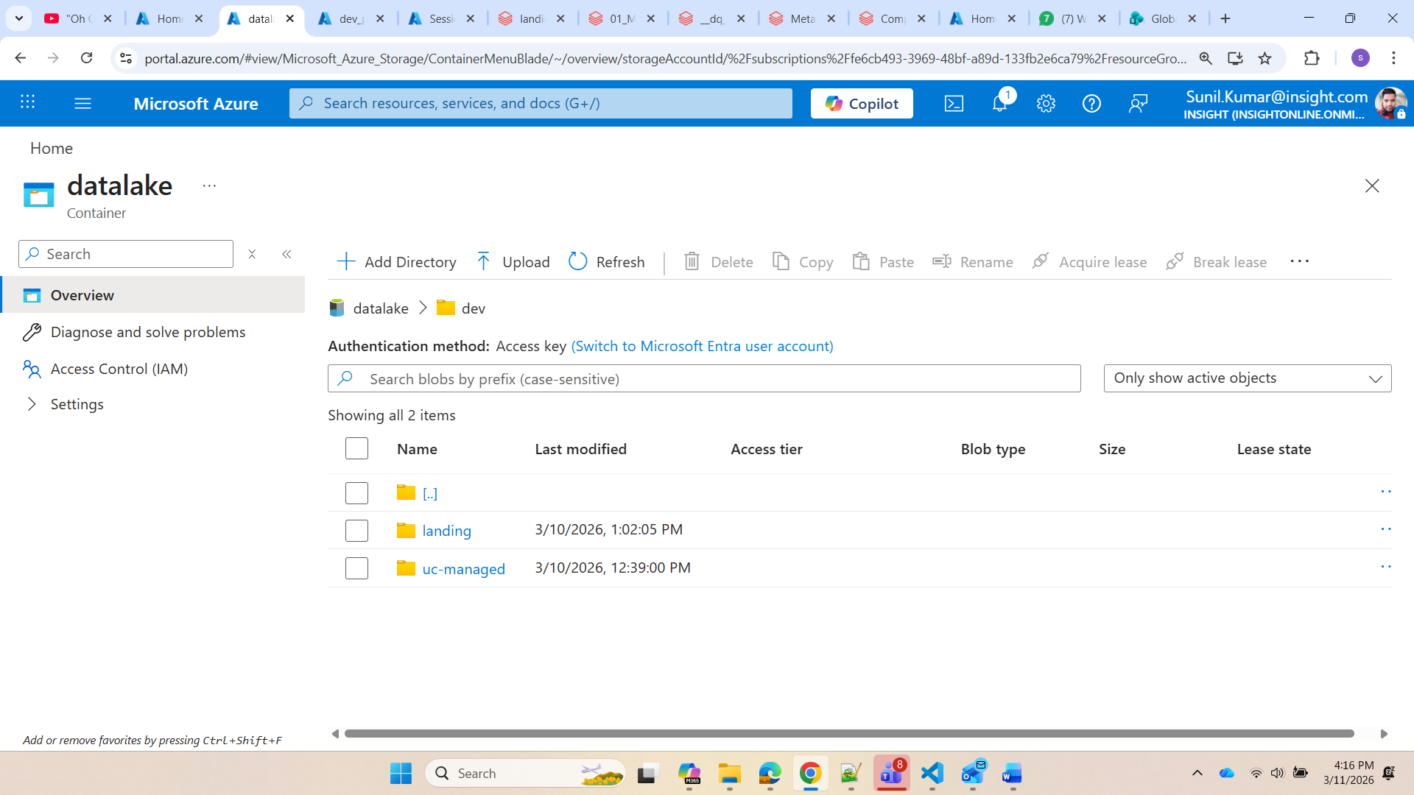

Slide 15
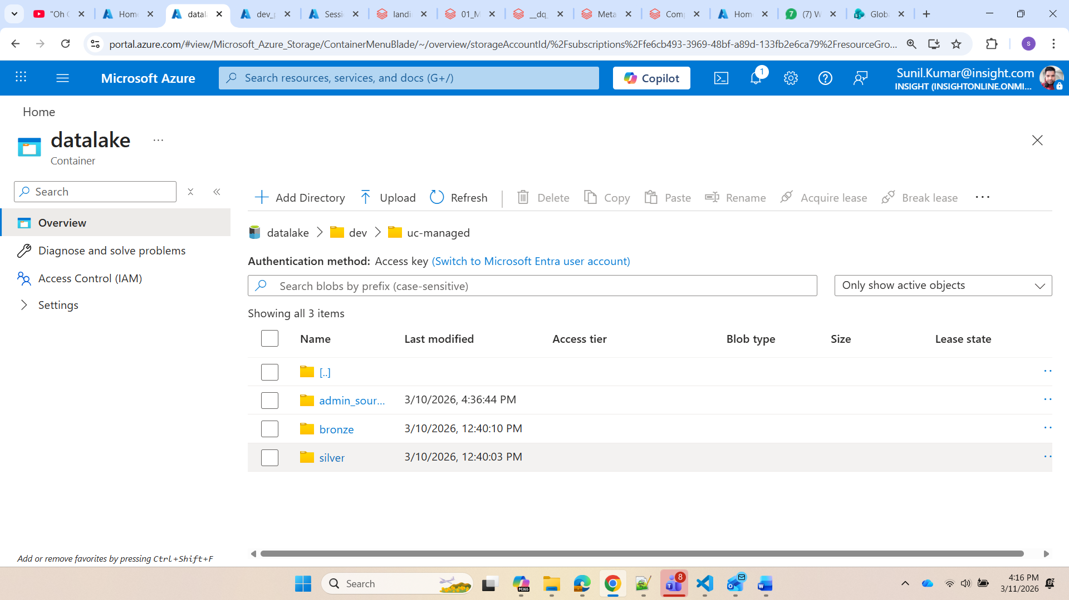

Slide 16
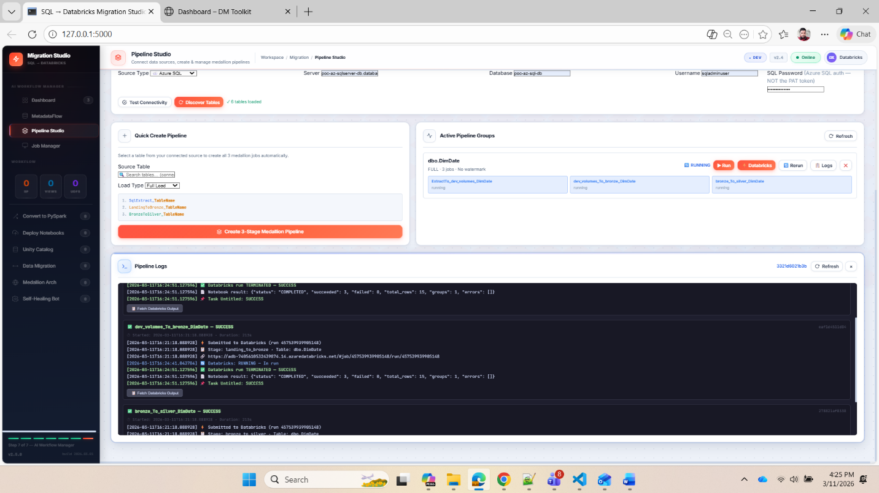
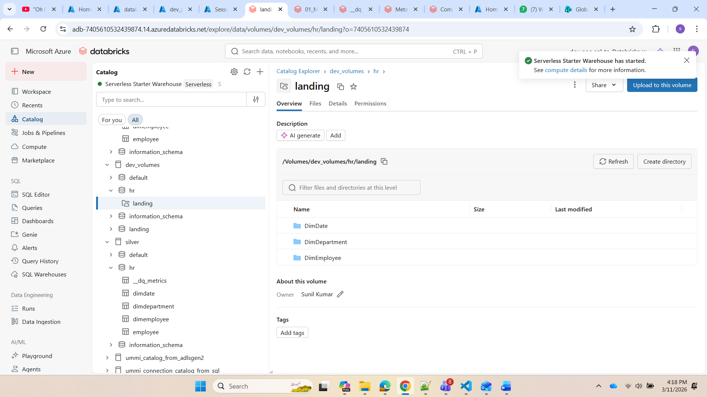

Slide 17
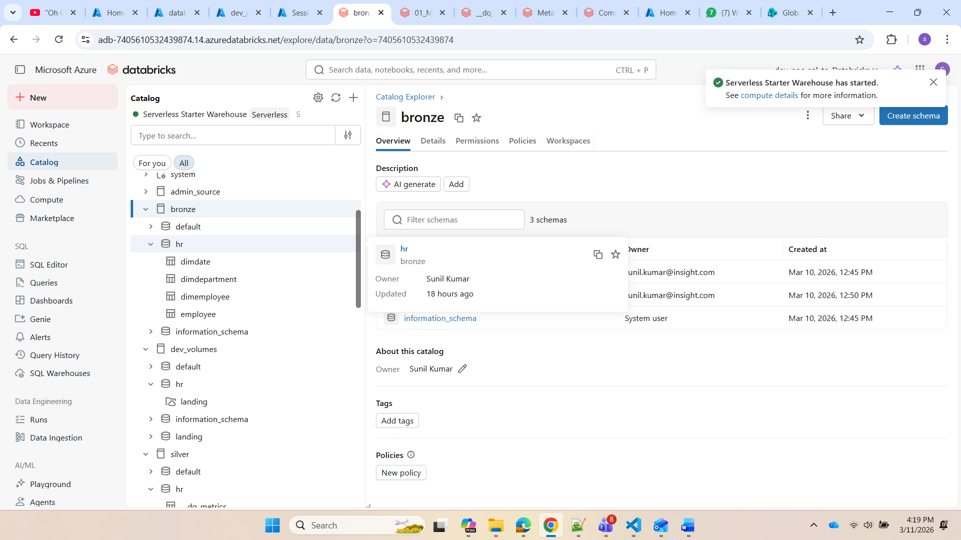

Slide 18
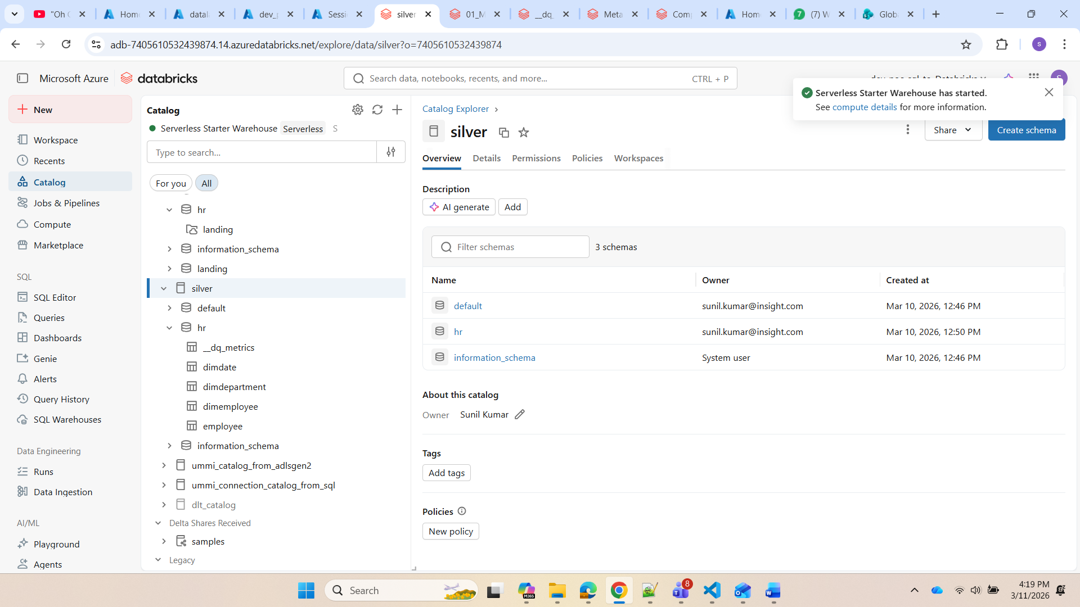

Slide 19
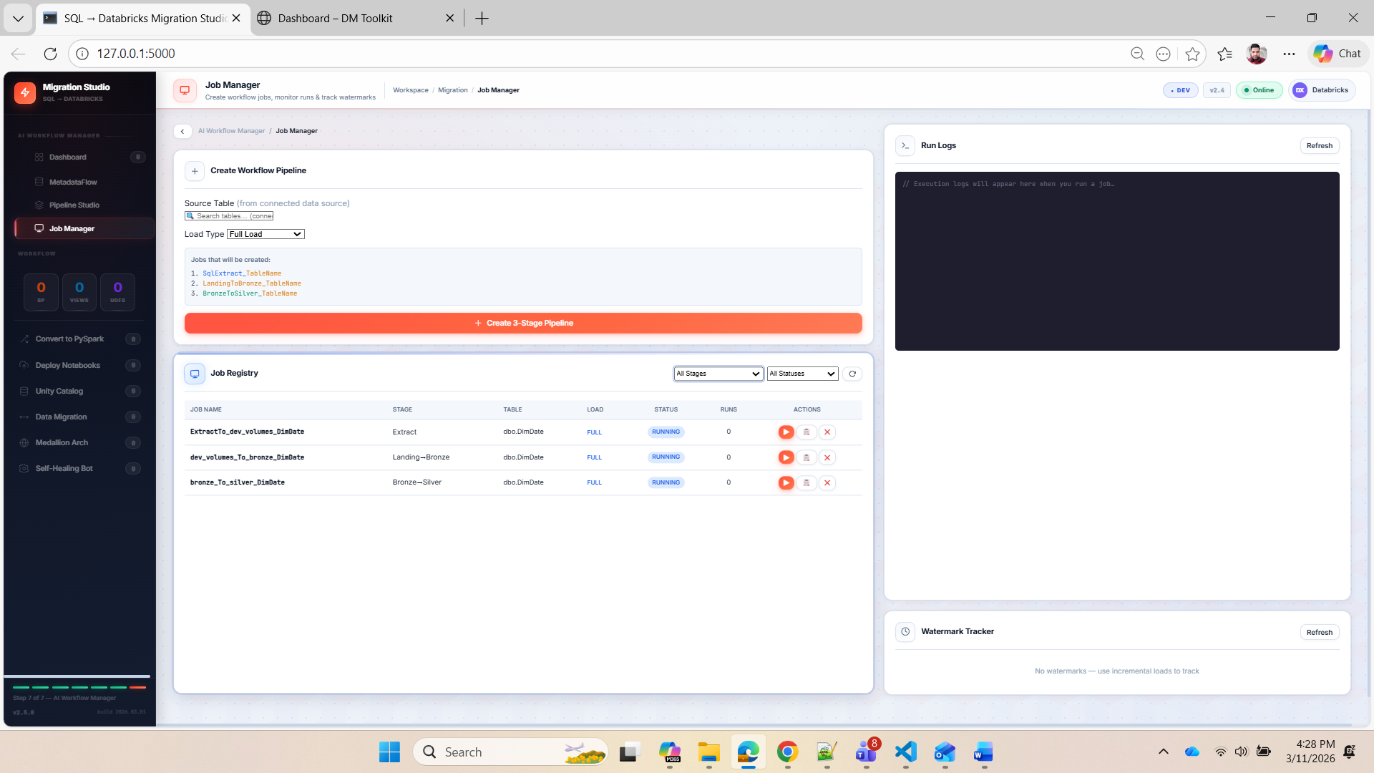

Slide 20
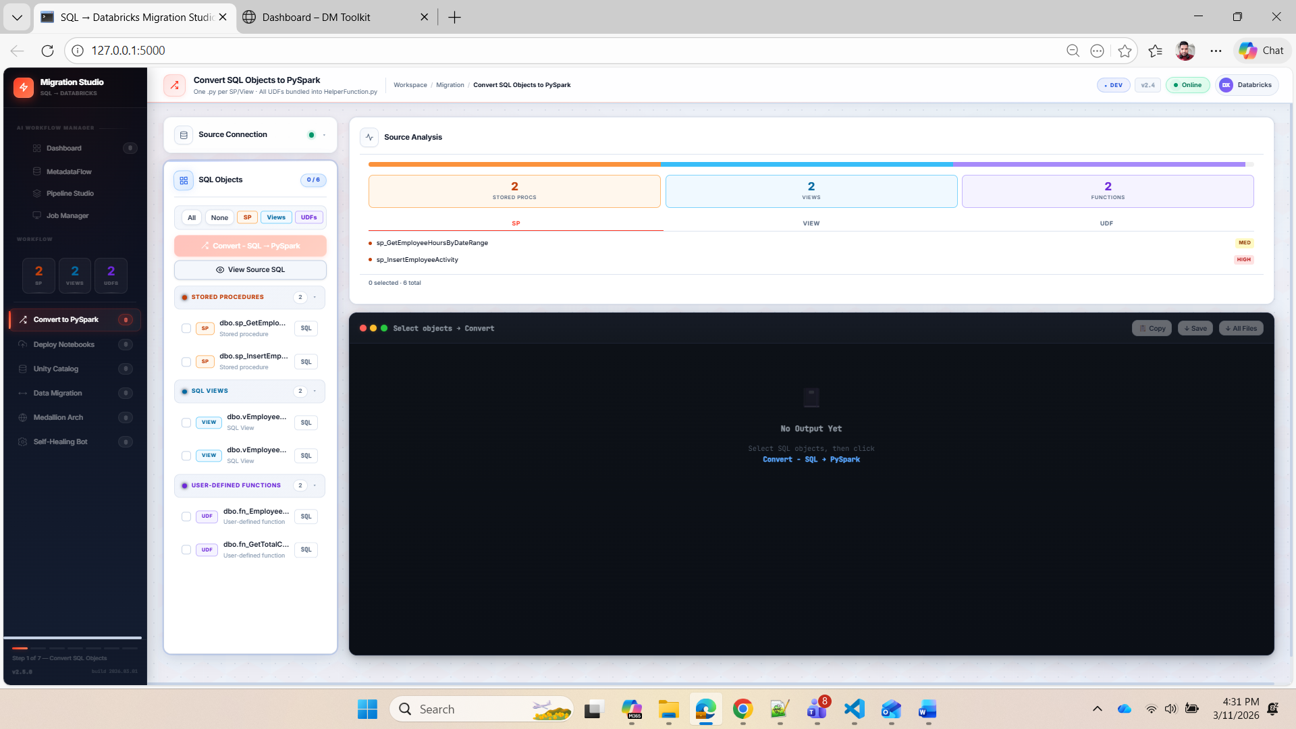

Slide 21
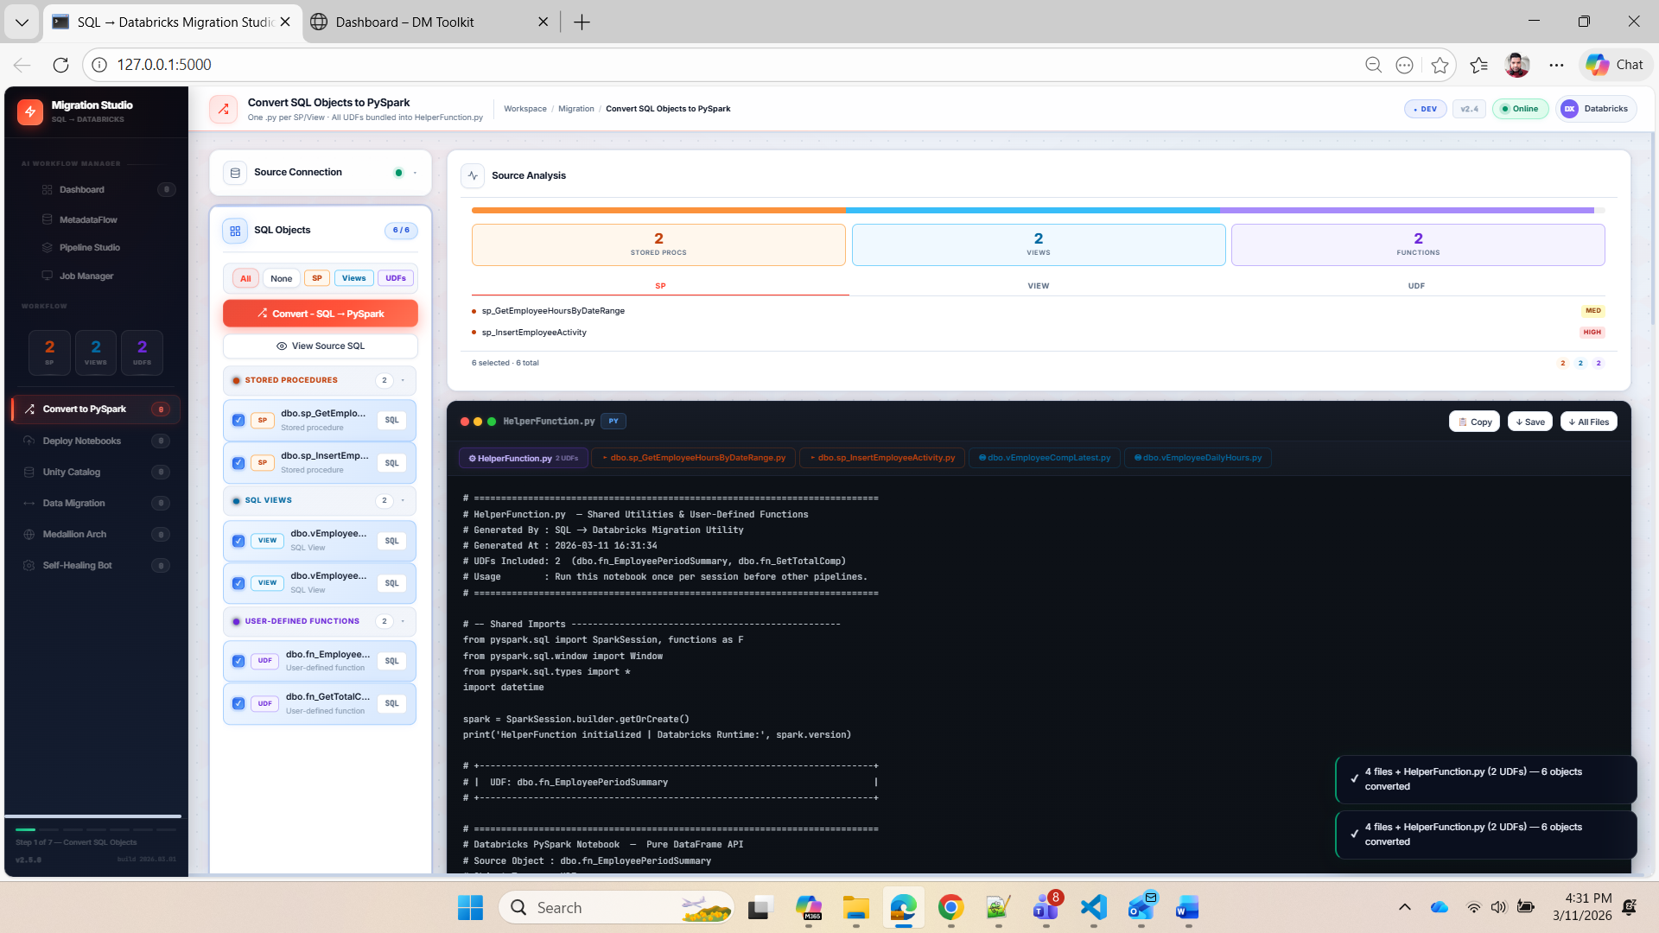

Slide 22
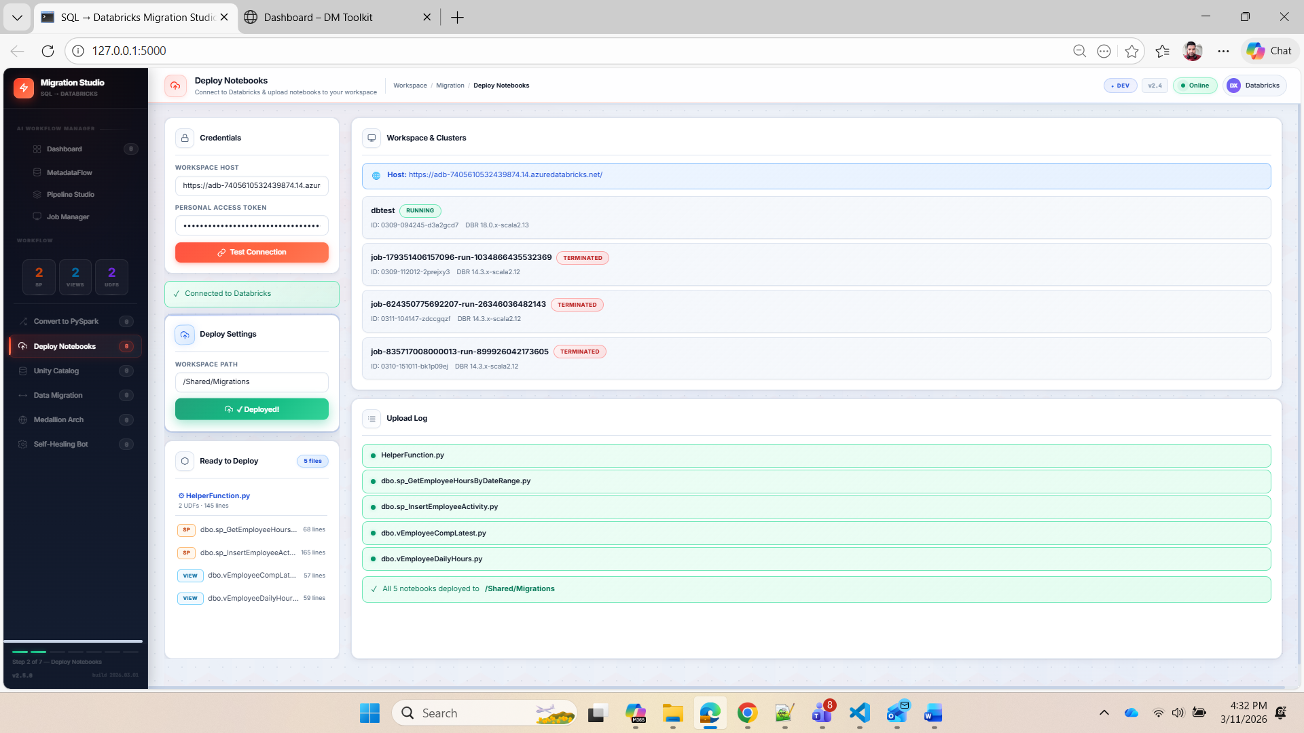

Slide 23
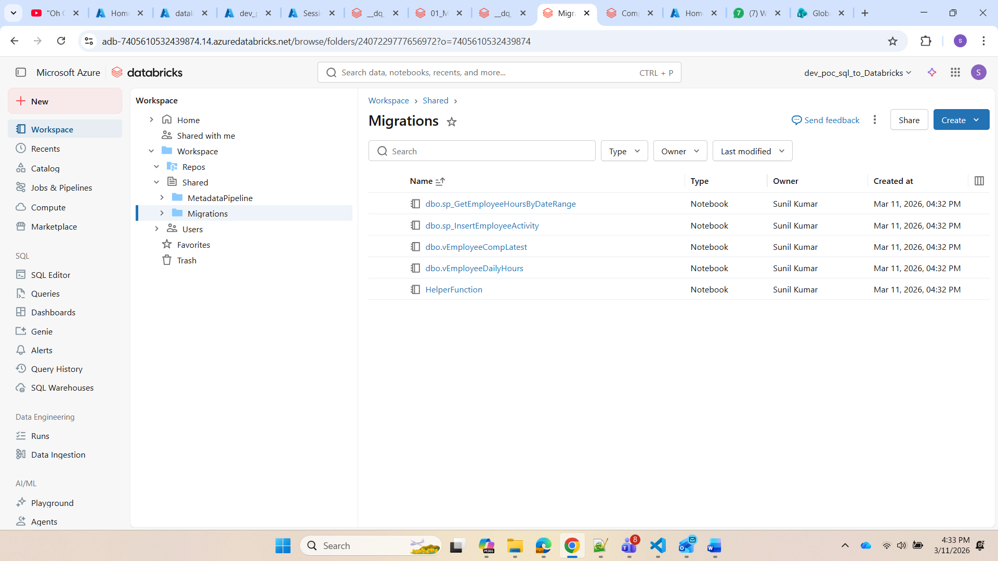

Slide 24
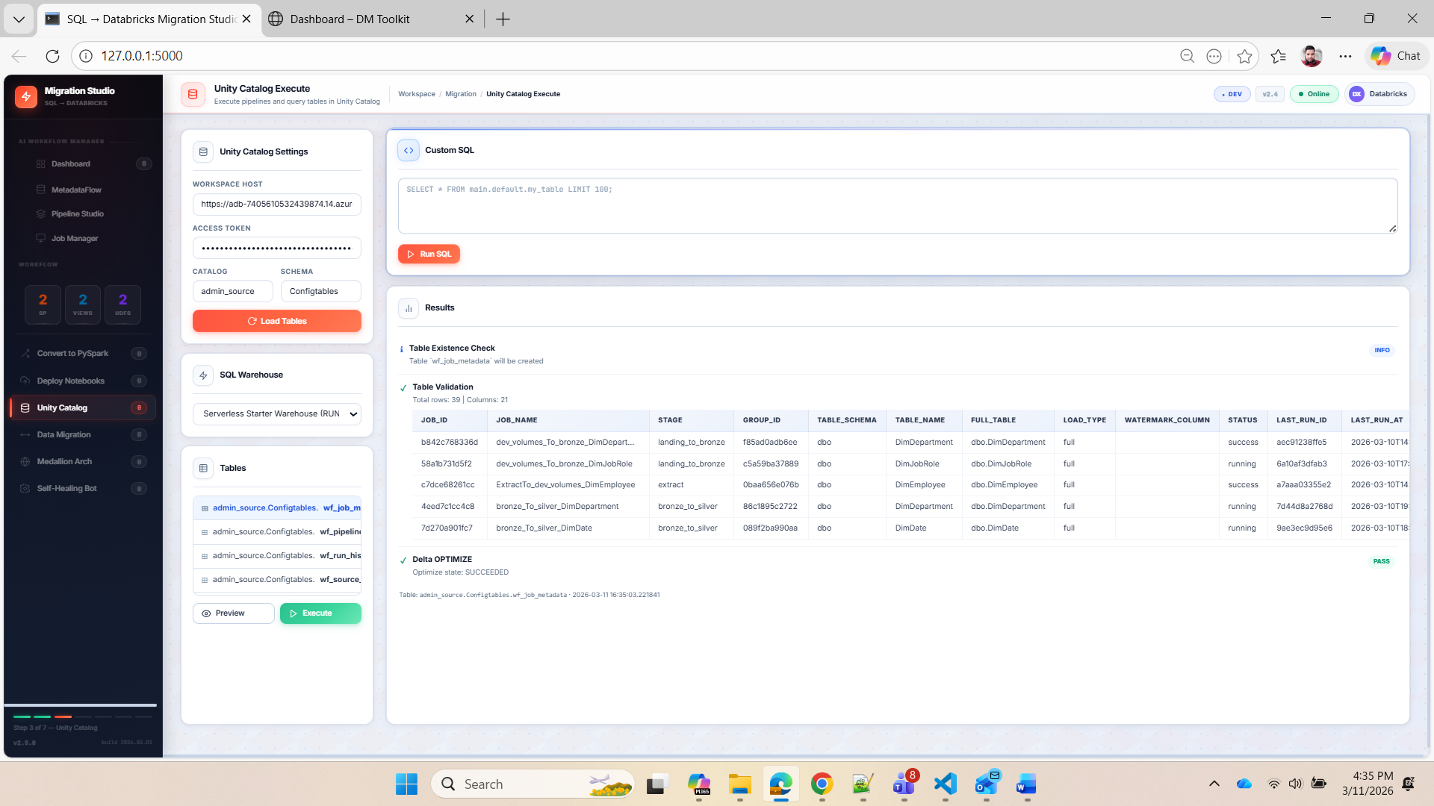

Slide 25
