Slide 1
Spring Boot REST Security

Slide 2
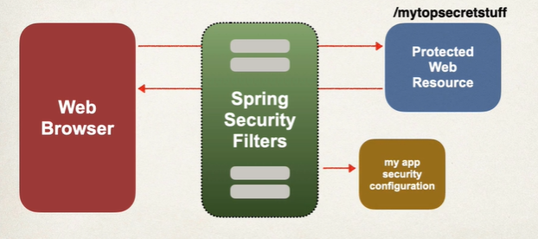
Spring Boot Security - Intro
https://docs.spring.io/spring-security/reference/
Implemented using Servlet Filters in the background
Two methods to secure an app : Declarative or Programmatic
Servlet Filters are used to pre-process & post-process web requests

Slide 3
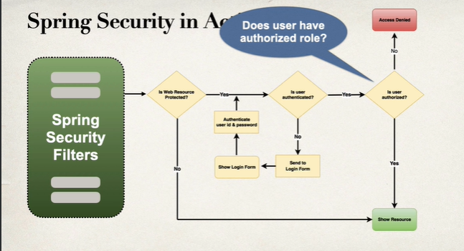
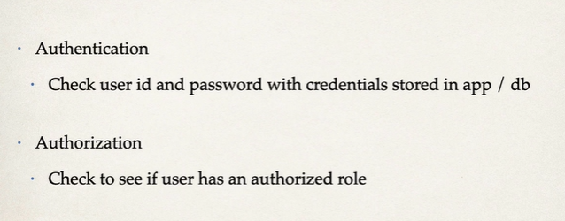
Spring Boot Security – In Action

Slide 4
Spring Security
POM dependency – spring-boot-starter-security
Secure all end points for application
Default user name – user
Password – will be generated; check app logs.
Will work only for GET till you disable CSRF (for POST, PUT, DELETE)
Application.properties will override the default user
spring.security.user.name=scott
Spring.security.user.password=tiger

Slide 5
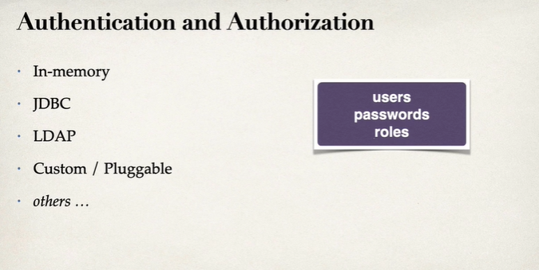
Spring Boot Security

Slide 6
Spring Boot Security – In-memory
Add a configuration Class(coding)
Add Bean method to return InMemoryUserDetailsManager
@Bean
public InMemoryUserDetailsManager userDetailsManager(){…
UserDetails susan = User.builder()
.username("susan")
.password("{noop}test123")
.roles("EMPLOYEE","MANAGER","ADMIN")
.build();
return new InMemoryUserDetailsManager(john,mary,susan);…

Slide 7
Spring Boot Security – In-memory
Add Bean method to return SecurityFilterChain
public SecurityFilterChain filterChain(HttpSecurity httpSecurity) throws Exception{
httpSecurity.authorizeHttpRequests(configurer ->
configurer
.requestMatchers(HttpMethod.GET,"/api/employees").hasRole("EMPLOYEE")
.requestMatchers(HttpMethod.GET,"/api/employees/**").hasRole("EMPLOYEE")
.requestMatchers(HttpMethod.POST,"/api/employees").hasRole("MANAGER")
.requestMatchers(HttpMethod.PUT,"/api/employees").hasRole("MANAGER")
.requestMatchers(HttpMethod.DELETE,"/api/employees/**").hasRole("ADMIN")
);
// Use Basic Authentication
httpSecurity.httpBasic(Customizer.withDefaults());
//Cross Site Request Forgery CSRF Not required for Stateless APIs
// using POST, PUT,DELETE and/or PATCH
httpSecurity.csrf(csrf-> csrf.disable());
return httpSecurity.build();

Slide 8
End

