Slide 1
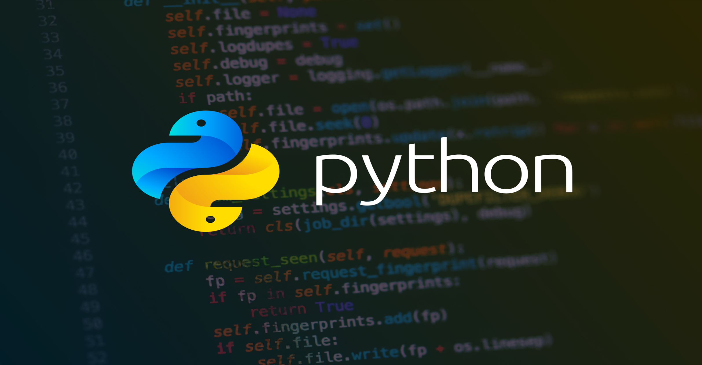

Slide 2
Graphical User Interface

Slide 3
GUI in python
tkinter module – tool kit interface
General steps
Create the root window
Create Containers (Canvas and Frames) - child windows in root window.
Display drawings or components
Canvas : shapes – lines, arcs etc.
Frames :Widgets – button, check boxes, menus etc.
Event handling

Slide 4
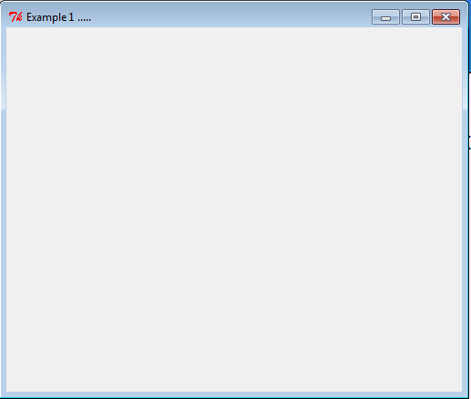
Root Window
Top – level window
Highest level GUI component
from tkinter import *
root=Tk() # creates window
root.title("Example 1 ..…") #set title
root.geometry("500x400") #set size
root.mainloop()

Slide 5
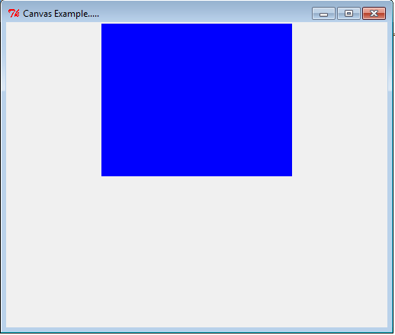
Canvas
Rectangular area used for drawing pictures
Syntax:
from tkinter import Canvas
c = Canvas(root)
Example:
c = Canvas(root, bg = "blue", height = 200, width = 250)
c.pack()

Slide 6
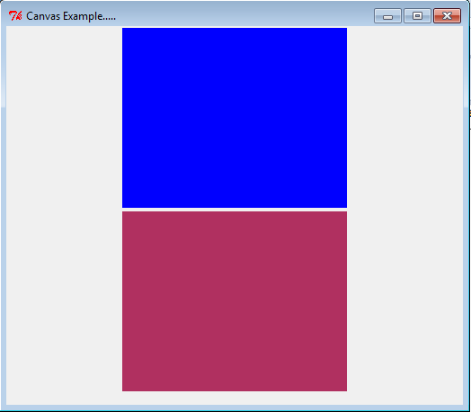
Canvas
Rectangular area used for drawing pictures
Syntax:
c = Canvas(root)
Example:
c1 = Canvas(root, bg = "blue",height = 200, width = 250)
c2 = Canvas(root, bg = "maroon",height = 200, width = 250)
c1.pack()
c2.pack()

Slide 7
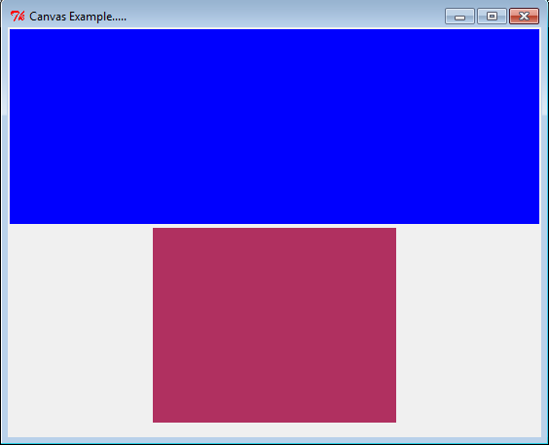
Layout Managers – Pack (1)
fill option
X – container/widget should occupy window/frame horizontally.
Y – container/widget should occupy window/frame Vertically.
BOTH – container/widget should occupy window/frame in both direction.
NONE – displayed as it is (default)
Example:
c1.pack(fill=X)

Slide 8
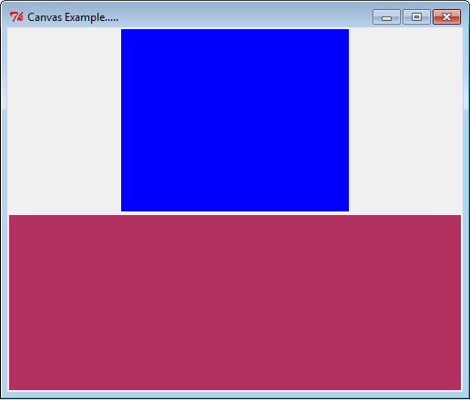
Layout Managers – Pack (2)
fill option
X – container/widget should occupy window/frame horizontally.
Y – container/widget should occupy window/frame Vertically.
BOTH – container/widget should occupy window/frame in both direction.
NONE – displayed as it is (default)
Example:
c2.pack(fill=BOTH)

Slide 9
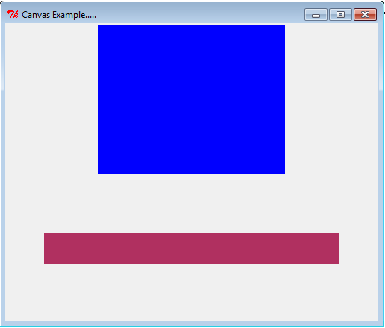
Layout Managers – Pack (3)
padx and pady option
How much space should be left around the component/container
Example
c2.pack(fill=BOTH, padx = 50, pady = 75)

Slide 10
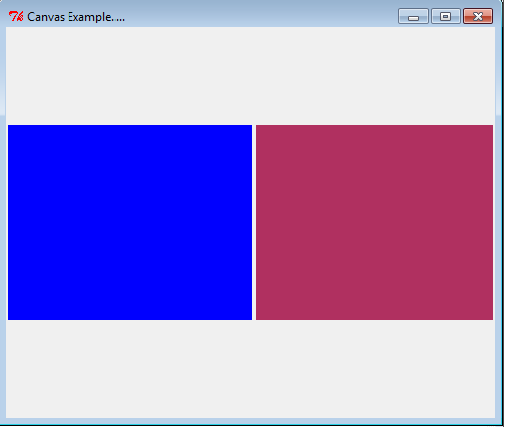
Layout Managers – Pack (4)
side option
Use to place widget/container side by side
Value : LEFT, RIGHT, DOWN, TOP (default)
Example
c1.pack(side = LEFT)
c2.pack(side = RIGHT)

Slide 11
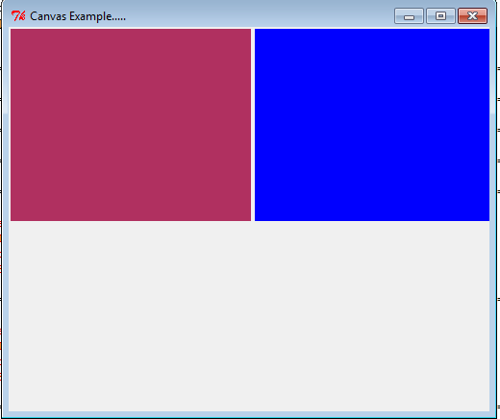
Layout Managers – Grid (1)
grid() to arrange widgets/containers in 2-D table that contains rows and columns.
Position of component is determined by row and column number
row and column option
Example
c2.grid(row = 0,column = 0)
c1.grid(row = 0, column = 1)

Slide 12
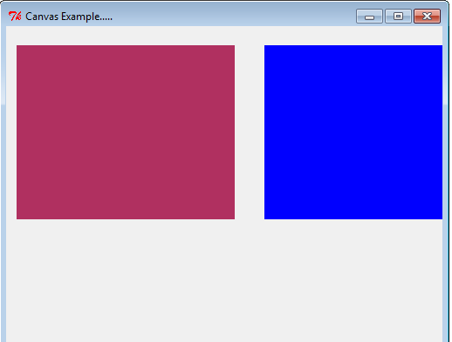
Layout Managers – Grid (2)
padx and pady option
Example
c2.grid(row = 0,column = 0, padx = 10, pady = 20)
c1.grid(row = 0, column = 1, padx = 20)

Slide 13
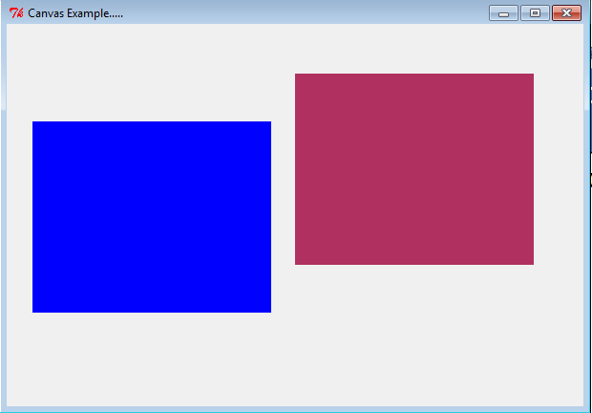
Layout Managers – Place (1)
place() to arrange widgets/containers as per x and y co-ordinate specified.
x and y option
Example
c1.place(x = 25, y = 100)
c2.place(x = 300, y = 50)

Slide 14
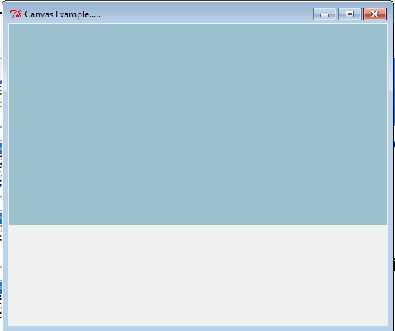
Canvas
Rectangular area used for drawing pictures
Syntax:
c = Canvas(root)
Example:
c1 = Canvas(root, bg = "light blue3",cursor = "hand1")
c1.pack(fill=X)

Slide 15
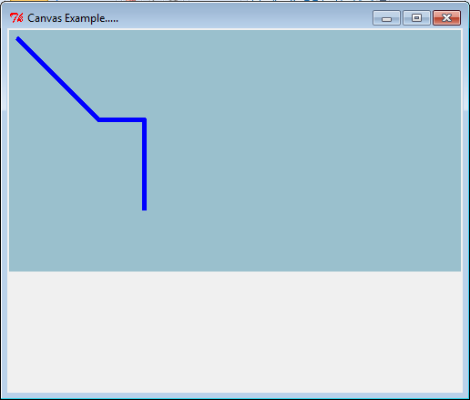
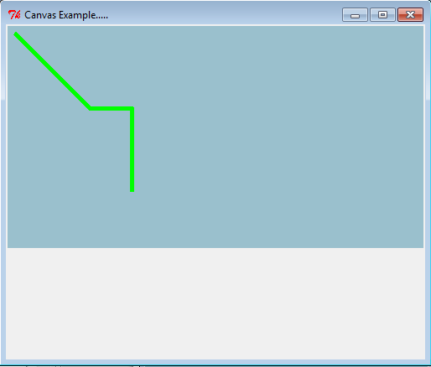
Canvas - line
id = c1.create_line(10,10,100,100,150,100,150,200,width = 5, fill = "blue", activefill="green")

Slide 16
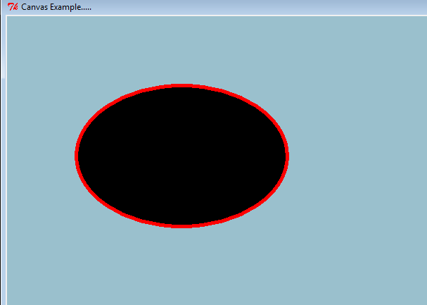
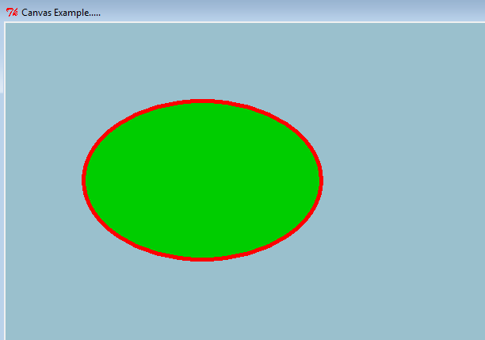
Canvas - oval
id = c1.create_oval(100,100,400,300,width = 5, fill = "black", activefill = "green3" , outline = "Red")

Slide 17
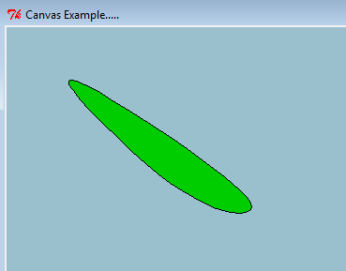
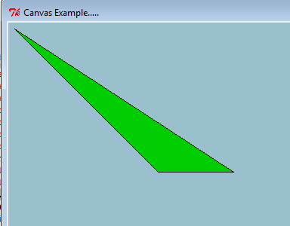
Canvas - polygon
id = c1.create_polygon(10,10,200,200,300,200, outline = 'black', fill = 'green3', smooth = '1')
id = c1.create_polygon(10,10,200,200,300,200, outline = 'black', fill = 'green3',smooth='0')

Slide 18
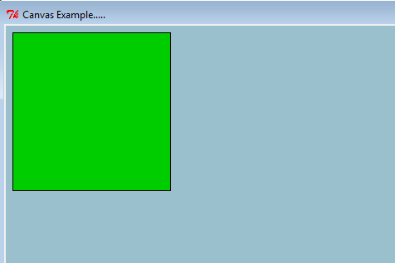
Canvas - rectangle
id = c1.create_rectangle(10,10,200,200, outline = 'black', fill = 'green3')

Slide 19
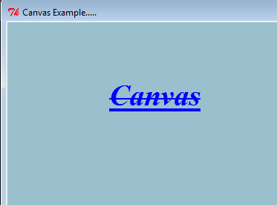
Canvas - text
id = c1.create_text(200,100,text = "Canvas", font = ("Times","30","bold italic underline overstrike"), fill = “blue")

Slide 20
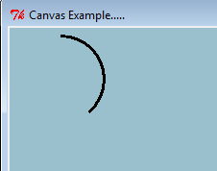
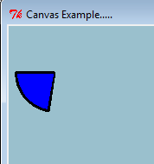
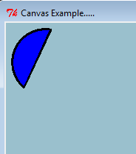
Canvas - arc
id = c1.create_arc(10,10,100,100,width=3, start =90, extent = -140,fill = "blue",style="arc")
id = c1.create_arc(10,10,100,100,width=3, start =180, extent = 80,fill = "blue",style="pie")
id = c1.create_arc(10,10,100,100,width=3, start =230, extent = -150,fill = "blue", style="chord")

Slide 21
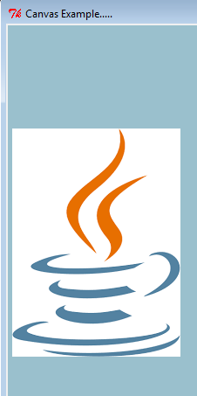
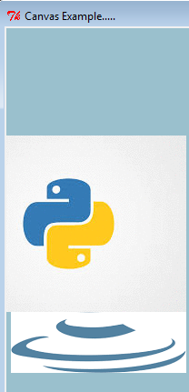
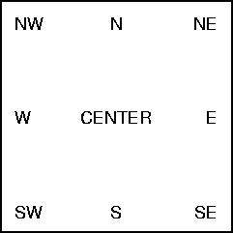
Canvas - Image
f1 = PhotoImage(file = "java.gif")
f2 = PhotoImage(file = "python.gif")
id = c1.create_image(200,120,anchor = NE, image = f1, activeimage = f2)

Slide 22
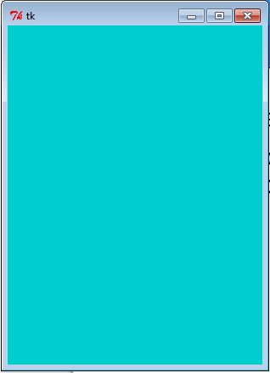
Frames
Like canvas, rectangular area of window to display widgets
f1 = Frame(root, height = 400, width = 300, bg = 'cyan3', cursor = 'cross’)
f1.pack()

Slide 23
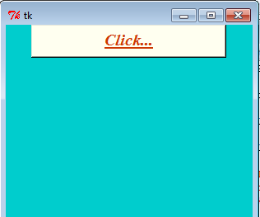
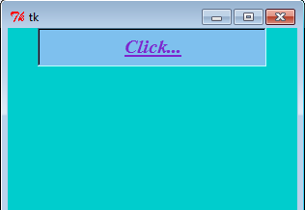
Button – Creating
Syntax
b = Button(f1 , text="Click...", width = -20, height = -5, bg = 'ivory', fg = 'OrangeRed3', activebackground = 'sky blue2', activeforeground = 'violet',font = ("Times","15","bold italic underline "))
b.pack()

Slide 24
Button – Event handler
Call back handler
Response to the event
They are instance methods.
Syntax
def bclick(self):
print ("Clicked …..")

Slide 25
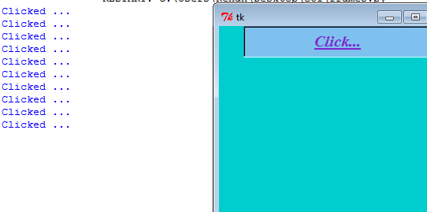
Button – Binding(1)
Linking clicking event and event handler.
Syntax
b.bind("<Button-1>",bclick)

Slide 26
Button – Binding(2)
b = Button(f1 , text="Click...", width = -20, height = -5, bg = 'ivory', fg = 'OrangeRed3', activebackground = 'sky blue2', activeforeground = 'violet',font = ("Times","15","bold italic underline "), command = bclick)

Slide 27
Program
from tkinter import *
def bclick():
print("You have clicked me")
root=Tk()
root.title("My Frame")
#create a frame to root window
f=Frame(root, height=400,width=500)
#attach the frame to root window
f.pack()
b = Button(f , text="Click...", width = -20, height = -5, bg = 'ivory', fg = 'OrangeRed3', activebackground = 'blue', activeforeground = 'violet',font = ("Times","15","bold italic underline "), command = bclick)
#attach button to frame
b.pack()
#let the root window wait for an events
root.mainloop()

Slide 28
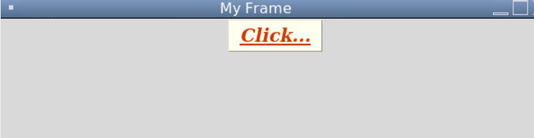
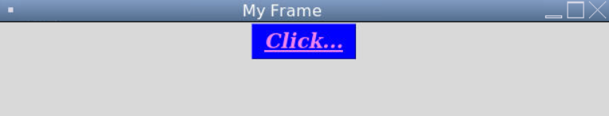
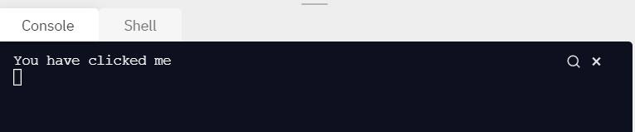

Slide 29
Which button is clicked?
When there are multiple buttons and we need to do specific task depending on which button is clicked.
Syntax:
command = lambda : bclick(arg1,arg2…)
Example:
def bclick(self,f1,num):
if num == 1:
self.f1["bg"] = 'red'
elif num == 2:
self.f1["bg"] = 'blue
self.b = Button(…..,command = lambda : self.bclick(f1,n))

Slide 30
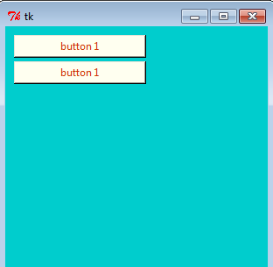
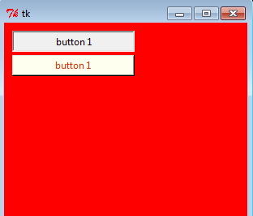
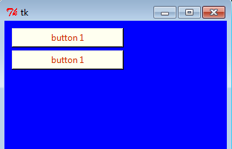
Which button is clicked?

Slide 31
Label
Constant text displayed on a frame.
Syntax:
lbl = Label(f1,text = "welcome")
b = Button(f1,text="Exit",command = quit)

Slide 32
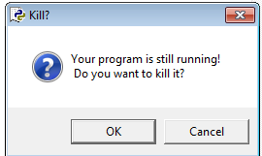
Label Example
class LabelEx:
def __init__(self,f1):
self.b1 = Button(f1,text="Click", command = lambda : self.bclick(f1))
self.b1.grid(row=0,column=1)
self.b2 = Button(f1,text="Exit", command = quit)
self.b2.grid(row=0,column=2)
def bclick(self,f1):
self.lbl = Label(f1,text = "welcome")
self.lbl.grid(row=2,column= 0)
root=Tk()
root.title("My Frame")
f1=Frame(root,height=350,width=500)
f1.pack()
mb=LabelEx(f1)
root.mainloop()

Slide 33
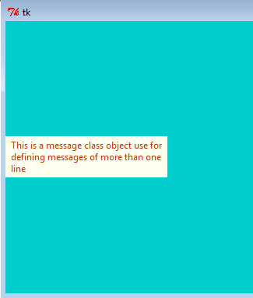
Message
Similar to label
Used for displaying multiple lines
All text will be displayed in same font
Syntax:
m = Message(f1,text="This is a message class object use for defining messages of more than one line ",width =200)

Slide 34
Text
Similar to label or message
Multiple lines of text can be displayed in different fonts and colors.
Syntax:
t = Text(f1,width =10, height = 10, font = ('Verdana',16,'bold'), wrap = WORD)
Wrap = WORD , break the line after last word fits
Wrap = CHAR, break line at any character
Wrap = None, will not wrap line.

Slide 35
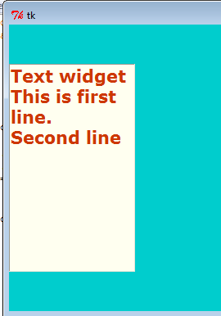
Text
Syntax:
t.insert(END,"Text widget\nThis is first line.\nSecond line\n")
END = add the end of the previous text
CURRENT = current cursor position.

Slide 36
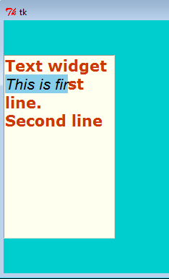
Text
Changing font and color of one line
t.tag_add('s','2.0',’2.10')
t.tag_config('s',background = 'sky blue', foreground = 'black',font = ('Helvetica',16,'italic')).

Slide 37
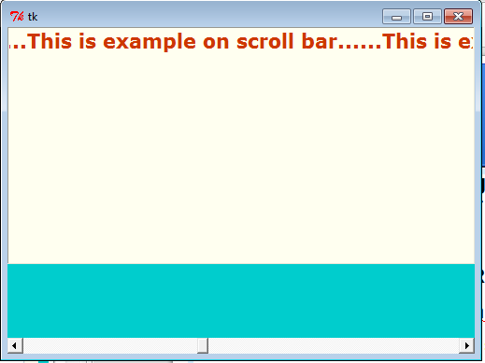
Scrollbar
To scroll text in another widget (Text, Frame, Canvas, Listbox ) can be scrolled top to bottom or left to right.
Syntax:
h = Scrollbar(f1,orient = HORIZONTAL, command = t.xview)
t.configure( xscrollcommand = h.set )
h.pack( side = BOTTOM, fill = X )

Slide 38
Checkbutton
More than one option from group of options.
Syntax :
c1 = Checkbutton(f1,variable = var1, command = display)
Option variable represents object of IntVar class ( state of the check button )
var1 = IntVar( )

Slide 39
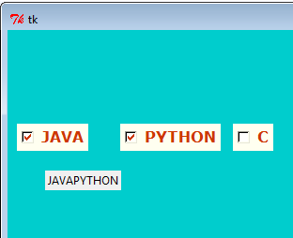
Checkbutton Example
def __init__(self,f1):
self.var1 = IntVar()
self.c1 = Checkbutton(f1, variable = self.var1, text=“Java”, command = lambda: self.display(f1))
self.c1.place(x=10,y = 100)
def display(self,f1):
x1 = self.var1.get()
str = ‘””
if x1 == 1:
str+=self.c1['text']
lbl = Label(f1,text = str).place(x=40,y=150)

Slide 40
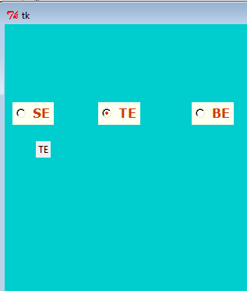
Radiobutton
Only one option from group of options.
Syntax :
r1 = Radiobutton(f1,variable = var, value = 1, command = display)
Option variable represents object of IntVar class ( state of the radio button )
var1 = IntVar( )

Slide 41
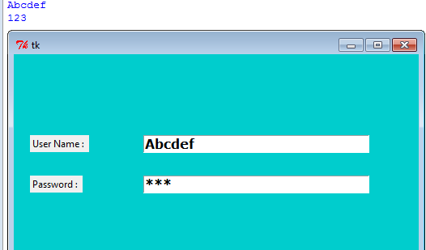
Entry
Rectangular box that is use to enter line of text.
Syntax :
e1 = Entry(f1, width = 25,show = '*' )
Event can be linked to entry widget
e1.bind("<return>",self.display)

Slide 42
Spinbox
Allows to select value from set of values.
Values can be range of numbers or fixed set of string.
Rectangular box with up and down arrow head
Syntax
self.s2 = Spinbox(f1, values = ('Mumbai','Delhi') , textvariable = self.val2, width = 15)
self.val2 = StringVar()

Slide 43
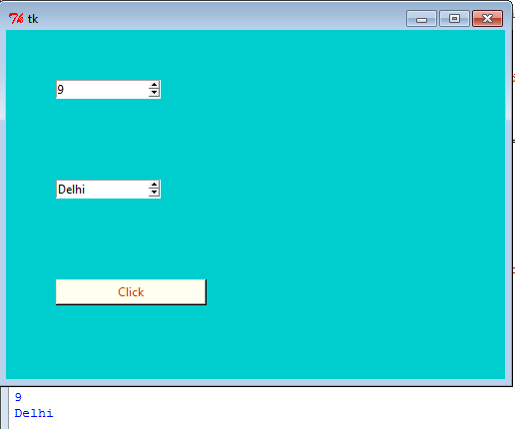
Spinbox Example

Slide 44
Listbox
List of items in a box so user can select one or more items.
Syntax
lb = Listbox(f1, height = 10,selectmode = SINGLE)
self.lb.place(x=50, y=100)
list1 =['Mumbai','Delhi','Kolkatta','Chennai','Banglore','Hyderabad']
for i in list1:
self.lb.insert(END,i)
self.lb.bind('<<ListboxSelect>>',self.onSelect)

Slide 45
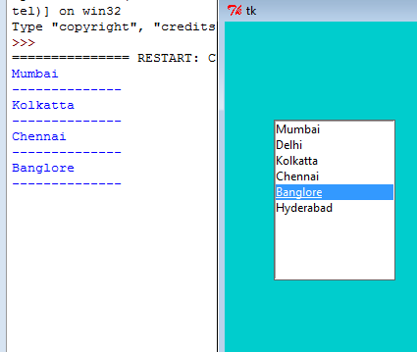
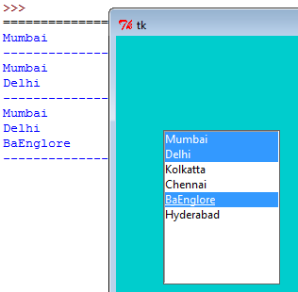
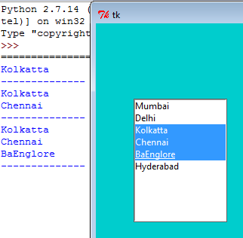
Listbox Example

Slide 46
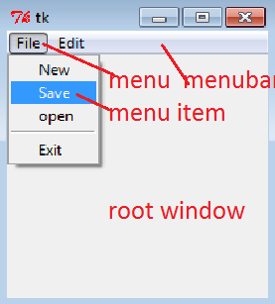
Menu

Slide 47
Menu
Menu bar as child of root
menubar = Menu(root)
menubar should be attached to root window
root.config(menu = menubar)
Create a menu with group of menu items
filemenu = Menu(root, tearoff=0)
To add menu items to the menu
filemenu.add_command(label="New",command = donothing)
Display horizontal line as separator between items
filemenu.add_separator()
Attach menu to menubar
menubar.add_cascade(label = 'File',menu = filemenu)

Slide 48
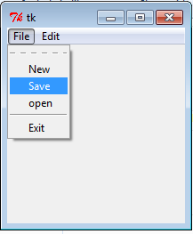


Menu Example

