Slide 1

Dr Tasneem Mirza

Slide 2
A thread is a basic unit of CPU utilization, consisting of a program counter, a stack, and a set of registers, ( and a thread ID. )
A thread refers to a single sequential flow of activities being executed in a process; it is also known as the thread of execution or the thread of control.
A process can have several threads.
The procedure can be easily broken down into
numerous different threads.
Multiple tabs in a browser
for example, can be considered threads. MS Word
employs many threads to prepare the text in one thread,
receive input in another thread, and so on.

Slide 3

Creating a new thread in a current process requires significantly less time than creating a new process.
Threads can share common data without needing to communicate with each other.
When working with threads, context switching is faster.
Terminating a thread requires less time than terminating a process.

Slide 4
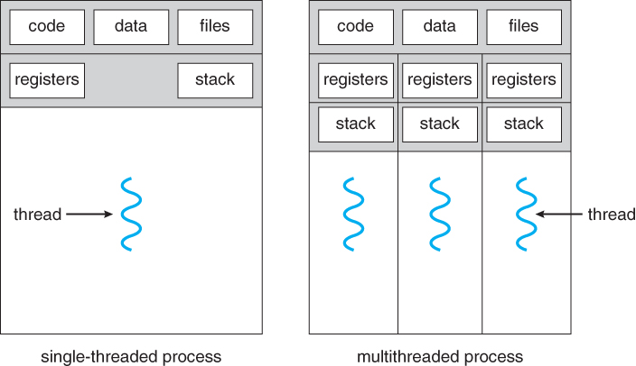
Traditional ( heavyweight ) processes have a single thread of control - There is one program counter, and one sequence of instructions that can be carried out at any given time.
Multi-threaded applications have multiple threads within a single process, each having their own program counter, stack and set of registers, but sharing common code, data, and certain structures such as open files.

Slide 5

There are two types of threads, user level threads, and kernel level threads.
User threads are implemented by users while kernel threads and implemented by operating systems.
User-level threads are small and much faster than kernel level threads. They are represented by a program counter(PC), stack, registers and a small process control block. Also, there is no kernel involvement in synchronization for user-level threads.

Slide 6
Adv of User level threads
User-level threads are easier and faster to create than kernel-level threads. They can also be more easily managed.
User-level threads can be run on any operating system.
There are no kernel mode privileges required for thread switching in user-level threads.
Kernel-Level Threads
Kernel-level threads are handled by the operating system directly and the thread management is done by the kernel. The context information for the process as well as the process threads is all managed by the kernel. Because of this, kernel-level threads are slower than user-level threads.
Advantage of kernel-level threads are as follows −
Multiple threads of the same process can be scheduled on different processors in kernel-level threads.

Slide 7
In Multithreading, the idea is to divide a single process into multiple threads instead of creating a whole new process.
Multithreading is done to achieve parallelism and to improve the performance of the applications as it is faster in many ways which were discussed above. The other advantages of multithreading are mentioned below.
Resource Sharing: Threads of a single process share the same resources such as code, data/file.
Responsiveness: Program responsiveness enables a program to run even if part of the program is blocked or executing a lengthy operation. Thus, increasing the responsiveness to the user.
Economy: It is more economical to use threads as they share the resources of a single process. On the other hand, creating processes is expensive

