Slide 1
MINI PROJECT
Explainable AI–Based Analysis of Factors Influencing Student Mental Health
Explainable AI
SHAP Analysis
Random Forest
Mental Health
Sunil Rao R (Reg: 3592310051) | Kamalesh V (Reg: 3592310019)

Slide 2
PROJECT OVERVIEW
⚠
🎯
✅
Problem
Objective
Outcome
Student mental health is deteriorating due to rising academic pressure, financial challenges, and lifestyle disruptions. Traditional ML models lack transparency.
Build an XAI-based analytical framework using Random Forest + Permutation Importance to identify and explain key risk factors transparently.
Interpretable insights on how academic pressure, sleep, financial stress, and social support influence student mental health risk.

Slide 3
METHODOLOGY & PIPELINE
01
02
03
04
05
→
→
→
→
Data Generation
EDA
Preprocessing
Random Forest
XAI Analysis
1,000 synthetic student records
14 features: academic, lifestyle,
psychosocial domains
Correlation analysis, class
distribution, boxplots,
demographic breakdowns
Label encoding for gender,
train-test split (80/20),
stratified sampling
200 trees, balanced classes,
5-fold cross-validation,
ROC-AUC evaluation
Gini importance, permutation
importance, SHAP-style
contribution analysis
Dataset Features: Academic Pressure · Financial Stress · Exam Anxiety · Sleep Hours · Physical Activity · Loneliness · Social Support · CGPA · Screen Time · Dietary Habits · Counseling Access · Year · Gender

Slide 4
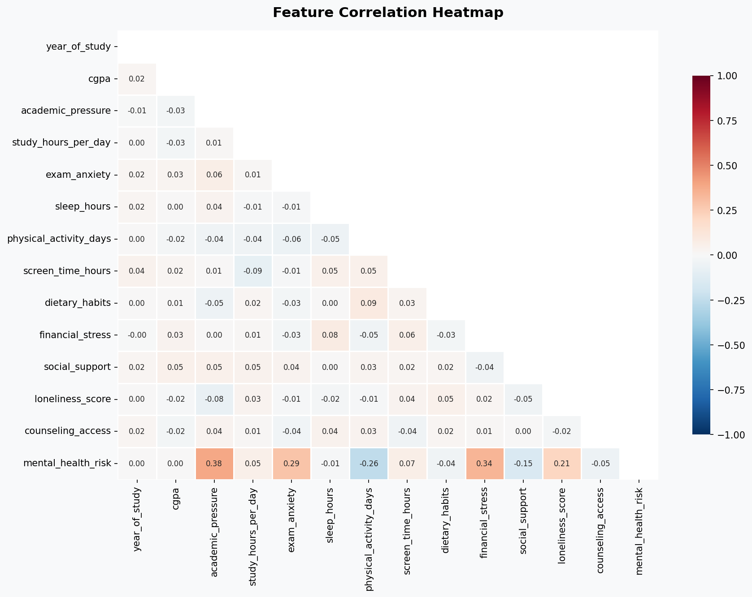
DATASET & EXPLORATORY DATA ANALYSIS
1,000
14
52%
48%
Student Records
Input Features
High Risk Cases
Low Risk Cases
Top Correlations with Mental Health Risk:
Academic Pressure
+0.385
Financial Stress
+0.339
Exam Anxiety
+0.286
Physical Activity
−0.255
Loneliness Score
+0.214
Social Support
−0.154

Slide 5
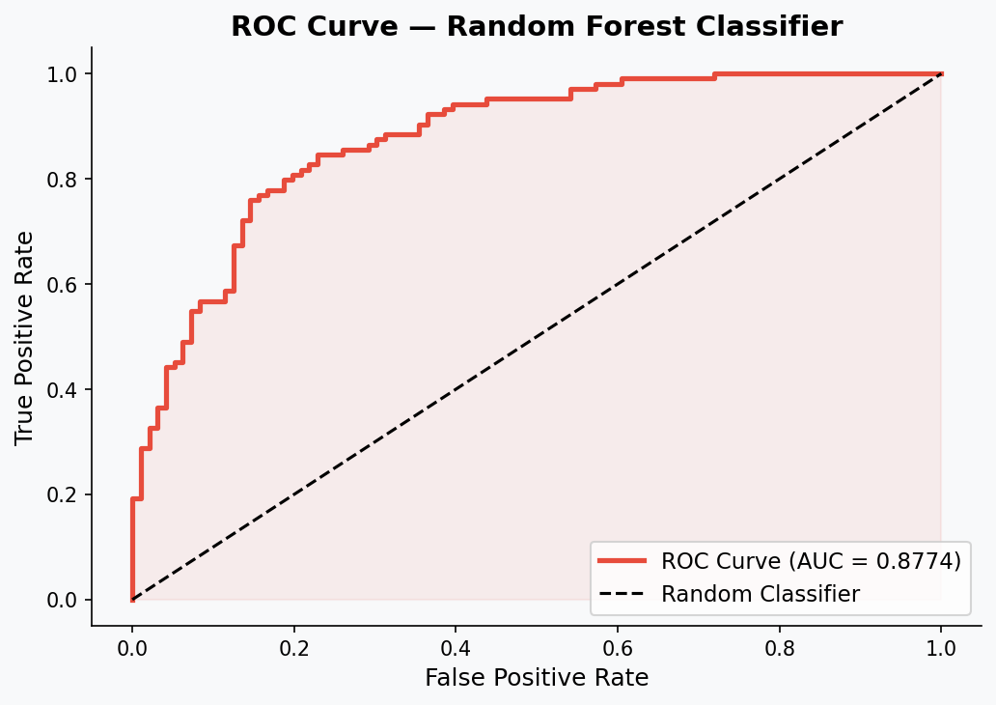
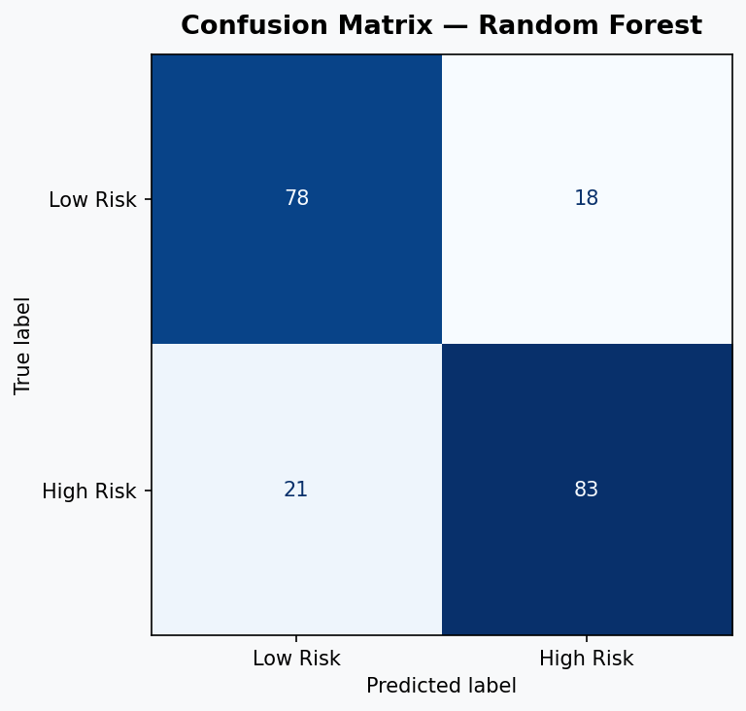
MODEL PERFORMANCE — RANDOM FOREST
80.50%
0.877
0.879 ± 0.021
82%
Test Accuracy
ROC-AUC Score
CV AUC (5-fold)
Precision (High Risk)

Slide 6
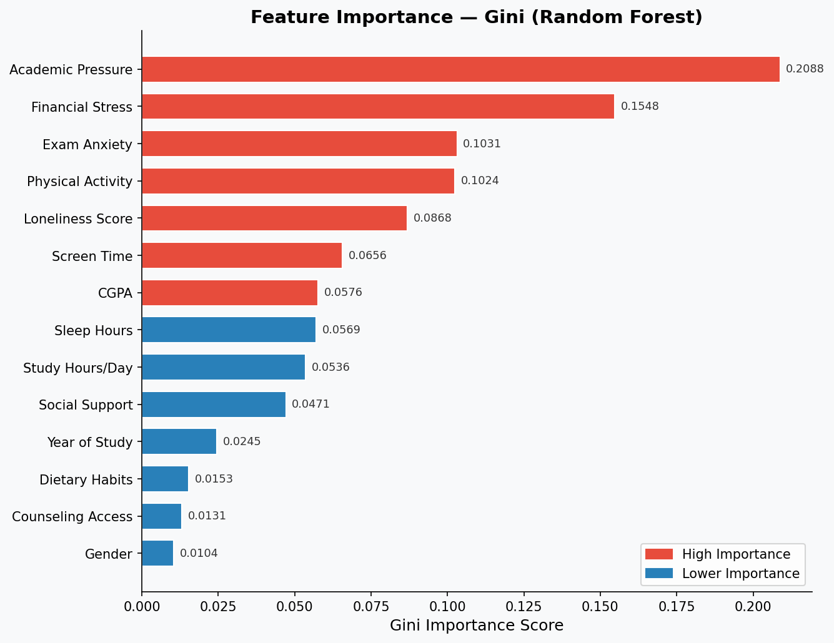
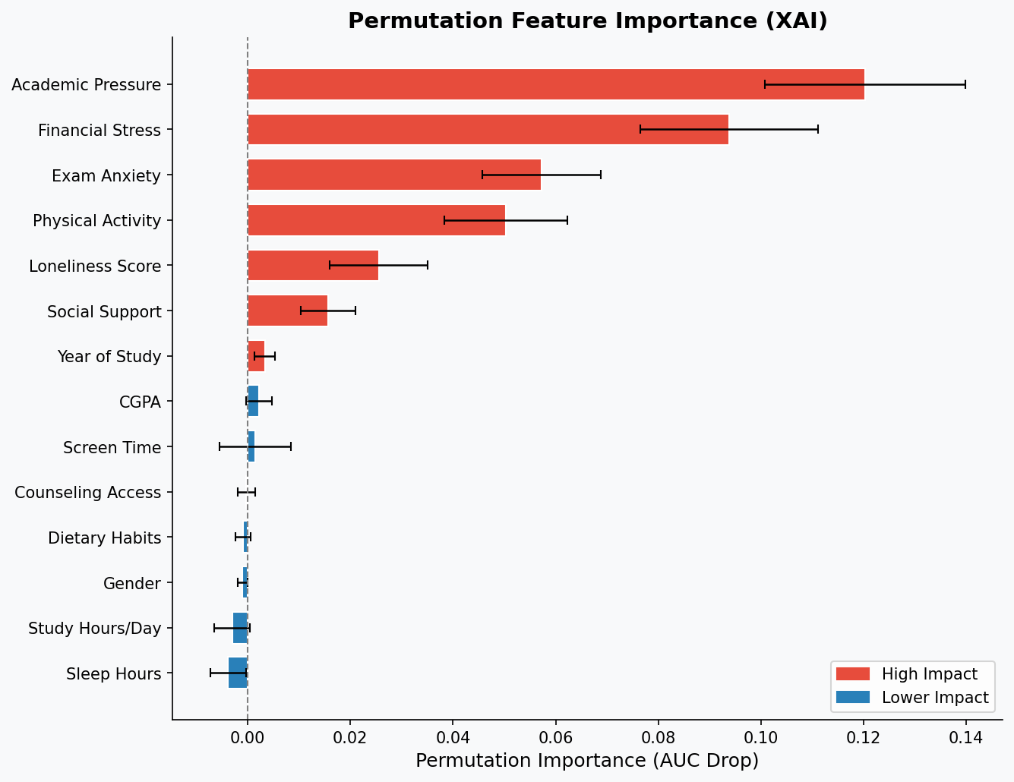
XAI — FEATURE IMPORTANCE ANALYSIS
Gini (Tree-Based) Importance
Permutation Importance (Model-Agnostic)

Slide 7
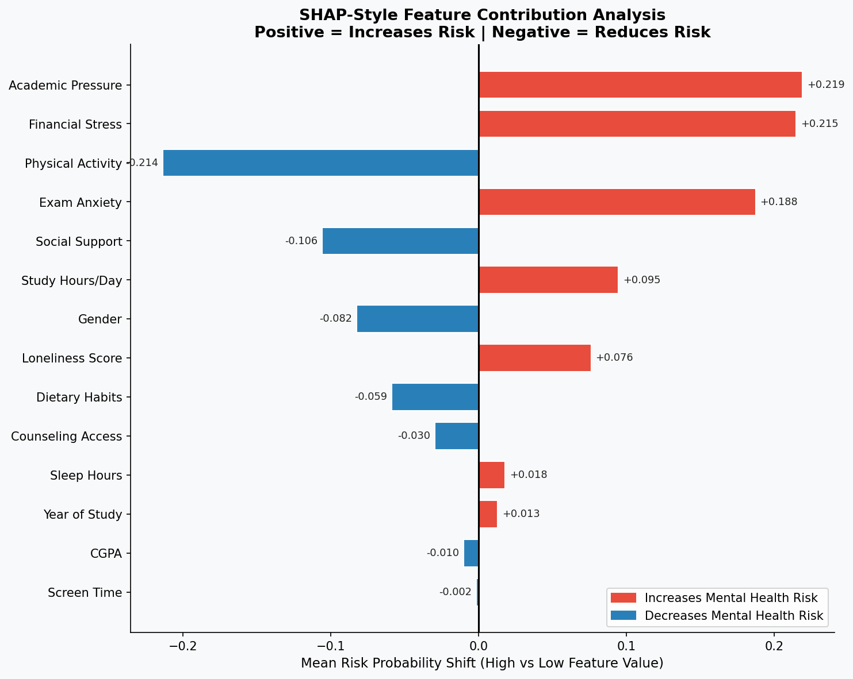
XAI — SHAP-STYLE CONTRIBUTION ANALYSIS
Key XAI Insights:
▲
Academic Pressure is the #1 risk amplifier (+0.219 shift)
▲
Financial Stress strongly elevates risk (+0.215)
▲
Exam Anxiety pushes risk higher (+0.188)
▼
Physical Activity significantly reduces risk (−0.214)
▼
Social Support is a key protective factor (−0.106)
▼
Counseling Access helps reduce risk (−0.030)

Slide 8
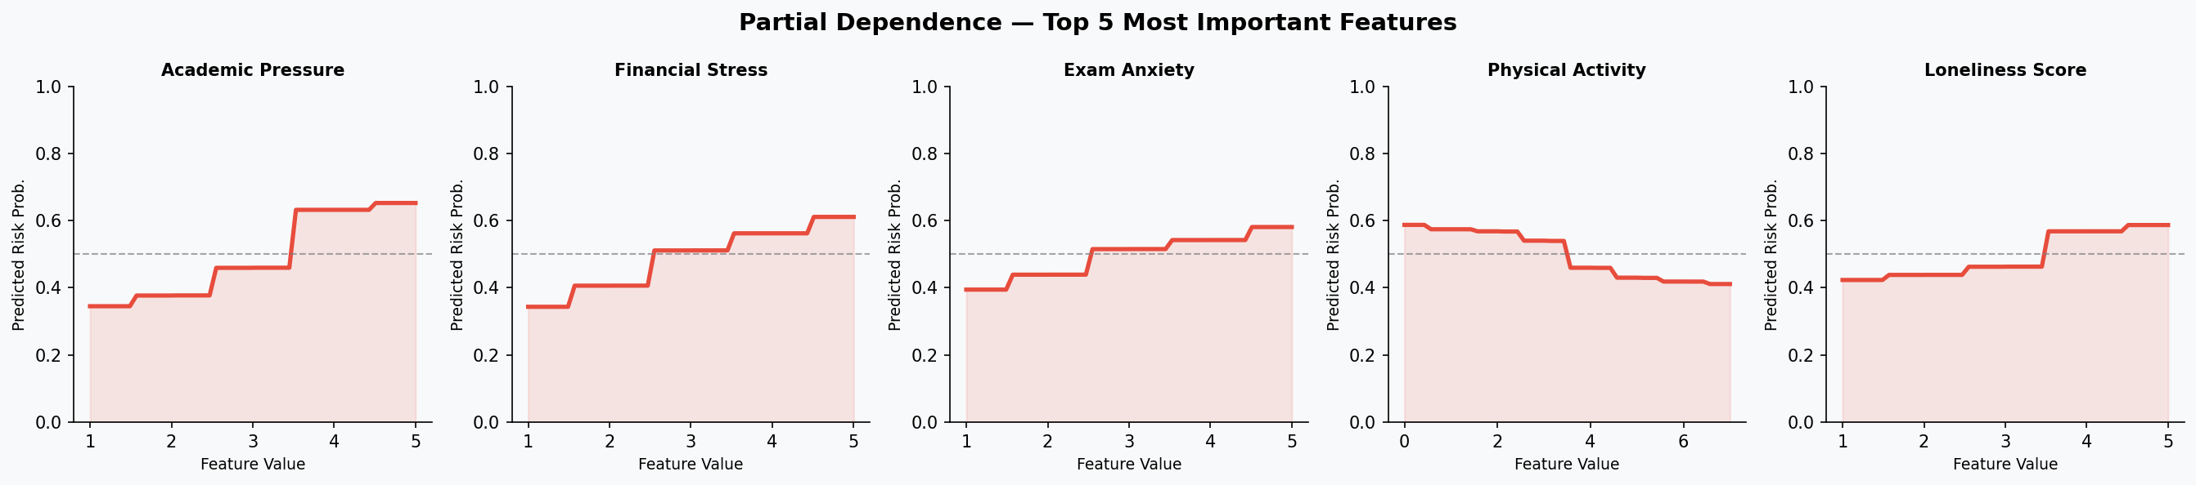
PARTIAL DEPENDENCE — TOP 5 FEATURES
How does each feature independently affect predicted mental health risk? (All other features held at median)
Academic Pressure: Risk rises sharply as pressure increases from 1→5
Financial Stress: Even moderate stress noticeably increases risk
Physical Activity: More active students show lower risk probabilities

Slide 9
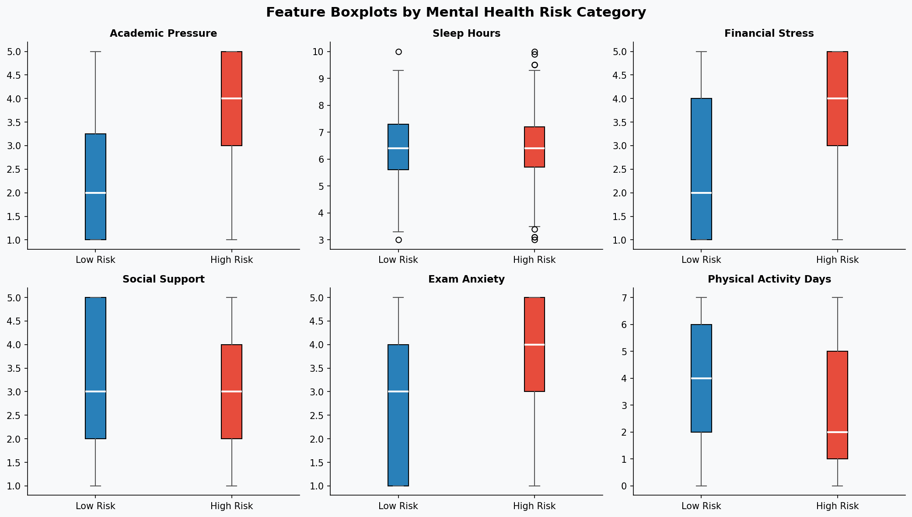
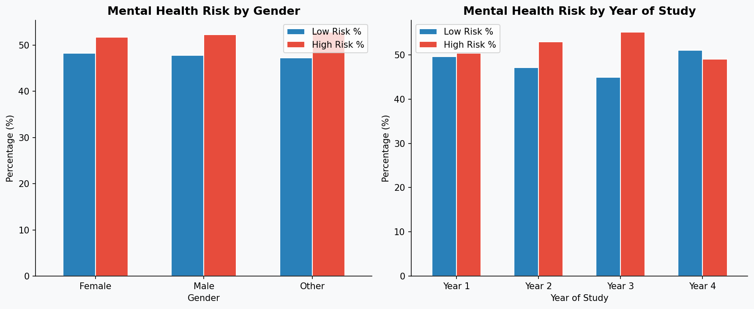
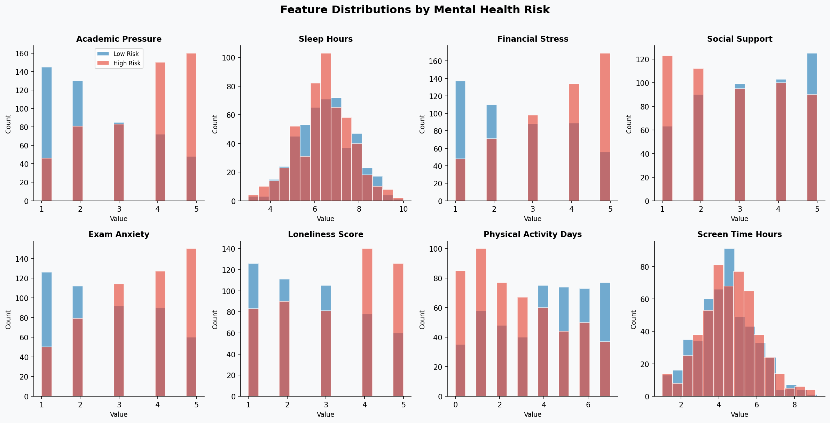
EDA VISUALIZATIONS
Boxplots by Risk Class
Risk by Gender & Year
Feature Distributions by Risk Class

Slide 10
CONCLUSIONS & FUTURE WORK
Key Findings
Future Enhancements
🔴
Academic Pressure is the strongest positive risk factor (Gini: 0.209, Contribution: +0.219)
01
Integrate full SHAP library for individual student-level explanations
🔴
Financial Stress & Exam Anxiety significantly increase mental health risk
Deploy as an institution-facing dashboard with real-time monitoring
02
🟢
Physical Activity is the strongest protective factor (−0.214 contribution)
03
Collect real student survey data to validate synthetic findings
🟢
Social Support acts as a meaningful buffer against mental health deterioration
04
Add NLP analysis of student journal entries / counseling notes
🔵
Random Forest achieved 80.5% accuracy and AUC 0.877, validating the approach
05
Explore federated learning to maintain student data privacy
🔵
XAI methods provided transparent, interpretable explanations for each prediction

Slide 11
Thank You!
Explainable AI–Based Analysis of Student Mental Health
Sunil Rao R (3592310051) | Kamalesh V (3592310019)
Technologies: Python · scikit-learn · Random Forest · Permutation Importance · Matplotlib · Seaborn

