Slide 1
Data Mining: Introduction
Lecture Notes for Chapter 2
Exploratory Data Analysis

Slide 2
Outline
Unit 2: Exploratory Data Analysis [6 Hrs.]
● Sources and types of data
● Non-graphical and graphical methods for exploring univariate, bivariate, multivariate data
● Visualization techniques

Slide 3
What are Data Source Types?
Databases: Structured data stored in relational databases like SQL, NoSQL databases, or data warehouses.
APIs: Data fetched from web services or applications via API calls.
Flat Files: Data from CSVs, Excel sheets, text files, or XML/JSON formats.
Streaming Data: Real-time data from IoT devices, sensors, or live feeds.
Cloud Services: Data stored in cloud platforms like AWS, Google Cloud, or Azure.
Manual Input: Data entered manually by users or operators into systems.
Other Sources: Data from alternative sources like RSS feeds, social media, or web scraping tools, often providing unstructured or semi-structured data that adds real-time insights to your analysis.

Slide 4
What is Data?
Collection of data objects and their attributes
An attribute is a property or characteristic of an object
Examples: eye color of a person, temperature, etc.
Attribute is also known as variable, field, characteristic, dimension, or feature
A collection of attributes describe an object
Object is also known as record, point, case, sample, entity, or instance
Attributes
Objects

Slide 5
Attribute Values
Attribute values are numbers or symbols assigned to an attribute for a particular object
Distinction between attributes and attribute values
Same attribute can be mapped to different attribute values
Example: height can be measured in feet or meters
Different attributes can be mapped to the same set of values
Example: Attribute values for ID and age are integers
But properties of attribute can be different than the properties of the values used to represent the attribute

Slide 6
Types of Data
Types of attributes in DM
Qualitative Attributes (Nominal (N), Ordinal (O), Binary(B))
Quantitative Attributes (Numeric, Discrete, Continuous)
Biological Sequences
Time Series
Images
Sound
Video

Slide 7
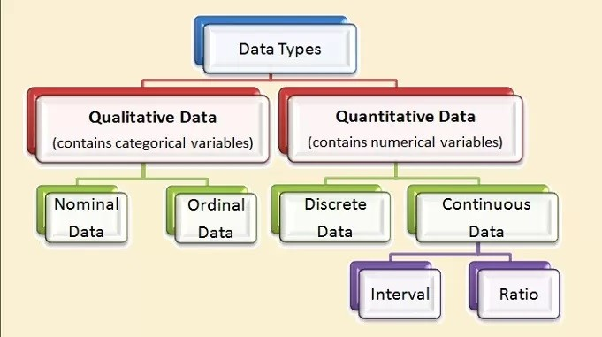
Types of Data

Slide 8
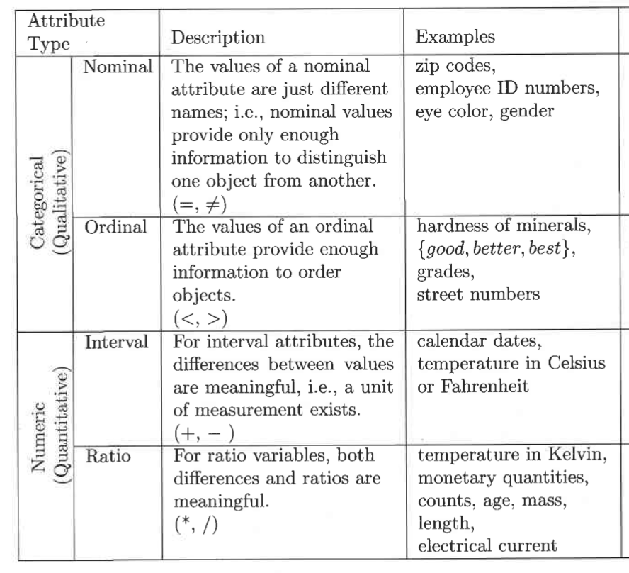
Types of Attributes: Approach 1

Slide 9
Approach 2: Discrete Attribute
Has only a finite or countably infinite set of values
Examples: zip codes, counts, or the set of words in a collection of documents
Often represented as integer variables.
Note: binary attributes are a special case of discrete attributes

Slide 10
Continuous Attribute
Has real numbers as attribute values
Examples: temperature, height, or weight.
Practically, real values can only be measured and represented using a finite number of digits.
Continuous attributes are typically represented as floating-point variables

Slide 11
Approach 3
Character: values are represented in forms of character or set of characters (string).
Number: values are represented in forms of number.
Number may be in form of whole number, decimal number.

Slide 12
Types of data sets
1. Record
Data that consists of a collection of records, each of which consists of a fixed set of attributes.
Data Matrix
Document Data
Transaction Data
2. Graph
3. Ordered

Slide 13
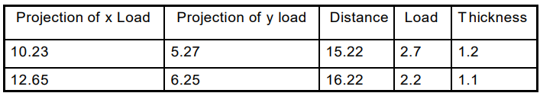
Data Matrix
If data objects have the same fixed set of numeric attributes, then the data objects can be thought of as points in a multi-dimensional space, where each dimension represents a distinct attribute
Such data set can be represented by an m by n matrix, where there are m rows, one for each object, and n columns, one for each attribute

Slide 14
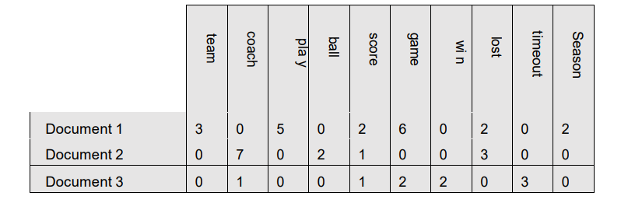
Document Data
Each document becomes a `term' vector, each term is a component (attribute) of the vector,
the value of each component is the number of times the corresponding term occurs in the document

Slide 15
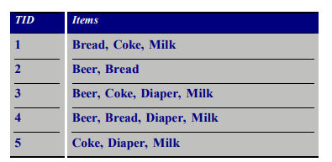
Transaction Data
A special type of record data, where each record (transaction) involves a set of items.
For example, consider a grocery store.
The set of products purchased by a customer during one shopping trip constitute a transaction,
while the individual products that were purchased are the items

Slide 16
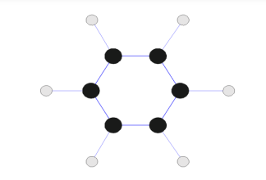
Graph
Contains notes and connecting vertices.
Eg: World Wide Web, Molecular Structures

Slide 17
Ordered
Has Sequences of transactions
Spatial Data
Spatial data, also known as geospatial data, is information about a physical object that can be represented by numerical values in a geographic coordinate system.
Temporal Data A temporal data denotes the evolution of an object characteristic over a period of time. Eg d=f(t).
Sequential Data Data arranged in sequence.

Slide 18
Continued…
Non-graphical and graphical methods for exploring univariate, bivariate, multivariate data

Slide 19
…
EDA is a way of exploring data through visual summaries and graphics, and there are several different types of EDA to choose from.
Univariate EDA involves looking at a single variable at a time.
Univariate EDA can help you understand the data distribution and identify any outliers.
Bivariate EDA involves looking at two variables at a time.
Bivariate EDA can help you understand the relationship between two variables and identify any patterns that might exist.

Slide 20
…
Multivariate EDA involves looking at three or more variables at a time. Multivariate EDA can help you understand the relationships between several variables and identify any complex patterns or outliers that might exist.

Slide 21
The End

