Slide 1
Scientific Calculator using Python
Title:
👉 Scientific Calculator using Python
Subtitle:
A GUI-based calculator using Tkinter
Presented by:
Sunil.Pujari

Slide 2
Introduction
This project is a scientific calculator built using Python.
It provides:
Basic arithmetic operations
Scientific functions (sin, cos, tan, log, sqrt)
Graphical interface
Error handling
User-friendly design
The calculator is created using Python’s Tkinter library.

Slide 3
Objective
The main objective of this project is:
To build a real-time calculator using Python
To learn GUI programming with Tkinter
To implement mathematical functions
To handle user input safely
To design an interactive application

Slide 4
Tools & Technologies
Python 3
Tkinter (GUI Library)
Math module
VS Code / Python IDE
Windows OS

Slide 5
Features
Addition, subtraction, multiplication, division
Square root function
Trigonometric functions (sin, cos, tan)
Logarithmic calculations
Factorial support
Clear & backspace buttons
Error detection

Slide 6
System Design
Title: System Design
User Input → Button Click
↓
Function Processing
↓
Math Computation
↓
Display Result
The calculator uses event-driven programming.
Each button triggers a Python function

Slide 7
Code Structure
The program contains:
Input handling functions
Math operation functions
GUI layout setup
Button event mapping
Error handling logic
Main modules used:
import tkinter as tk
import math

Slide 8
Sample Code
Title: Sample Code
def equal():
try:
result = eval(entry.get())
clear()
entry.insert(tk.END, result)
except:
entry.insert(tk.END, "Error")
This function evaluates user input safely.

Slide 9
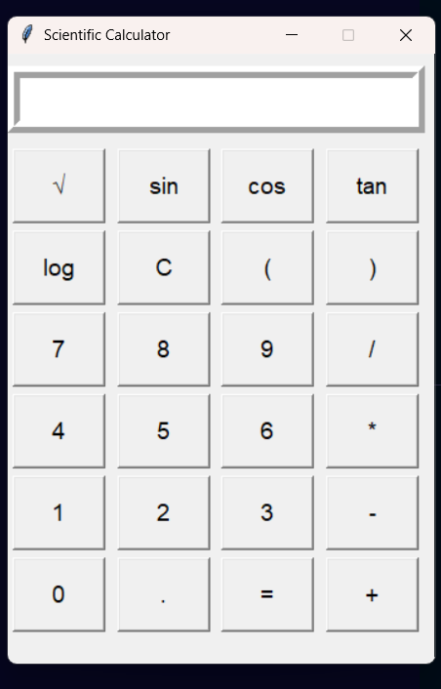
Output Screen
Description:
• Display screen at top
• Scientific buttons
• Numeric keypad
• Clean grid layout

Slide 10
Advantages
Lightweight application
Easy to use
Fast calculations
Cross-platform compatibility
Educational value

Slide 11
Future Scope
Dark theme UI
Graph plotting
Memory functions
History tracking
Voice input
Mobile version

Slide 12
Conclusion
This project demonstrates:
GUI programming
Mathematical computation
Event-driven design
Python application development
It is a practical example of combining logic + interface.

Slide 13
Thank You

