Slide 1
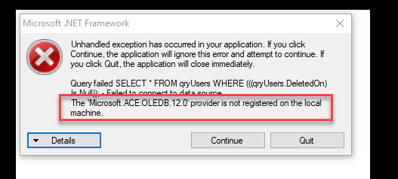
Perquisite before installing Points Management application
Make sure you have .NET runtime 4.0 or above. You can get this from Microsoft, just google it.
Once installed, if you get below issue, then you need to install AccessDatabaseEngine.exe. I have copied the setup exe.
https://www.microsoft.com/en-us/download/details.aspx?id=23734

Slide 2
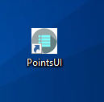
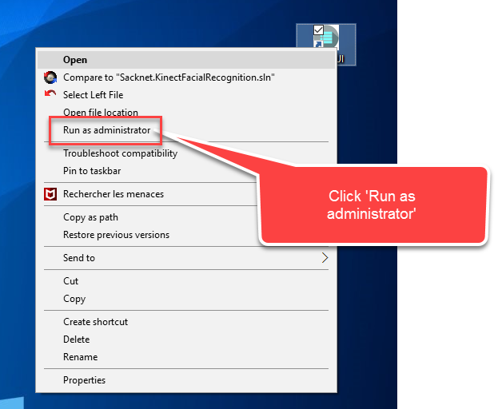
Installation Guide
Run the setup.exe and follow the instructions to install the application.
Once the application is installed, you will see the below icon in desktop.
3. For first time you need to set the DB, so we need to run it as administrator

Slide 3
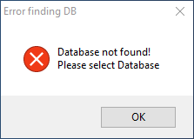
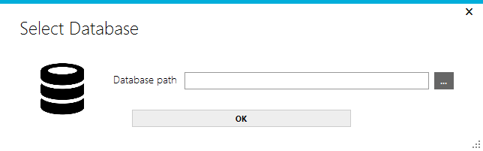
4. You will see that it didn’t find the DB, so just click OK
5. Select the DB ms access file and say OK, it will set the DB path and ask to restart the application.
6. Restart the application, now you don’t have to run it as admin mode. Just run it.

Slide 4
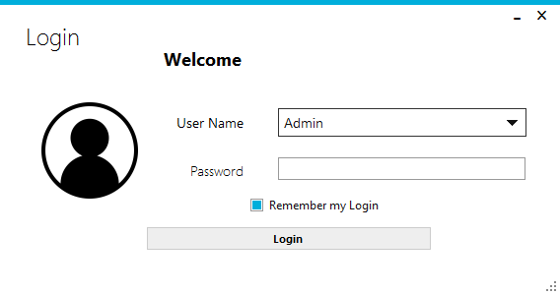
Manual
1. The app launches with below screen, put your password and login

Slide 5
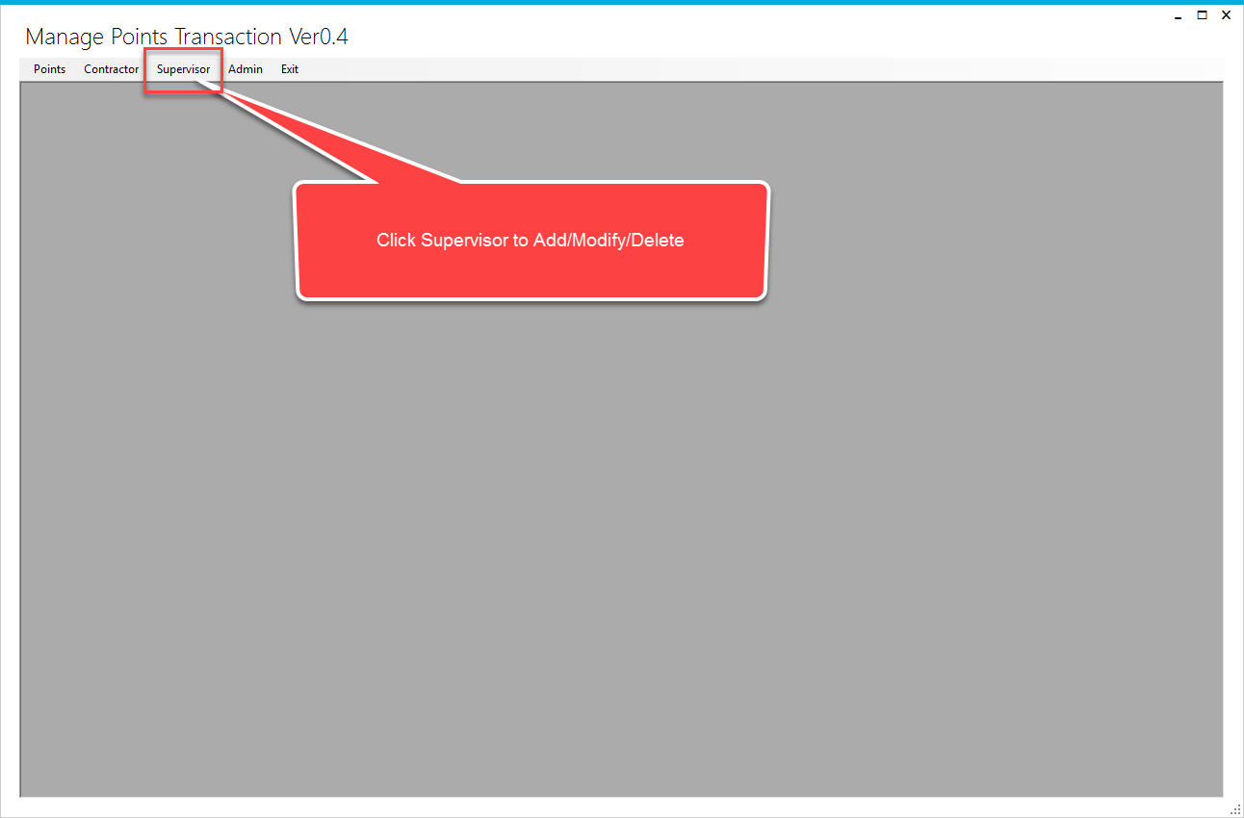
2. Add Supervisor Name first, so that you can assign contractor to the respective supervisors

Slide 6
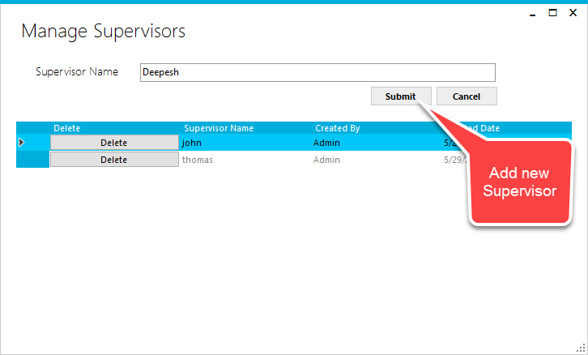
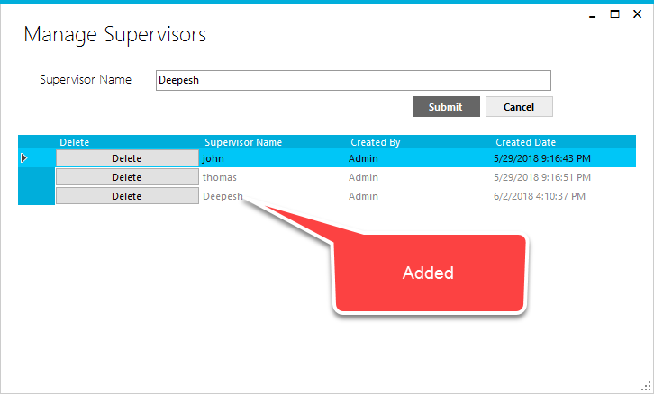

Slide 7
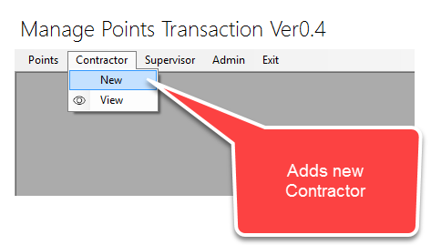
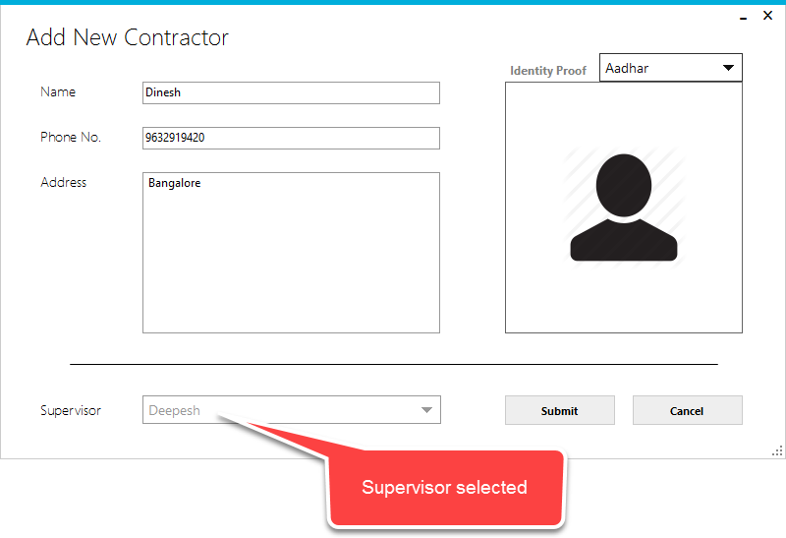
3. After adding supervisor, now you can add Contractors
4. Add new contractor and submit.

Slide 8
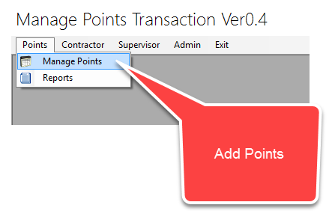
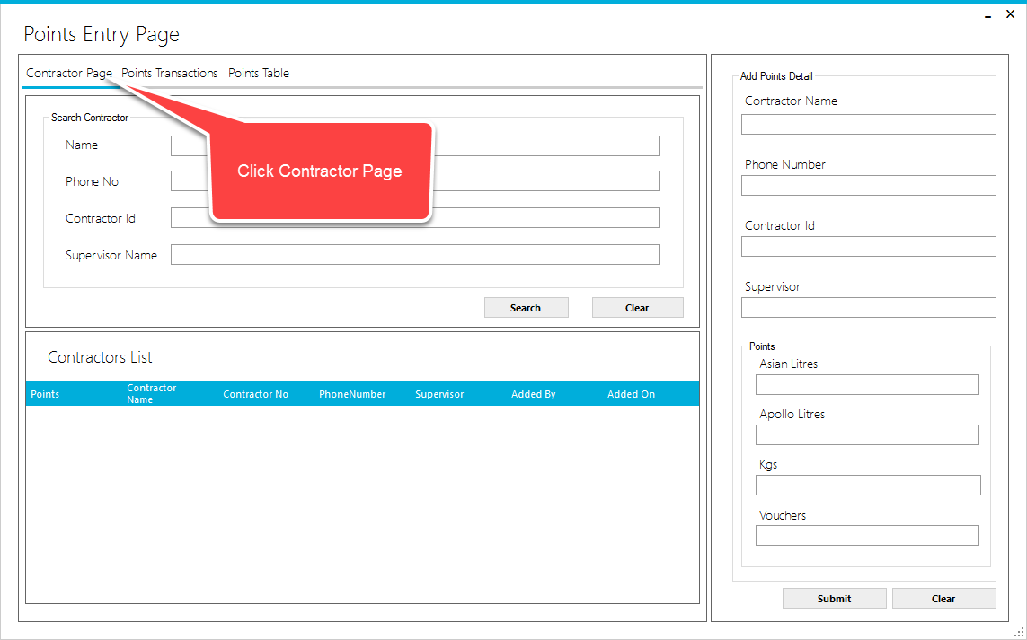
5. Now you can add points to contractor
6. Below page will be shown, Click on contractor page

Slide 9
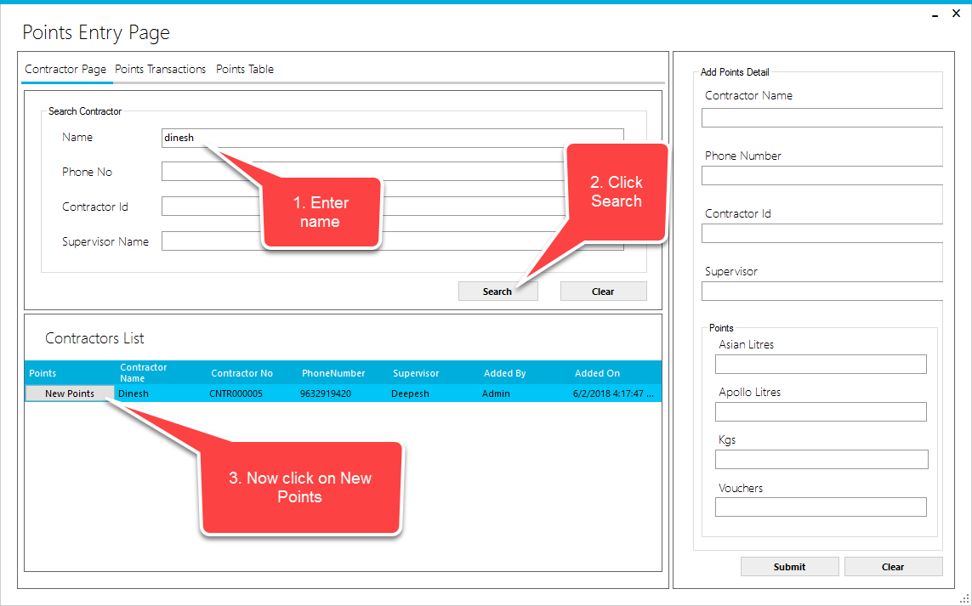
6. To add new points, follow below steps

Slide 10
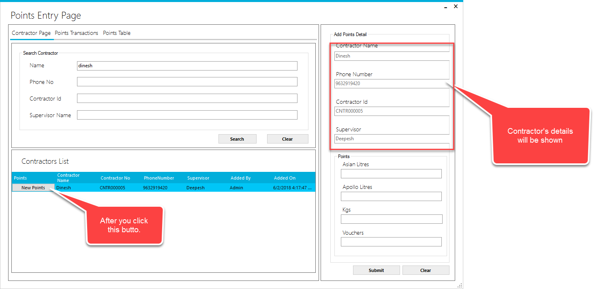

Slide 11
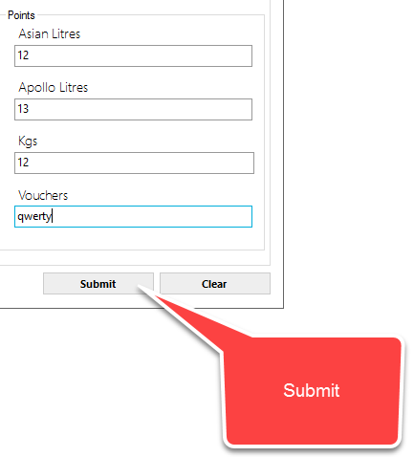
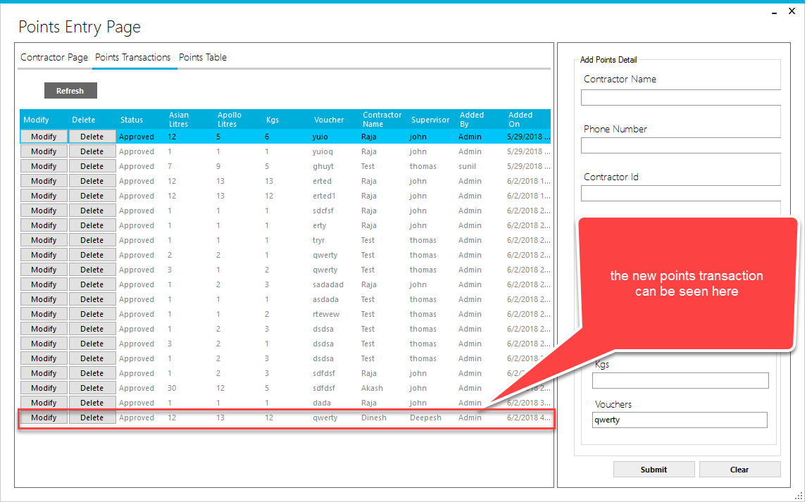
7. Once you click submit, the transactions will be added to DB and SMS will be sent.

Slide 12
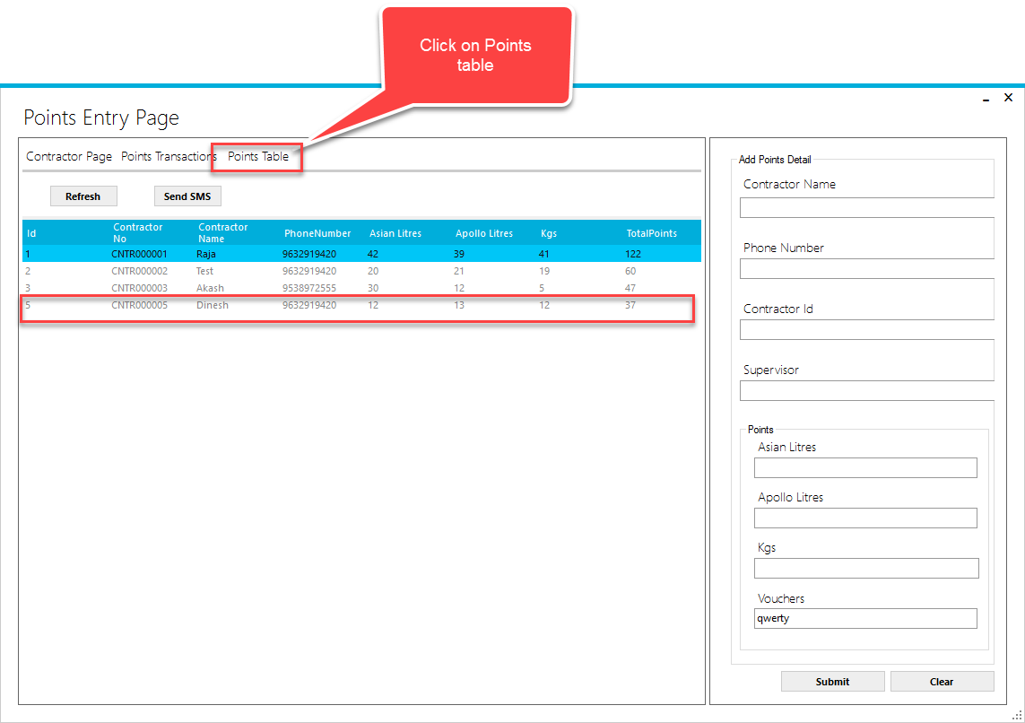
Click on Points table to see the total points transactions.

Slide 13
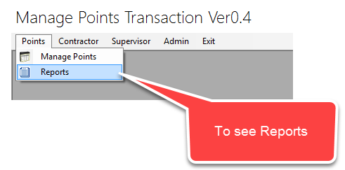
You can print the report from below menu link

Slide 14
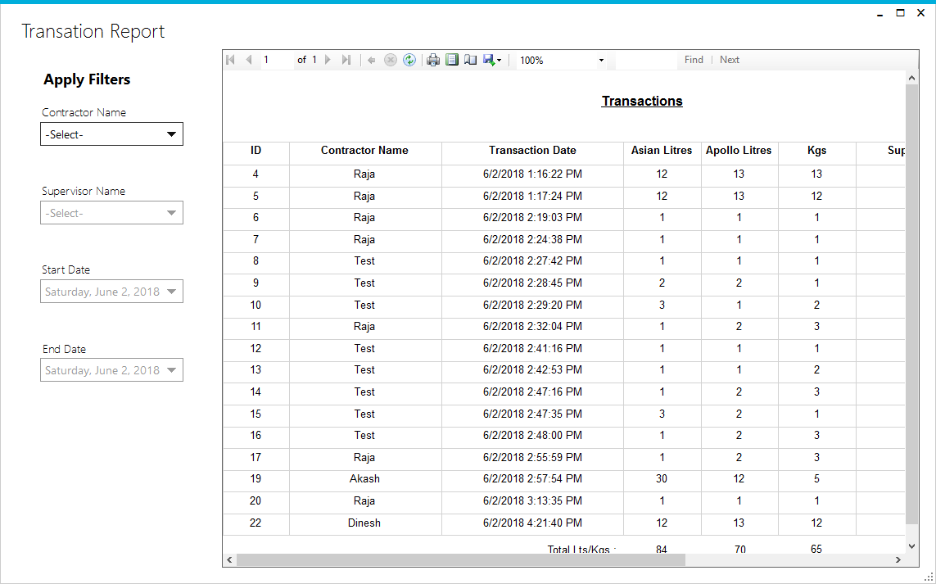
Below report is shown based on today’s transactions.

Slide 15
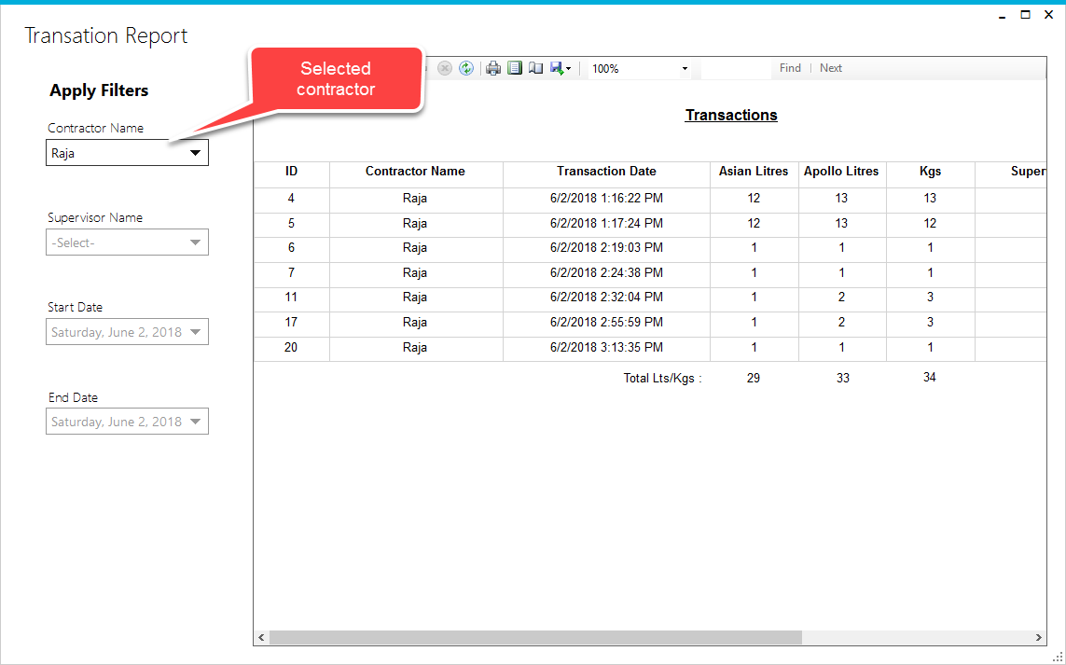
You can use filters to see transactions based on ContractorName,Supervisor,Date etc

