Slide 1
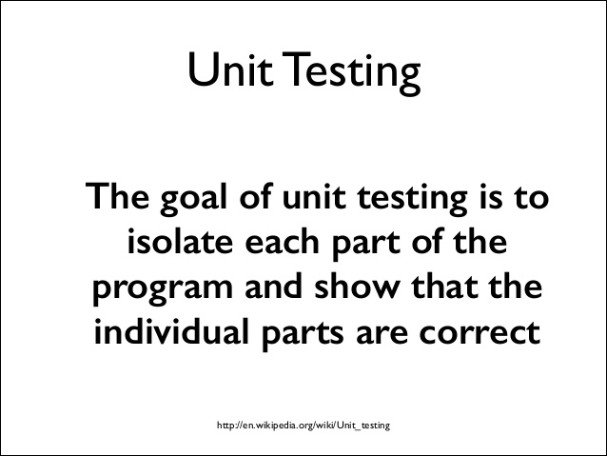
Unit test

Slide 2
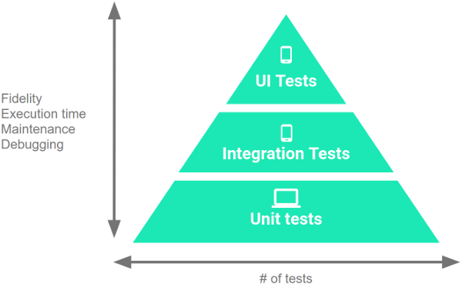
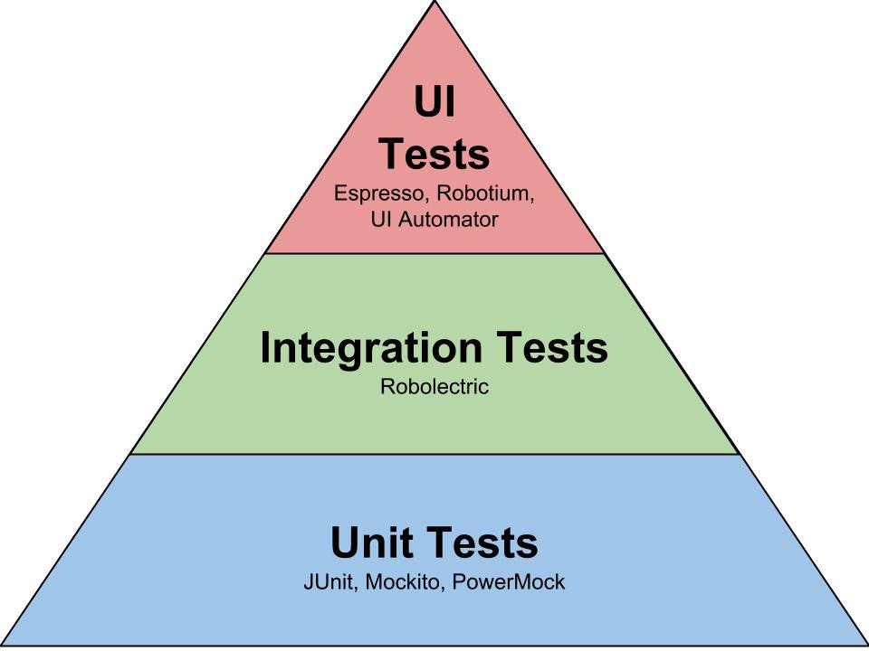
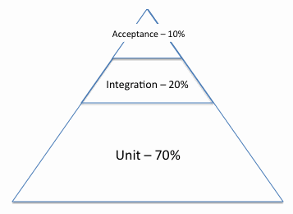
Understand the Testing Pyramid

Slide 3
Test methods
JUnit 4 | Description
import org.junit.* | Import statement for using the following annotations.
@Test | Identifies a method as a test method.
@Before | Executed before each test. It is used to prepare the test environment (e.g., read input data, initialize the class).
@After | Executed after each test. It is used to cleanup the test environment (e.g., delete temporary data, restore defaults). It can also save memory by cleaning up expensive memory structures.
@BeforeClass | Executed once, before the start of all tests. It is used to perform time intensive activities, for example, to connect to a database. Methods marked with this annotation need to be defined as static to work with JUnit.
@AfterClass | Executed once, after all tests have been finished. It is used to perform clean-up activities, for example, to disconnect from a database. Methods annotated with this annotation need to be defined as static to work with JUnit.
@Ignore or @Ignore("Why disabled") | Marks that the test should be disabled. This is useful when the underlying code has been changed and the test case has not yet been adapted. Or if the execution time of this test is too long to be included. It is best practice to provide the optional description, why the test is disabled.
@Test (expected = Exception.class) | Fails if the method does not throw the named exception.
@Test(timeout=100) | Fails if the method takes longer than 100 milliseconds.

Slide 4
Assert statements
Statement | Description
fail([message]) | Let the method fail. Might be used to check that a certain part of the code is not reached or to have a failing test before the test code is implemented. The message parameter is optional.
assertTrue([message,] boolean condition) | Checks that the boolean condition is true.
assertFalse([message,] boolean condition) | Checks that the boolean condition is false.
assertEquals([message,] expected, actual) | Tests that two values are the same. Note: for arrays the reference is checked not the content of the arrays.
assertEquals([message,] expected, actual, tolerance) | Test that float or double values match. The tolerance is the number of decimals which must be the same.
assertNull([message,] object) | Checks that the object is null.
assertNotNull([message,] object) | Checks that the object is not null.
assertSame([message,] expected, actual) | Checks that both variables refer to the same object.
assertNotSame([message,] expected, actual) | Checks that both variables refer to different objects.

Slide 5
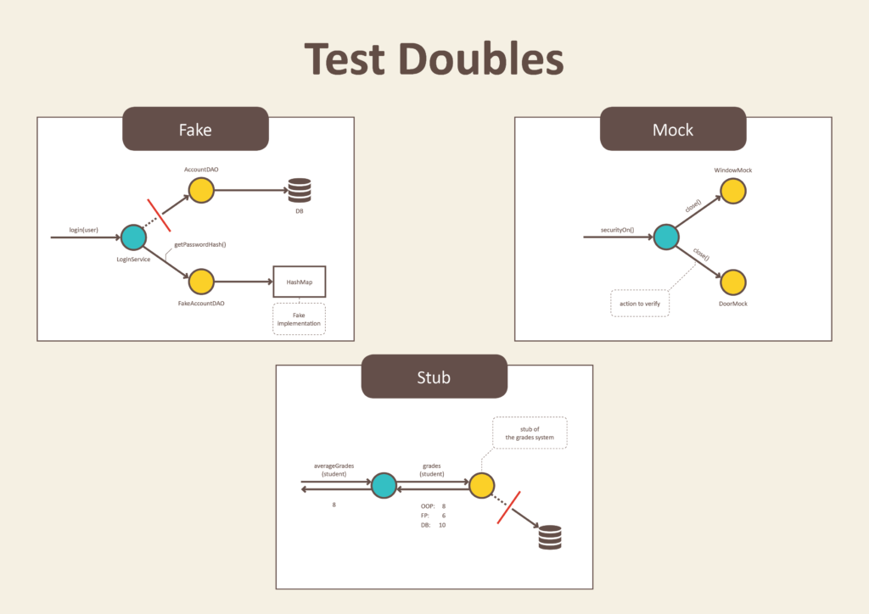
Test Doubles
A test double is an object that can stand in for a real object in a test
Similar to how a stunt double stands in for an actor in a movie.
The most common types of test doubles
are stubs, mocks, and fakes.

Slide 6
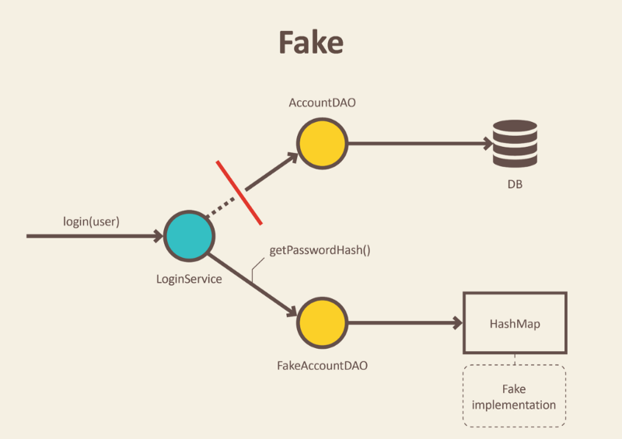
Fake
Fakes are objects that have working implementations, but not same as production one. Usually they take some shortcut and have simplified version of production code.
Fakes can be used when you can't
use a real implementation in your
test. (e.g. if the real implementation
is too slow or it talks over the
network).

Slide 7
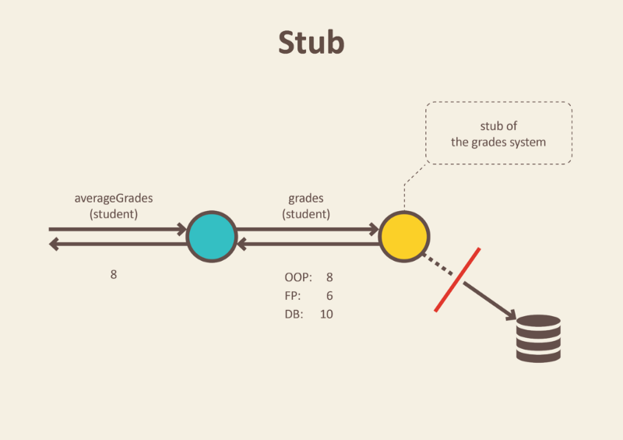
Stub
Stub is an object that holds predefined data and uses it to answer calls during tests. It is used when we cannot or don’t want to involve objects that would answer with real data or have undesirable side effects.
A stub has no logic, and only returns
what you tell it to return. Stubs can
be used when you need an object to
return specific values in order to get
your code under test into a certain
state.

Slide 8
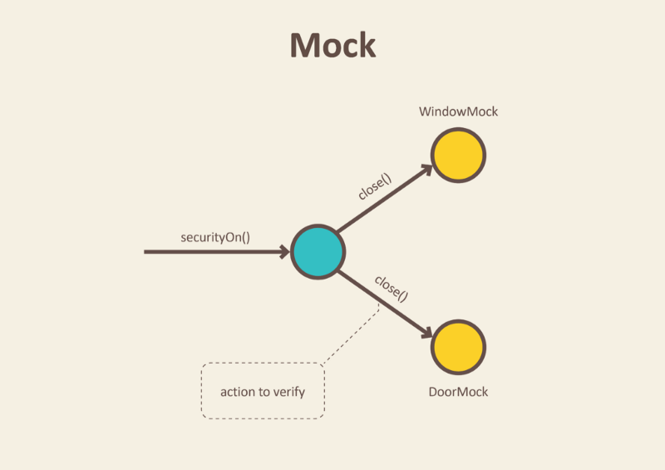
Mock
We use mocks when we don’t want to invoke production code or when there is no easy way to verify, that intended code was executed.
We don’t want to send e-mails each time we run a test.
Moreover, it is not easy to verify
in tests that a right email was send.
Only thing we can do is to verify the
outputs of the functionality that is
exercised in our test. In other worlds,
verify that e-mail sending service was called.

Slide 9
When and Then
use when(mock).thenReturn(value) to specify the stub value for a method.
when(listMock.add(anyString())).thenReturn(false);

Slide 10
Stub and Mocks
Mocks and stubs are fake Java classes that replace external dependencies.
A stub is a fake class that comes with preprogrammed return values.
A mock is a fake class that can be examined after the test is finished for its interactions with the class under test.
Typical mocks are classes with side effects that need to be examined, e.g. a class that sends emails or sends data to another external service.

Slide 11
Stubbing and Mocking with Mockito
Typically, we mock all other classes that interact with the class that we want to test. Mockito uses "mocks" for everything.
Common targets for mocking are:
Database connections,
Web services,
Classes that are slow ,
Classes with side effects and non-deterministic behavior.

