Slide 1
AMRITA
VISHWA VIDYAPEETHAM
S7 PROJECT MID REVIEW
Context-Aware Cross-Slice Transformer Framework for Automated Glioma Segmentation Using Multi-Modal MRI
Guided by, Dr. Tintu Vijayan
Harinandan G — AM.SC.U4CSE23122
Nived G Nair — AM.SC.U4CSE23139
Satvik Chaudhary — AM.SC.U4CSE23142
Sunil Swaine — AM.SC.U4CSE23160

Slide 2
Outline
1
Introduction
6
Design / Architecture
2
Problem Definition
7
Algorithms
3
Literature Review Summary
8
Result Analysis
4
Research Gap
9
Project Time Line (Plan)
5
Methodology
10
Reference
2
Cross-Slice Transformer for Glioma Segmentation
AMRITA
VISHWA VIDYAPEETHAM

Slide 3
Introduction
Gliomas are among the most common primary brain tumours; accurate segmentation of tumour boundaries directly supports surgical planning and radiotherapy targeting.
Manual, slice-by-slice segmentation by radiologists is time-consuming and subject to inter-observer variability.
This project proposes a Context-Aware Cross-Slice Transformer that fuses information across neighbouring MRI slices to produce more consistent, automated glioma segmentation.
The framework is built and evaluated on the BraTS2020 multi-modal MRI dataset (369 patient volumes; T1, T1ce, T2, FLAIR).
Goal: reduce diagnostic delay and radiologist workload with a reliable, automated segmentation pipeline — especially valuable in resource-limited healthcare settings (SDG 3).
3
Cross-Slice Transformer for Glioma Segmentation
AMRITA
VISHWA VIDYAPEETHAM

Slide 4
Problem Definition
Motivation
Manual, slice-by-slice tumour segmentation is time-consuming and inconsistent across radiologists.
Automated, clinically reliable segmentation can reduce diagnostic delay and ease radiology workload, particularly where specialists are scarce.
Problem Statement
Conventional 2-D segmentation networks process each MRI slice independently, ignoring anatomical continuity between adjacent slices — limiting volumetric consistency of predicted tumour boundaries.
Objectives
Design a Cross-Slice Transformer that fuses neighbouring-slice context at the U-Net bottleneck.
Achieve Dice scores competitive with or better than CNN/Transformer baselines, with emphasis on the Enhancing Tumour (ET) region.
Run a controlled ablation (K = 1 baseline vs. K = 5 proposed) to isolate the contribution of cross-slice attention.
4
Cross-Slice Transformer for Glioma Segmentation
AMRITA
VISHWA VIDYAPEETHAM

Slide 5
Literature Review Summary
Yr | Paper | Key Contribution | Demerit / Gap | Dataset
2025 | MM-MSCA-AF: Multi-Modal Multi-Scale Context Aggregation and Adaptive Fusion for Glioma Segmentation | Combines multi-scale context aggregation with adaptive attention fusion for better feature extraction and segmentation accuracy on multi-modal MRI. | Doesn't really model how context relates across slices in the MRI volume. | BraTS2020
2025 | MRI Transformer Deep Learning and Radiomics for Predicting IDH Wild-Type TERT Promoter Mutant Gliomas | Uses a CrossFormer-based Transformer with radiomics features to capture global context for glioma analysis and predicting molecular subtypes. | More focused on predicting molecular subtype rather than doing pixel-level tumor segmentation. | 1185 Glioma MRI Cases
2025 | An Integrated MRI-Based Diagnostic Framework for Glioma with Incomplete Imaging Sequences and Imperfect Annotations (SSL-MISS-Net) | Applies self-supervised learning with a missing-modality optimization strategy so the model stays robust with incomplete MRI modalities or noisy annotations. | Handles missing modalities well but is built more for diagnosis than precise segmentation. | Multi-center MRI
2025 | DeepGlioSeg: Advanced Glioma MRI Data Segmentation with Integrated Local-Global Representation Architecture | Proposes a CNN-Transformer Parallel Combination (CTPC) module that brings together local and global feature representations for glioma segmentation. | Captures local and global features but doesn't explicitly learn cross-slice context or do uncertainty-aware refinement. | BraTS2019/2020
2025 | A Deep Ensemble Learning Framework for Glioma Segmentation and Grading Prediction | Introduces GSG-UNet, which uses dual-domain attention, asymmetric convolutions, and multi-task learning to do segmentation and grading at the same time. | Mostly CNN-based, so it doesn't model long-range inter-slice dependencies the way attention-based methods could. | BraTS2020
2026 | Cross-Slice Transformer With Adaptive Slice Fusion for Lymph Node Segmentation in CT Imaging | Suggests a Cross-Slice Transformer with Adaptive Slice Fusion for inter-slice context modelling in segmentation of CT scans. Main paper our proposed approach is based on. | Designed for CT lymph nodes, not MRI glioma — adapting it to multi-modal brain MRI is the gap this project addresses. | CT Lymph Node data
Eval. metrics used per paper — to be added once confirmed from each paper.
5
Cross-Slice Transformer for Glioma Segmentation
AMRITA
VISHWA VIDYAPEETHAM

Slide 6
Research Gap
Reviewed Work | Gap Identified
MM-MSCA-AF | Doesn't really model how context relates across slices in the MRI volume.
MRI Transformer + Radiomics | More focused on predicting molecular subtype than doing pixel-level tumour segmentation.
SSL-MISS-Net | Handles missing modalities well but is built more for diagnosis than precise segmentation.
DeepGlioSeg | Captures local and global features but doesn't explicitly learn cross-slice context.
Deep Ensemble (GSG-UNet) | Mostly CNN-based — doesn't model long-range inter-slice dependencies.
Cross-Slice Transformer (CT) | Built for CT lymph nodes, not MRI glioma — not yet adapted to this clinical domain.
Overall Gap
No existing glioma-segmentation method explicitly models inter-slice context with attention. The closest mechanism (Cross-Slice Transformer with Adaptive Slice Fusion) was built for CT lymph nodes — adapting it to multi-modal brain MRI glioma segmentation is the gap this project addresses.
6
Cross-Slice Transformer for Glioma Segmentation
AMRITA
VISHWA VIDYAPEETHAM

Slide 7
Methodology
Category | Details
Dataset | BraTS2020 — preprocessed per-slice HDF5 files, 369 patient volumes; 4 MRI modalities (T1, T1ce, T2, FLAIR) + one-hot segmentation masks; patient-level 80/20 train-val split (no leakage).
Platform | Google Colab (GPU training); Visual Studio Code and Jupyter Notebook for development; Git/GitHub for version control.
Hardware | NVIDIA RTX 3050 Laptop GPU (4 GB VRAM, min. spec); 12th Gen Intel Core i5-12500H; 16 GB RAM; ~15 GB SSD storage.
Technology Stack | Python 3.13, PyTorch 2.7 (CUDA 12.6); torch.nn, torch.cuda.amp, NumPy, h5py; LaTeX, Mermaid, Lucidchart for documentation/diagrams.
7
Cross-Slice Transformer for Glioma Segmentation
AMRITA
VISHWA VIDYAPEETHAM

Slide 8
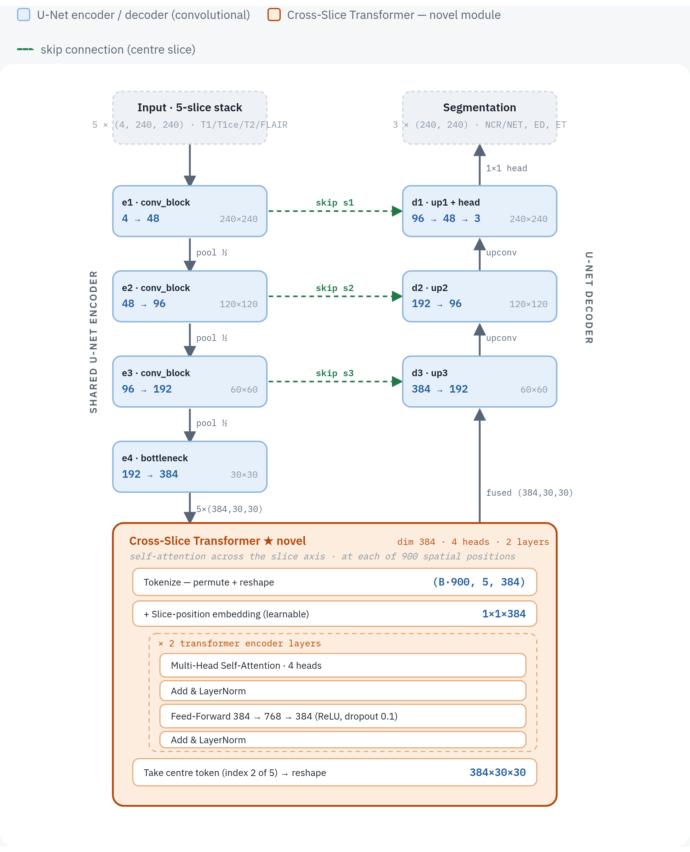
Design / Architecture
8
Figure: Cross-Slice U-Net — shared 2-D U-Net encoder (down) → Cross-Slice Transformer at the bottleneck (novel) → U-Net decoder (up); K=1 removes the orange block, giving the baseline.
Cross-Slice Transformer for Glioma Segmentation
AMRITA
VISHWA VIDYAPEETHAM

Slide 9
Algorithms
Novelty / Innovation
Training & Testing Steps
Cross-Slice Transformer fuses bottleneck features of K neighbouring slices via multi-head self-attention with learnable slice-position embeddings.
Centre slice attends to surrounding-slice context — no extra gating or explicit fusion module required.
Encoder (shared 2-D U-Net) → Cross-Slice Transformer → decoder (centre-slice skips).
Loss: 0.5×Dice + 0.5×BCE-with-logits; optimiser AdamW with cosine LR schedule; mixed precision (AMP).
Per-epoch validation: sigmoid → threshold 0.5 → WT / TC / ET Dice; best checkpoint saved.
Hyperparameters
K = 5 neighbouring slices (odd, centre = target); foreground-only sampling (centre slice must contain tumour)
U-Net width base_ch = 48 → ~6.7M params, ~2.5 GB VRAM at batch 4 (fits 4 GB GPUs)
Cross-Slice Transformer: 4 attention heads, 2 encoder layers
Batch size 4 · 30 epochs · LR 2e-4 · weight decay 1e-5 · AdamW + cosine-annealing LR (T_max = epochs)
Loss: 0.5 Dice + 0.5 BCE · AMP mixed precision · patient-level 80/20 split (val_frac = 0.2) · seed = 42
9
Cross-Slice Transformer for Glioma Segmentation
AMRITA
VISHWA VIDYAPEETHAM

Slide 10
Result Analysis
Ablation — cross-slice contribution (Dice ×100, our protocol)
Context vs. published BraTS 2020 works (Dice ×100)
Model | Data | WT | TC | ET | Mean
Baseline U-Net (K=1) | Full 369 | 76.1 | 81.1 | 81.3 | 79.5
Cross-Slice (K=5) | Full 369 | 75.8 | 80.5 | 80.7 | 79.0
Baseline U-Net (K=1) | Limited 16 | 75.7 | 67.6 | 63.4 | 68.9
Cross-Slice (K=5) | Limited 16 | 77.3 | 72.3 | 65.2 | 71.6
Method | Year | WT | TC | ET
3D U-Net | 2016 | 84.1 | 79.1 | 68.8
Attention U-Net | 2018 | 85.6 | 76.0 | 71.8
TransUNet | 2021 | 89.5 | 78.9 | 78.2
TransBTS | 2021 | 90.1 | 81.7 | 78.7
nnU-Net | 2021 | 90.4 | 82.5 | 78.9
Swin-UNet | 2022 | 89.4 | 78.8 | 78.5
UNETR | 2022 | 88.3 | 75.9 | 71.2
CFCI-Net | 2025 | 90.8 | 84.0 | 79.6
Ours (2.5-D, 4 GB) | 2026 | 76.1 | 81.1 | 81.3
Cross-slice wins most when data is scarce (+2.7 mean at 16 vols); ties on full data.
Effect of slice context K (16-volume study)
Slices K | WT | TC | ET | Mean
K = 1 (baseline) | 75.7 | 67.6 | 63.4 | 68.9
K = 3 | 76.5 | 70.4 | 64.7 | 70.5
K = 5 (proposed) | 77.3 | 72.3 | 65.2 | 71.6
Monotonic gain — more slice context = higher Dice.
Published = 3-D volumetric Dice on the official BraTS 2020 validation server (24 GB+ GPUs). Ours = 2-D slice Dice, local split, 4 GB budget — shown for context, NOT a like-for-like comparison. Our TC/ET are competitive; WT gap is largely a 2-D-vs-3-D metric artifact.
10
Cross-Slice Transformer for Glioma Segmentation
AMRITA
VISHWA VIDYAPEETHAM

Slide 11
Project Time Line (Plan)
Sem. | Milestone | Target Date | Status
S6 | Project domain exploration | 15 Feb 2026 | Completed
S6 | Literature review | 15 Mar 2026 | Completed
S6 | Baseline implementation | 30 Apr 2026 | Completed
S7-1 | Comprehensive literature survey | 15 Jul 2026 | Completed
S7-1 | Research gap identification | 20 Jul 2026 | Completed
S7-1 | Problem statement finalised | 25 Jul 2026 | Completed
S7-2 | System design (architecture & workflow) | 06 Aug 2026 | Current
S7 | Prototype implementation | 15 Oct 2026 | Planned
S7 | Module integration | 15 Nov 2026 | Planned
S7 | Testing and validation | 15 Dec 2026 | Planned
S8 | System enhancement | 31 Jan 2027 | Planned
S8 | Performance evaluation | 28 Feb 2027 | Planned
11
Cross-Slice Transformer for Glioma Segmentation
AMRITA
VISHWA VIDYAPEETHAM

Slide 12
Reference
[1] W. Aslam, J. Hussain, M. Z. Aslam, S. Jan, T. B. Riaz, A. Iqbal, M. Arif, and I. Khan, "Enhanced Brain Tumor Segmentation in Medical Imaging Using Multi-Modal Multi-Scale Contextual Aggregation and Attention Fusion," Scientific Reports, vol. 15, 2025.
[2] P. Song, C. Shen, Z. Fan, F. Yin, Y. Wu, F. Liu, C. Zhao, W. Zeng, X. Xie, G. Wu, B. Yang, Z. Shi, and J. Yu, "An Integrated MRI-Based Diagnostic Framework for Glioma With Incomplete Imaging Sequences and Imperfect Annotations," npj Precision Oncology, vol. 9, 2025.
[3] R. Li, Y. Liao, Y. Huang, X. Ma, G. Zhao, Y. Wang, and C. Song, "DeepGlioSeg: Advanced Glioma MRI Data Segmentation With Integrated Local-Global Representation Architecture," Frontiers in Oncology, vol. 15, Art. no. 1449911, 2025.
[4] L. Wen, H. Sun, G. Liang, and Y. Yu, "A Deep Ensemble Learning Framework for Glioma Segmentation and Grading Prediction," Scientific Reports, vol. 15, Art. no. 4448, 2025.
[5] B. Abdikenov, Z. Kairat, T. Zhaksylyk, Y. Orazayev, B. Ayanbayev, and N. Saidnassim, "Cross-Slice Transformer With Adaptive Slice Fusion for Lymph Node Segmentation in CT Imaging," IEEE Access, vol. 14, pp. 98650–98670, 2026.
12
Cross-Slice Transformer for Glioma Segmentation
AMRITA
VISHWA VIDYAPEETHAM

