Slide 1
Navigating India's Commodity Markets
Insights through Analysis and Visualization
P Sunil Kumar | 20211ISD0005
Abhi C N | 20211ISD0039
P Sushmanth | 20211ISD0020

Slide 2
Introduction: Overall Project Objective
To provide insights into the trends and fluctuations in commodity prices across different regions of India.
This project aims to utilize data analysis and visualization techniques to offer actionable insights for stakeholders in the commodities market.

Slide 3
Motivation
Objectives
Commodity prices play a crucial role in the economy, impacting various sectors including agriculture, manufacturing, and consumer goods.
Analyze historical commodity price data to identify trends and patterns.
Visualize the spatial distribution of commodity prices across different states and regions.
Provide actionable insights for stakeholders such as farmers, traders, and policymakers.
Enhance understanding of factors influencing commodity price movements in India.

Slide 4
Background
India's economy heavily relies on commodities such as agricultural produce, minerals, and industrial raw materials.
Commodity prices are influenced by factors like supply-demand dynamics, weather conditions, government policies, and global market trends.
Understanding commodity price fluctuations is vital for decision-making in sectors like agriculture, manufacturing, and trade.
This project seeks to delve into the dynamics of commodity prices in India and provide valuable insights for stakeholders.
Notes:
Relies- depend
Vital- Essential/ Necessary
Delve- Go through

Slide 5

Methodology: Procedures
Data Collection
Data Preprocessing
Analysis Techniques
Visualization Tools
Spatial Analysis
Machine Learning
Notes:
Data Collection: Gather historical commodity price data from reliable sources such as government databases, commodity exchanges, and research reports.
Data Preprocessing: Cleanse and preprocess the data to remove outliers, handle missing values, and ensure consistency.
Analysis Techniques: Utilize statistical methods and time series analysis to identify trends, seasonality, and correlations.
Visualization Tools: Employ data visualization libraries such as Matplotlib, Seaborn, and Plotly for creating interactive visualizations.
Spatial Analysis: Utilize geographical information systems (GIS) tools to visualize commodity prices on maps and analyze spatial patterns.
Machine Learning: Explore the potential of machine learning algorithms for predictive modeling and forecasting of commodity prices.
Collaboration: Foster collaboration with domain experts and stakeholders to validate findings and gather insights for informed decision-making.

Slide 6

Tools
Software:
Google Collab
Libraries:
NumPy
Pandas
Seaborn
Matplotlib
Geopandas
Dataset: Price of Agricultural Commodities in India

Slide 7
Outputs

Slide 8
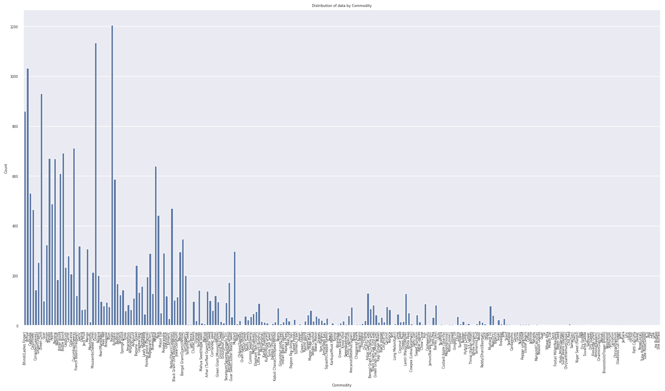

Slide 9
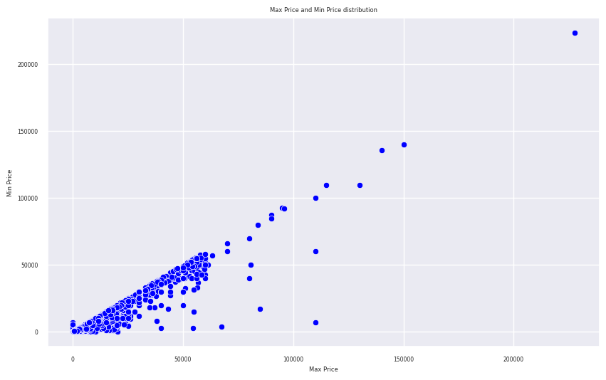

Slide 10
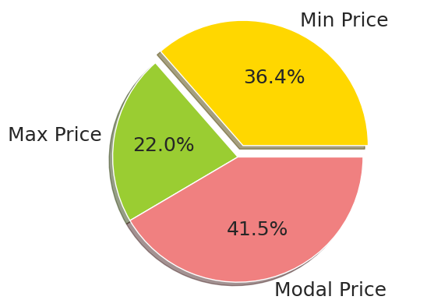

Slide 11
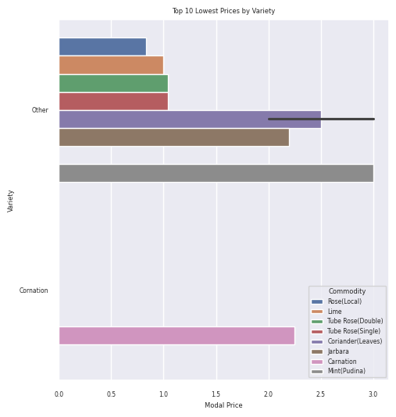

Slide 12
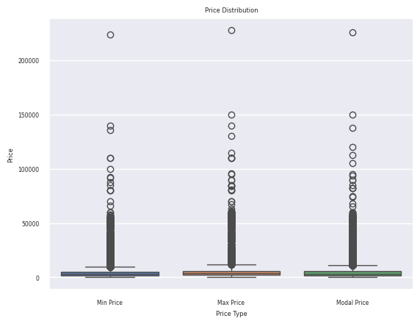

Slide 13
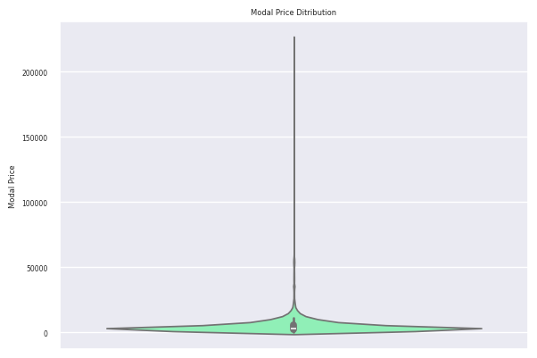

Slide 14
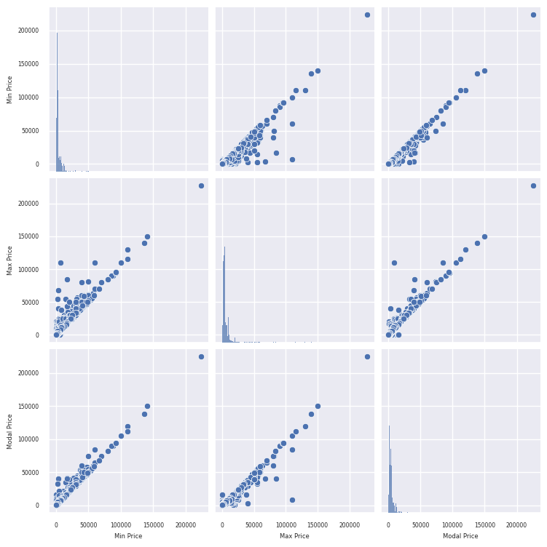

Slide 15
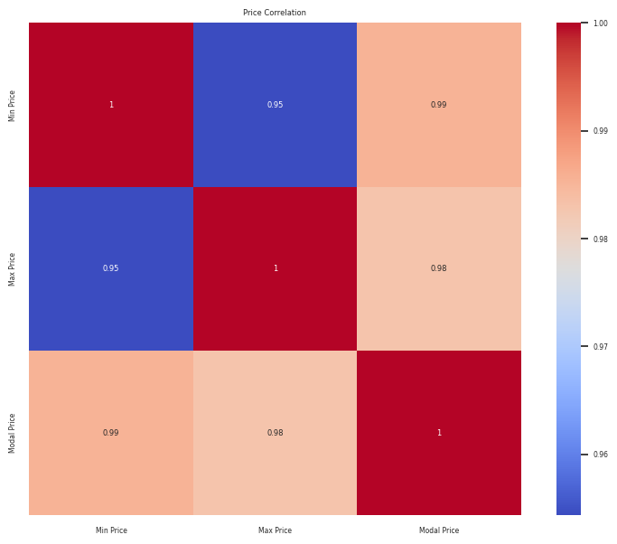

Slide 16
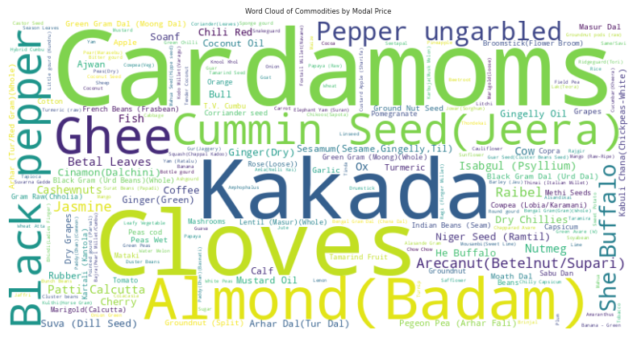

Slide 17
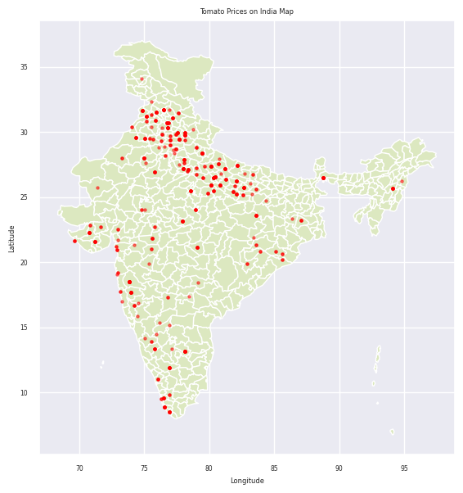

Slide 18
Business Objective
Forecast Price Trends
Compare Regional Prices
Analyze Seasonal Demand
Gain Market Intelligence
Conduct Competitive Analysis
Optimize Pricing
Evaluate Suppliers

Slide 19
Conclusion
Uttar Pradesh has the highest number of market located and Kerala has second highest number of market.
But Palakkad (Kerala) has 162 number of market, and Kangra (Himachal Pradesh) has 138 market and Bulandshahar (Uttar Pradesh) has 115 markets.
Potato, onion, tomato and green chilly are the commodity has the highest demand and supply but in descending order.
Kerala contribute the highest Modal Price whereas Gujrat, NCT Delhi and Rajasthan have almost equal contribution.
Kattappana (Kerala) market has highest modal price.
Cardamoms commodity has highest modal price, whereas cloves, jeera and fish have also almost high modal price.
Other variety has highest Modal Price while jeera's variety has second.

Slide 20
Thank you
For your patience

