Slide 1
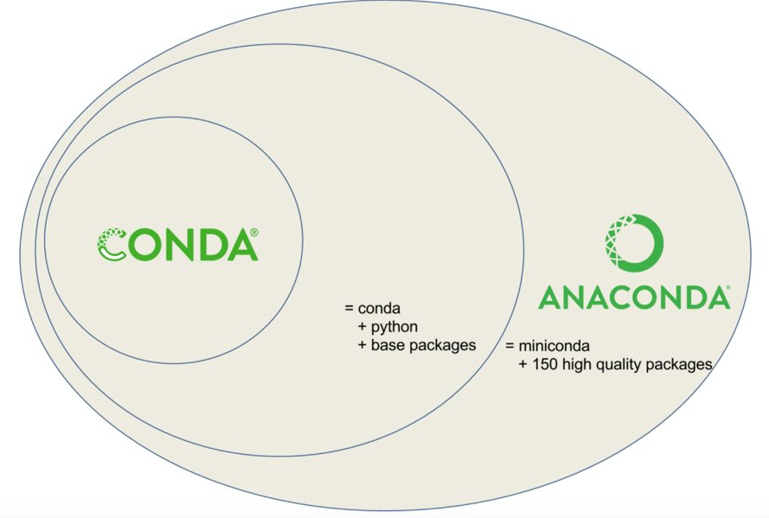
MINIFORGE

Slide 2


Operating System
Process
Process Control Block (PCB)
Virtual address space
Program Counter (PC)
Stack
Heap
Open file descriptors
Other resources(network socket etc)
CPU
Contiguous Block of Memory
Program
Process
Kernel
MMU
RAM

Slide 3



Kernel level
Process level
Reference Count of open file,
Current file position
Pointer to v-node Table
Pointers to the open file Table
Information about file on disk
File Descriptor Table
Open File Table
v-node Table
Open()
fopen()
Per Process
Global

