Slide 1
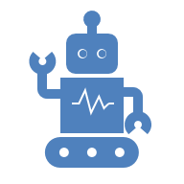
HEALTHCARE
&
WELLBEING

Slide 2
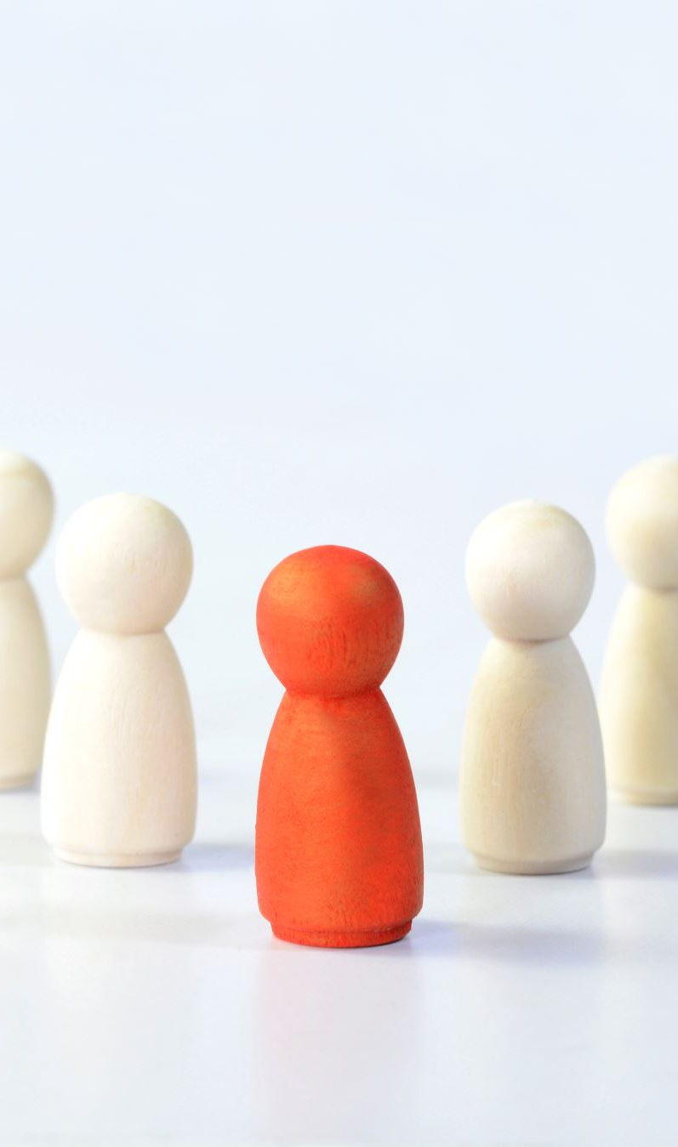
Problem
The number of people with diabetes has increased significantly from 32 million in 2000 to 101 million in 2025.
REASON: Factors such as poor diet, lack of physical activity, lifestyle changes, and increased stress level contribute to the hypertension epidemic.

Slide 3


Diabetes
The number of peoples with diabetes has increase significantly from 32 million in 2000 to 101 million in 2025.
REASON:Factors such as poor diet ,lack of physical activity , lifestyle changes and increase stress level contribute to the obesity epidemic.

Slide 4

Introduction
Food quality and personalized nutrition are critical for health and well-being.
This project proposes a dual-purpose AI system:
1. Detect food and get nutritional info (sugar, carbs).
2. Recommend diet charts for health conditions like diabetes and hypertension.

Slide 5
Technologies Used
• Computer Vision: YOLOv5/YOLOv8, CNN, Vision Transformers
• NLP: For interpreting user health inputs

Slide 6

Components
• Arduino Uno
• ESP32-CAM
• 16×2 LCD Display
• 4×4 Keypad
•

Slide 7
Arduino Code Overview
• LCD and Keypad integration
• User selects condition (Diabetes/Hypertension)
• Displays diet chart on LCD

Slide 8
CONCLUSION
•NutriVision aims to improve healthcare and well-being through AI-powered food recognition and personalized diet recommendations for hypertension and diabetes.

