Slide 1

The Evolution of NLP – Comparing Three Eras of Sentiment Analysis
Traditional ML • Deep Learning (LSTM) • Pretrained NLP
A controlled comparison of three NLP paradigms on the same movie-review test set
2,000 NLTK Movie Reviews | 80% Train / 20% Test | 400 held-out reviews
Traditional ML
Deep Learning
Pretrained NLP
1
2
3
TF-IDF + Logistic Regression
PyTorch Embedding + LSTM
NLTK VADER
Natural Language Processing — Graded Take-Home Assignment

Slide 2
EXECUTIVE SUMMARY
02
Executive Summary
The business decision is clear: accuracy, F1, speed and operational simplicity all matter.
BEST ACCURACY
BEST F1
FASTEST INFERENCE
LSTM TRAINING
85.50%
0.8578
0.0053 s
550.9 s
TF-IDF + Logistic Regression
Balanced precision / recall
400 reviews in 5.25 ms
CPU-only environment
What the experiment showed
Why the result matters
Client recommendation
TF-IDF + Logistic Regression delivered the strongest predictive performance. VADER was a useful no-training baseline and achieved 64.75% accuracy. LSTM required substantially more compute but did not generalize well on this dataset.
The comparison isolates model choice because every pipeline was evaluated on the same 400-review test set. This makes the performance and deployment trade-offs directly comparable.
Deploy TF-IDF + Logistic Regression for the current use case. It offers the best accuracy/F1 with negligible inference cost and low operational complexity.
NLP Sentiment Analysis | Graded Assignment

Slide 3
CLIENT CONTEXT
03
Business Objective & Decision Criteria
The consultancy firm must choose between building from scratch and using an off-the-shelf model.
Client problem
Controlled experiment
Build an automated sentiment-analysis solution for unstructured movie reviews and determine which NLP paradigm is most suitable for production.
All three approaches use the NLTK Movie Reviews dataset and the exact same held-out 20% test set (400 reviews), enabling a fair comparison.
Production decision criteria
Decision lens
Predictive quality
Accuracy + Precision + Recall + F1
A model is not “best” merely because it is more sophisticated. For this client, the winning solution should maximize useful predictive performance while minimizing compute, latency, development effort and ongoing complexity.
Operational speed
Training cost + inference latency
Data requirement
Task-specific labeled data vs pretrained
Deployment effort
Complexity, maintenance and reproducibility
NLP Sentiment Analysis | Take-Home Assignment

Slide 4
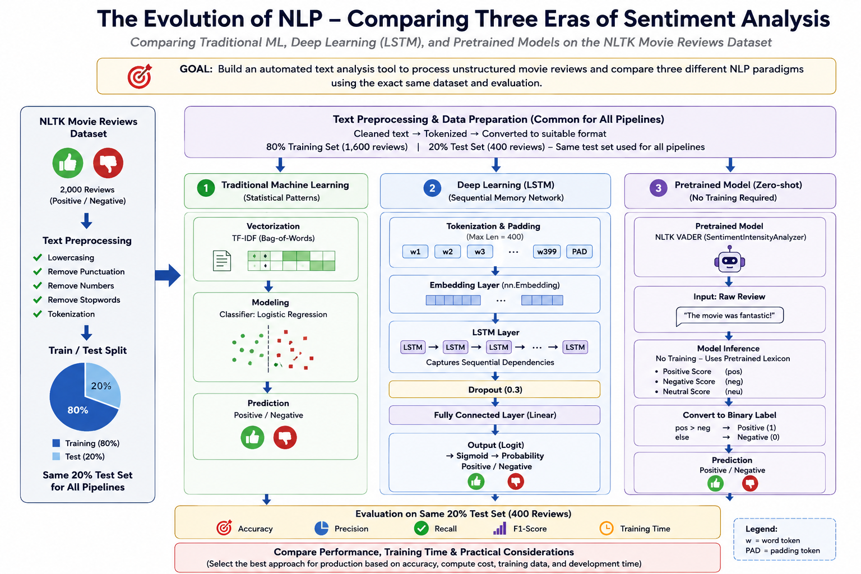
EXPERIMENTAL ARCHITECTURE — COMMON DATA, THREE NLP ERAS
Architecture supplied as part of the project design and aligned to the assignment pipeline.

Slide 5
TASK 1 — DATA SOURCING & PREPROCESSING
05
Dataset & Common Preprocessing Pipeline
The same source data and held-out test set were preserved across all three approaches.
DATASET
TRAINING
TEST
CLASSES
2,000
1,600
400
2
NLTK Movie Reviews
80%
20% — held out
Positive / Negative
Raw reviews
Clean text
Split
Same test set
NLTK Movie Reviews
Lowercase • punctuation/numbers removed • stopwords removed
80% train / 20% test
400 reviews for every pipeline
Rubric alignment
Fair-comparison principle
Robust cleaning + correct 80/20 split + identical held-out test set satisfy the Level 4 Task 1 requirements.
No pipeline receives a different test sample. Model differences therefore reflect approach, not test-set composition.
NLP Sentiment Analysis | Graded Assignment

Slide 6
TASK 2 — TRADITIONAL MACHINE LEARNING
06
Pipeline 1 — TF-IDF + Logistic Regression
A lightweight statistical approach that converts reviews into sparse lexical features.
Pipeline
ACCURACY
PRECISION
RECALL
F1
1. Clean review text 2. TF-IDF vectorization • word-level statistical representation 3. Logistic Regression • binary classifier 4. Predict Positive / Negative 5. Evaluate on the 400-review test set
85.50%
84.13%
87.50%
0.8578
TRAINING TIME
INFERENCE
0.4909 s
0.00525 s
One-time model fit
400 reviews
Interpretation
Best overall predictive performance. The model is fast, simple to reproduce, inexpensive to operate, and well matched to this dataset.
NLP Sentiment Analysis | Graded Assignment

Slide 7
TASK 3 — DEEP LEARNING
07
Pipeline 2 — PyTorch Embedding + LSTM
A sequence model trained from scratch to learn dense representations and sequential dependencies.
Tokens
Embedding
LSTM
Dropout
Linear
Vocabulary 35,542
128-dim nn.Embedding
128 hidden units
0.3
1 logit
ACCURACY
PRECISION
RECALL
F1
TRAINING
53.75%
57.43%
29.00%
0.3854
550.9 s
CPU
What happened?
Business interpretation
Early stopping after 4 epochs. Best validation loss = 0.6899 at epoch 2. The model learned training patterns but did not generalize effectively.
More sophisticated architecture ≠ better result. On this small dataset, the additional compute and complexity were not justified by predictive performance.
NLP Sentiment Analysis | Graded Assignment

Slide 8
TASK 4 — PRETRAINED MODEL INFERENCE
08
Pipeline 3 — NLTK VADER
A pretrained lexicon/rule-based sentiment analyzer used without task-specific training.
Inference workflow
ACCURACY
PRECISION
RECALL
F1
Raw review → VADER sentiment scores → compound score → binary label Decision rule used: compound ≥ 0.05 → Positive; otherwise → Negative.
64.75%
61.13%
81.00%
0.697
INFERENCE TIME
Training time
6.7448 s
N/A — no task-specific training
400 reviews
Why it is useful
• No model training required • Very quick to integrate • Strong positive recall on this test set • Useful baseline when labeled data is unavailable
Key observation
VADER outperformed the LSTM but remained below TF-IDF + Logistic Regression on this movie-review benchmark.
NLP Sentiment Analysis | Graded Assignment

Slide 9
COMPARATIVE RESULTS
09
Results: Predictive Performance vs Operational Cost
All metrics below are measured on the same 400-review test set.
Pipeline
Accuracy
Precision
Recall
F1
Train (s)
Inference (s)
Decision
TF-IDF + Logistic Regression
85.50%
84.13%
87.50%
0.8578
0.4909
0.00525
RECOMMENDED
Refined PyTorch LSTM
53.75%
57.43%
29.00%
0.3854
550.8902
2.2820
Not justified
VADER
64.75%
61.13%
81.00%
0.6968
N/A
6.7448
Baseline / fallback
Performance winner
Compute winner
Important trade-off
TF-IDF + Logistic Regression leads every primary predictive metric except none — it is best on accuracy, precision, recall and F1.
Traditional ML trains in under 1 second and processes the 400-review test set in 5.25 ms.
VADER avoids training but has the slowest measured inference; LSTM has the highest training cost and lowest F1.
NLP Sentiment Analysis | Graded Assignment

Slide 10
TASK 5 — ANALYSIS
10
Why Did the Pretrained Model Perform Differently?
Domain adaptation explains why “pretrained” does not automatically mean “best for this task.”
VADER’s original strength
Target domain
Observed result
VADER is a general-purpose sentiment lexicon/rule-based system designed and tuned around sentiment-bearing language, particularly social-media-style text. It brings broad sentiment knowledge without training on this assignment’s movie-review labels.
The evaluation data consists of long-form movie reviews with: • nuanced criticism • context-dependent sentiment • mixed positive / negative language • movie-specific expressions These characteristics differ from the language patterns VADER was optimized to capture.
Accuracy 64.75% F1 0.6968 Positive recall 81.00% VADER identified many positive reviews, but its negative recall was only 48.50%. That asymmetry is consistent with imperfect domain fit.
DOMAIN SHIFT
Bottom line
Pretraining reduces development effort, but domain-specific labeled data can still produce a stronger task-adapted model — as demonstrated by TF-IDF + Logistic Regression.
NLP Sentiment Analysis | Graded Assignment

Slide 11
TASK 5 — ANALYSIS
11
Why These Evaluation Metrics?
Accuracy alone can hide class-specific errors; the metric set gives a more complete operational view.
1
Accuracy
Overall proportion of correct predictions.
Useful headline measure because the held-out test set is balanced: 200 negative / 200 positive.
2
Precision
Of predicted positives, how many are truly positive?
Important when false-positive sentiment labels create downstream business noise.
3
Recall
Of actual positives, how many are detected?
Important when missing positive sentiment is costly; it also exposes VADER’s positive-heavy behavior.
4
F1-score
Harmonic mean of precision and recall.
Best single balanced comparison when both false positives and false negatives matter.
Selection rationale
Accuracy + Precision + Recall + F1 provide complementary views of performance and directly support the production decision.
NLP Sentiment Analysis | Graded Assignment

Slide 12
TASK 5 — PRODUCTION RECOMMENDATION
12
Production Recommendation: Deploy TF-IDF + Logistic Regression
For the current problem, the simplest model is also the strongest model.
RECOMMENDED
TF-IDF + Logistic Regression
Predictive quality
Speed
Compute
Development
85.50% accuracy 0.8578 F1
0.00525 s for 400 reviews
0.4909 s training CPU-friendly
Simple pipeline Easy to retrain
Why not LSTM now?
Where VADER still fits
53.75% accuracy and 0.3854 F1 after 550.9 seconds of CPU training. The added complexity does not produce a competitive result on this dataset.
Excellent rapid baseline when labeled data or training time is unavailable. However, its 64.75% accuracy and domain mismatch make it weaker than the task-specific statistical model here.
NLP Sentiment Analysis | Graded Assignment

Slide 13
TASK 5 — FINAL ANSWERS
13
Final Answers — The Four Questions the Client Needs Resolved
The final decision combines predictive evidence with practical production constraints.
1
Which performed best?
TF-IDF + Logistic Regression. It achieved the highest accuracy (85.50%) and F1 (0.8578), while also being the fastest and least computationally demanding.
2
Why did VADER perform differently?
VADER requires no task-specific training, but its general sentiment lexicon/rules are not adapted to this movie-review domain. Domain shift limits performance, especially for negative recall.
3
Why these metrics?
Accuracy gives the headline result; precision and recall expose error trade-offs; F1 provides a balanced summary. Together they prevent a misleading accuracy-only conclusion.
4
What should be deployed?
Deploy TF-IDF + Logistic Regression for the current production use case. Keep VADER as a lightweight baseline/fallback. Revisit LSTM only with substantially more labeled data, tuning and compute.
CLIENT TAKEAWAY | Choose the model that delivers the most business value — not the most architectural complexity.
NLP Sentiment Analysis | Final recommendation

