Slide 1
BANKING MANAGEMENT SYSTEM
SQL Database Design, Queries & Analysis
Project focus
A relational banking database covering customers, accounts, transactions and loans, followed by practical SQL analysis.

Slide 2
1. Project Overview
OVERVIEW
Purpose and scope of the database project
• Design a relational database for basic banking operations.
• Store customer, account, transaction and loan information.
• Connect related records using primary keys and foreign keys.
• Use SQL to answer practical banking-analysis questions.
• Progress from simple SELECT/JOIN queries to analytical window functions.
Database
Bank
Core tables
Customers • Accounts • Transactions • Loans
Analysis
Joins • Aggregation • Subqueries • Window functions

Slide 3
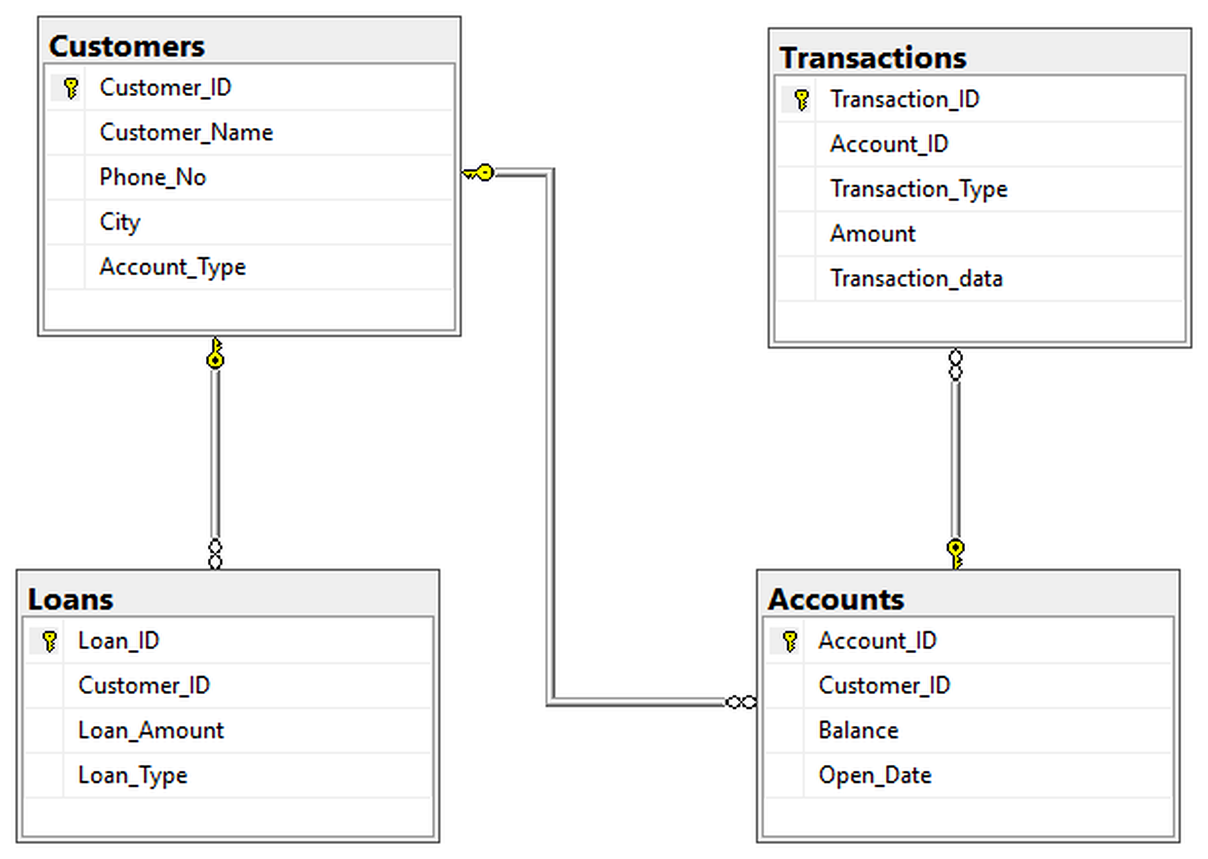
2. Database Schema
DATABASE DESIGN
How the four main entities are connected
RELATIONSHIP DIAGRAM
Customers
Customer_ID uniquely identifies each customer.
Accounts
Customer_ID connects each account to its owner.
Transactions
Account_ID connects every transaction to an account.
Loans
Customer_ID connects loans to borrowers.

Slide 4
3. Database & Tables
SETUP
Creation sequence used in the submitted SQL
Step 1 — Create database
CREATE DATABASE Bank; then USE Bank;
Step 2 — Customers
10 customer records with identity, phone, city and account type.
Step 3 — Accounts
10 accounts with balance and opening date.
Step 4 — Transactions
15 transaction records linked to accounts.
Step 5 — Loans
8 loan records linked to customers.

Slide 5
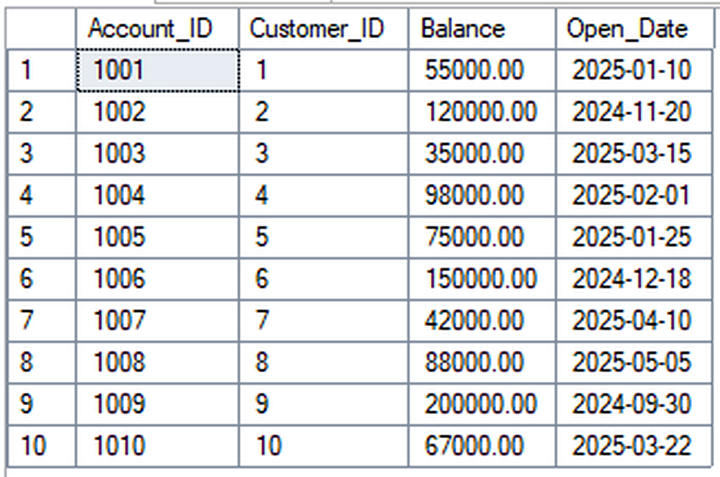
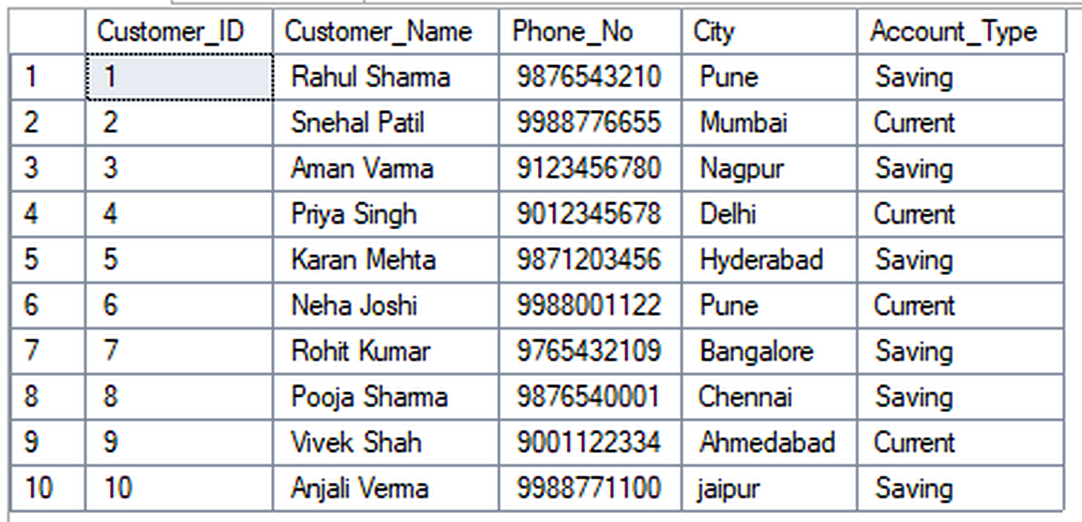
4. Initial Data — Customers & Accounts
DATA
Base records used by subsequent queries
CUSTOMERS TABLE
ACCOUNTS TABLE
Data summary
10 customers • 10 accounts • total account balance = ₹9,30,000

Slide 6
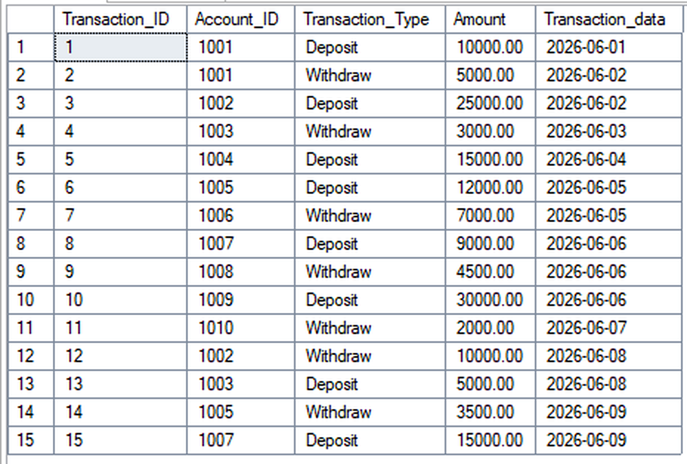
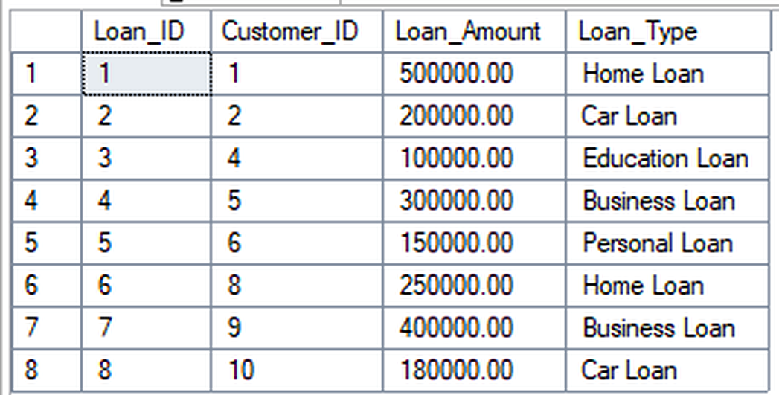
5. Initial Data — Transactions & Loans
DATA
Operational records linked to the core entities
TRANSACTIONS TABLE
LOANS TABLE
Data summary
15 transactions • 8 loans • deposits = ₹1,21,000 • withdrawals = ₹35,000

Slide 7
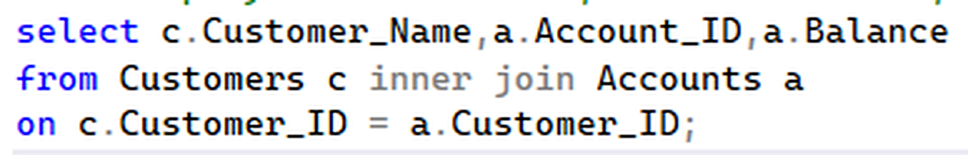
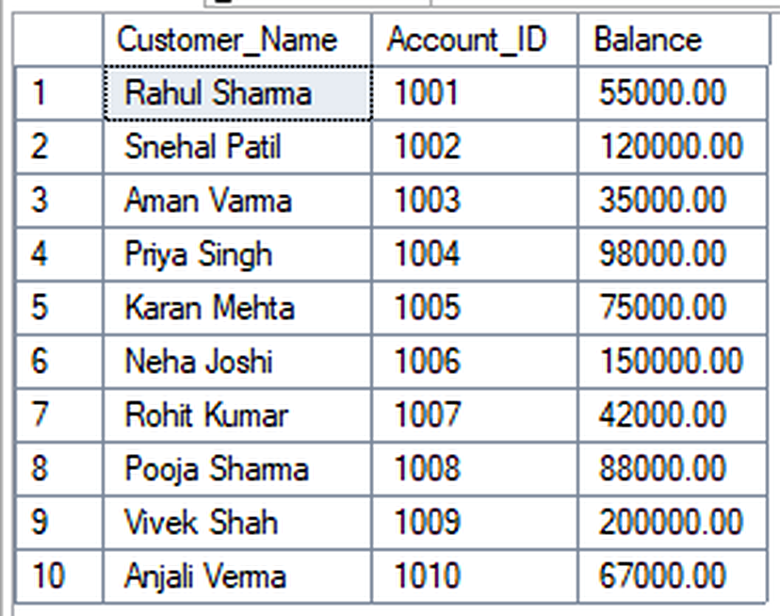
6. INNER JOIN — Customer, Account & Balance
SQL ANALYSIS
Query + execution result • sequence from the submitted screenshots
SQL QUERY
What the query does
Combines Customers and Accounts through Customer_ID to show the customer, account number and balance.
EXECUTION OUTPUT
Why it matters
Demonstrates the basic relational lookup pattern used throughout the project.
SQL technique
JOIN

Slide 8
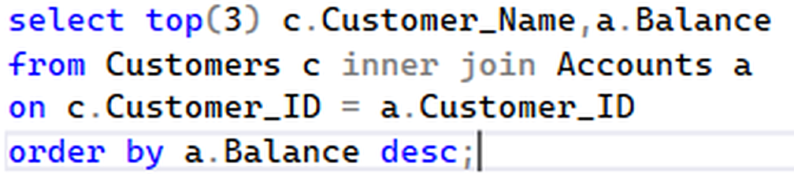
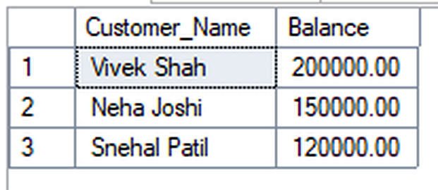
7. Top 3 Customers by Account Balance
SQL ANALYSIS
Query + execution result • sequence from the submitted screenshots
SQL QUERY
What the query does
Sorts balances in descending order and returns only the first three rows.
EXECUTION OUTPUT
Why it matters
Useful for quickly identifying high-value account holders.
SQL technique
ORDER BY + LIMIT

Slide 9
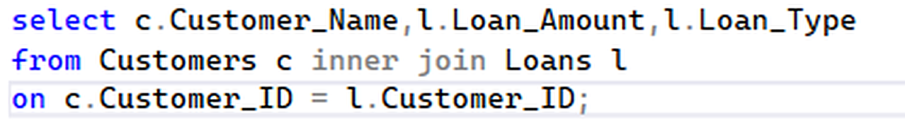
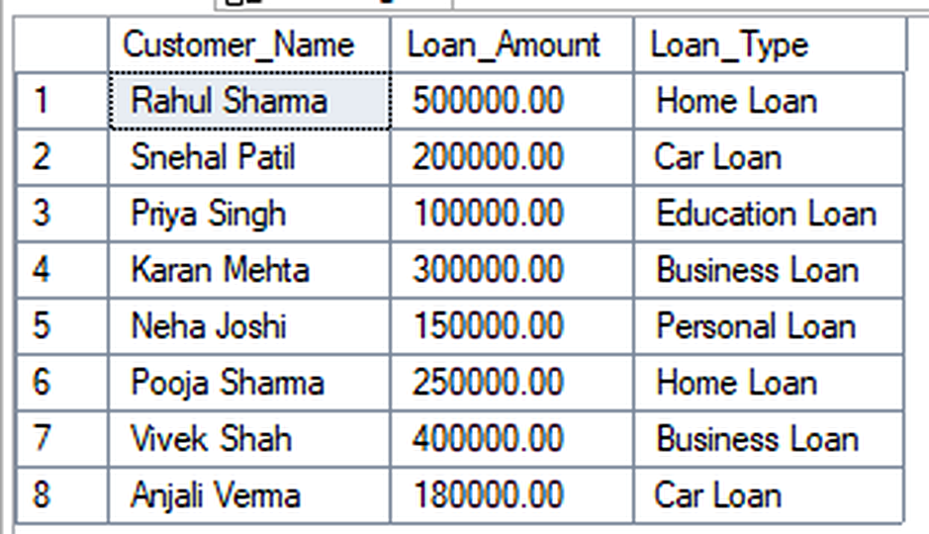
8. Customers Who Have Taken Loans
SQL ANALYSIS
Query + execution result • sequence from the submitted screenshots
SQL QUERY
What the query does
Joins Customers with Loans to display borrower, loan amount and loan type.
EXECUTION OUTPUT
Why it matters
Connects customer information with lending activity.
SQL technique
INNER JOIN

Slide 10
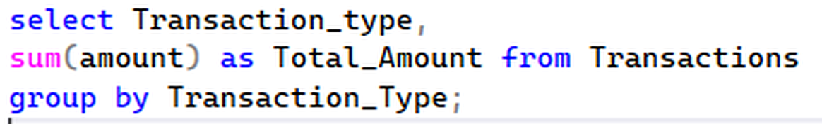
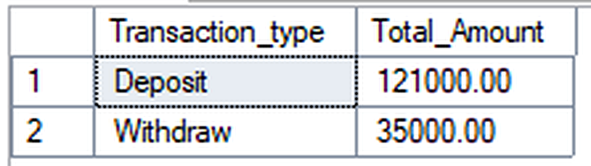
9. Total Deposits vs Withdrawals
SQL ANALYSIS
Query + execution result • sequence from the submitted screenshots
SQL QUERY
What the query does
Groups transactions by type and calculates SUM(Amount).
EXECUTION OUTPUT
Why it matters
Gives a quick view of money flowing into and out of accounts.
SQL technique
GROUP BY + SUM

Slide 11
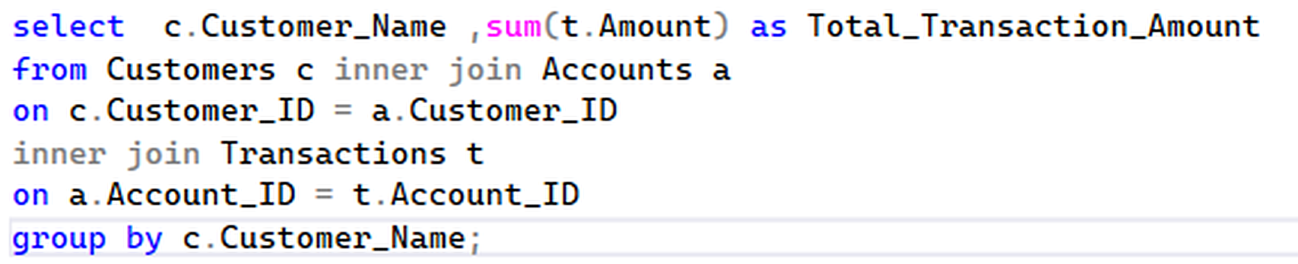
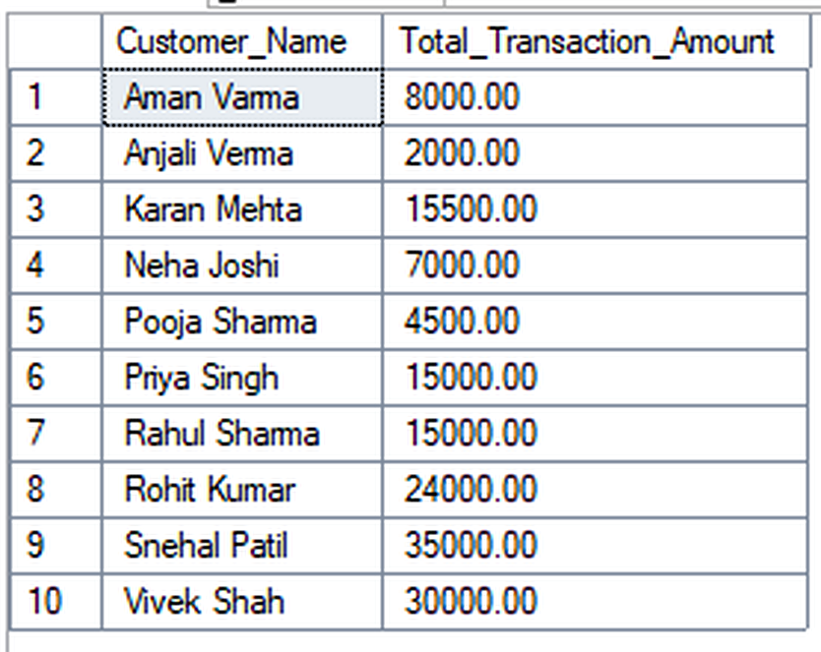
10. Customer-wise Total Transaction Amount
SQL ANALYSIS
Query + execution result • sequence from the submitted screenshots
SQL QUERY
What the query does
Joins Customers → Accounts → Transactions and totals each customer's transaction amount.
EXECUTION OUTPUT
Why it matters
Measures customer transaction activity.
SQL technique
GROUP BY + SUM

Slide 12
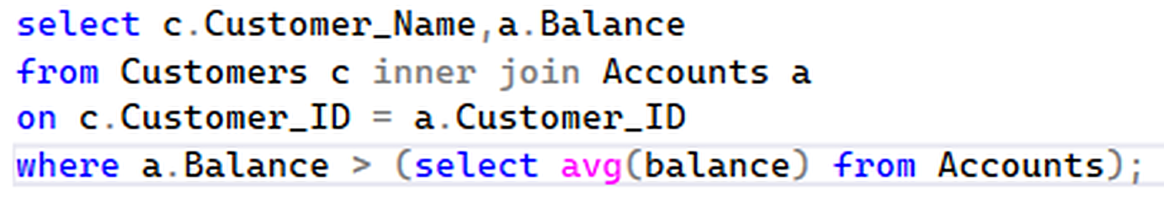
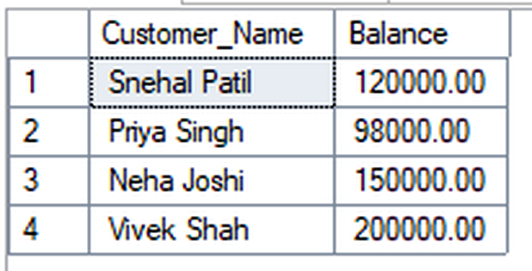
11. Customers Above Average Balance
SQL ANALYSIS
Query + execution result • sequence from the submitted screenshots
SQL QUERY
What the query does
Calculates the average balance in a subquery and returns customers above that value.
EXECUTION OUTPUT
Why it matters
Shows how a calculated benchmark can be used for filtering.
SQL technique
SUBQUERY + AVG

Slide 13
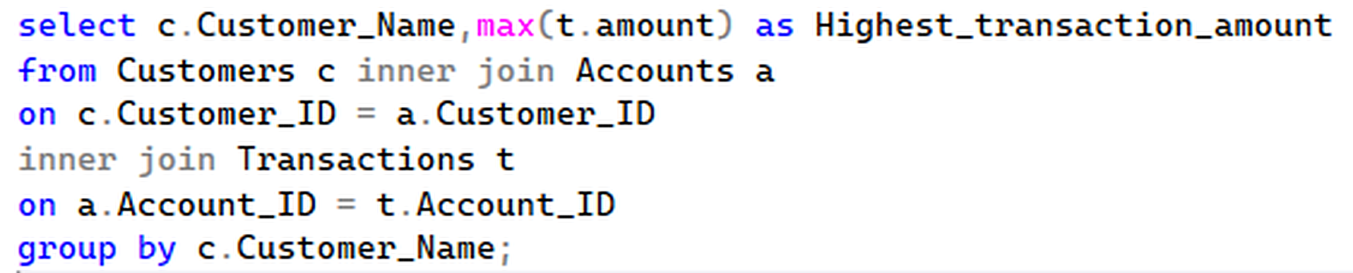
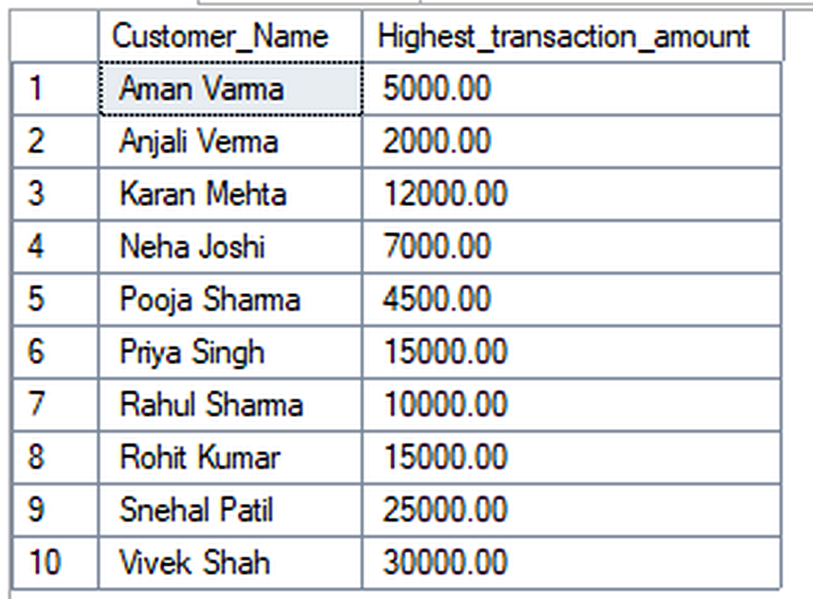
12. Highest Transaction per Customer
SQL ANALYSIS
Query + execution result • sequence from the submitted screenshots
SQL QUERY
What the query does
Groups transactions by customer and finds the maximum transaction amount.
EXECUTION OUTPUT
Why it matters
Identifies each customer's largest transaction.
SQL technique
GROUP BY + MAX

Slide 14
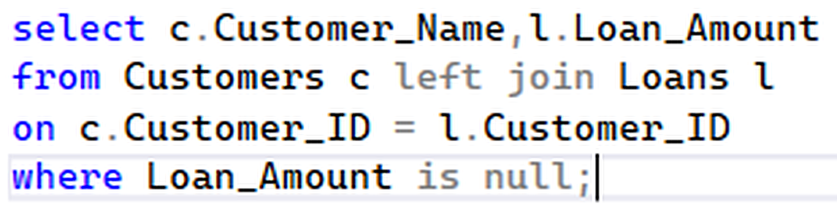
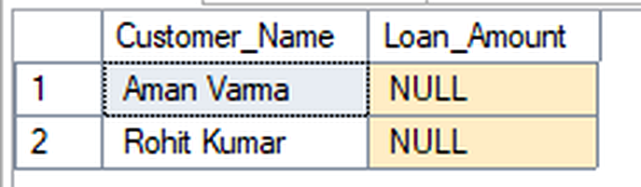
13. Customers Without Loans
SQL ANALYSIS
Query + execution result • sequence from the submitted screenshots
SQL QUERY
What the query does
Uses LEFT JOIN and checks for NULL loan records.
EXECUTION OUTPUT
Why it matters
Finds customers who have accounts but no matching loan record.
SQL technique
LEFT JOIN + IS NULL

Slide 15
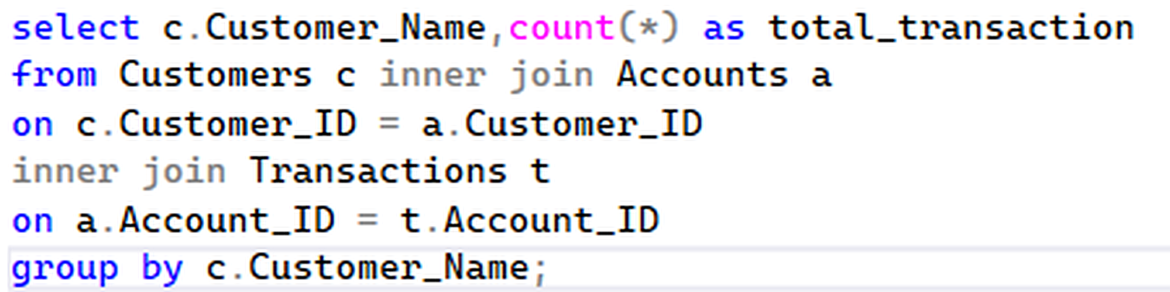
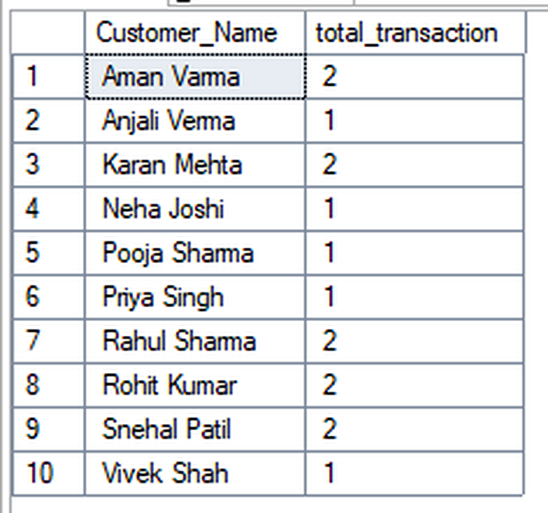
14. Number of Transactions per Customer
SQL ANALYSIS
Query + execution result • sequence from the submitted screenshots
SQL QUERY
What the query does
Counts transaction rows for each customer after joining the related tables.
EXECUTION OUTPUT
Why it matters
Measures customer activity level.
SQL technique
COUNT + GROUP BY

Slide 16
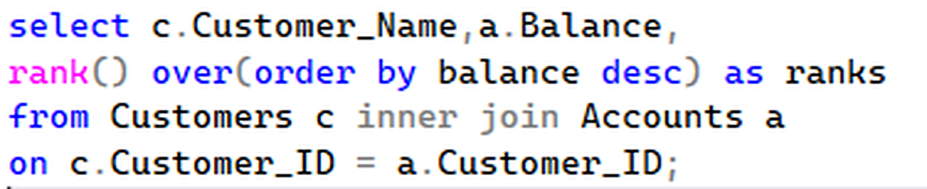
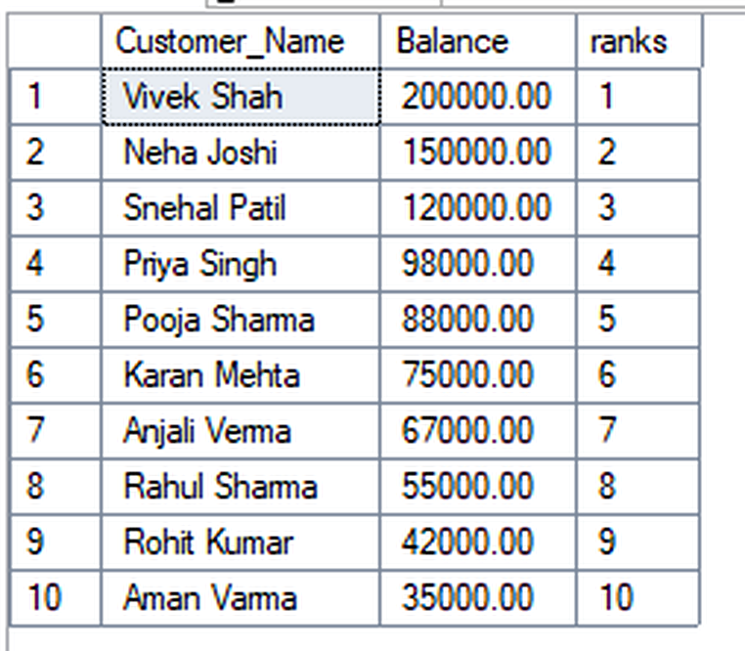
15. RANK() — Customers by Balance
SQL ANALYSIS
Query + execution result • sequence from the submitted screenshots
SQL QUERY
What the query does
Assigns balance positions using RANK() OVER(ORDER BY Balance DESC).
EXECUTION OUTPUT
Why it matters
RANK() leaves gaps when two rows share the same rank.
SQL technique
WINDOW FUNCTION

Slide 17
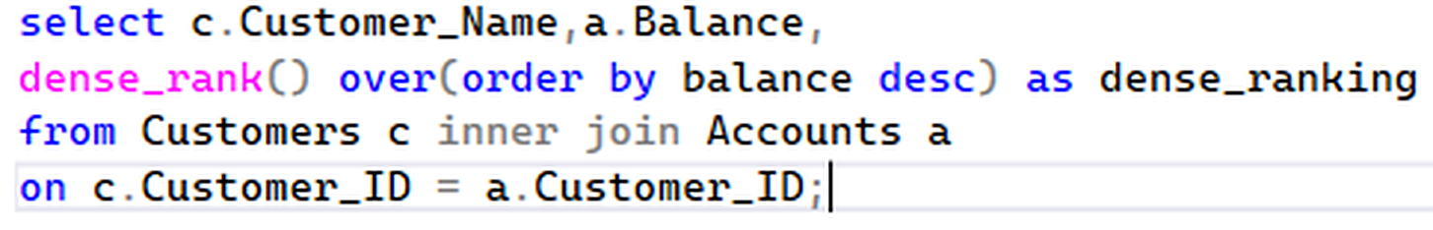
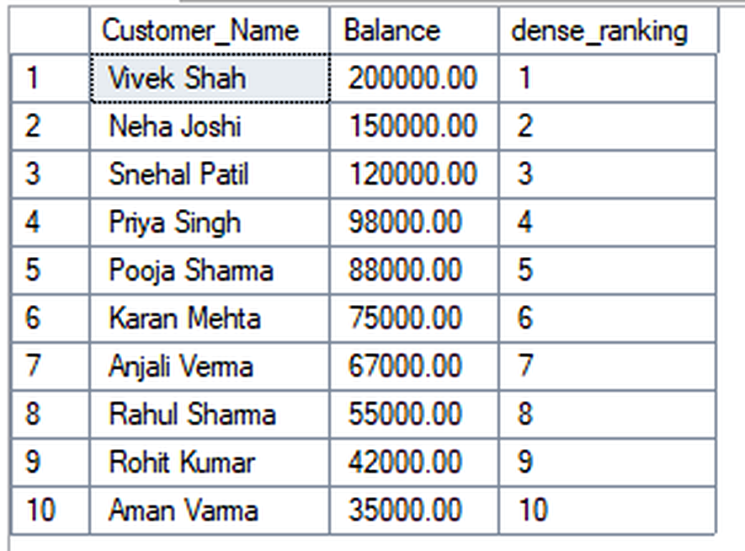
16. DENSE_RANK() — Customers by Balance
SQL ANALYSIS
Query + execution result • sequence from the submitted screenshots
SQL QUERY
What the query does
Assigns balance positions using DENSE_RANK() OVER(ORDER BY Balance DESC).
EXECUTION OUTPUT
Why it matters
DENSE_RANK() does not leave gaps after ties.
SQL technique
WINDOW FUNCTION

Slide 18
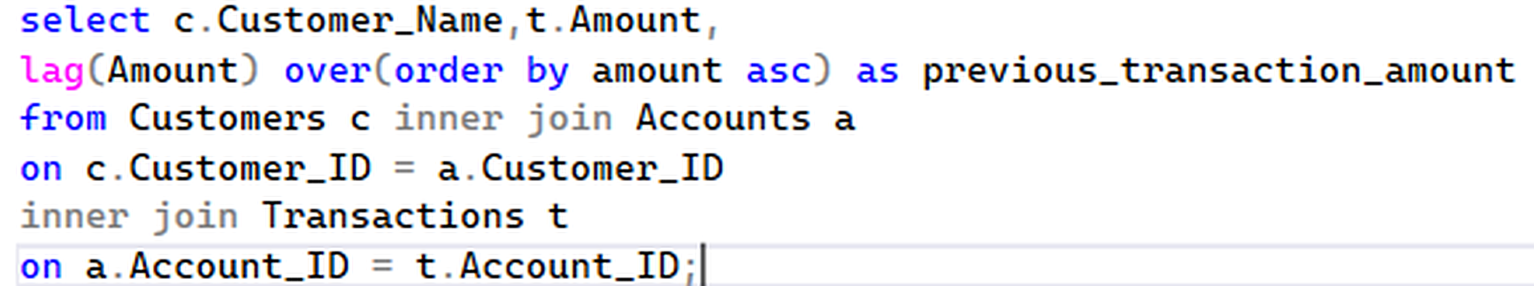
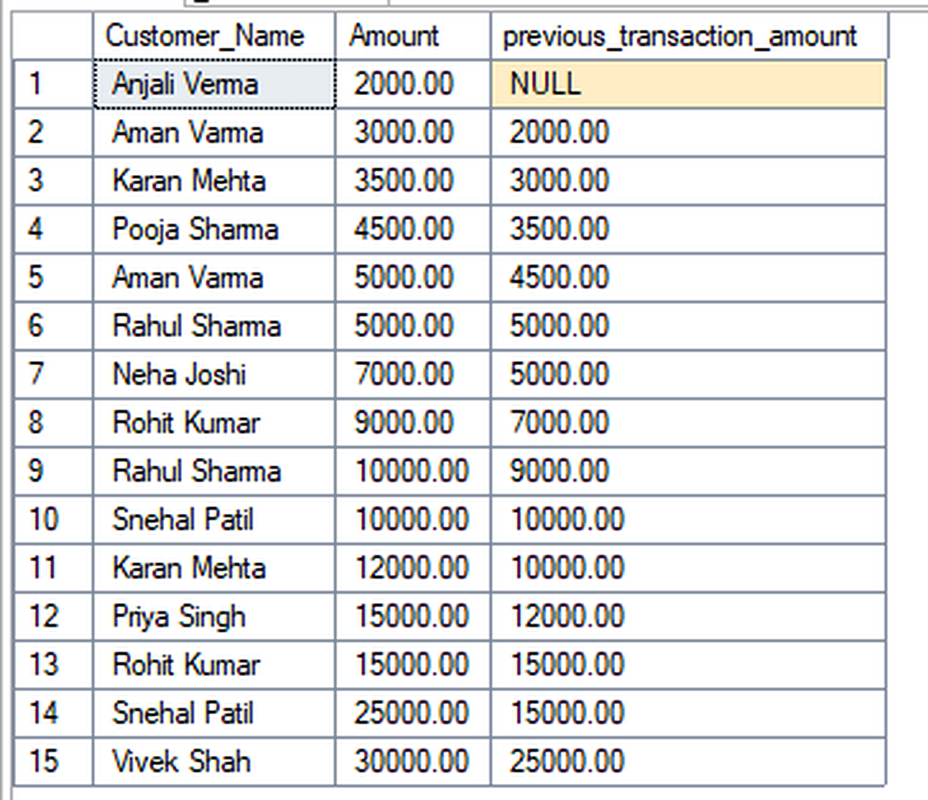
17. LAG() — Previous Transaction Amount
SQL ANALYSIS
Query + execution result • sequence from the submitted screenshots
SQL QUERY
What the query does
Uses LAG() to access the previous transaction amount in the chosen order.
EXECUTION OUTPUT
Why it matters
Enables row-to-row comparisons and trend analysis.
SQL technique
WINDOW FUNCTION

Slide 19
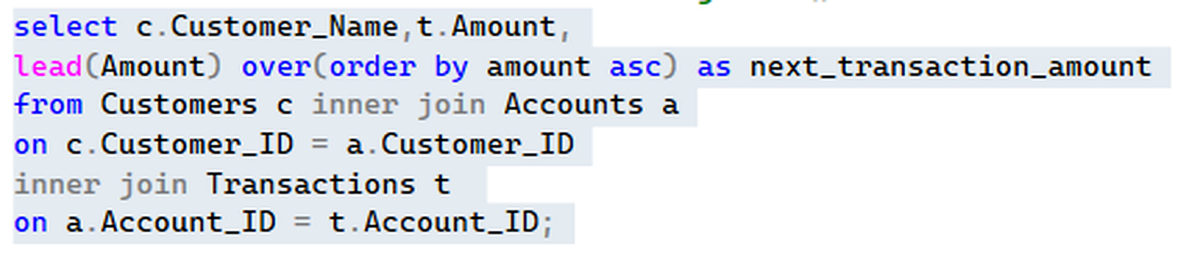
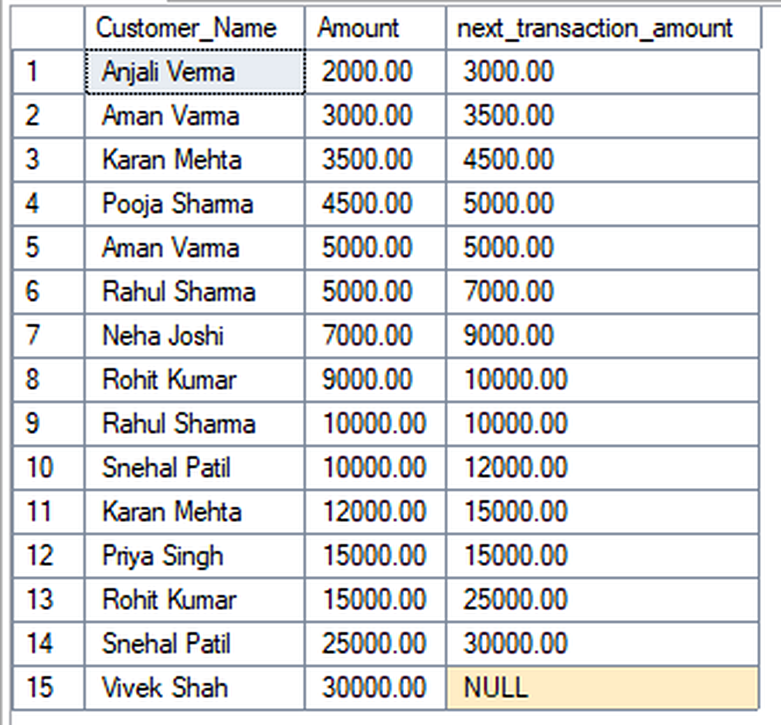
18. LEAD() — Next Transaction Amount
SQL ANALYSIS
Query + execution result • sequence from the submitted screenshots
SQL QUERY
What the query does
Uses LEAD() to access the next transaction amount.
EXECUTION OUTPUT
Why it matters
Useful for forward-looking comparisons.
SQL technique
WINDOW FUNCTION

Slide 20
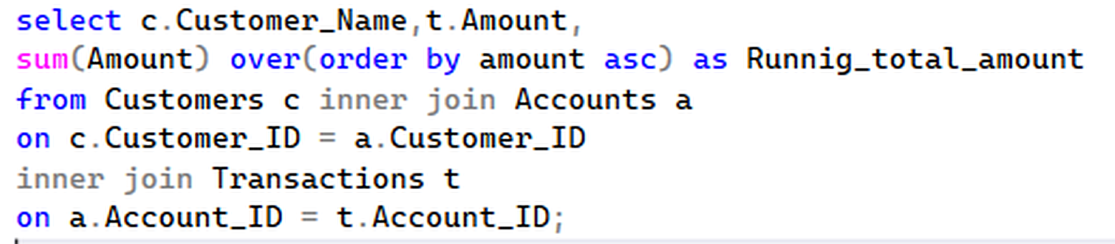
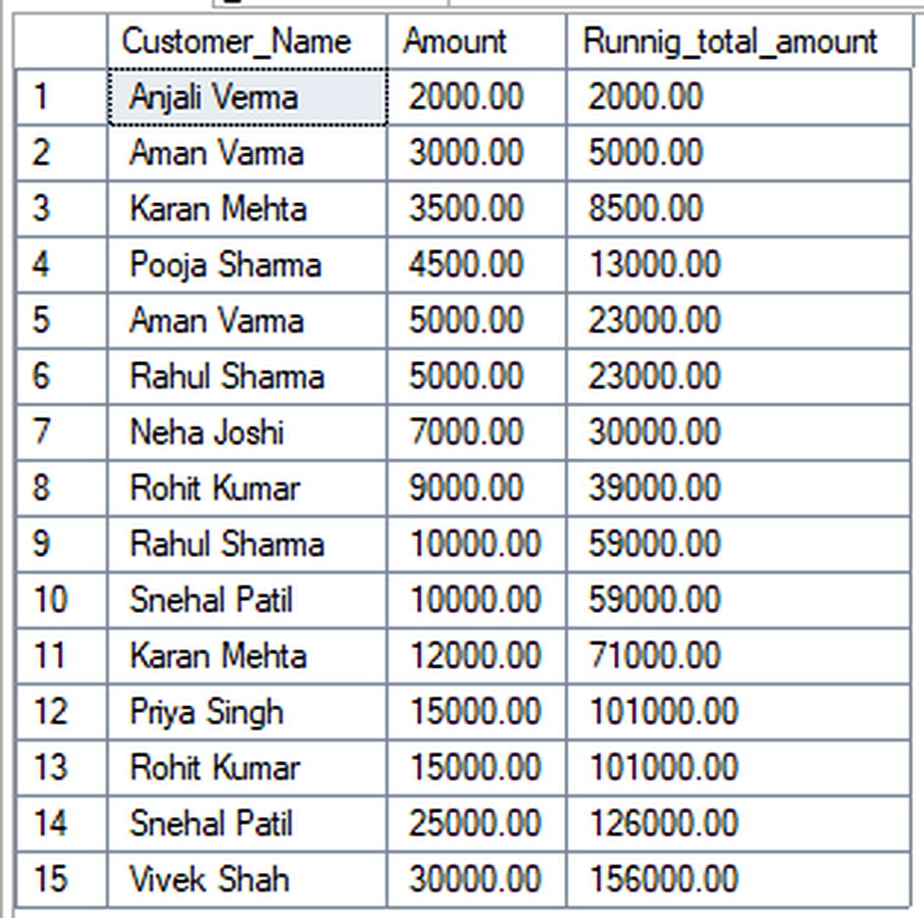
19. Running Total with SUM() OVER()
SQL ANALYSIS
Query + execution result • sequence from the submitted screenshots
SQL QUERY
What the query does
Creates a cumulative transaction total while keeping each row visible.
EXECUTION OUTPUT
Why it matters
Demonstrates windowed aggregation.
SQL technique
WINDOW FUNCTION

Slide 21
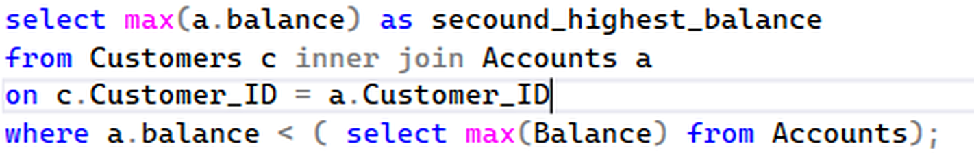
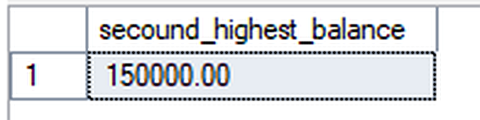
20A. Second Highest Balance — Subquery
SQL ANALYSIS
Query + execution result • sequence from the submitted screenshots
SQL QUERY
What the query does
Finds the highest balance below the overall maximum balance.
EXECUTION OUTPUT
Why it matters
A classic subquery approach for second-highest-value problems.
SQL technique
SUBQUERY

Slide 22
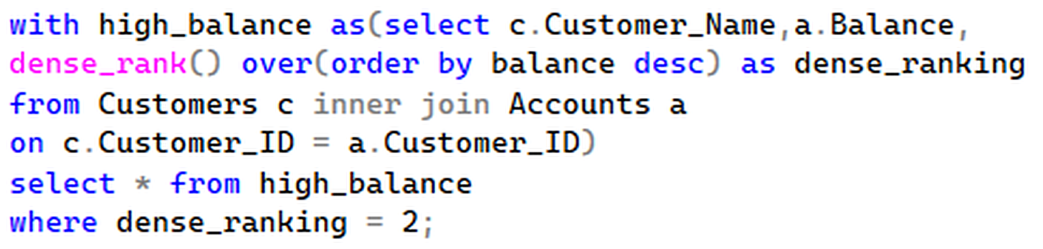
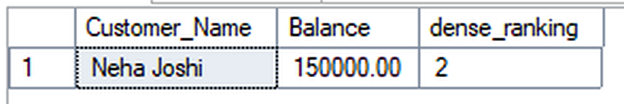
20B. Second Highest Balance — DENSE_RANK
SQL ANALYSIS
Query + execution result • sequence from the submitted screenshots
SQL QUERY
What the query does
Ranks balances and selects the row with DENSE_RANK() = 2.
EXECUTION OUTPUT
Why it matters
Provides an analytical alternative to the subquery solution.
SQL technique
DENSE_RANK

Slide 23
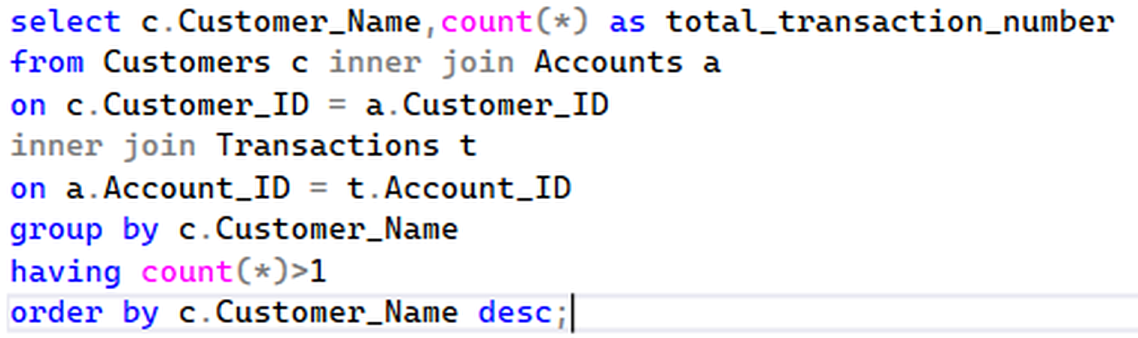
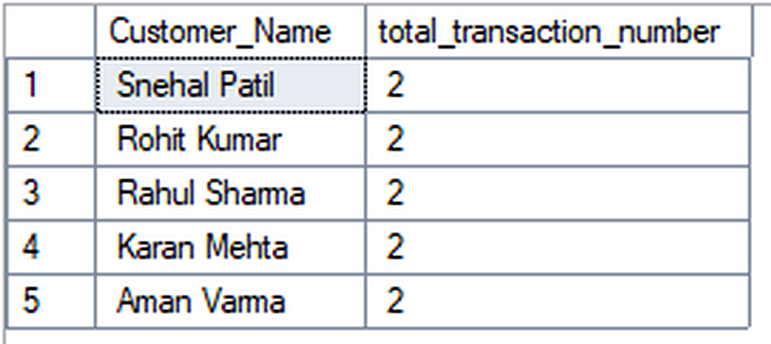
21. Customers with More Than One Transaction
SQL ANALYSIS
Query + execution result • sequence from the submitted screenshots
SQL QUERY
What the query does
Groups customers and keeps only those with COUNT(*) greater than one.
EXECUTION OUTPUT
Why it matters
HAVING filters groups after aggregation.
SQL technique
GROUP BY + HAVING

Slide 24
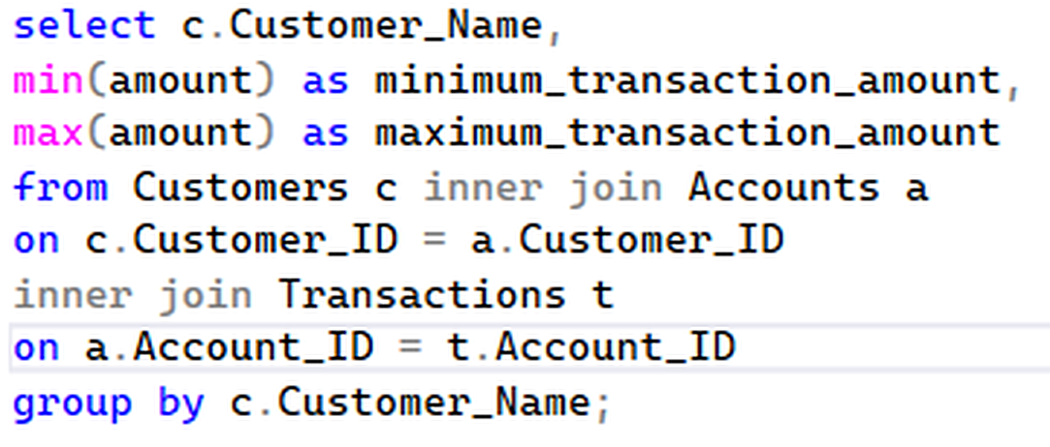
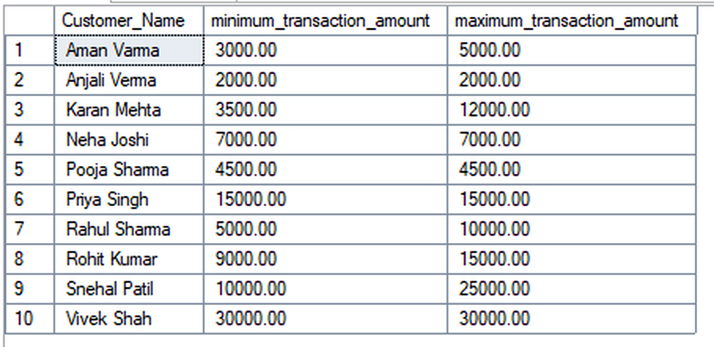
22. Minimum & Maximum Transaction Amount
SQL ANALYSIS
Query + execution result • sequence from the submitted screenshots
SQL QUERY
What the query does
Finds each customer's minimum and maximum transaction amount.
EXECUTION OUTPUT
Why it matters
Shows the transaction-size range for each customer.
SQL technique
MIN + MAX

Slide 25
23. Key Findings from the Dataset
RESULTS
Important values visible in the executed results
Highest balance
Second-highest balance
Average balance
Vivek Shah — ₹2,00,000
Neha Joshi — ₹1,50,000
₹93,000
Deposits
Withdrawals
Net transaction value
₹1,21,000
₹35,000
₹86,000
• Customers with multiple transactions are identified using GROUP BY + HAVING.
• Customers without loans are found using LEFT JOIN + IS NULL.
• RANK and DENSE_RANK demonstrate two different ranking behaviors.
• LAG and LEAD enable row-to-row comparisons; SUM OVER creates a running total.

Slide 26
24. SQL Concepts Demonstrated
LEARNING
Main database and analytical skills represented in the project
Primary & Foreign Keys
INNER / LEFT JOIN
GROUP BY / HAVING
Maintain unique records and relationships.
Combine related data and identify missing matches.
Aggregate data and filter grouped results.
Subqueries
Window Functions
Aggregate Functions
Use calculated intermediate results in filters.
RANK, DENSE_RANK, LAG, LEAD and SUM OVER.
SUM, COUNT, AVG, MIN and MAX.

Slide 27
25. Conclusion
CONCLUSION
End-to-end SQL banking analysis
• The project builds a relational structure around customers, accounts, transactions and loans.
• The query sequence moves from basic retrieval and joins to aggregation, subqueries and window functions.
• The screenshots provide direct evidence of query execution and results.
• The same techniques can be extended to banking dashboards, customer segmentation, transaction monitoring and loan analysis.
Core takeaway
SQL converts linked banking records into useful business information.
Production improvements
Indexes, views, stored procedures, constraints and transaction handling.
Thank you
Questions & Discussion

