Slide 1




Employee Database Operations
A structured database workbook illustrating table instantiation, updates, queries,
and key performance metric operations.
Presented by Sunita palkar
Guided by Mangesh Sir
Project Info: Implemented a secure backend DDL structure mapping employee demographics and metrics. This presentation details hands-on solutions addressing core execution scenarios sourced from "SQL simple problem solving.docx", demonstrating clean relational integrity and optimization techniques.

Slide 2

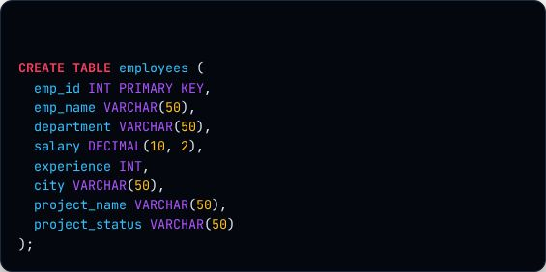


Creating the Employees Table
Primary Key Protection
The emp_id column ensures entity integrity, guaranteeing that every employee record has a unique identifier.
Decimal For Salary
We use DECIMAL(10,2) to maintain absolute precision for payroll details, supporting up to 8 digits before and 2 digits after the decimal point.
Variable-Length Fields
Using VARCHAR(50) dynamically optimizes data storage for text inputs like departments, projects, and names.

Slide 3
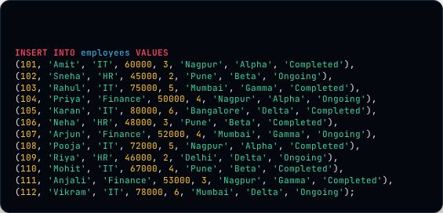

Populating the Database Table
A Diverse Dataset Seeding
We insert 12 records comprising a wide variety of salaries, geographic locations, and functional departments (IT, HR, Finance).
DML Values Matching
The insert parameters perfectly map to the predefined table schema order, aligning with data types without breaking schema integrity constraints.

Slide 4


Initial State of Employees Table
emp_id | emp_name | department | salary | experience | city | project_name | project_status
101 | Amit | IT | 60000.00 | 3 | Nagpur | Alpha | Completed
102 | Sneha | HR | 45000.00 | 2 | Pune | Beta | Ongoing
103 | Rahul | IT | 75000.00 | 5 | Mumbai | Gamma | Completed
104 | Priya | Finance | 50000.00 | 4 | Nagpur | Alpha | Ongoing
105 | Karan | IT | 80000.00 | 6 | Bangalore | Delta | Completed
106 | Neha | HR | 48000.00 | 3 | Pune | Beta | Completed
107 | Arjun | Finance | 52000.00 | 4 | Mumbai | Gamma | Ongoing
108 | Pooja | IT | 72000.00 | 5 | Nagpur | Alpha | Completed
109 | Riya | HR | 46000.00 | 2 | Delhi | Delta | Ongoing
110 | Mohit | IT | 67000.00 | 4 | Pune | Beta | Completed
111 | Anjali | Finance | 53000.00 | 3 | Nagpur | Gamma | Completed
112 | Vikram | IT | 78000.00 | 6 | Mumbai | Delta | Ongoing

Slide 5




Amit's Salary Update Analysis
DML Operation Impact
Executing an UPDATE statement filters row records utilizing the conditional WHERE clause before modifying values. Here, only "Amit" is affected.
emp_name
salary
Amit
70000.00

Slide 6

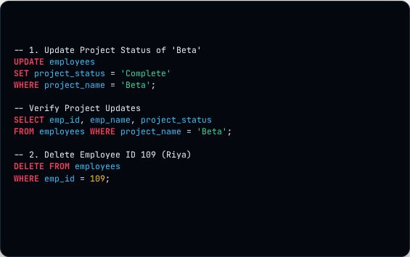




Status Update & Row Deletion
Batch Update Status (Beta)
emp_id | emp_name | project | status
102 | Sneha | Beta | Complete
106 | Neha | Beta | Complete
110 | Mohit | Beta | Complete
Row Deletion Check (ID 109)
emp_id | emp_name | status
109 | Riya | Deleted Record

Slide 7





Filtering High Earners & Nagpur Staff
id | name | salary | city
103 | Rahul | 75000.00 | Mumbai
105 | Karan | 80000.00 | Bangalore
108 | Pooja | 72000.00 | Nagpur
112 | Vikram | 78000.00 | Mumbai
id | name | city | salary
101 | Amit | Nagpur | 70000.00
104 | Priya | Nagpur | 50000.00
108 | Pooja | Nagpur | 72000.00
111 | Anjali | Nagpur | 53000.00

Slide 8





Department Analytics & Counts
department | depertmen_count
Finance | 3
HR | 2
IT | 6
442,000.0
TOTAL I₀T PAYROLL

Slide 9




Averages and Top Salaries
city | Average_salary
Bangalore | 80000.000000
Mumbai | 68333.333333
Nagpur | 61250.000000
Pune | 53333.333333
id | name | dept | salary
105 | Karan | IT | 80000.00
112 | Vikram | IT | 78000.00
103 | Rahul | IT | 75000.00

Slide 10




Completed Projects & HR Filters
id | name | exp | status
103 | Rahul | 5 | Completed
105 | Karan | 6 | Completed
108 | Pooja | 5 | Completed
id | name | dept | salary
101 | Amit | IT | 70000.00
103 | Rahul | IT | 75000.00
104 | Priya | Finance | 50000.00
105 | Karan | IT | 80000.00
107 | Arjun | Finance | 52000.00
108 | Pooja | IT | 72000.00
110 | Mohit | IT | 67000.00
111 | Anjali | Finance | 53000.00
112 | Vikram | IT | 78000.00

Slide 11
Database Lab Summary
Throughout this execution workflow, we successfully configured the Schema DDL, loaded seed records, managed transactional updates (DML), deleted records correctly with reference constraints, and resolved complex analytical filtering and aggregate statistics.
Prepared by Sunita palkar | Guided by Mangesh Sir | Task Complete

