Slide 1

Note: The data and information in this document is reflective of a hypothetical situation and client. This document is to be used for KPMG Virtual Internship purposes only.
Sprocket Central Pty Ltd
Data analytics approach
[Division Name] - [Engagement Manager], [Senior Consultant], [Junior Consultant]

Slide 2
Note: The data and information in this document is reflective of a hypothetical situation and client. This document is to be used for KPMG Virtual Internship purposes only.
Agenda
Introduction
Data Exploration
Model Development
Interpretation

Slide 3
Note: The data and information in this document is reflective of a hypothetical situation and client. This document is to be used for KPMG Virtual Internship purposes only.
Introduction
Customers Data Analysis
Age Distributions
Number of bike purchases in 3 years / percentages purchases
Job industry category
Wealth segments
Number of cars own on each states

Slide 4
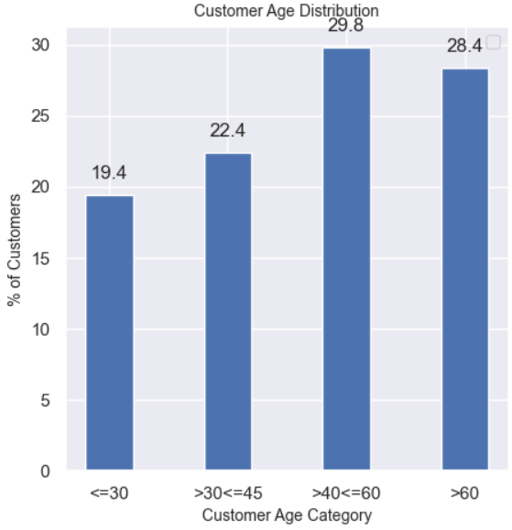
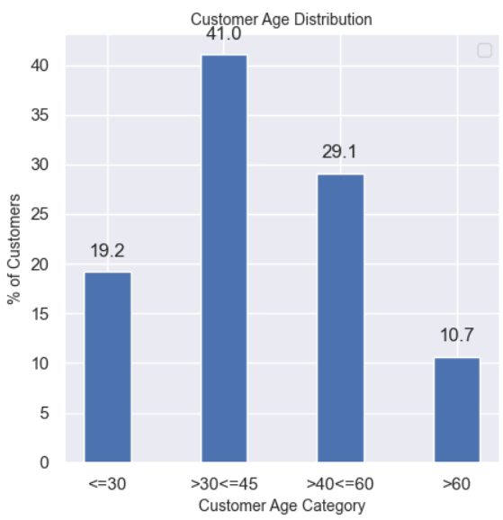
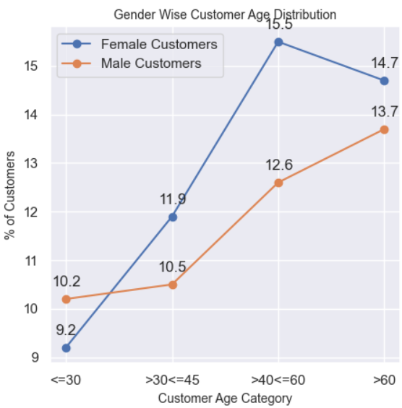
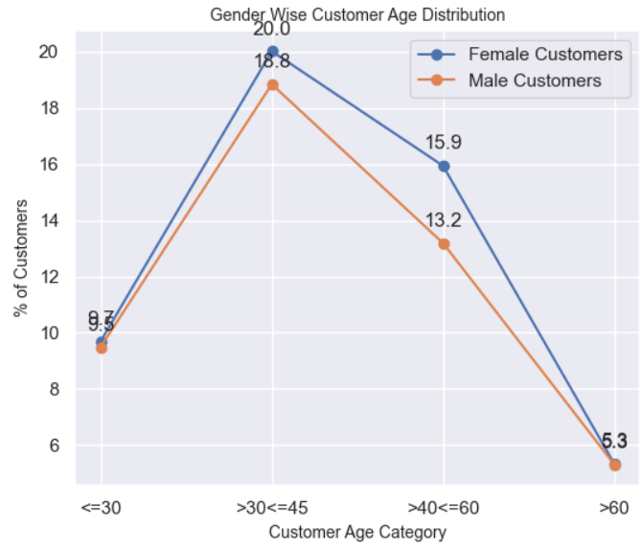
Note: The data and information in this document is reflective of a hypothetical situation and client. This document is to be used for KPMG Virtual Internship purposes only.
Data Exploration – Customer Age Distribution
New Customers
Existing Customer
Customers under the age of 30 and between age 40 to 60 are equally same for New and Old Customers
Number of customers above the age of 60 are higher in New Customers than Old Customers
The customers between the age 30 to 45 are higher in Old Customers than New Customers
It is clearly seen that the customers in Female category are more interested in purchasing bikes.

Slide 5
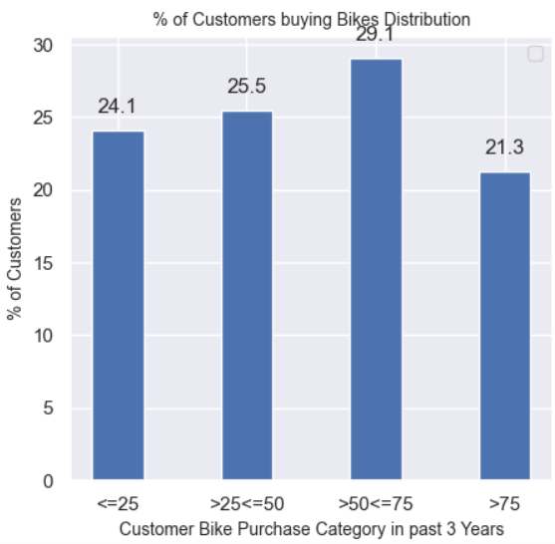
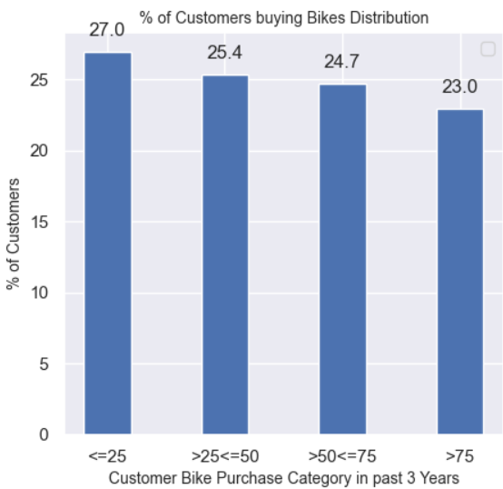
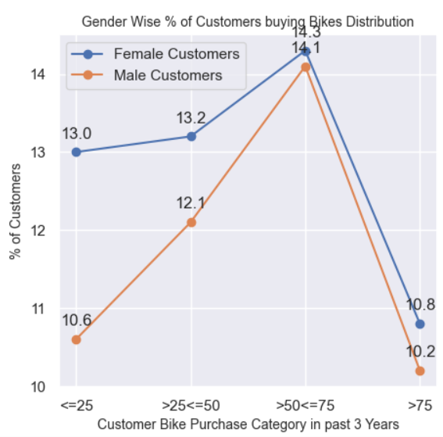
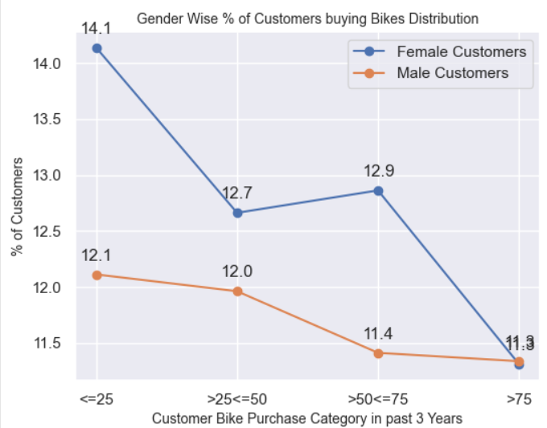
Note: The data and information in this document is reflective of a hypothetical situation and client. This document is to be used for KPMG Virtual Internship purposes only.
Model Development - Bike purchases last 3 years
New Customers
Existing Customer
The count of customers who has purchased more than 50 and less than 75 bikes in last 3 years is higher in New Customers than Old Customers
The count of customers who has purchased less than 25 bikes in last 3 years is as higher in Old Customers than New Customers
It is clearly seen that the customers in Female category have purchased more bikes in past 3 years.

Slide 6
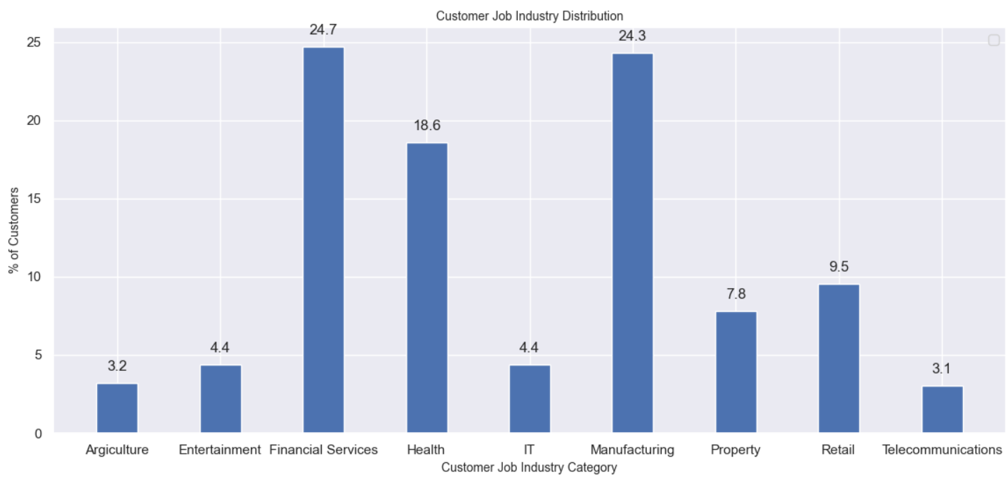
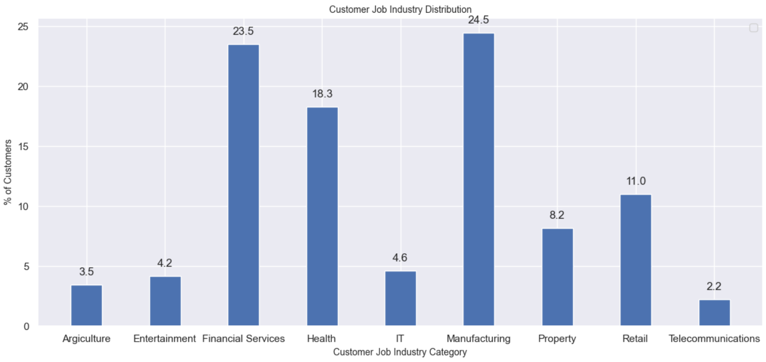
Note: The data and information in this document is reflective of a hypothetical situation and client. This document is to be used for KPMG Virtual Internship purposes only.
Interpretation - Job Industry Category
New Customers
Existing Customer
The Customer purchasing bikes in Finance, Health and Manufacturing industries are higher compared to other industries for both New and existing customers. Focus more on these industry customers.

Slide 7
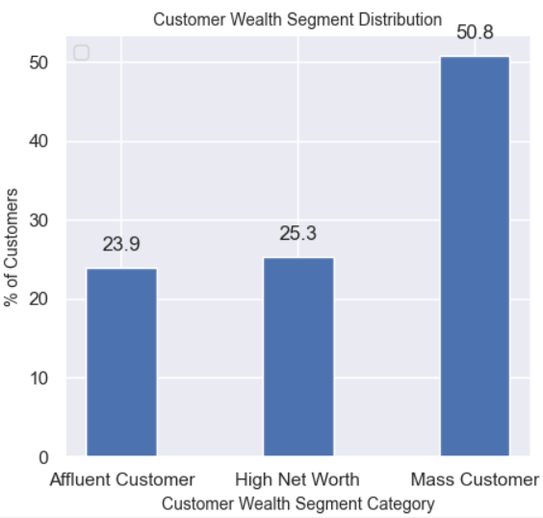
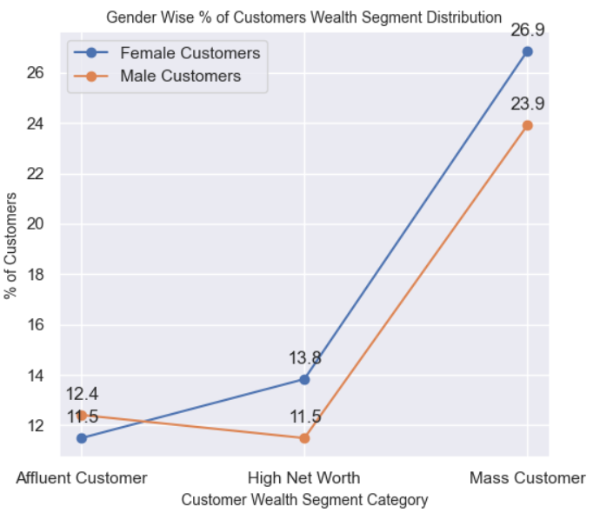
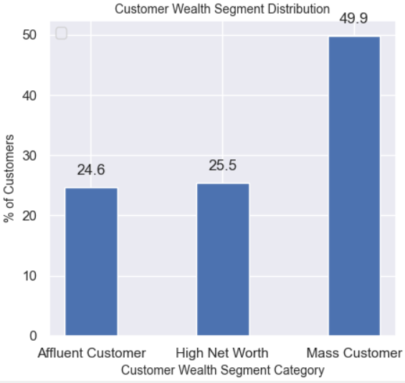
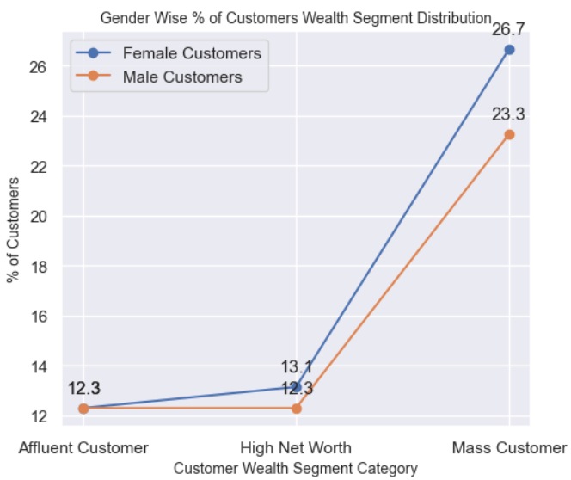
Note: The data and information in this document is reflective of a hypothetical situation and client. This document is to be used for KPMG Virtual Internship purposes only.
Interpretation – Wealth Segment
New Customers
Existing Customer
The Customer purchasing bikes in Mass wealth category are higher compared to other wealth segments for both New and existing customers. Focus more on these wealth segment customers.

Slide 8
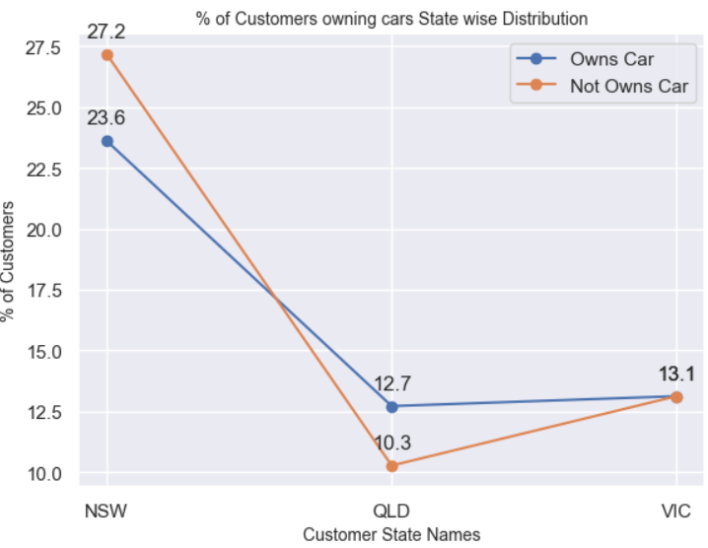
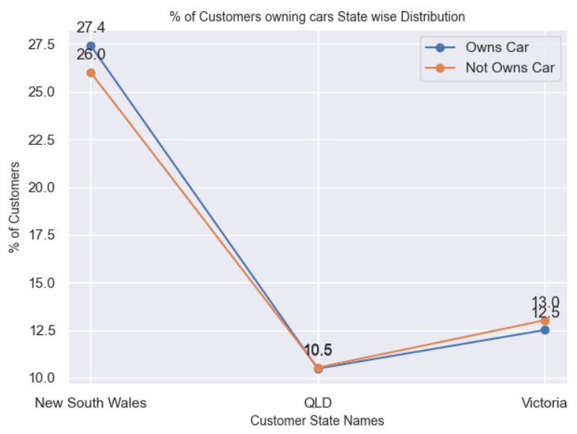
Note: The data and information in this document is reflective of a hypothetical situation and client. This document is to be used for KPMG Virtual Internship purposes only.
Interpretation – Car owned in each State
New Customers
Existing Customer
The Customers purchasing bikes in New South Wales state owns higher number of cars compared to other states. Focus more on this state of customers.

Slide 9
Note: The data and information in this document is reflective of a hypothetical situation and client. This document is to be used for KPMG Virtual Internship purposes only.
Appendix

Slide 10
Note: The data and information in this document is reflective of a hypothetical situation and client. This document is to be used for KPMG Virtual Internship purposes only.
Appendix
All supporting items in that attachment.

