Slide 1
FIRST PROJECT {Smart Contact Manager}
We have create one project smart contact manager using spring , spring boot and frontend Html,CSS and Bootstrap.
We developed a curd project in that we have functionality to create a new employ, to update existing employ, to get existing employ and to delete employ
In this application we have used MySql as database,

Slide 2
From Spring side, we have used Controller, Service, Repository and Bean class
We have put all the database related configuration in application.properties file.
Challenges I faced in this project –
1 - Mapping the request and response with JSP and HTML
2 – Making connection with database

Slide 3
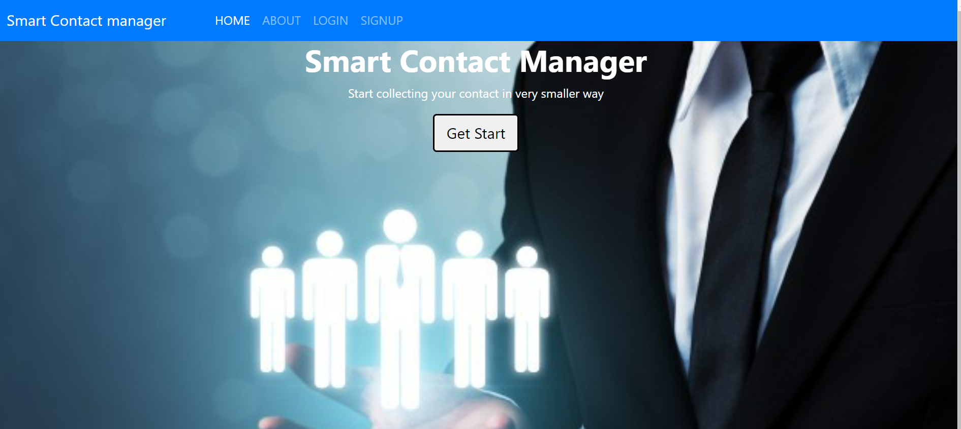

Slide 4
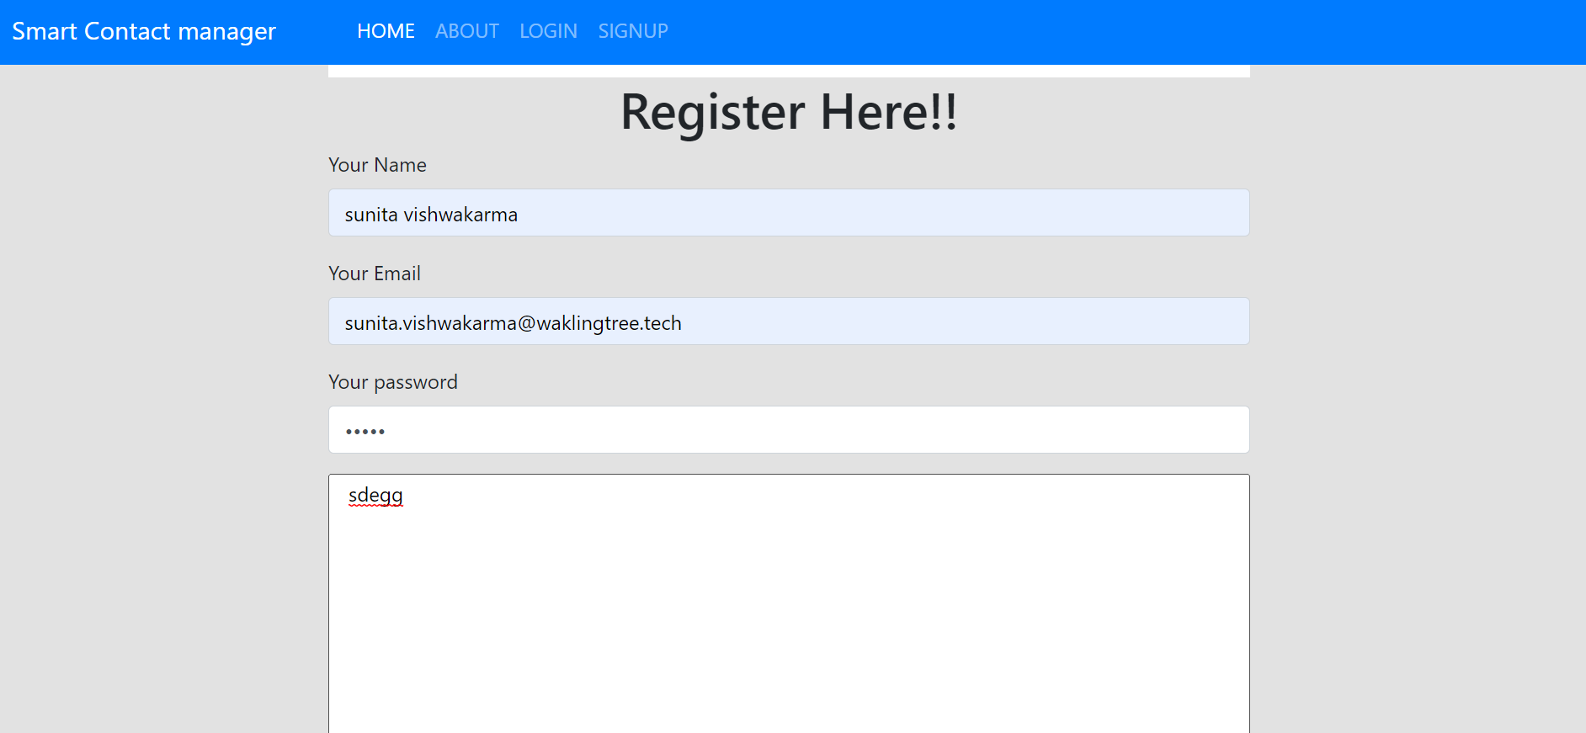
In this project user can register itself and he can save his contact detailed he can add any contact number that user want .

Slide 5
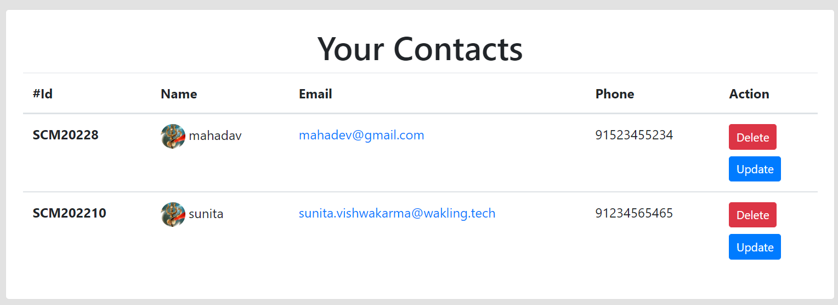
From backend we have used JPA and spring boot, we have used JPA existing function like getAll(), getByID(), delete(), deleteById(), and update();

Slide 6
Learnt below things in six months.
In Core java
1 - Oop concept
2 - Basic of Collection
3 – Multithreading
4 - Exception handling
In Spring –
1 – Spring Core
2 – Spring MVC
3 – Spring Boot
Micro service
Support we need
We need some support in Spring, Micro service and Spring Boot area

Slide 7
Thank You

