Slide 1

BPM Solution

Slide 2

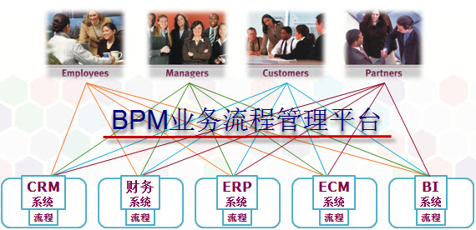
Business Process Management(BPM)
Business process management (BPM) is a holistic management approach focused on aligning all aspects of an organization with the wants and needs of clients. It promotes business effectiveness and efficiency while striving for innovation, flexibility, and integration with technology. BPM attempts to improve processes continuously. It can therefore be described as a "process optimization process." It is argued that BPM enables organizations to be more efficient, more effective and more capable of change than a functionally focused, traditional hierarchical management approach.

Slide 3
Business Process Management Platform
 | JBPM4 | JBPM5 | Activiti5
License | LGPL and the JBoss End User License Agreement (EULA) | Engine: ASL 2.0 Eclipse Disigner: EPL Modeller: MIT | ASL 2.0
Support PVM | Y | N | Y
Support BPMN | Y | Y | Y
Support Rule | Y | Y | Y
Rules storage | DB by Hibernate | Guvnor(Jackrabbit) | DB by MyBatis
REST API | Y | Y | Y
Modeler | Signavio | Oryx Designer | Signavio

Slide 4
Activiti
The Activiti Engine will have a clear focus on being light weight and easy to use for Java developers. In that respect, Activiti will continue on the successful path that we started at jBPM. The big difference between Activiti and jBPM will not be in the engine, but in the more sophisticated tools that we'll be able to build on top.
Why is the first version called 5.0?
That's to indicate that we're not building experimental stuff here. We continue to build on our experience that we gained developing the jBPM versions 1 to 4. We use that knowledge as a base line and work with the community to build the next generation BPM solution.

Slide 5
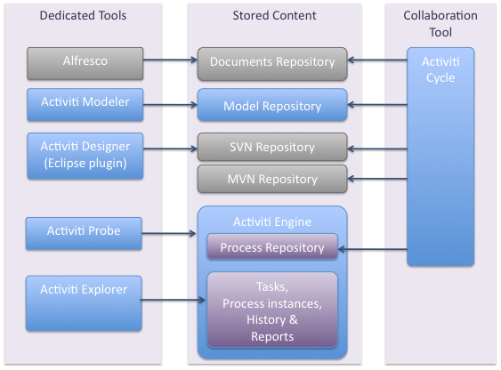
Components(blue components)

Slide 6
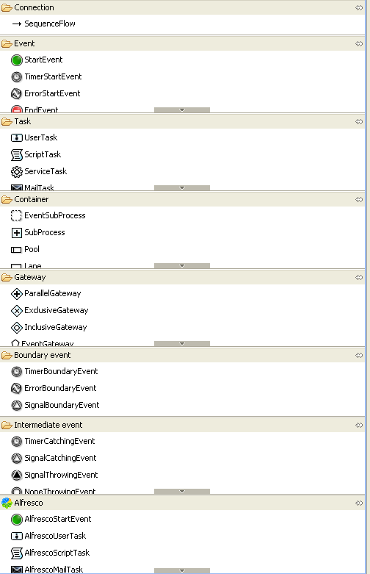
BPMN Elements

Slide 7
Case
Bus出现故障, 向BusMonitor系统发送Event消息.
系统接收到消息会先对事件进行记录.
然后向人工控制台发送消息, 并等待处理.
如果10分钟内没有人工台的处理响应, 自动处理流程将会被激发.
自动处理流程会根据event type来判断event level. 然后向管理者发送一份包含event信息的邮件.

Slide 8
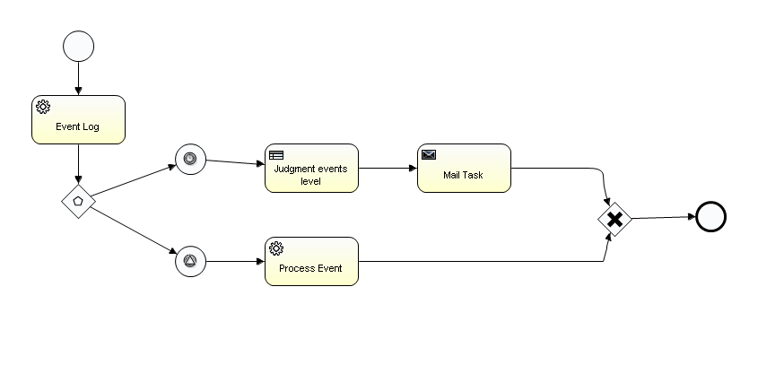
Bus Monitor Process Diagram

Slide 9
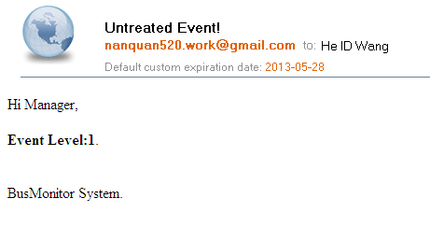

Slide 10
Codes
Configuration(activiti.cfg.xml)
Process Definition (BusMonitorProcess.bpmn20.xml)
Rules Definition(event_rules.drl)

Slide 11
Configuration(activiti.cfg.xml)
<beans xmlns="http://www.springframework.org/schema/beans"
xmlns:xsi="http://www.w3.org/2001/XMLSchema-instance"
xsi:schemaLocation="http://www.springframework.org/schema/beans http://www.springframework.org/schema/beans/spring-beans.xsd">
<bean id="processEngineConfiguration" class="org.activiti.engine.impl.cfg.StandaloneInMemProcessEngineConfiguration">
<property name="jdbcUrl" value="jdbc:h2:tcp://localhost/activiti" />
<property name="jdbcDriver" value="org.h2.Driver" />
<property name="jdbcUsername" value="sa" />
<property name="jdbcPassword" value="" />
<!-- Database configurations -->
<property name="databaseSchemaUpdate" value="true" />
<!-- job executor configurations -->
<property name="jobExecutorActivate" value="true" />
<!-- mail server configurations -->
<property name="mailServerHost" value="smtp.126.com" />
<property name="mailServerPort" value="25" />
<property name="mailServerUsername" value="nanquan520_tmp@126.com" />
<property name="mailServerPassword" value="passw0rd" />
<property name="history" value="full" />
<property name="customPostDeployers">
<list>
<bean class="org.activiti.engine.impl.rules.RulesDeployer" />
</list>
</property>
</bean>
</beans>

Slide 12
Process Definition
<process id="BusMonitorProcess" name="BusMonitorProcess">
<startEvent id="startevent1" name="Event Start"></startEvent>
<serviceTask id="servicetask1" name="Event Log" activiti:class="org.nanquan.activiti.examples.bus.EventLogService"></serviceTask>
<sequenceFlow id="flow1" name="" sourceRef="startevent1" targetRef="servicetask1"></sequenceFlow>
<eventBasedGateway id="eventgateway1" name="Event Gateway" />
<sequenceFlow id="flow2" name="" sourceRef="servicetask1" targetRef="eventgateway1"></sequenceFlow>
<intermediateCatchEvent id="timerintermediatecatchevent1" name="TimerCatchEvent">
<timerEventDefinition>
<timeDuration>${autoDueTime}</timeDuration>
</timerEventDefinition>
</intermediateCatchEvent>
<sequenceFlow id="flow4" name="" sourceRef="eventgateway1" targetRef="timerintermediatecatchevent1"></sequenceFlow>
<intermediateCatchEvent id="signalintermediatecatchevent1" name="SignalCatchEvent">
<signalEventDefinition signalRef="alertSignal" activiti:async="false"/>
</intermediateCatchEvent>
<sequenceFlow id="flow5" name="" sourceRef="eventgateway1" targetRef="signalintermediatecatchevent1"></sequenceFlow>
<serviceTask id="servicetask2" name="Process Event" activiti:class="org.nanquan.activiti.examples.bus.HandleManualBackObjectDelegate"></serviceTask>
<businessRuleTask id="businessruletask1" name="Judgment events level" activiti:ruleVariablesInput="${busEvent}"
activiti:resultVariable="rulesOutput"></businessRuleTask>
<serviceTask id="mailtask1" name="Mail Task" activiti:type="mail">
<extensionElements>
<activiti:field name="from" expression="${sender}" />
<activiti:field name="to" expression="${recipient}" />
<activiti:field name="subject" expression="Untreated Event!" />
<activiti:field name="html">
<activiti:expression>
<![CDATA[
<html>
<body>
Hi Manager,<br/><br/>
<b>Event Level:${busEvent.level}</b>.<br/><br/>
<br/>
BusMonitor System.
</body>
</html>
]]>
</activiti:expression>
</activiti:field>
</extensionElements>
</serviceTask>
<sequenceFlow id="flow6" name="" sourceRef="timerintermediatecatchevent1" targetRef="businessruletask1"></sequenceFlow>
<sequenceFlow id="flow7" name="" sourceRef="signalintermediatecatchevent1" targetRef="servicetask2"></sequenceFlow>
<sequenceFlow id="flow8" name="" sourceRef="businessruletask1" targetRef="mailtask1"></sequenceFlow>
<endEvent id="endevent1" name="End Process"></endEvent>
<sequenceFlow id="flow9" name="" sourceRef="mailtask1" targetRef="exclusivegateway1"></sequenceFlow>
<sequenceFlow id="flow10" name="" sourceRef="servicetask2" targetRef="exclusivegateway1"></sequenceFlow>
<exclusiveGateway id="exclusivegateway1" name="Exclusive Gateway"></exclusiveGateway>
<sequenceFlow id="flow11" name="" sourceRef="exclusivegateway1" targetRef="endevent1"></sequenceFlow>
</process>

Slide 13
Rules Definition
import org.nanquan.activiti.examples.bus.BusEvent;
rule "rule1"
salience 100
when
busEvent : BusEvent( type == "Type1" )
then
busEvent.setLevel(1);
System.out.println("Setting level in rule " + busEvent);
insert( busEvent );
end
rule "rule2"
salience 101
when
busEvent : BusEvent( type == "Type2" )
then
busEvent.setLevel(2);
System.out.println("Setting level in rule " + busEvent);
insert( busEvent );
end

Slide 14
Java Codes
Load Process Definition
public void loadProcess(String deployFile, String deploymentName) {
if (deployFile != null && deployFile != "") {
// Get Activiti services
RepositoryService repositoryService = processEngine
.getRepositoryService();
RuntimeService runtimeService = processEngine.getRuntimeService();
TaskService taskService = processEngine.getTaskService();
// Deploy the process definition
Deployment deployment = repositoryService.createDeployment()
.name(deploymentName).addClasspathResource(deployFile)
.deploy();
deploymentId = deployment.getId();
// repositoryService.activateProcessDefinitionByKey("financialReport");
}
}

Slide 15
public void loadProcessByString(String deploymentName, Map<String, String> resources) {
if (resources != null && resources.size() > 0) {
// Get Activiti services
RepositoryService repositoryService = processEngine
.getRepositoryService();
RuntimeService runtimeService = processEngine.getRuntimeService();
TaskService taskService = processEngine.getTaskService();
DeploymentBuilder deploymentBuilder = repositoryService
.createDeployment().name(deploymentName);
for (Map.Entry<String, String> entry : resources.entrySet()) {
String resourceName = entry.getKey(), text = entry.getValue();
deploymentBuilder.addString(resourceName, text);
}
Deployment deployment = deploymentBuilder.deploy();
deploymentId = deployment.getId();
}
}

Slide 16
startEvent
public void startEvent() {
Map map = new HashMap();
map.put("autoDueTime", autoDueTime);
BusEvent busEvent = new BusEvent();
String type = RandomUtils.nextBoolean() ? "Type1" : "Type2";
busEvent.setType(type);
map.put("busEvent", busEvent);
map.put("sender", from);
map.put("recipient", recipient);
// Start process instance
ProcessInstance pi = runtimeService
.startProcessInstanceByKey(key, map );
processInstanceId = pi.getProcessInstanceId();
executionId = pi.getId();
}

Slide 17
startEvent
public void startEvent() {
Map map = new HashMap();
map.put("autoDueTime", autoDueTime);
BusEvent busEvent = new BusEvent();
String type = RandomUtils.nextBoolean() ? "Type1" : "Type2";
busEvent.setType(type);
map.put("busEvent", busEvent);
map.put("sender", from);
map.put("recipient", recipient);
// Start process instance
ProcessInstance pi = runtimeService
.startProcessInstanceByKey(key, map );
processInstanceId = pi.getProcessInstanceId();
executionId = pi.getId();
}

Slide 18
signalEvent
public void signalEvent(){
runtimeService.signalEventReceived(signal);
}

Slide 19
main function
public static void main(String[] args) {
BusMonitorTest test = new BusMonitorTest();
String deployFile = "archive/BusMonitorProcess.zip";
String deploymentName = "BusMonitorProcessDeployment";
test.loadProcessByZip(deployFile, deploymentName);
// test.loadProcess("org/nanquan/activiti/examples/bus/BusMonitorProcess.bpmn20.xml", deploymentName);
try {
test.startEvent();
test.signalEvent();
} catch (Exception e) {
e.printStackTrace();
}
test.unloadProcess();
}

Slide 20
Integrate LDAP
<bean id="processEngineConfiguration" class="org.activiti.engine.impl.cfg.StandaloneInMemProcessEngineConfiguration">
<property name="databaseSchemaUpdate" value="true" />
<property name="customSessionFactories">
<list>
<bean class="org.bpmnwithactiviti.chapter10.ldap.LDAPUserManagerFactory">
<constructor-arg ref="ldapConnectionParams" />
</bean>
<bean class="org.bpmnwithactiviti.chapter10.ldap.LDAPGroupManagerFactory">
<constructor-arg ref="ldapConnectionParams" />
</bean>
</list>
</property>
</bean>
<bean id="ldapConnectionParams" class="org.bpmnwithactiviti.chapter10.ldap.LDAPConnectionParams">
<property name="ldapServer" value="localhost" />
<property name="ldapPort" value="10389" />
<property name="ldapUser" value="uid=admin,ou=system" />
<property name="ldapPassword" value="secret" />
</bean>

Slide 21
public class LDAPUserManager extends UserManager {
private static final String USER_GROUP = "dc=users,DC=ITS";
private LDAPConnectionParams connectionParams;
public LDAPUserManager(LDAPConnectionParams params) {
this.connectionParams = params;
}
..........
@Override
public Boolean checkPassword(String userId, String password) {
boolean credentialsValid = false;
LdapNetworkConnection connection = new LdapNetworkConnection(
connectionParams.getLdapServer(),
connectionParams.getLdapPort());
try {
BindRequestImpl bindRequest = new BindRequestImpl();
Dn dn = new Dn("uid=" + userId + ","
+ USER_GROUP);
bindRequest.setDn(dn );
bindRequest.setCredentials(password);
BindResponse response = connection.bind(bindRequest);
if (response.getLdapResult().getResultCode() == ResultCodeEnum.SUCCESS) {
credentialsValid = true;
}
} catch (Exception e) {
e.printStackTrace();
throw new ActivitiException("LDAP connection bind failure", e);
}
LDAPConnectionUtil.closeConnection(connection);
return credentialsValid;
}

Slide 22
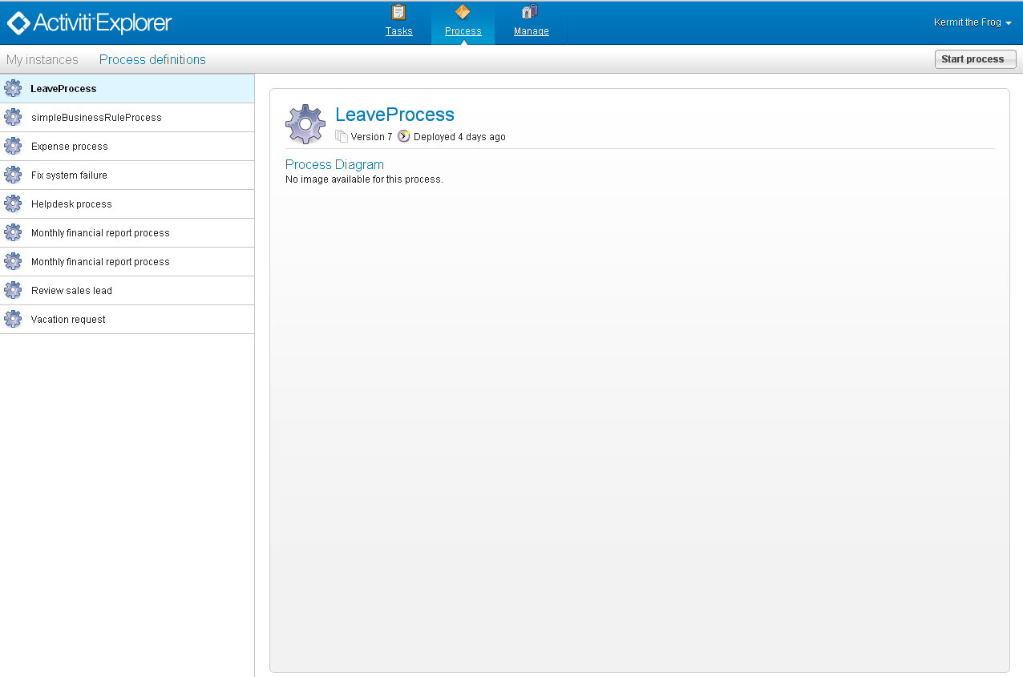
Activiti Explorer

