Slide 1

Presentation Title
Company name
My name
My position, contact information
or project description

Slide 2

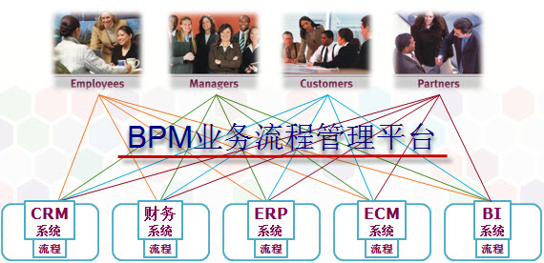
Business Process Management(BPM)
Business process management (BPM) is a holistic management approach focused on aligning all aspects of an organization with the wants and needs of clients. It promotes business effectiveness and efficiency while striving for innovation, flexibility, and integration with technology. BPM attempts to improve processes continuously. It can therefore be described as a "process optimization process." It is argued that BPM enables organizations to be more efficient, more effective and more capable of change than a functionally focused, traditional hierarchical management approach.

Slide 3
Business Process Management Platform
 | JBPM4 | JBPM5 | Activiti5
License | LGPL and the JBoss End User License Agreement (EULA) | Engine: ASL 2.0 Eclipse Disigner: EPL Modeller: MIT | ASL 2.0
Support PVM | Y | N | Y
Support BPMN | Y | Y | Y

Slide 4
Activiti
Why is the first version called 5.0?
That's to indicate that we're not building experimental stuff here. We continue to build on our experience that we gained developing the jBPM versions 1 to 4. We use that knowledge as a base line and work with the community to build the next generation BPM solution.
gdfg

Slide 5
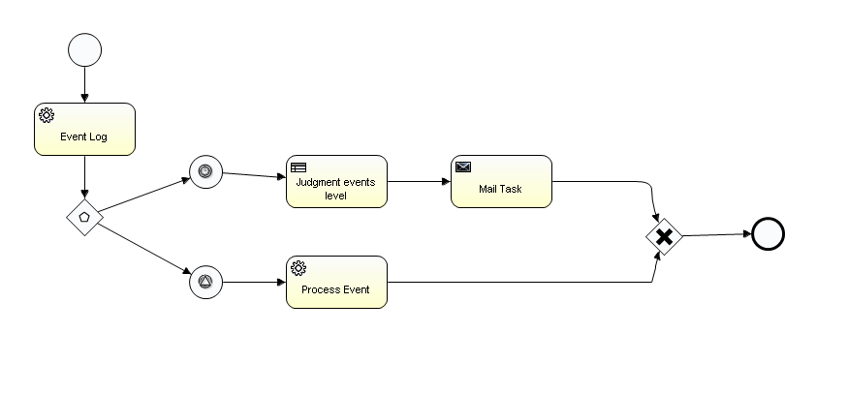

Slide 6
Case
bus出现故障, 激发故障处理流程.
流程开始, 进入事件记录模块,
然后转向两个分支(事件流程):
一个是人工监控台, 等待人工确认太响应
一个是自动处理(会延迟30分钟, 如果人工确认没有激发的话), 就会自动进入警告升级.

Slide 7
JBPM4 vs Activiti
 | JBPM4 | Activiti
 | Configuration.getProcessEngine() | ProcessEngine processEngine = ProcessEngines.getDefaultProcessEngine()
 | repositoryService.createDeployment() .addResourcesFromZipInputStream(zis).deploy() | repositoryService.createDeployment() .addZipInputStream(zis).deploy()
 | Group group = identityService.findGroupById(firstMgrGroup) | Group group = identityService.createGroupQuery().groupId(secondMgrGroup).list().get(0)
 | identityService.createUser(firstMgr, "Jack", "Zhang"); | identityService.newUser(firstMgr);
 | String groupId = identityService.createGroup(firstMgrGroup) | String groupId = identityService.newGroup(firstMgrGroup).getId()
 | ExecutionService executionService = processEngine.getExecutionService(); executionService.startProcessInstanceById(pid, map) | processEngine.getRuntimeService().startProcessInstanceById(pid, map)
 | List<Task> taskList = taskService.findPersonalTasks(name)

