Slide 1

Rossmann Sales Forecasting Across Multiple Retail Stores
Presented by: Sunitha Malla

Slide 2
The Challenge
Rossmann operates a large network of retail stores and needs reliable sales forecasts several weeks in advance.
Existing Approach
Store managers rely heavily on experience and personal judgement.
Forecasting is inconsistent across locations.
Manual forecasting is difficult to scale.
Important factors such as promotions, holidays and competition may be overlooked.
Business Need
Build an automated machine learning solution capable of forecasting sales across multiple stores and supporting finance-team planning.

Slide 3
Project Objectives
Objectives
Analyze historical sales patterns across stores.
Identify key factors influencing sales.
Integrate store-level and time-dependent information.
Engineer meaningful forecasting features.
Build and fine-tune a machine learning model.
Evaluate predictions using an appropriate forecasting metric.
Generate future sales predictions.
Deploy the model through a web application/API.
Establish a foundation for MLOps and automated model lifecycle management.
Expected Outcome:
A scalable forecasting system that converts historical retail data into actionable future sales estimates.

Slide 4
Dataset Overview
Dataset | Purpose
Historical sales and store-day information
train.csv
Future store-day records requiring predictions
test.csv
store.csv
Store characteristics and promotion/competition information

Slide 5
Solution Architecture
End-to-End Pipeline
Historical Data
↓
Data Cleaning
↓
Exploratory Data Analysis
↓
Feature Engineering
↓
Time-Based Validation
↓
Model Training → Model Evaluation →Final Model →Future Forecasting → Flask REST API → Web Application

Slide 6
Modeling Approach
Machine Learning Model
Selected Model: LightGBM Regressor
LightGBM was selected because it is well suited to:
Large tabular datasets
Nonlinear relationships
Feature interactions
High-dimensional engineered features
Fast model training
Large-scale prediction
Target Transformation
The sales target is transformed using:
log1p(Sales)
The prediction is converted back using:
expm1(Prediction)
This helps reduce the effect of highly skewed sales values.

Slide 7
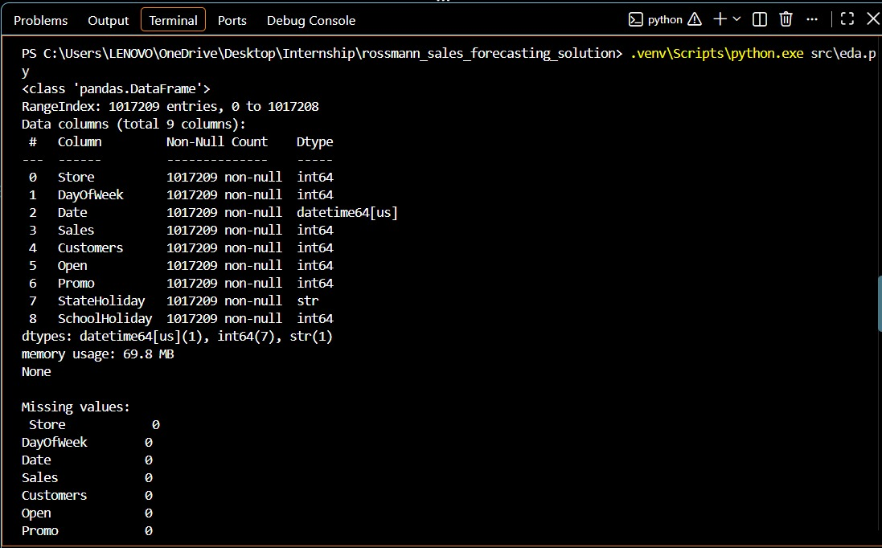
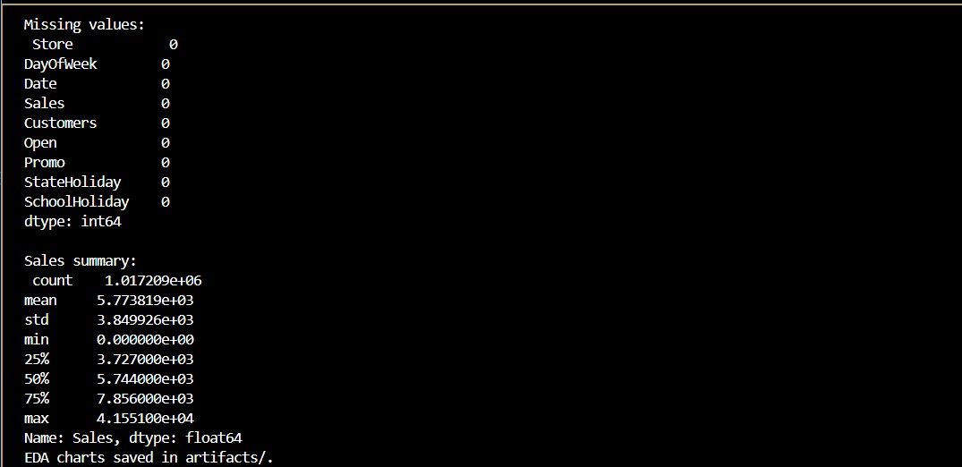
Outputs

Slide 8
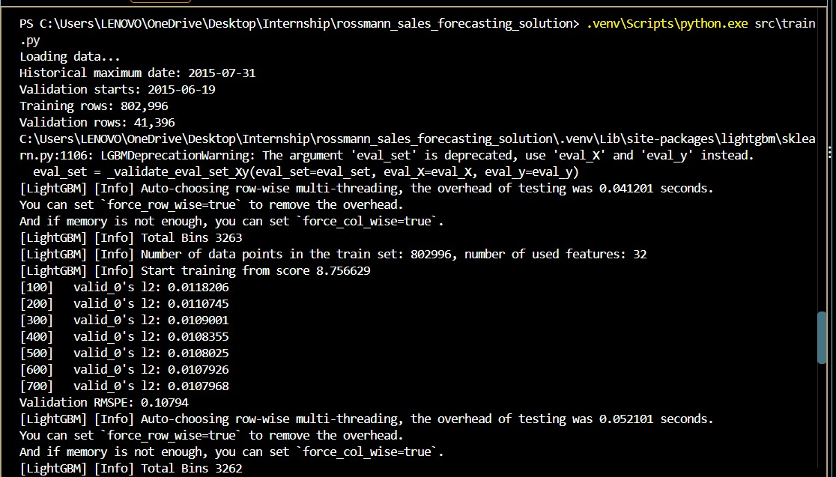
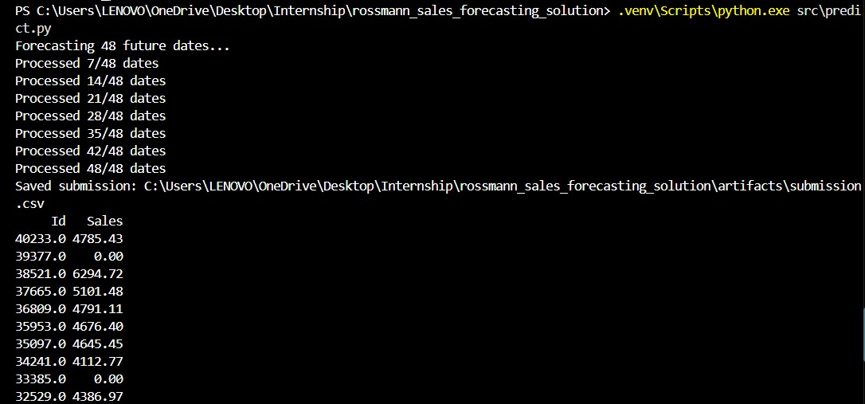
Outputs

Slide 9
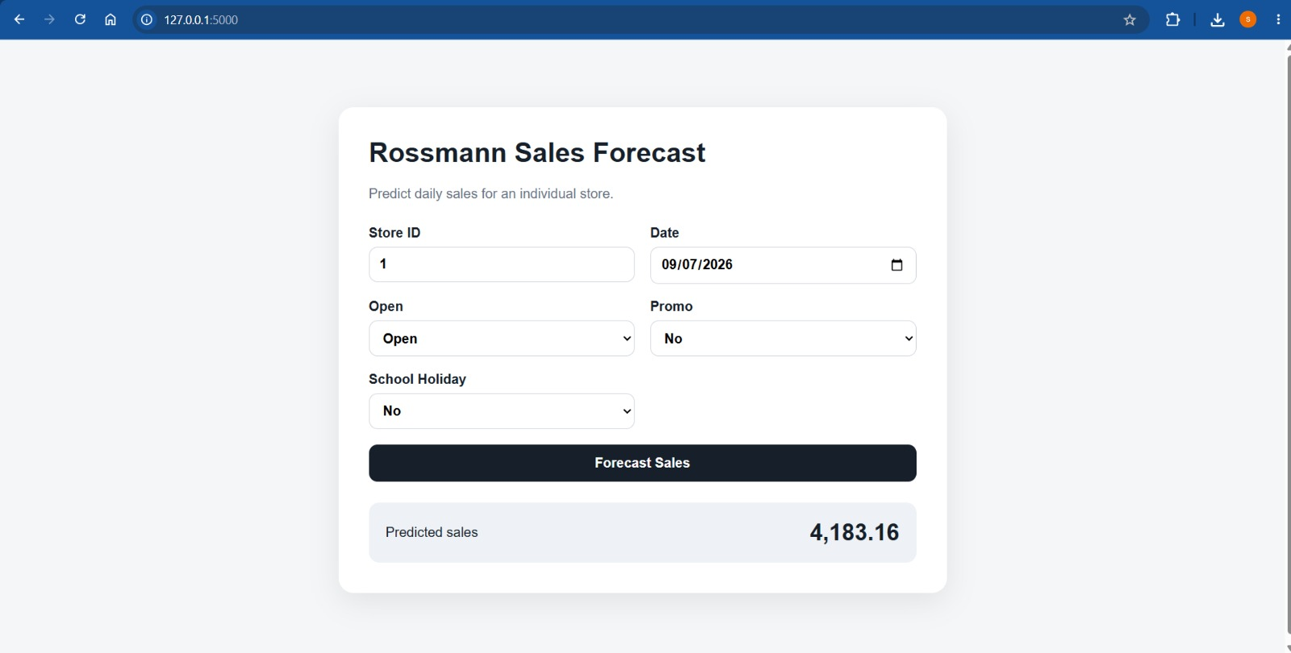
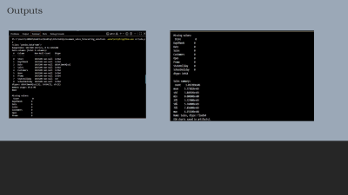
Outputs

Slide 10
Conclusion
The project developed an end-to-end machine learning pipeline for forecasting sales across multiple retail stores.
Key Achievements
✓ Historical retail data analyzed
✓ Business and temporal features engineered
✓ Lag and rolling sales features created
✓ Time-based validation implemented
✓ LightGBM forecasting model developed
✓ RMSPE used for evaluation
✓ Future sales predictions generated
✓ Flask prediction API developed
✓ Web-based prediction interface implemented
✓ MLOps architecture established

Slide 11

Final Takeaway
The solution provides Rossmann with a scalable, data-driven approach to future sales forecasting and creates a foundation for production-grade ML operations.

