Slide 1
K Nearest Neighbors
The Data Bootcamp |
April 14, 2018

Slide 2
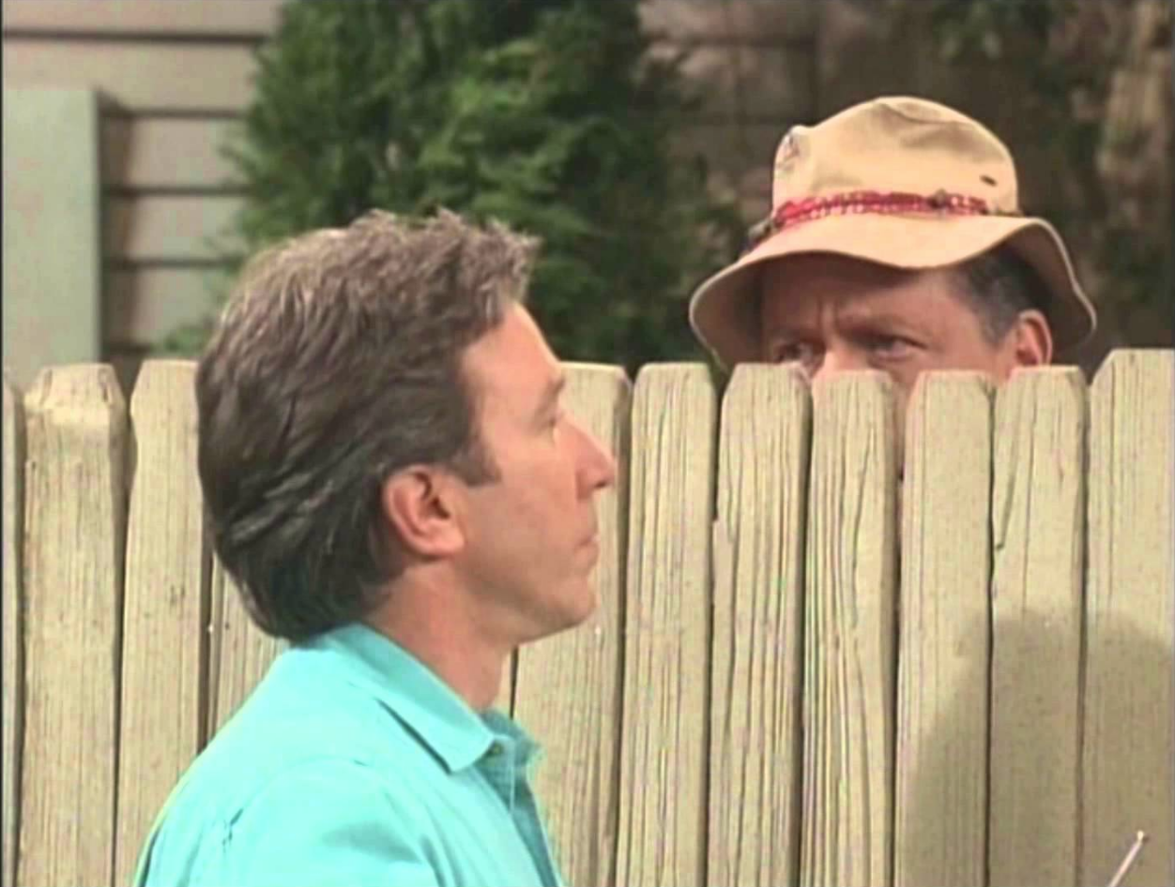
K Nearest Neighbors Algorithm
KNN is a really simple and robust algorithm for classification (and sometimes regression).
It has many benefits such as outlier insensitivity, ability to classify non-linear data, a high accuracy.
It does require a lot of memory ☹

Slide 3
K = 1
When K = 1, this is simply Nearest Neighbor. You find the point nearest to your new data point and that is the class that the new data point (Green Circle) will belong to. In this case, the closest neighbor is a red triangle, so the data point will belong to red.
?

Slide 4
K = 3
When K = 3, We find the 3 closest neighbors. In this case, there are two blue square and 1 red triangle, so the new data point will be grouped with the blue squares
?

Slide 5
K = 5
When K = 5, there are 3 red triangles and 2 blue squares, so the new data point will belong to the red triangles.
?

Slide 6
K = 7
Finally, when k = 7, the majority are red triangles, so the new data point still belongs to red.
?

Slide 7
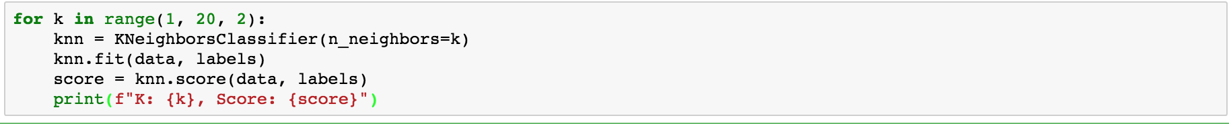
Choosing K
Because k can vary your results, the easiest technique for choosing a k value is to loop through a range k and calculate the score. Choose the lowest value of k where the score starts to stabilize. Note: We only use odd numbers so there are no ties between classes.

Slide 8
Questions / Discussion
Notes:
It’s important to keep in mind why you joined this class. Let’s talk about your goals.

