Slide 1
Logistic Regression
The Data Bootcamp |
April 14th, 2018

Slide 2
Why not Linear Regression?
In theory, linear regression could be used for classification, i.e. to predict qualitative response variables, e.g. ”Happy” or “Sad”.
We could encode “Sad” as the number 0 and “Happy” as the number 1. Since there’s a natural ordering to these categories (“Sad” has a lower value than “Happy” on a scale of happiness), this might make sense.
Moreover, we can reason about values between 0 and 1 as probabilities. If the linear regression model returned values of < 0.5, that’s closer to ”Sad” than it is to “Happy”, so you’d predict “Sad”. If the model predicted a value of > 0.5, you’d call that “Happy”.
Would that work? If not, why not?

Slide 3
Why not Linear Regression?
What happens if you had three values: “Happy”, “OK”, and “Sad”?
You could still map categories to values:
Happy: 2
OK: 1
Sad: 0
Is the distance between these values 1?

Slide 4
Why not Linear Regression?
What about categories that don’t have a natural ordering? Like “Apple” and “Banana”.

Slide 5
Our problems with Linear Regression, in a nutshell
Categories with no natural ordering cannot be easily mapped to ranges of values.
Even for categories with natural ordering, difficult to quantify the “distance” between categories numerically.
And even if you can quantify the distance, and only have binary outcomes, your linear model is likely to return values < 0 and > 1, which is difficult to interpret as probabilities.
There has to be a better way!

Slide 6
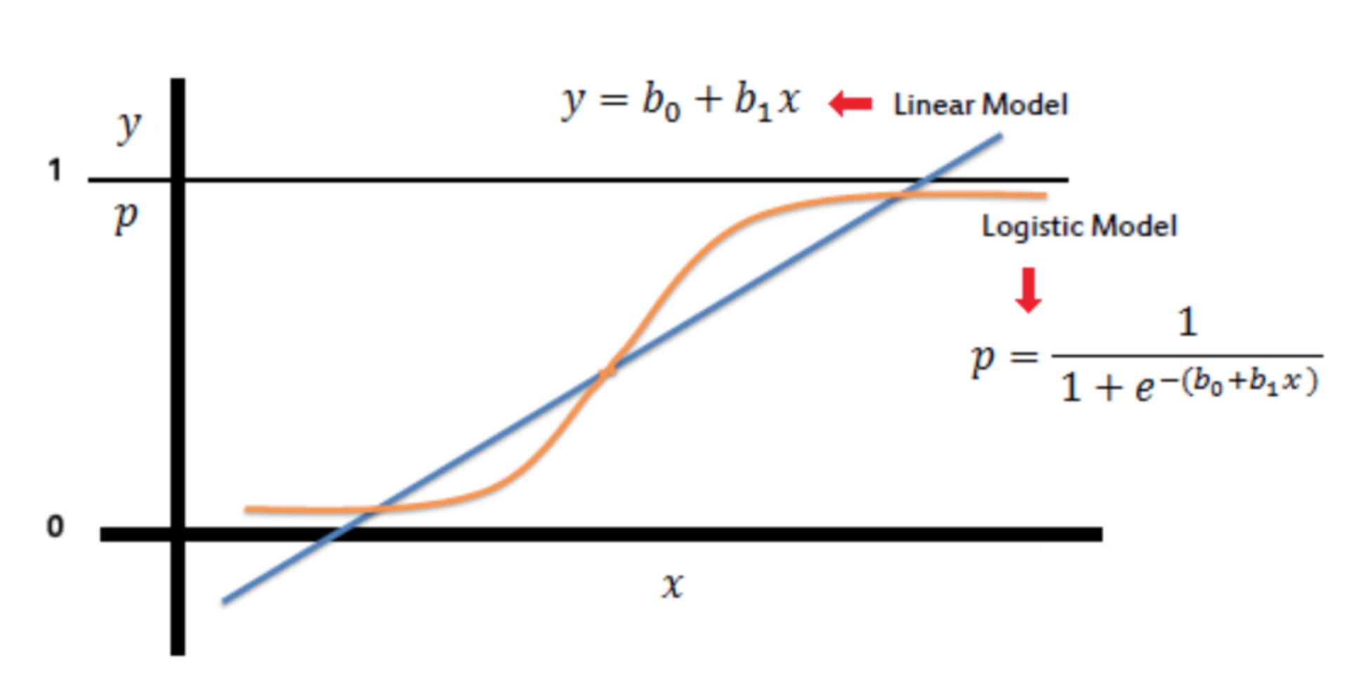
Logistic Regression
Logistic regression is a classification algorithm used to predict binary outcomes (i.e. Yes/No, Young/Old, Happy/Sad).
Unlike linear regression which outputs continuous number values (for example, age), logistic regression creates a model that returns a probability that our response variable is in a particular category. This can then be mapped to a discrete class like “Young” or “Old”.

Slide 7
Questions / Discussion
Notes:
It’s important to keep in mind why you joined this class. Let’s talk about your goals.

