Slide 1
Sales Analytics Software (Mini CRM)
Sunitha Ramakrishnan

Slide 2
How to Run the ProductSalesApp
(PythonData) Sunithas-MacBook-Pro:ProductSaleProject sunitharamakrishnan$ pwd
/Users/sunitharamakrishnan/Documents/UCB_HomeWork_submission/ProductSaleProject
(PythonData) Sunithas-MacBook-Pro:ProductSaleProject sunitharamakrishnan$ source activate PythonData
(PythonData) Sunithas-MacBook-Pro:ProductSaleProject sunitharamakrishnan$ ipython salesanalytics.py
* Running on http://127.0.0.1:5000/ (Press CTRL+C to quit)
* Restarting with stat
* Debugger is active!
* Debugger PIN: 319-527-629

Slide 3
Contents
Our Story (almost True)….
Business Challenge
Our Approach
Our innovation
Demo
Conclusion

Slide 4
Our Story…
Customer Profile
Orox, a CPG (Consumer Packaged Goods) customer ($6B in sales)
Manufactures bleaches and cleaning products (approx. 1000 SKUs products)
Different Business Units/Markets – Healthcare, JanSan & Food Services
Sales channel
Direct Sales – direct selling to End consumers
In-Direct Sales (Trace Sales) – indirect selling to End consumers via Distribution Channel

Slide 5
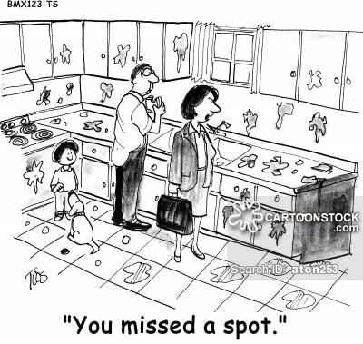
Use Orox Kitchen Floral Scent Cleaner…..

Slide 6
Business Challenges
In-direct sales challenges,
Sales lack visibility into sales data - cannot do upsell/cross sell
Execs don’t have visibility into Business performance
Marketing missing data in terms of their marketing focus
What product is selling most and what price?
What should be our marketing strategy to help sales & distributors sell more ?

Slide 7
Questions
Difficult to answer simple questions,
Q1. What are my top selling products?
Q2. How can we sell more?
Q3. What should be our marketing and sales strategy to uplift sales?

Slide 8
Our Approach
Understand Data
Define Data Visualization Reports
Define ETL process
Define Architecture
Design a MVP (Minimum Viable Product) – scalable and sellable
Gather Data
Store that data in Database
Design Cloud based reporting analytics solution
Present Data Visualization Reports

Slide 9
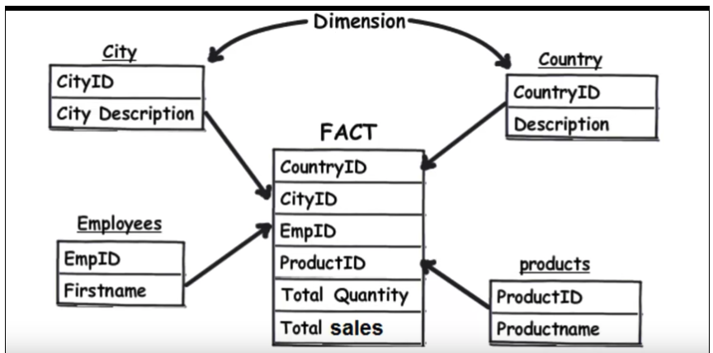
Data Model - Star Schema Design - example:
The star schema is the simplest style of data mart schema and is the approach most widely used to develop data warehouses and dimensional data marts.
The star schema consists of one or more fact tables referencing any number of dimension tables.

Slide 10
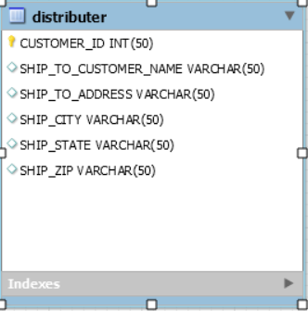
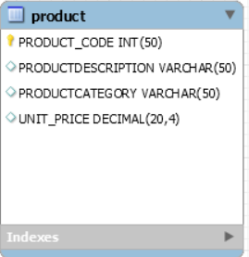
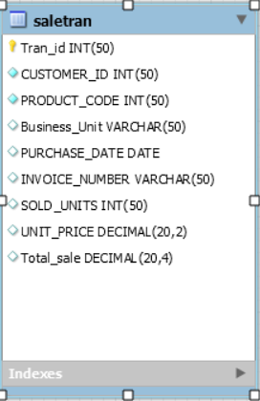
Data Model - Star Schema Design
Primary Keys
Sales Transaction
Product Code

Slide 11
Architecture – Client – Server using REST APIs
Request Data
Receive Data
MySQL Database , loads csv sales data
Client Web UI - will receive data and render Dashboards and Reports
Server side API will present reports to clients on request
Notes:
Priti –Will present

Slide 12
ETL - MySQL DB
Package Prep,
>pip install mysql-connector
DB Connect,
>import mysql.connector
>cnx = mysql.connector.connect(user='root', password='*****’, host='localhost’,
database='prosaledata’)
>print(cnx)
# you must create a Cursor object. It will let you execute all the queries you need,
>cur = db.cursor()
# Use all the SQL you like,
>cur.execute("SELECT * FROM salestran")
# print all the first cell of all the rows
>for row in cur.fetchall():
> print(row)

Slide 13
JavaScript libraries for building user interfaces….
Pivottable.js
D3.js
Dc.js (JS lib)
Used for Dimensional charting
Good for Dashboards
Crossfilter.js ( JS lib)
Used for exploring large multivariate datasets
Supports interaction with coordinated views with large datasets containing million of records

Slide 14
Demo
Demo

Slide 15
Conclusion
Enhance Sales analytics using
ML and AI

