Slide 1
48th National Safety Week 2019
Aparna Aura
Safety Tool Box training

Slide 2
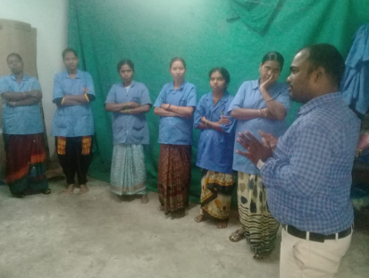
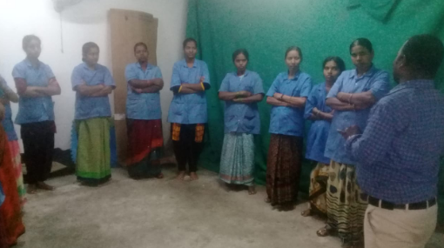
TOPICS
HOUSEKEEPING SAFETY
WORKPLACE SAFETY
GARBAGE FLAMMABLE OBJECTS
ROAD SAFETY
FIRE SAFETY
PPE
ELECTRICAL SAFETY
HANDLING
USE OF FIRE EXTINGUISHERS
EMERGENCY EVACUATION
USE OF RUBBER SHOES & GLOVES
WORKING IN WET & SMOOTH SURFACES
WORKINGS ON HEIGHTS
HANDLING GARBAGES

Slide 3
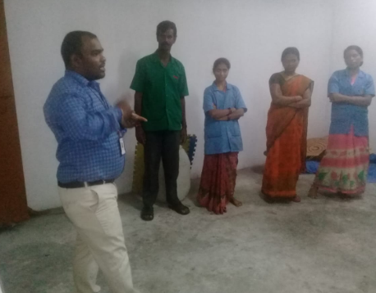
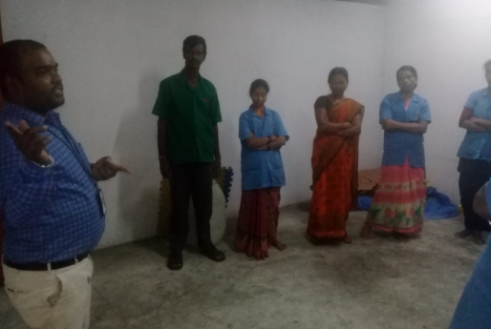
TOPICS
FIRE PUMP ROOM
ELECTRICAL PANELS
ACCIDENT PREVENTION
HANDLING
SAFETY BELTS
LPG CYLINDERS
TANKS CLEANING
HEALTH IS EVERYTHING
BATTERIES HANDLING
TROLLY USING

Slide 4


