Slide 1
Effects of Common Foods on Bacteria in Water
Group ID: 1-030
Team Members:
Sun Yudong 2O2 (L)
Koh Yi Zhe 2O2
Tan Hsien En 2O2
Ho Jie Feng 2O4
Notes:
Slide 1: Good Morning, today, we will be presenting on our project, the effects of common foods on bacteria in water.

Slide 2
Contents
Objectives and Rationale
Food & Water Sources
Hypothesis
Timeline for Experiments
Materials & Apparatus
Process and Variables
Results
Conclusion
Applications
Picture from: Microsoft Clipart
Notes:
Slide 2: This will be the contents that we will be talking about today.

Slide 3

Objectives and Rationale
We were inspired to find out how to get rid of the bacteria in water.
We intend to find common food substances that have anti-bacterial properties to make the water cleaner.
www.paranormalpointofview.blogspot.com
Notes:
Slide 3 - Our objective is to find out how to get rid of the bacteria in water, in particular, we intend to find common food substances, which we encounter in our daily lives that have anti-bacterial characteristics to make the water drinkable /*cleaner for consumption.*/

Slide 4

Food, water sources and micro-organisms used
Food extracts
Lime
Coffee grounds
Onion
Garlic
Water sources
Rainwater
Micro-Organisms
E. coli
M. luteus
Yeast
www.teachengineering.org
Notes:
Slide 4 - We used lime, coffee grounds, onion and garlic for food extracts, rainwater for water sources and E.coli, M.luteus and yeast as our test organisms.

Slide 5
Lime | Garlic | Onion | Coffee Grounds
It has been found to be protective against the transmission of cholera, and to be effective against yeast Antibacterial properties of acidic lime extracts: average amount of viruses and bacteria in waste water had drastic drops of up to 96% W.O.K Grabow, Nerrie C. Basson , 1997. National Institute for Water Research of the Council of Scientific and Industrial research | Contains a disulfide, Ajeone, prevents infections with yeast Candida albicans Crushed garlics prevent infection of Pseudomonas aeruginosa in burn patients Alan.J.Sulsarenko, Anant Patel, Daniela Portz, 2007, 27th September | Quercetin was extracted from the onions and tested on different species of Bacteria, such as M.luteus Quercetin had an inhibitory effect on all the strains of bacteria that were studied Jonathan Santas; María Pilar Almajano; The University of Barcelona, Spain, 2010. The International Journal of Food Science and Technology | Coffee grounds has been tested on E. coli and other bacteria Coffee Grounds was more effective at inhibiting bacterial strains than was the antibiotic ampicillin Greenwood, B. 2011, September 29. Retrieved from http://www.livestrong.com/article/545173-does-caffeine-affect-bacteria
Notes:
Slide 5 – This is what we have found from the literature reviews.

Slide 6
Our Hypothesis
Lime extracts have the best anti-bacterial properties
Notes:
Slide 6 - So, Our Hypothesis is that lime extracts have the best anti-bacterial properties

Slide 7
General Timeline for Experiments
1
Preparation of Food Extracts
Zone of Inhibition (ZOI)
3
Colony Count (CC) (Time point Experiment)
2
4
Heat Stability Tests
5
Food Extract on Water Samples as a Proof of Concept
Notes:
Slide 7 - Our experiments were conducted in this order

Slide 8
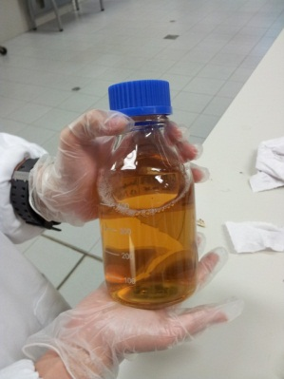
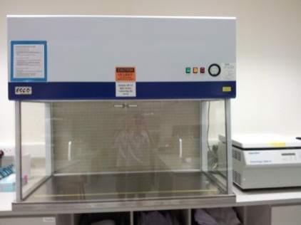
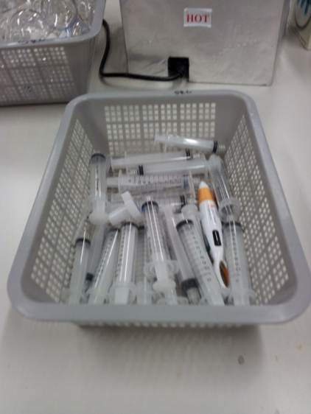
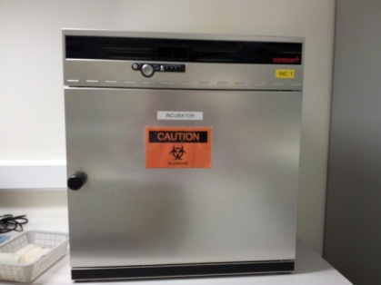
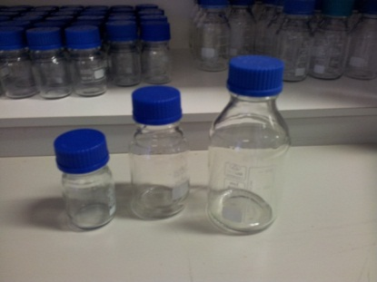
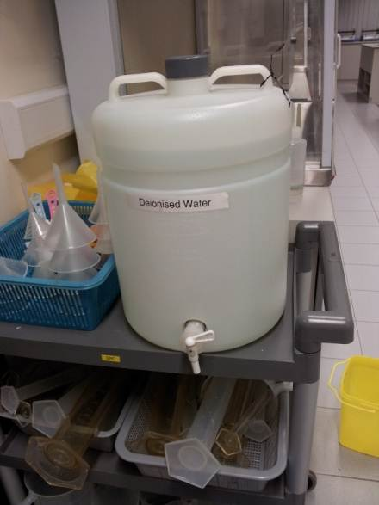
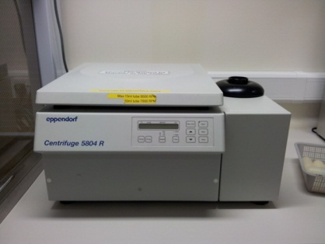
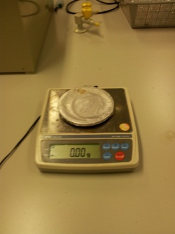
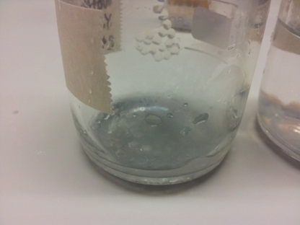
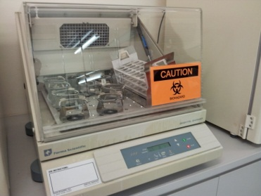
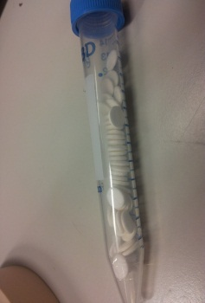
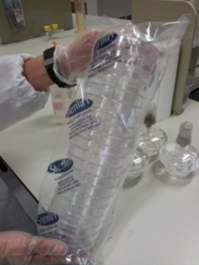
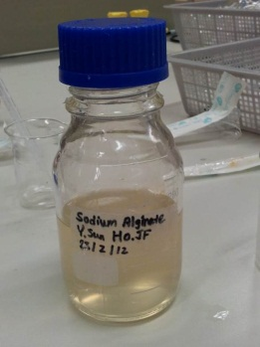
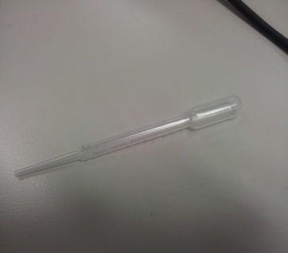
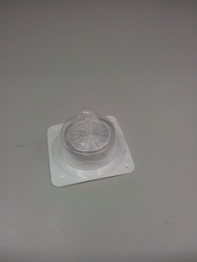
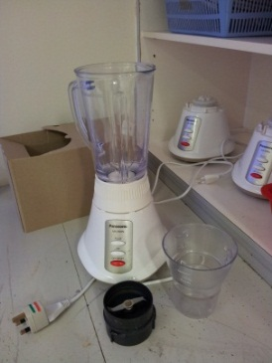
Materials and Apparatus
Notes:
Slide 8, 9 – These are materials and apparatus

Slide 9
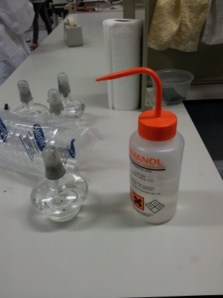
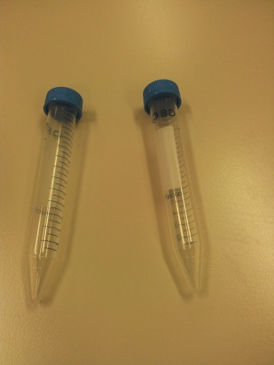
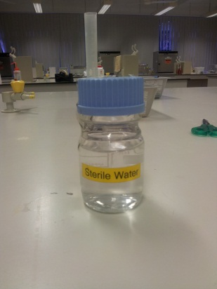
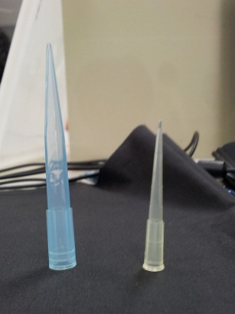
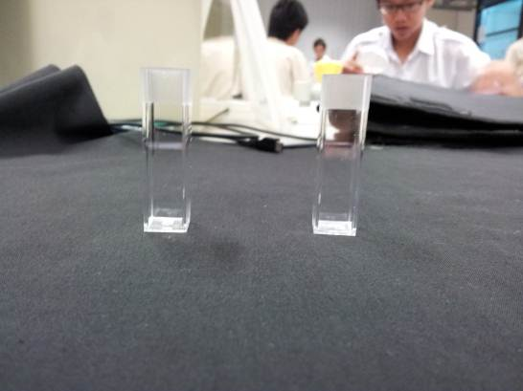
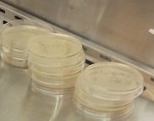
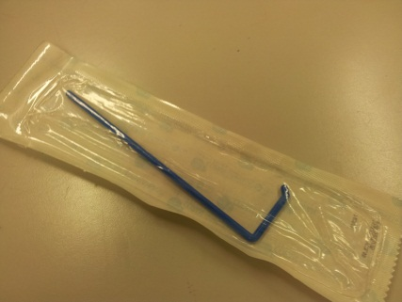
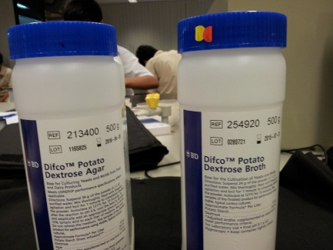
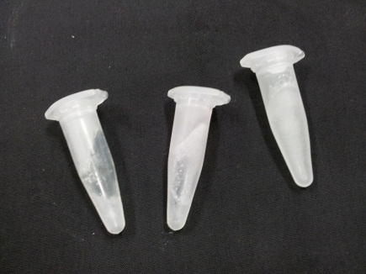
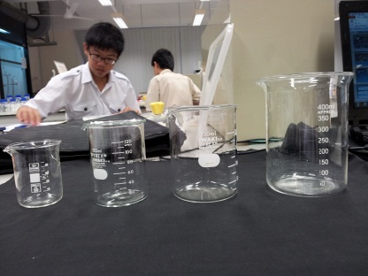
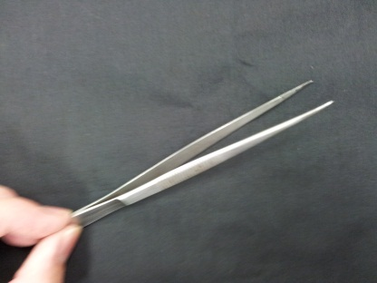
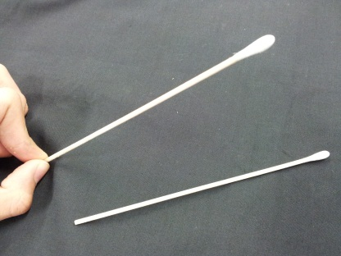
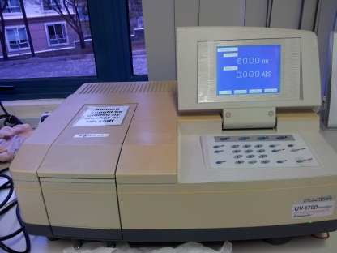
Materials and Apparatus
Notes:
FLASH THROUGH

Slide 10
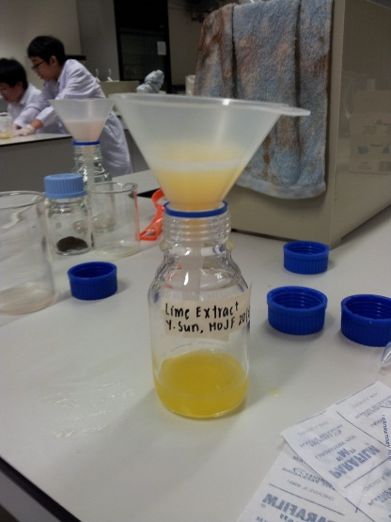
Preparation of food extracts
Garlic, Onion, and Coffee Beans are blended separately. They are then made into 50% extracts (m/v). The lime is squeezed to extract the juice.
The blended extracts with water are centrifuged and then
filtered to extract any solid residue left in them.
Notes:
Slide 10 - For the preparation of foods sources, the garlic and onion skin are peeled off, and then along withcoffee beans, they are blended separately, and made into 50% extracts. Lime was squeezed to extract the juice. All the extracts are then filtered and centrifuged to extract all the solid residue.

Slide 11
Variables – Preparation of Food Sources
Controlled Variable | Dependent Variables | Independent Variables
Mass of food to grind up | Concentration of food extract | Type of active compounds from different foods
Volume of water added to food extract
Notes:
Slide 11 - These are the variables for preparing of food sources.

Slide 12
Zone of Inhibition
The bacterium and Yeast are then swabbed on separate agar plates. The plates are then left in the incubator to grow overnight.
The agar plates are then incubated at 37 ⁰C overnight. The diameter of the zone of inhibition for each of the food sources are then measured and recorded.
Food samples are then introduced on small paper discs, together with a control (sterile water), which are then placed on the agar plates.
Notes:
Slide 12 - The purpose of the zone of inhibition is to find out if the anti bacterial substances do work on the micro-organisms, namely E.coli, M.luetus and Yeast. For zone of inhibition, the micro organisms are swabbed on agar plates, and then food sample are introduced on small paper discs, with a control, sterile water, and placed on agar plates. After which they are left overnight in the incubator at 37 Degrees. The following day the the zone of inhibition of each food source measured and recorded.

Slide 13
Variables - Zone of Inhibition
Controlled Variable | Dependent Variables | Independent Variables
Time of incubation | Diameter of Zone of Inhibition | Type of micro-organism
Temperature of incubation |  | Type of active compounds from different foods
Notes:
Slide 13 - These are the variables for zone of inhibition.

Slide 14
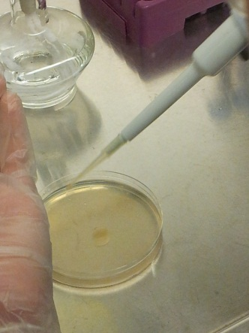
Colony Counting (Time Point Experiment)
The micro-organisms are adjusted to a concentration of 10⁷ CFU/ml
The food extracts are then introduced in liquid suspensions
Every 20 min, samples of the mixture were taken, diluted and plated
After overnight incubation, the resultant colony numbers were then recorded and used to calculate the final numbers of micro-organisms
Notes:
Starting point: Although we know through the zone of inhibition that the anti bacterial food is showing effectiveness on the bacteria, we do not know for sure whether it is bactericidal or bacteriostatic. After all, we are trying to find out food sources that can not only stop the bacteria in water from continuing to grow, but also kill the bacteria and show a decrease. By colony counting, we are able to find out, by counting the colonies of bacteria at every interval.

Slide 15
Variables – Colony Count
Controlled Variable | Dependent Variables | Independent Variables
Volume of liquid suspension plated | Colony left in each agar plate (resultant CFU) | Type of micro-organism
Time of incubation |  | Type of active compounds from different foods
Notes:
Slide 15 - These are the variables of the colony counting experiment.

Slide 16
Extracts on Rainwater
Using a pipette, a fixed volume of rainwater is mixed with food extracts
The samples are then incubated overnight at 37°C
The mixture is then plated on agar.
The next day, the plates are removed. The resultant micro-organism growth was compared, relative to a negative control
Notes:
Slide 16 - Next, the extracts on water (field test) is done as a prove of concept, and to make sure that the anti bacterial food sources not only work on the isolated species of bacteria we used in the lab, but also on mixtures of bacteria found in rainwater. Firstly, a fixed volume of rainwater is mixed with food extracts. The mixture is plated on agar and left the incubator to grow at 37 degree celcius. The next day, the resultant micro-organism growth is then compared, relative to a negative control.

Slide 17
Variables-Extracts on Rainwater
Controlled Variable | Dependent Variables | Independent Variables
Volume of liquid suspension plated | Resultant CFU | Type of micro-organism
Time of incubation |  | Type of active compounds from different foods
Notes:
Slide 17 - These are the variables of the Extracts on Rainwater experiment.

Slide 18
Results
Zone of Inhibition
Colony Count
Extracts on Water
Heat Stability Test
Notes:
Slide 18 - I will be presenting on the results of the experiments.

Slide 19
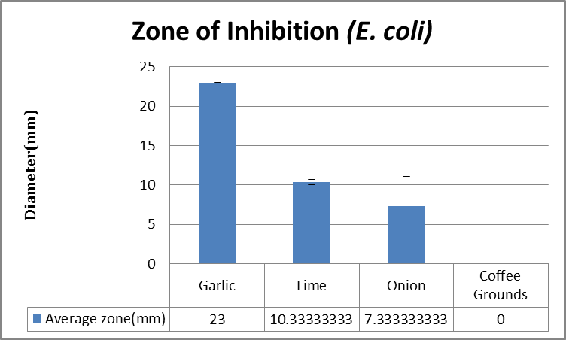
Zone of Inhibition of E.coli by Food Extracts
10.33
7.33
Standard error | 0 | 0.333333333 | 3.711842909 | 0
Notes:
Slide 19 - E.coli, M.luteus were chosen for testing. We used the Zone Of Inhibition experiment as a first test for the food extracts. This is the graph for the results of inhibition of E.coli by the different food extracts. Garlic and Lime proved to work the best in inhibiting E.coli.

Slide 20
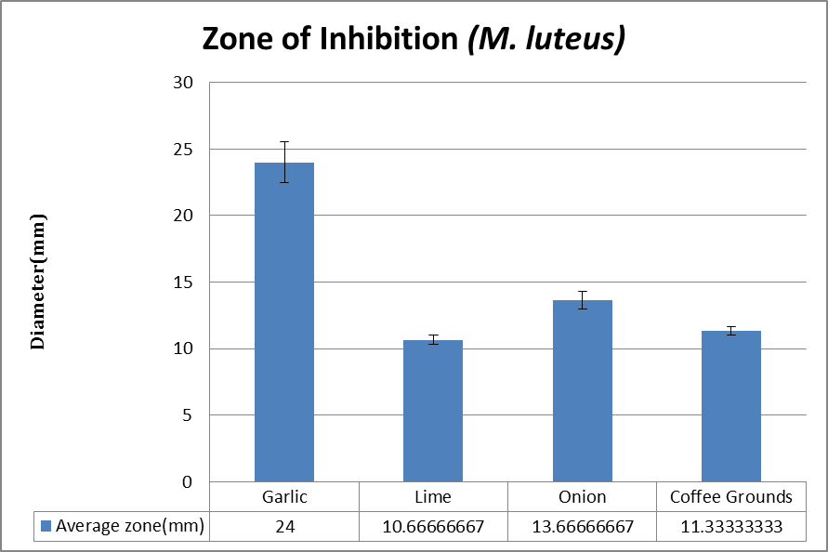
Zone of Inhibition of M.luteus by Food Extracts
10.7
13.7
11.3
Standard error | 1.53 | 0.333 | 0.667 | 0.333
Notes:
Slide 20 - This is the graph for the results of inhibition of M.luteus by the different food extracts. However, in this case, Garlic and Onion worked the best when inhibiting M.luteus. In both cases, garlic demonstrated the highest efficacy indicating it targets elements or structures common in both Gram-positive and Gram-negative bacteria.

Slide 21
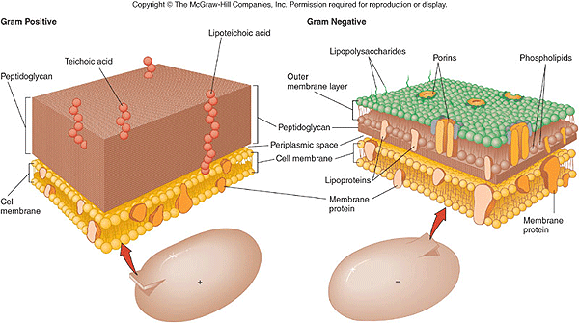
http://water.me.vccs.edu/courses/env108/clipart/cellwall.gif
Notes:
Slide 21 - In constrast, coffee extract demonstrate efficacy only towards ML, suggesting that it target Gram-positive specific structures, such as the petidoglycan cell wall.

Slide 22
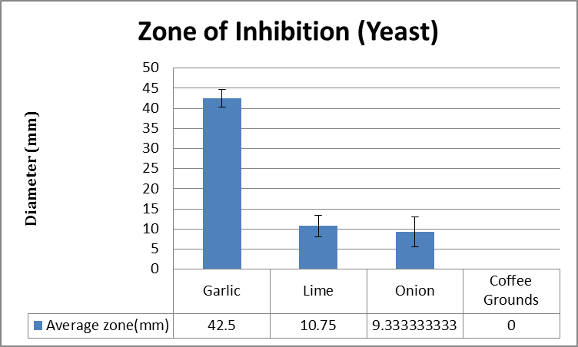
Zone of Inhibition of Yeast by Food Extracts
9.33
Standard error | 2.25 | 2.69 | 3.71 | 0
Notes:
Slide 22 - So after this, we know that our food extracts work on prokaryotic cells such as E.coli and M.luteus. However, we also want to test if they work on eukaryotic cells such as Yeast. Therefore we tested that our food extracts on Yeast. This time, Garlic and Lime again worked the best in inhibiting Yeast.

Slide 23
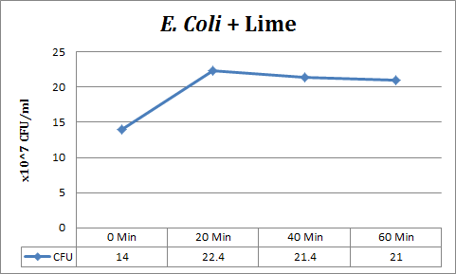
Colony Count – E.coli + Lime Extract
Notes:
Slide 23 - So therefore, we have found out that Garlic and Lime extracts are the best inhibiting E.coli, and worked the best. Therefore, we now want to see if they are bacteriostatic or bactericidal. Therefore, we carried out the Time Point Experiment (Colony Count) to check this.
We tested Lime extracts on E.coli over 1 hr. The results show that the number of colonies increase during the first 20 minutes before starting to stabilise, showing that it is bacteriostatic.

Slide 24
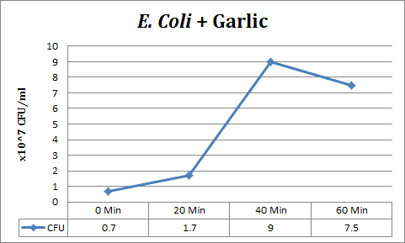
Colony Count – E.coli + Garlic Extract
Notes:
Slide 24 – We also tested our Garlic extracts on E.coli over 1 hr. For the first 20 mins, it was bactericidal, and after that it started to lose its effect.

Slide 25
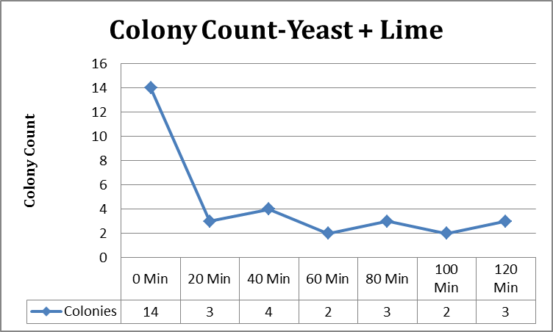
Colony Count – Yeast + Lime Extract
Notes:
Slide 25 - As stated earlier, we want to test colony counting on eukaryotic cells such as yeast. We tested yeast with lime, and it showed that there was a sharp and rapid decrease of bacteria from the 0 min to 20 min interval, thereafter the number of bacteria remained constant.

Slide 26
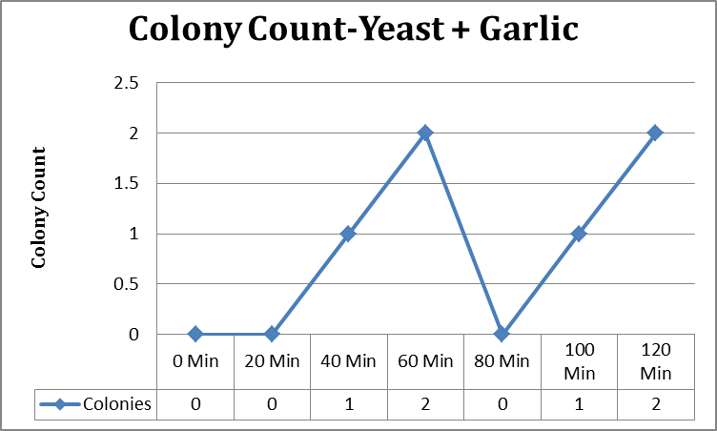
Colony Count – Yeast + Garlic Extract
Notes:
Slide 26 - We also tested yeast with garlic, and for the first 20 minutes, the bacteria was constantly low, and after that there was a rapid spike, where the bacteria increased all the way.

Slide 27
Garlic & Lime Mixture
Notes:
Slide 27 - Therefore, since lime is bacteriostatic and garlic is bactericidal, we postulate that adding both together would result in a synergistic effect when combating bacteria

Slide 28
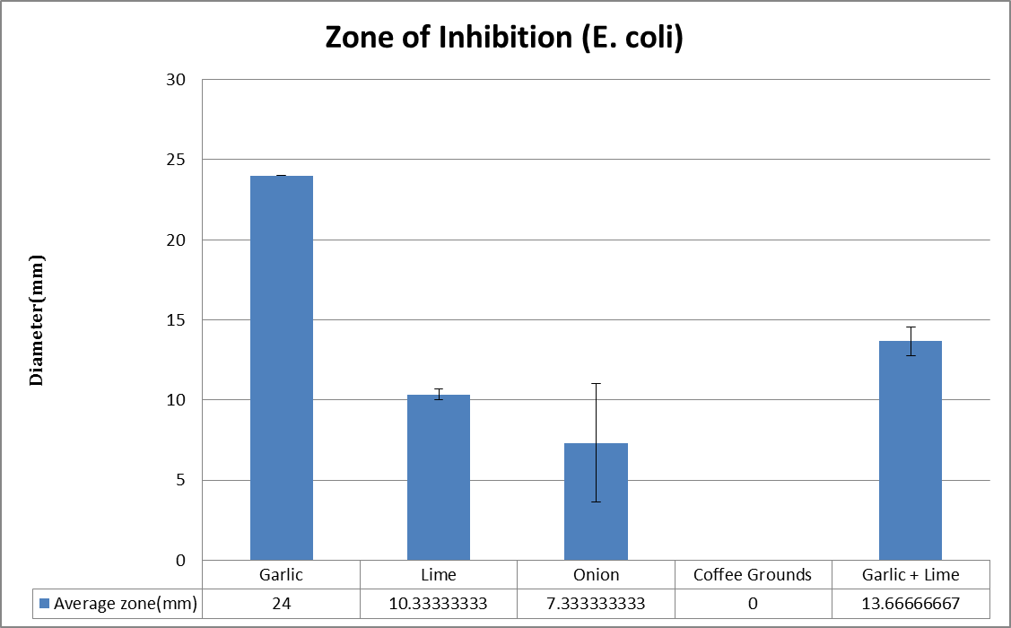
(E.coli)
Zone of Inhibition of E.coli by Garlic-Lime Mixtures
43%
10.3
7.33
13.7
Standard error | 0 | 0.333 | 3.71 | 0 | 0.882
Notes:
Slide 28 - We did a Zone of Inhibition experiment to test the effect of Garlic & Lime mixtures on the Bacteria. However, the results showed that the Garlic & Lime mixture did not work as well as Garlic, performing approximately 43% worse than Garlic.

Slide 29
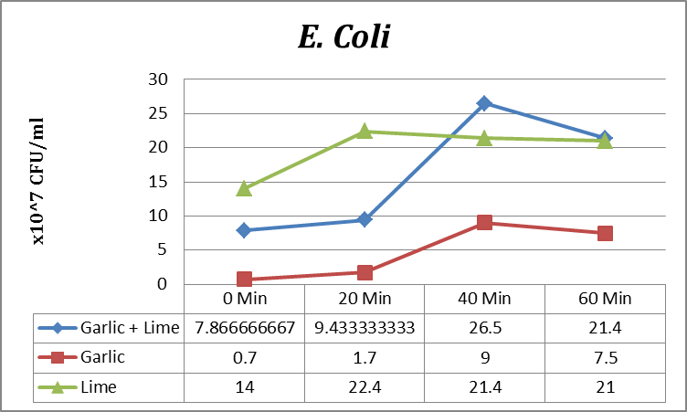
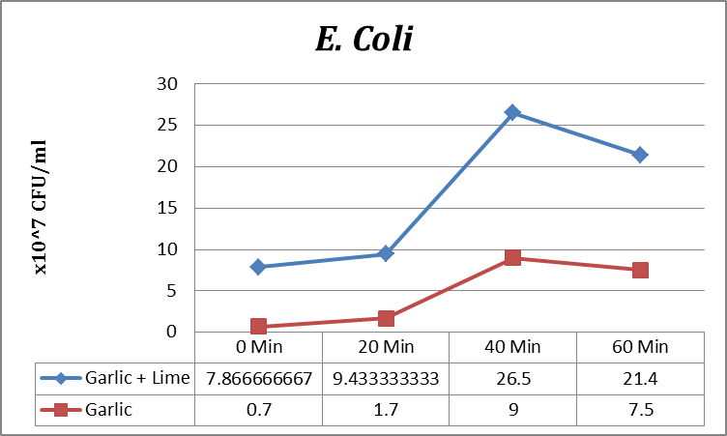
7.87
9.43
Standard error | 3.27 | 4.25 | 11.0 | 3.32
Notes:
Slide 29: The data from the zone of inhibition are not conclusive enough, so we decided to do a time point experiment to find out the effect of garlic & lime mixture on E.coli over time.
It can be seen from this graph that Garlic & Lime mixture did not work as well as garlic.
For the first 20 mins, it followed the bacteriostatic effect, but loses its effect thereafter, allowing for a greater rebound than garlic extract.

Slide 30
Heat Stability Tests
Notes:
Slide 30: To test whether the extracts still work under different temperature, we did heat stability tests.

Slide 31
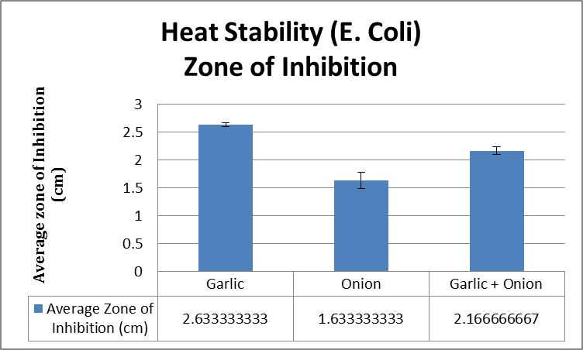
Zone of Inhibition of E.coli by heat-treated extracts
Lime
Garlic + Lime
2.63
1.63
2.17
Standard error | 0.0333 | 0.145 | 0.0667
Notes:
Slide 31: As it can be seen, Garlic extract, with heat had exhibited an efficacy towards E.Coli that is comparable to that of itself under room temperature. Thus, it showed that Garlic extract is heat stable.
Onion, which although performing worse than Garlic, under heat, has also exhibited an efficacy towards E.Coli that is comparable to that of itself under normal conditions. Thus also showing that Onion is also heat stable.
At the same time, Onion and Garlic mixture, which performed worse than Garlic, but better than Onion, under heat, has also exhibited an efficacy towards E.Coli that is comparable to that of it under normal conditions. Thus also showing that Onion and Garlic mixture is heat stable.

Slide 32
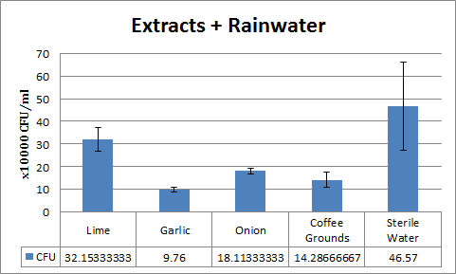
Field Test Results – Extracts on Rainwater
32.6
18.1
14.3
Standard error | 5.326 | 1.01 | 1.22 | 3.35 | 19.5
Notes:
Slide 32: After all these. we decided to do a field test by looking at the effects of extracts on rainwater itself as a proof of concept. From the results of the field test, it can be seen that Garlic displayed the highest efficacy for inhibiting bacteria growth, and not Lime. And this is reflected throughout all the results of all our anti-bacterial tests.

Slide 33
Conclusions
Garlic has the best anti-bacterial properties across a variety of microorganisms
Coffee extracts seems to target Gram-positive specific structures
Garlic and Lime have antagonistic effects on each other.
Notes:
Slide 33: Therefore, according to the results, we conclude that our hypothesis was wrong and garlic has the best anti-bacteria properties across a variety of microorganisms
, and not lime. Also, it seems that coffee extracts targets Gram-positive specific structures. It also seemed that Garlic and Lime proved to have antagonistic effects on each other.

Slide 34
Conclusions
Garlic and Onion mixtures also have slight antagonistic effects
The active compounds in our food extracts are not affected by heat
Garlic has demonstrated efficacy in combating bacteria and protozoans
Notes:
Slide 34: Furthermore, Garlic and Onion mixtures also have slight antagonistic effects. After the heat stability tests. we found out that the active compounds are not affected by heat, and garlic demonstrated efficacy in combating bacteria and protozoans.

Slide 35


Future Work
Sterile Water (Control)
Lime
Garlic
Onion
Daphnia (Protozoa)
Petri Dishes
Viable Protozoa will be counted at 20 Min Intervals

Slide 36
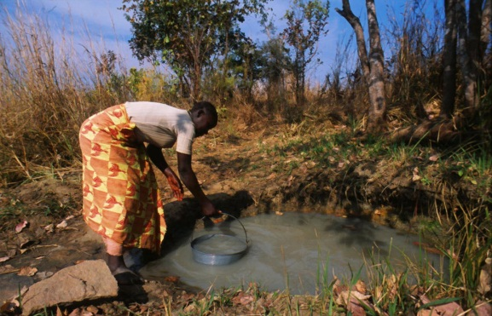
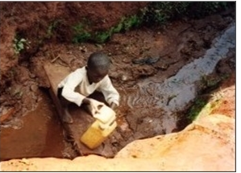
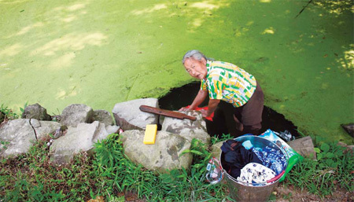
Applications
Picture from:
http://www.mwdws.com/
For use in places where there is
  Abundant rainfall
  Lack of H₂O treatment facilities
  Poor sanitation
Using the extracts to make a product
  Use in filters to purify water
Practicality
  Environment friendly
  Cheap
  Can be mass produced
Picture from:
http://www.mwdws.com/
Picture from:
http://images.china.cn/
Notes:
Slide 35: In places where there is abundant rainfall, but a lack of water treatment facilities, we can collect rainwater, and add the extracts and we can prevent the incidences of water-borne diseases. It can be used in filters to purify water. It is rather environmentally friendly, cheap and can be mass produced

Slide 37
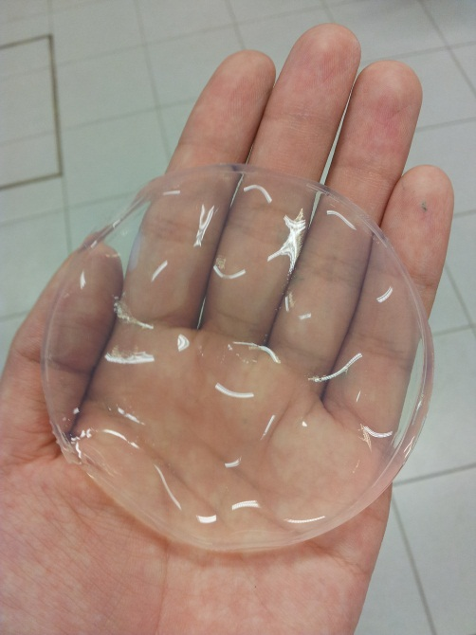
Applications
1% Agar
Tests on Water Samples show that the product does demonstrate some efficacy against the bacteria in rainwater.
It could be a replacement for the sold water purification pills
  Easier to make
  Easier transport
Notes:
Slide 36: We have created a product. It mainly consists of 1% Agar mixed with Garlic extract. This could be used as a replacement for the conventionally sold water-purfication pills, being easier to transport. Also, being heat-stable, the extracts would be able to work even if the agar is thrown into boiling water.

Slide 38
Bibliography
A review of disinfection practices and issues. N.p., n.d. Web. 19 Feb 2012. <http://www.waterandhealth.org/drinkingwater/wp.html>
Peter H.Gleick, 2002, 15th August, Pacific Institute Research Report
  W.O.K Grabow, Nerrie C. Basson , 1997. National Institute for Water Research of the Council of Scientific and Industrial research
Alan.J.Sulsarenko, Anant Patel, Daniela Portz, 2007, 27th September
Ramanaviciene, A., Mostovojus, V., Bachmotova, I., & Ramanavicius, A. (2003). Anti-bacterial effect of caffeine on Escherichia coli and Pseudomonas fluorescens. Acta Medica Lituanica, 10(4), 185-188.
Greenwood, B. 2011, September 29. Retrieved from http://www.livestrong.com/article/545173-does-caffeine-affect-bacteria
Essence of life. (n.d.). Retrieved from http://www.rense.com/1.mpicons/acidalka.htm
Jonathan Santas; María Pilar Almajano; The University of Barcelona, Spain, 2010. The International Journal of Food Science and Technology
Notes:
This is our bibliography

Slide 39
The End
Thank you for your time :D
Notes:
Danke

