Slide 1
Effects of Common Foods on Bacteria in Water
Group ID: 1-030
Team Members:
Sun Yudong 2O2 (L)
Koh Yi Zhe 2O2
Tan Hsien En 2O2
Ho Jie Feng 2O4

Slide 2
Contents
Background Information
Rationale & Objectives
Food & Water Sources
Hypothesis
Materials & Apparatus
Process
Variables

Slide 3
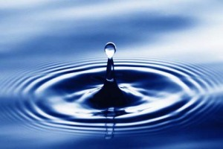
Background Information
www.hydrogenhealthwater.com
Water-borne diseases are any illness caused by drinking water contaminated by faeces, which contain pathogenic microorganisms.
Over the past decades, outbreaks of water-borne diseases have been increasing, and they continue do so today.
Reference: A review of disinfection practices and issues. N.p., n.d. Web. 19 Feb 2012. <http://www.waterandhealth.org/drinkingwater/wp.html>

Slide 4
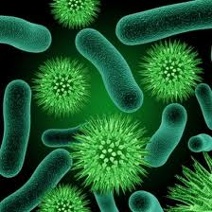
Background Information
www.shalinikagal.hubpages.com
3.575 million people die each year from water-related diseases
Water plays an essential role in the transmission of diseases.
Reference: A review of disinfection practices and issues. N.p., n.d. Web. 19 Feb 2012. <http://www.waterandhealth.org/drinkingwater/wp.html>

Slide 5
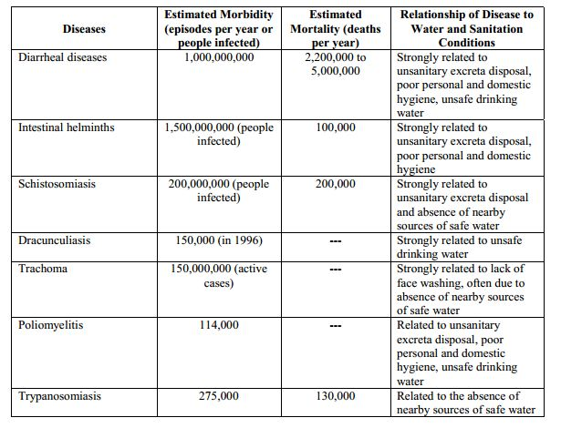
Peter H.Gleick, 2002, 15th August, Pacific Institute Research Report

Slide 6

Rationale & Objectives
Because of this, we were inspired to find out more on getting rid of the bacteria in water.
We intend to find common food substances that are anti-bacteria to make the water cleaner for consumption.
www.paranormalpointofview.blogspot.com

Slide 7
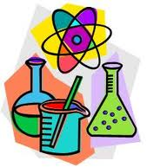

Food Sources
Lime
Coffee grounds
Onion
Garlic
www.teachengineering.org
www.teachengineering.org

Slide 8
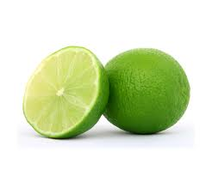
Food Source 1: Lime
Lime contains unique flavonoid compounds
It has been found to be protective against the transmission of cholera, and to be effective against yeast
Antibacterial properties of acidic lime extracts: average amount of viruses and bacteria in waste water had drastic drops of up to 96%
Reference: W.O.K Grabow, Nerrie C. Basson , 1997. National Institute for Water Research of the Council of Scientific and Industrial research
www.chemical-industries.com

Slide 9
Food Source 2: Garlic
www.clipartreview.com
Contains a disulfide, Ajeone, prevents infections with yeast Candida albicans
Crushed garlics prevent infection of Pseudomonas aeruginosa in burn patients
Garlic extract, (Allicin) was once tested on carrot seeds infested with Alternaria. For the control, 12/100 seeds grew. For the samples treated with Allicin, 47/100 seeds grew.
Reference: 1) The world, 2011, 1 1
2) Alan.J.Sulsarenko, Anant Patel, Daniela Portz, 2007,
27th September

Slide 10

Food Source 3: Coffee Grounds
Coffee grounds has been tested for antibacterial effects on staphylococcus, enterobacter, salmonella and E. coli. (Ramanaviciene, A., Mostovojus, V., Bachmotova, I., & Ramanavicius, A. (2003). Anti-bacterial effect of caffeine on Escherichia coli and Pseudomonas fluorescens. Acta Medica Lituanica, 10(4), 185-188.
Coffee Grounds was more effective at inhibiting bacterial strains than was the antibiotic ampicillin. (Greenwood, B. 2011, September 29). Retrieved from http://www.livestrong.com/article/545173-does-caffeine-affect-bacteria)
www.clipart-for-free.blogspot.com

Slide 11
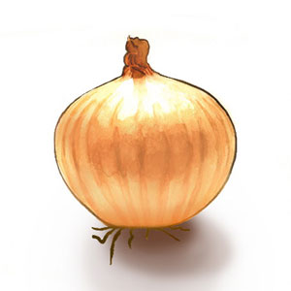
Food Source 4: Onion
Onion extracts are found to have high antioxidant capacity.
Quercetin was extracted from the onions and separately added to cultures of Bacillus cereus, Staphylococcus aureus, M. luteus
Quercetin had an inhibitory effect on all the strains of bacteria that were studied.
Jonathan Santas; María Pilar Almajano; The University of Barcelona,
Spain, 2010. The International Journal of Food Science and Technology
delish.com

Slide 12
Hypothesis
Lime extracts have the best anti-bacteria properties

Slide 13
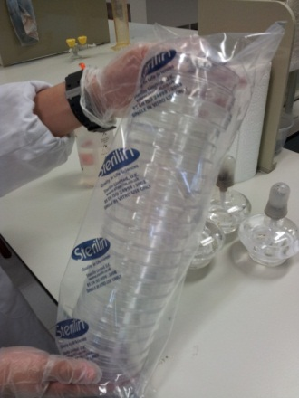
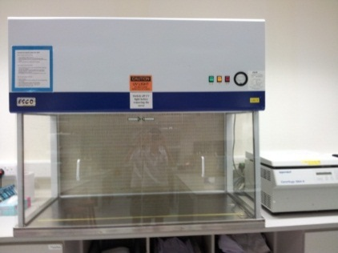
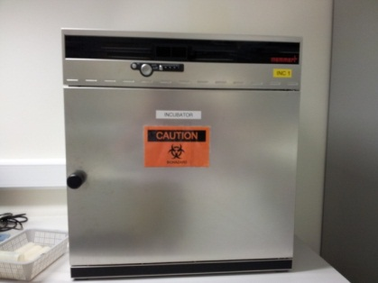
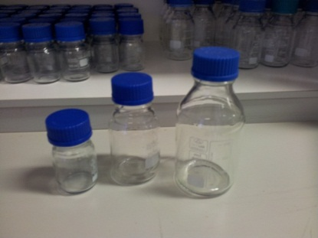
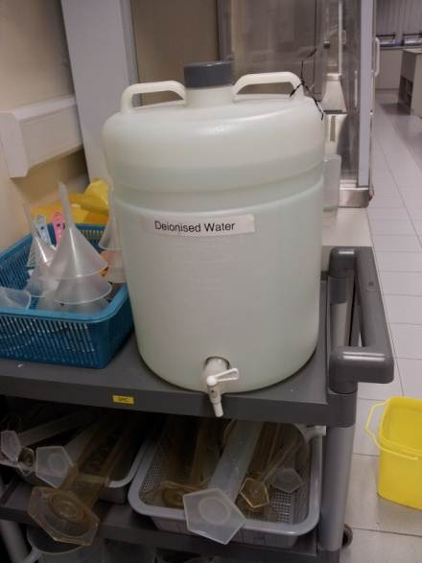
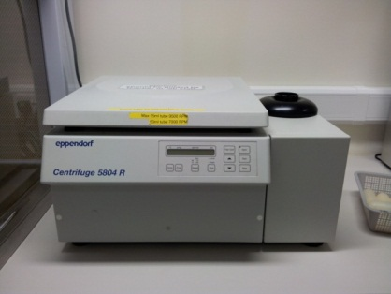
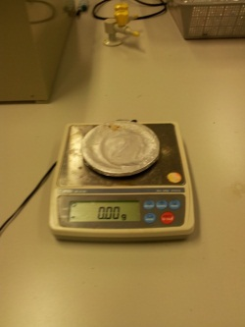
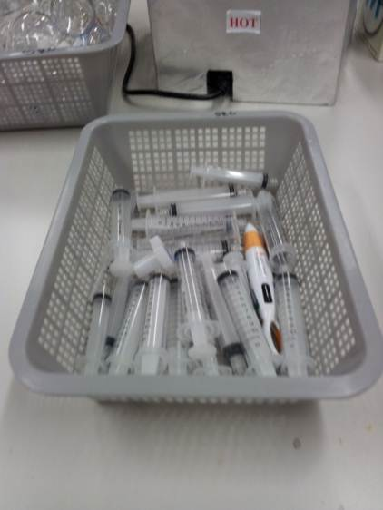
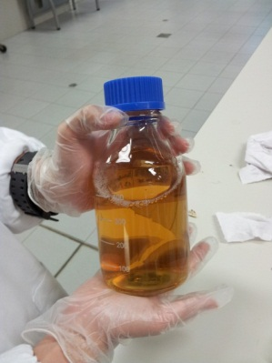
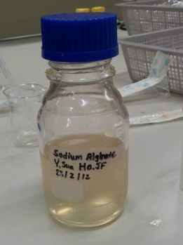
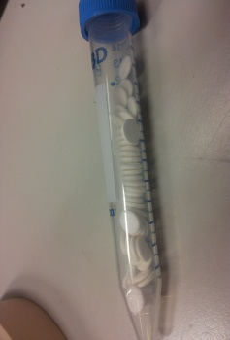
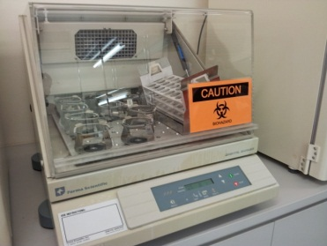
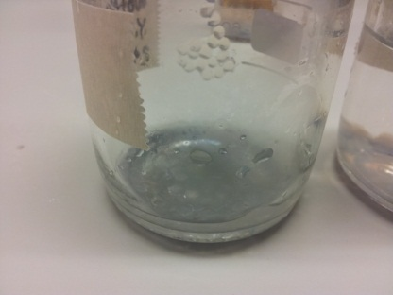
Materials and Apparatus
Laminar Flow Hood
Incubator
Glass Bottles
Petri Dishes
Centrifuge Shaker
Electronic Scale
Syringes
Deionised Water
Sterile Agar
(Molten Form)
Orbital Shaker
Sodium Alginate (Beads)
Sodium Alginate
(Molten Form)
Sterile Paper Discs

Slide 14
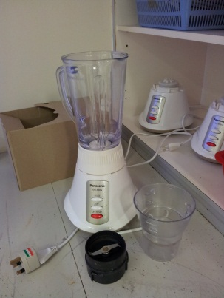
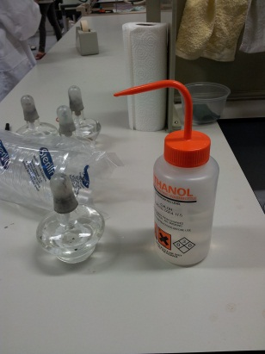
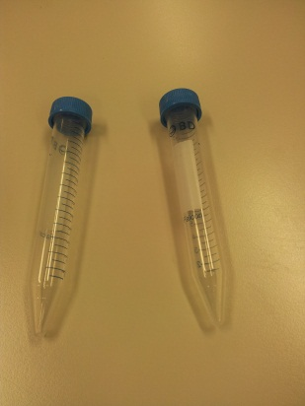
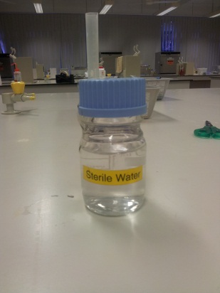
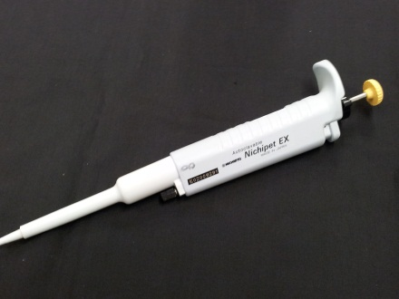
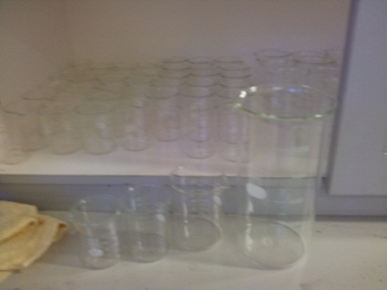
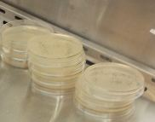
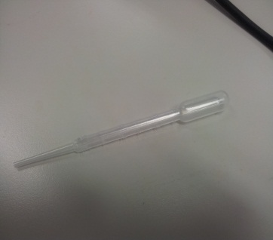
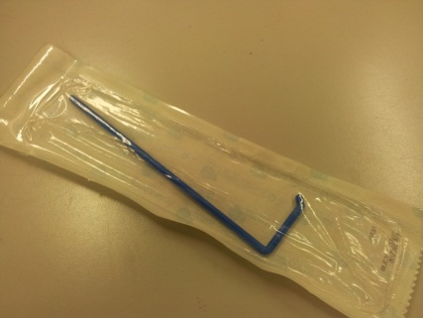
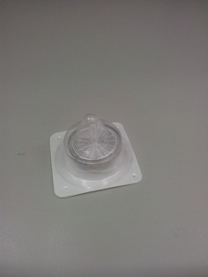
Materials and Apparatus
Blender
Pipette
Ethanol and
Alcohol Burner
Centrifuge Tubes
Sterile Water
Beakers
Nutrient Agar (Plated)
Dropper
Spreader
Filter Membrane

Slide 15
Preparation of food sources
Garlic, Onion, and Coffee Beans are blended separately. The lime is squeezed to extract the juice. They are then made into 50% extracts.
The blended coffee with water is centrifuged. All the extracts are then filtered to extract any solid residue left in them.
The food is cut into pieces. For garlic and onion, the skin is peeled off. The limes are cut into half.
The liquefied food extracts are then frozen

Slide 16
Variables – Preparation of Food Sources
Controlled Variable | Dependent Variables | Independent Variables
Mass of food to grind up | Concentration of food extract | Type of food extract
Volume of water added to food extract
Controlled Variable | Dependent Variables | Independent Variables
Amount of substance | Amount of bacteria after the substance was added in | Amount of bacteria in the start
Time taken for the bacteria to grow |  | Type of food

Slide 17
Zone of Inhibition
Micro-organisms used: E.coli, M. luetus and Yeast
The bacteria is then swabbed on the agar plates, and food samples are introduced on small paper discs. The bacteria is then left in the incubator to grow overnight
The bacteria are placed in the centrifuge tube with Nutrient Broth, and placed in the orbital shaker for overnight culture
The next day, the agar plates are removed from the incubator. The diameter of the zone of inhibition is then measured and recorded
The food substance which produced the largest zone of inhibition is the best anti-bacteria food

Slide 18
Variables - Zone of Inhibition
Controlled Variable | Dependent Variables | Independent Variables
Time allowed for the bacteria to grow | Diameter of Zone of Inhibition | Type of micro-organism
Temperature which bacteria grows at |  | Type of food extract
Controlled Variable | Dependent Variables | Independent Variables
Amount of substance | Amount of bacteria after the substance was added in | Amount of bacteria in the start
Time taken for the bacteria to grow |  | Type of food

Slide 19
Colony Count
The micro organisms are adjusted to a concentration of 10⁷ CFU/ml
The food extracts are then introduced in liquid suspensions
Every 20 minutes, a sample of each mixture is plated and incubated
After overnight incubation, the plates are removed from the incubator. The resultant colony number is then recorded

Slide 20
Variables – Colony Count
Controlled Variable | Dependent Variables | Independent Variables
Amount of liquid suspension plated | The colony left in each agar plate (resultant CFU) | Type of micro-organism & food extract in mixture
Time given for bacteria to grow

Slide 21
Food Extracts on Water Samples
The water samples taken before are unfrozen. Using a pipette, a fixed amount of each type of water is then introduced onto 5 agar plates each
The bacteria is then left to grow
Each type of food extract, and with a control (sterile water) are introduced on to 3 different agar plates containing different types of water. They are then mixed with the water
After a few days, the plates are removed. The results (amount of bacteria in each plate) are then compared with those done with E.coli, M.luetus and Yeast

Slide 22
Variables - Food Extracts on Water Samples
Controlled Variable | Dependent Variables | Independent Variables
Amount of substance | Amount of bacteria after the substance was added in | Amount of bacteria in the start
Time taken for the bacteria to grow |  | Type of food
Controlled Variable | Dependent Variables | Independent Variables
Time allowed for the bacteria to grow | Amount of Bacteria left on the Agar Plate | Type of Water
Amount of micro-organism |  | Type of micro-organism
Amount of water sample

Slide 23
General Timeline for Experiments
1
Preparation of Food Extracts
Zone of Inhibition
3
Colony Count
2
Food Extract on Water Samples as a Prove of Concept
4

Slide 24
Bibliography
A review of disinfection practices and issues. N.p., n.d. Web. 19 Feb 2012. <http://www.waterandhealth.org/drinkingwater/wp.html>
A review of disinfection practices and issues. N.p., n.d. Web. 19 Feb 2012. <http://www.waterandhealth.org/drinkingwater/wp.html>
Peter H.Gleick, 2002, 15th August, Pacific Institute Research Report
W.O.K Grabow, Nerrie C. Basson , 1997. National Institute for Water Research of the Council of Scientific and Industrial research
The world, 2011, 1 1
Alan.J.Sulsarenko, Anant Patel, Daniela Portz, 2007, 27th September
Ramanaviciene, A., Mostovojus, V., Bachmotova, I., & Ramanavicius, A. (2003). Anti-bacterial effect of caffeine on Escherichia coli and Pseudomonas fluorescens. Acta Medica Lituanica, 10(4), 185-188.
Greenwood, B. 2011, September 29). Retrieved from http://www.livestrong.com/article/545173-does-caffeine-affect-bacteria
Jonathan Santas; María Pilar Almajano; The University of Barcelona, Spain, 2010. The International Journal of Food Science and Technology

Slide 25
Bibliography
Jonathan Santas; María Pilar Almajano; The University of Barcelona, Spain, 2010. The International Journal of Food Science and Technology

Slide 26
The End
Thank you for your time :D

