Slide 1
Effects of Common Foods on Bacteria in Water
Group ID: 1-030
Team Members:
Sun Yudong 2O2 (L)
Koh Yi Zhe 2O2
Tan Hsien En 2O2
Ho Jie Feng 2O4

Slide 2
Contents
Objectives and Rationale
Food & Water Sources
Hypothesis
Timeline for Experiments
Materials & Apparatus
Process and Variables
Results
Conclusion
Applications
Picture from: Microsoft

Slide 3

Objectives and Rationale
We were inspired to find out how to get rid of the bacteria in water.
We intend to find common food substances, which we encounter in our daily lives that have anti-bacterial characteristics to make the water cleaner for consumption.
www.paranormalpointofview.blogspot.com

Slide 4

Food, water sources and micro-organisms used
Food extracts
Lime
Coffee grounds
Onion
Garlic
Water sources
Rainwater
Micro Organisms
E. coli
M. luteus
Yeast
www.teachengineering.org

Slide 5
Lime | Garlic | Onion | Coffee Grounds
It has been found to be protective against the transmission of cholera, and to be effective against yeast Antibacterial properties of acidic lime extracts: average amount of viruses and bacteria in waste water had drastic drops of up to 96% W.O.K Grabow, Nerrie C. Basson , 1997. National Institute for Water Research of the Council of Scientific and Industrial research | Contains a disulfide, Ajeone, prevents infections with yeast Candida albicans Crushed garlics prevent infection of Pseudomonas aeruginosa in burn patients Alan.J.Sulsarenko, Anant Patel, Daniela Portz, 2007, 27th September | Quercetin was extracted from the onions and tested on different species of Bacteria, such as M.luteus Quercetin had an inhibitory effect on all the strains of bacteria that were studied Jonathan Santas; María Pilar Almajano; The University of Barcelona, Spain, 2010. The International Journal of Food Science and Technology | Coffee grounds has been tested on E. coli and other bacteria Coffee Grounds was more effective at inhibiting bacterial strains than was the antibiotic ampicillin Greenwood, B. 2011, September 29. Retrieved from http://www.livestrong.com/article/545173-does-caffeine-affect-bacteria

Slide 6
Our Hypothesis
Lime extracts have the best anti-bacterial properties

Slide 7
General Timeline for Experiments
1
Preparation of Food Extracts
Zone of Inhibition (ZOI)
3
Colony Count (CC)(Time point Experiment)
2
4
Food Extract on Water Samples as a Proof of Concept

Slide 8
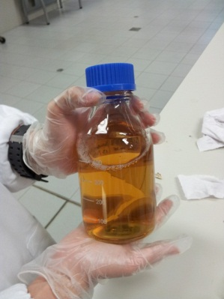
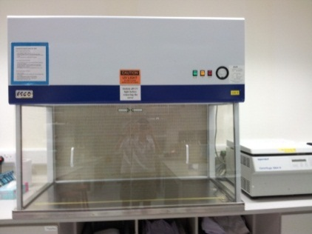
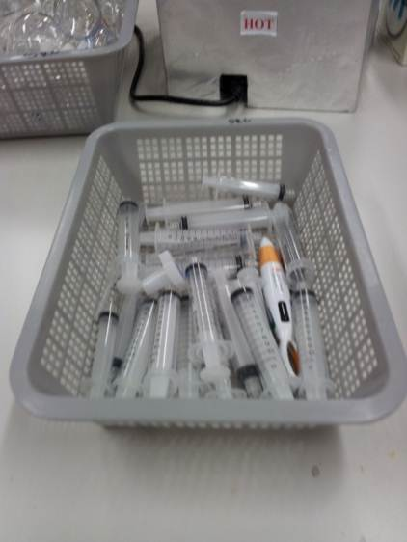
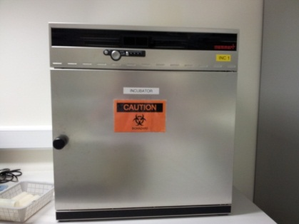
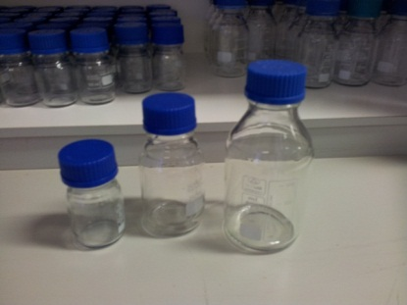
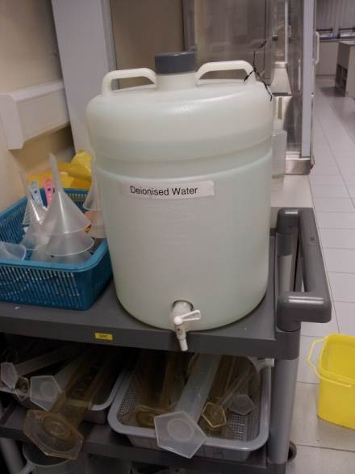
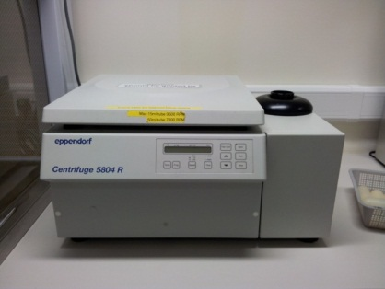
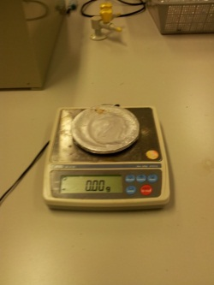
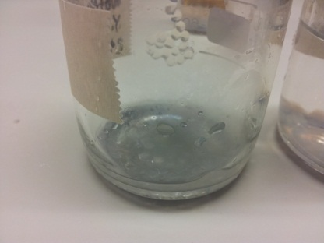
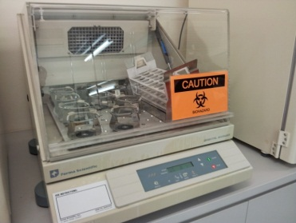
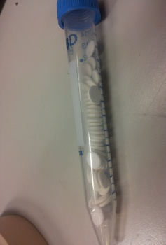
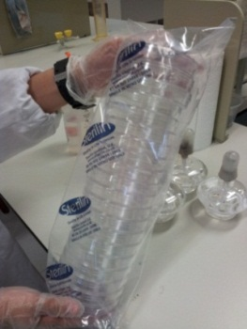
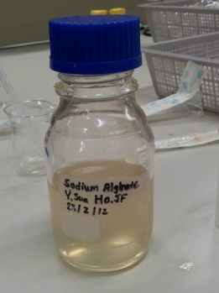
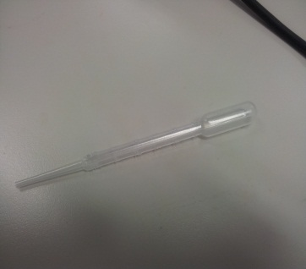
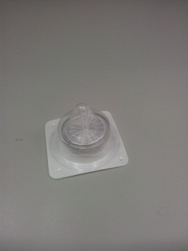
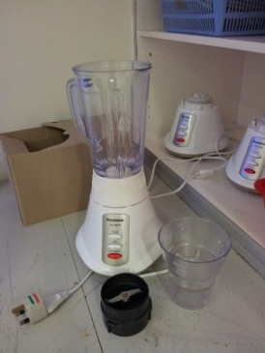
Materials and Apparatus

Slide 9
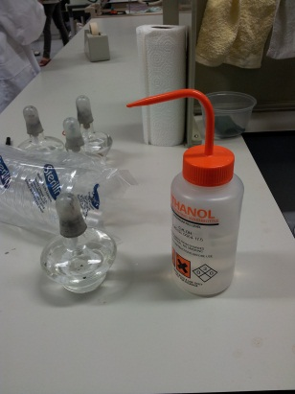
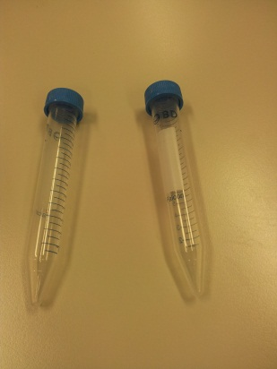
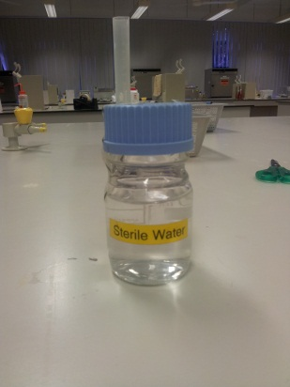
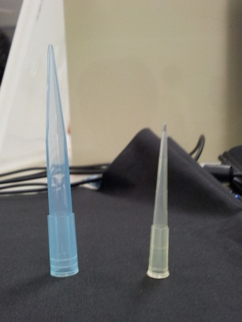
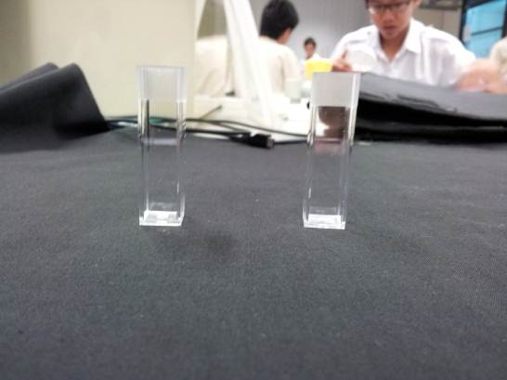
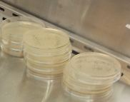
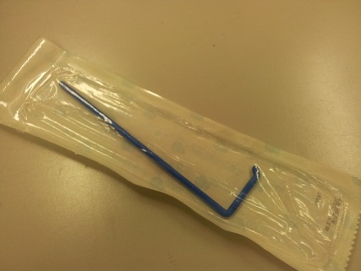
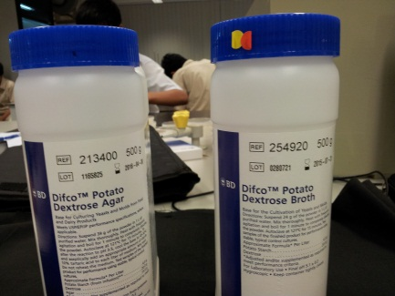
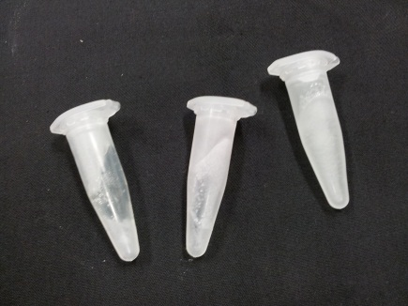
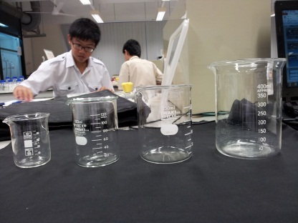
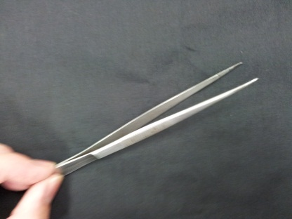
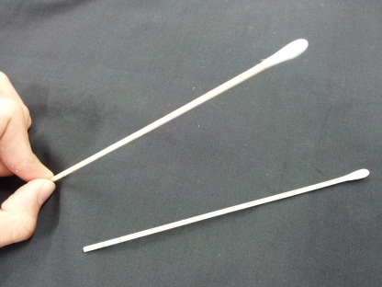
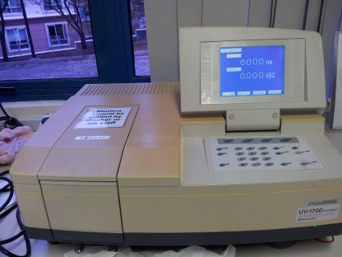
Materials and Apparatus

Slide 10
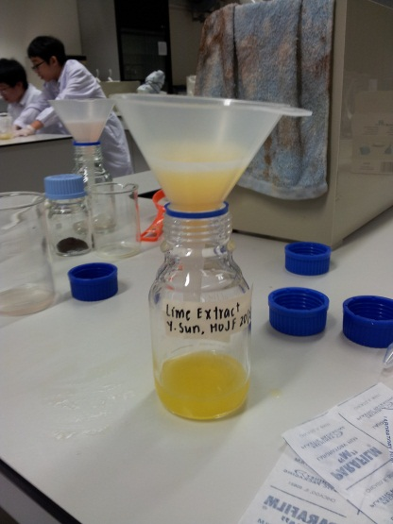
Preparation of food extracts
Garlic, Onion, and Coffee Beans are blended separately. The lime is squeezed to extract the juice. They are then made into 50% extracts (M/V).
The blended extracts with water are centrifuged and then filtered to extract any solid residue left in them.
The liquefied food extracts are then frozen
Notes:
First step, elaborate that garlic and onion skin peeled off
Also, explain 50% extracts

Slide 11
Variables – Preparation of Food Sources
Controlled Variable | Dependent Variables | Independent Variables
Mass of food to grind up | Concentration of food extract | Type of food extract
Volume of water added to food extract

Slide 12
Zone of Inhibition
Micro-organisms used: E.coli, M. luteus and Yeast
The bacterium and Yeast are then swabbed on separate agar plates. Food samples are then introduced on small paper discs, together with a control (sterile water), which are then placed on the agar plates. The plates are then left in the incubator to grow overnight.
The next day, the agar plates are removed from the incubator. The diameter of the zone of inhibition for each of the food sources are then measured and recorded.
The food substance which produced the largest zone of inhibition is the best anti-bacteria food
Notes:
Purpose of ZOI is to find out if the anti bacterial substances do have a effect on the bacteria.
Second step: Elaborate that the nb is to be put around 9-10 ml
Third step: Using cotton swaps to swab bacteria
Using marker to mark on the agar plate using a “X” to show that the food source will be placed there to react with the bacteria.

Slide 13
Variables - Zone of Inhibition
Controlled Variable | Dependent Variables | Independent Variables
Time allowed for the bacteria to grow | Diameter of Zone of Inhibition | Type of micro-organism
Temperature which bacteria grows at |  | Type of food extract

Slide 14
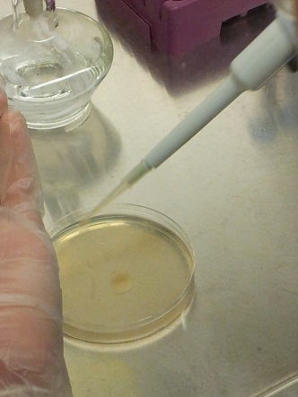
Colony Counting (Time Point Experiment)
The micro organisms are adjusted to a concentration of 10⁷ CFU/ml
The food extracts are then introduced in liquid suspensions
Every 20 min, samples of the mixture were taken, diluted and plated
After overnight incubation, the resultant colony numbers were then recorded and used to calculate the final numbers of microorganisms
Notes:
Starting point: Although we know through the zone of inhibition that the anti bacterial food is showing effectiveness on the bacteria, we do not know for sure whether it is bactericidal or bacteriostatic. After all, we are trying to find out food sources that can not only stop the bacteria in water from continuing to grow, but also kill the bacteria and show a decrease. By colony counting, we are able to find out, by counting the colonies of bacteria at every interval.

Slide 15
Variables – Colony Count
Controlled Variable | Dependent Variables | Independent Variables
Amount of liquid suspension plated | The colony left in each agar plate (resultant CFU) | Type of micro-organism & food extract in mixture
Time given for bacteria to grow

Slide 16
Extracts on Rainwater
Using a pipette, a fixed volume of rainwater is mixed with food extracts
The samples are then left to grow overnight at 37°C
The mixture is then plated on agar.
The next day, the plates are removed. The resultant micro-organism growth was compared, relative to a negative control
Notes:
Purpose of Extracts of water: To make sure that the anti-bacterial food sources work on not only the bacteria, E. coli and M. luteus, but also water.

Slide 17
Results
Zone of Inhibition
Colony Count Extracts on Water

Slide 18
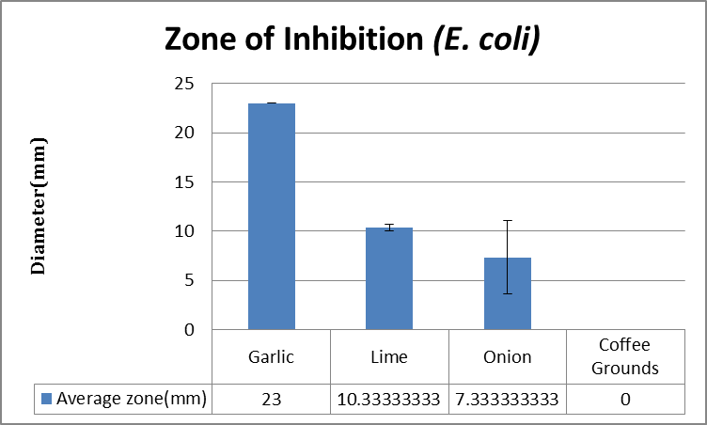
Standard error | 0 | 0.333333333 | 3.711842909 | 0

Slide 19
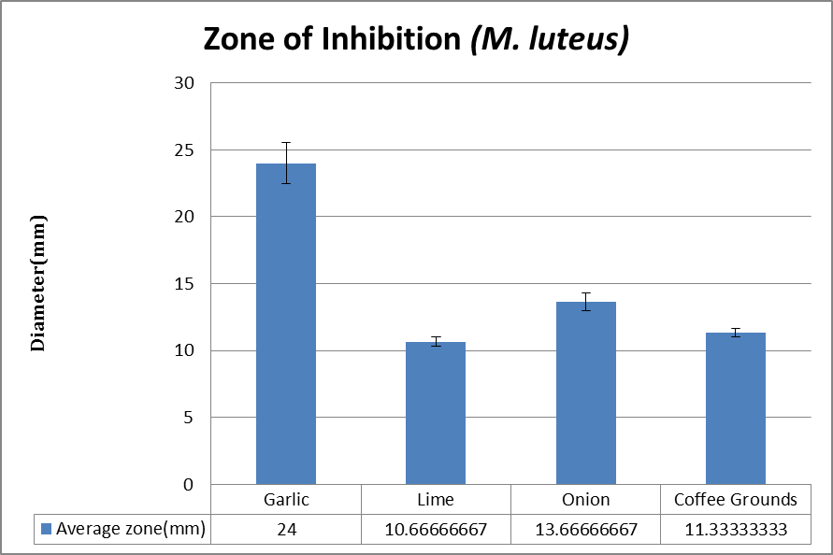
Standard error | 1.527525232 | 0.333333333 | 0.666666667 | 0.333333333
Notes:
You need to have some form of discussion for these 2 slides eg: in both cases, lime demonsrated the highest efficacy indicating it targets elements or structures common in both Gram-positive and Gram-negative bacteria. In constrast, coffee extract demonstrate efficacy only towards ML, suggesting that it target Gram-positive specific structures, such as the petidoglycan cell wall. (add pic)

Slide 20
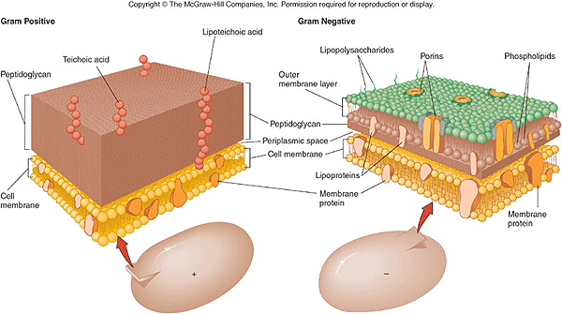
http://water.me.vccs.edu/courses/env108/clipart/cellwall.gif

Slide 21
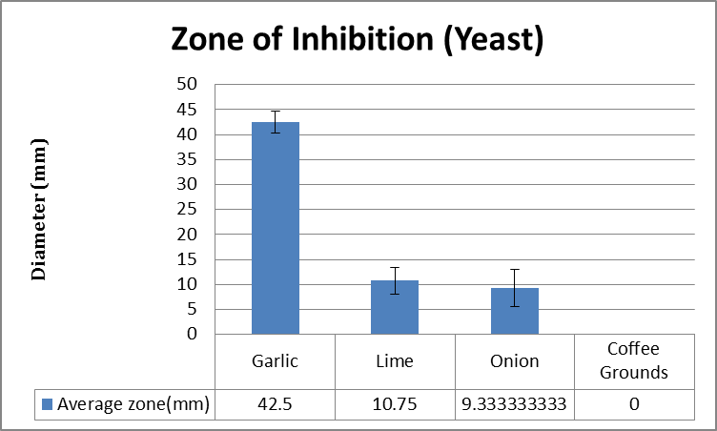
Standard error | 2.254624876 | 2.688710967 | 3.711842909 | 0
Notes:
Since it works on prokaryotic cells such as Bacteria E.coli and M.luteus , we want to test if it works on eukaryotic cells such as Yeast.

Slide 22
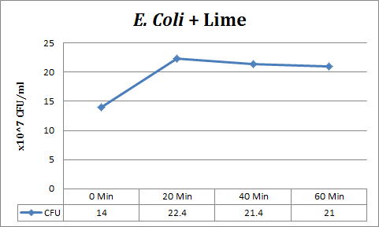
Colony Count Results
Notes:
Again, you need to have some form of a conclusion—bacteriostatic/ bactericidal upto ~60min (?)

Slide 23
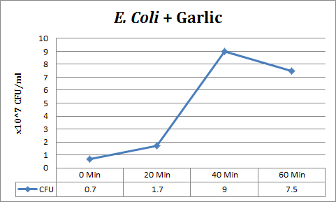
Colony Count Result
Notes:
Again, you need to have some form of a conclusion—bacteriostatic/ bactericidal upto ~60min (?)

Slide 24
Garlic & Lime Mixture

Slide 25
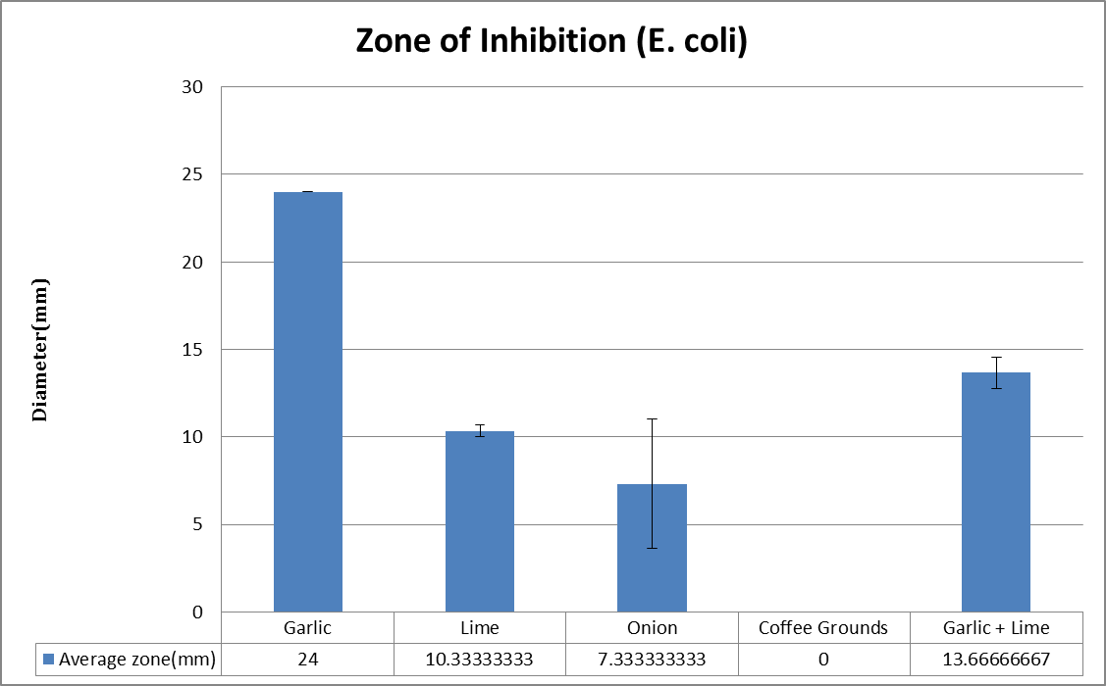
(E.coli)
43%
Standard error | 0 | 0.333333333 | 3.711842909 | 0 | 0.881917104
Notes:
Percentage
Custom animation

Slide 26
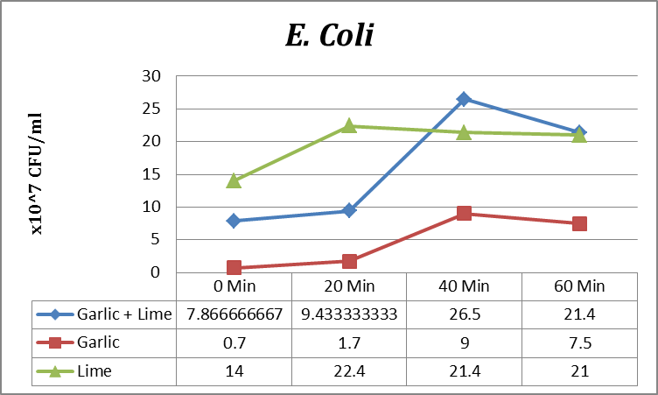
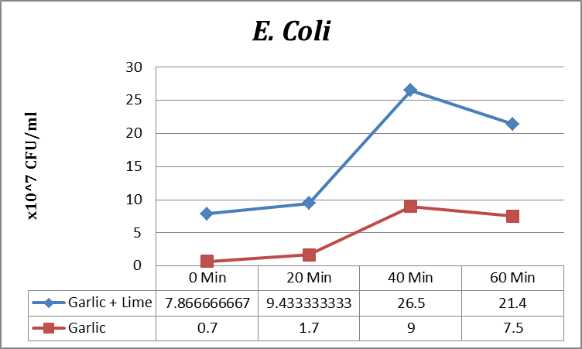
Colony Count
Notes:
Restangle 20 min followed bacterial static effect for the 1st 20 mins, but lopses its effect thereafter, allowing a greater rebound than garlic extract alone
Lime fade out
Text box
Show with red arrow

Slide 27
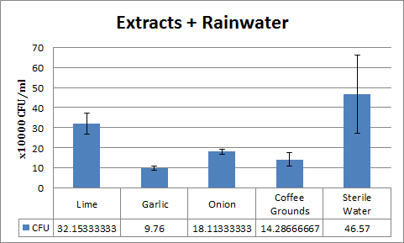
Extracts on Rainwater (Field Test)
Standard error | 5.321279086 | 1.01128631 | 1.220619151 | 3.348279824 | 19.52523239
Notes:
Error row

Slide 28
Conclusions
Garlic has the best anti-bacteria properties across a variety of microorganisms
Coffee extracts seems to target Gram-positive specific structures
Garlic and Lime have antagonistic effects on each other.
Notes:
Conclusions bullet point here, dun scatter throughout ppt

Slide 29
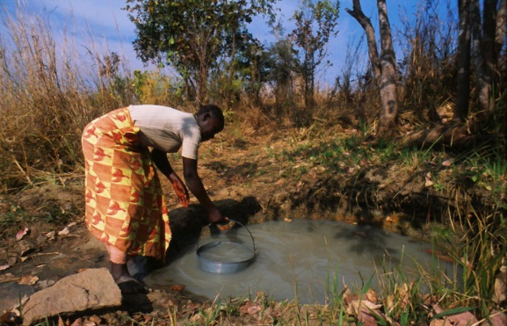
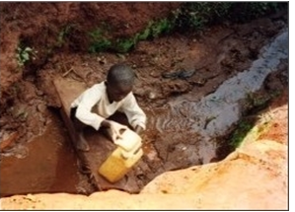
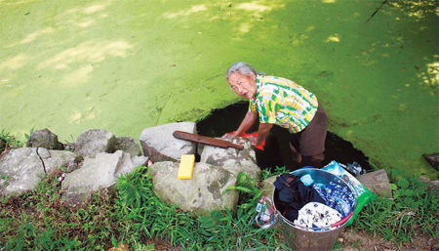
Applications
Picture from:
http://www.mwdws.com/
For use in places where there is
Abundant rainfall
Lack of H O treatment facilities
Poor sanitation
Using the extracts to make a product
Use in filters to purify water
Soap, detergent and other related products.
Practicality
Environment friendly
Cheap
Can be mass produced
2
Picture from:
http://images.china.cn/
Notes:
In places wheree………… We can collect rainwater,, and add the extracts and we can prevent the incidences of water borne diseases
Show pics of rural areas water treatment nappy cloth

Slide 30
Bibliography
A review of disinfection practices and issues. N.p., n.d. Web. 19 Feb 2012. <http://www.waterandhealth.org/drinkingwater/wp.html>
Peter H.Gleick, 2002, 15th August, Pacific Institute Research Report
W.O.K Grabow, Nerrie C. Basson , 1997. National Institute for Water Research of the Council of Scientific and Industrial research
The world, 2011, 1 1
Alan.J.Sulsarenko, Anant Patel, Daniela Portz, 2007, 27th September
Ramanaviciene, A., Mostovojus, V., Bachmotova, I., & Ramanavicius, A. (2003). Anti-bacterial effect of caffeine on Escherichia coli and Pseudomonas fluorescens. Acta Medica Lituanica, 10(4), 185-188.
Greenwood, B. 2011, September 29. Retrieved from http://www.livestrong.com/article/545173-does-caffeine-affect-bacteria
Jonathan Santas; María Pilar Almajano; The University of Barcelona, Spain, 2010. The International Journal of Food Science and Technology
Essence of life. (n.d.). Retrieved from http://www.rense.com/1.mpicons/acidalka.htm

Slide 31
The End
Thank you for your time :D

