Slide 1
Modeling and Analysis of Adaptive Frequency Synthesis for Supply Droop Mitigation
Sunjin Choi
EE241B Project
Notes:
Intro
Affilitation
Title

Slide 2
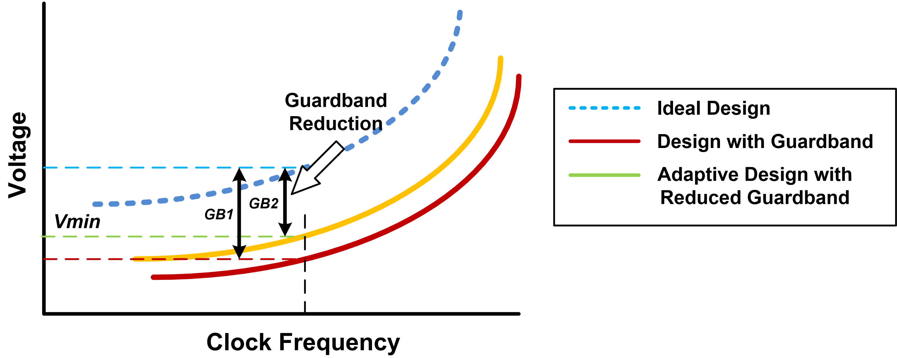


Motivation
To guard digital system against supply variations, should add enough static margin, or guardband to supply voltage
Supply Voltage Margin $↑$, Power Efficiency $↓$
Adaptive Techniques in Clocking Design $⇒$ Power Efficiency $↑$
$Vmin$: minimum operating supply voltage
Notes:
Read
Adaptive clocking contributes to the guardband reduction
+ terminology Vmin

Slide 3
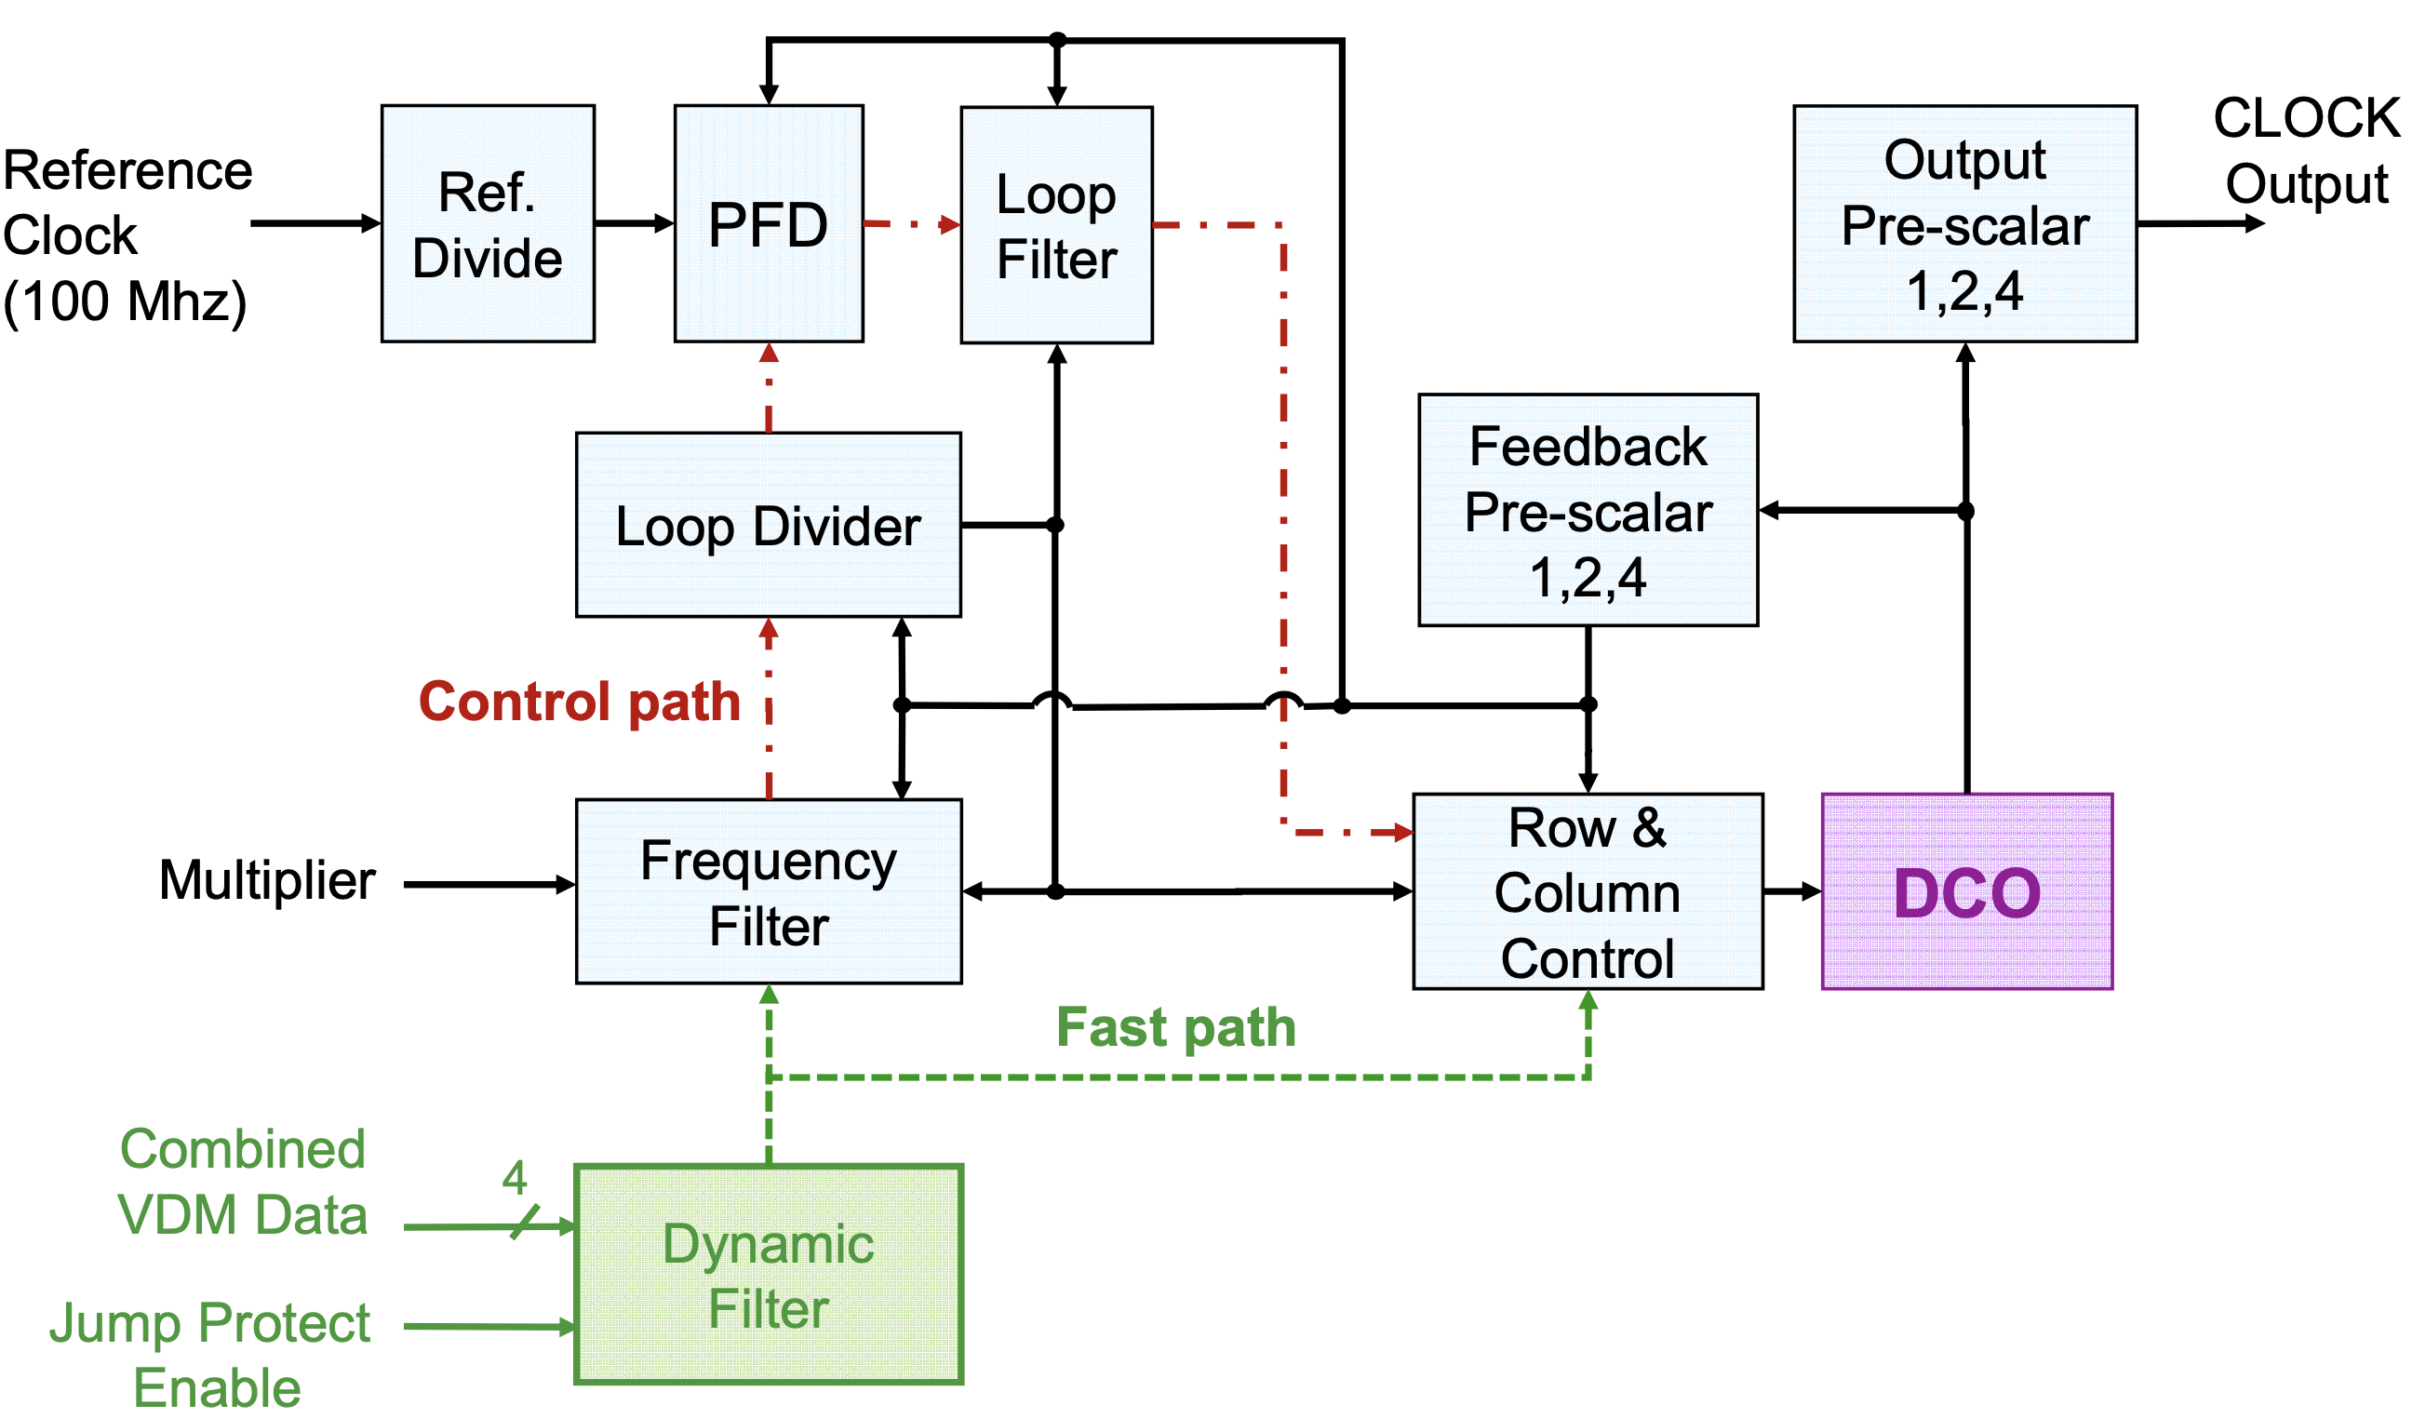
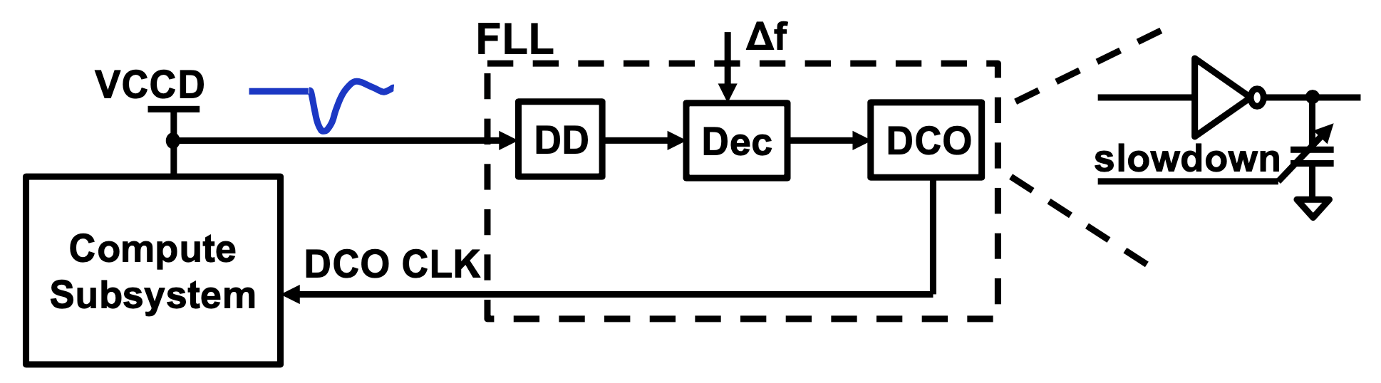
Challenges
Promising technique is Adaptive Frequency Synthesis, where PLL output frequency is directly modulated by Supply Droop Detector
Lacks System-Level Modeling and Analysis works
?
System-Level Models for
Identifying Key Design Params
Identifying Design Tradeoffs
Design Space Exploration
[IBM ISSCC 2017]
[Intel ISSCC 2021]
Notes:
Out there CDC, Clock Stretcher

Slide 4
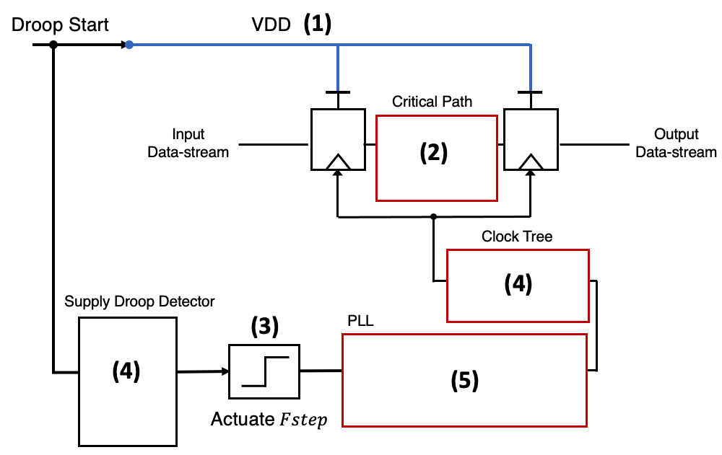
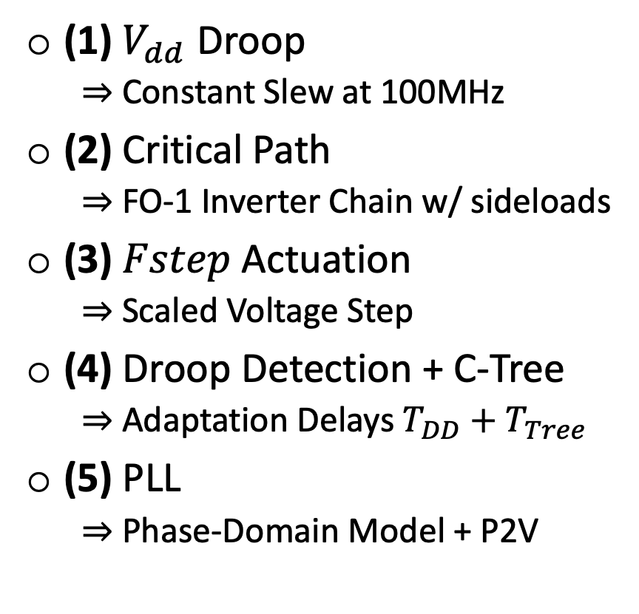
Proposed Model
Simple System-Level Model Compatible with SPICE Simulations
(1) $V_{dd}$ Droop
$⇒$ Constant Slew at 100MHz
(2) Critical Path
$⇒$ FO-1 Inverter Chain w/ sideloads
(3) $Fstep$ Actuation
$⇒$ Scaled Voltage Step
(4) Droop Detection + C-Tree
$⇒$ Adaptation Delays $T_{DD}+T_{Tree}$
(5) PLL
$⇒$ Phase-Domain Model + P2V
cf., Assuming Per-Core PLL for Adaptation
Notes:
Read
Each component

Slide 5
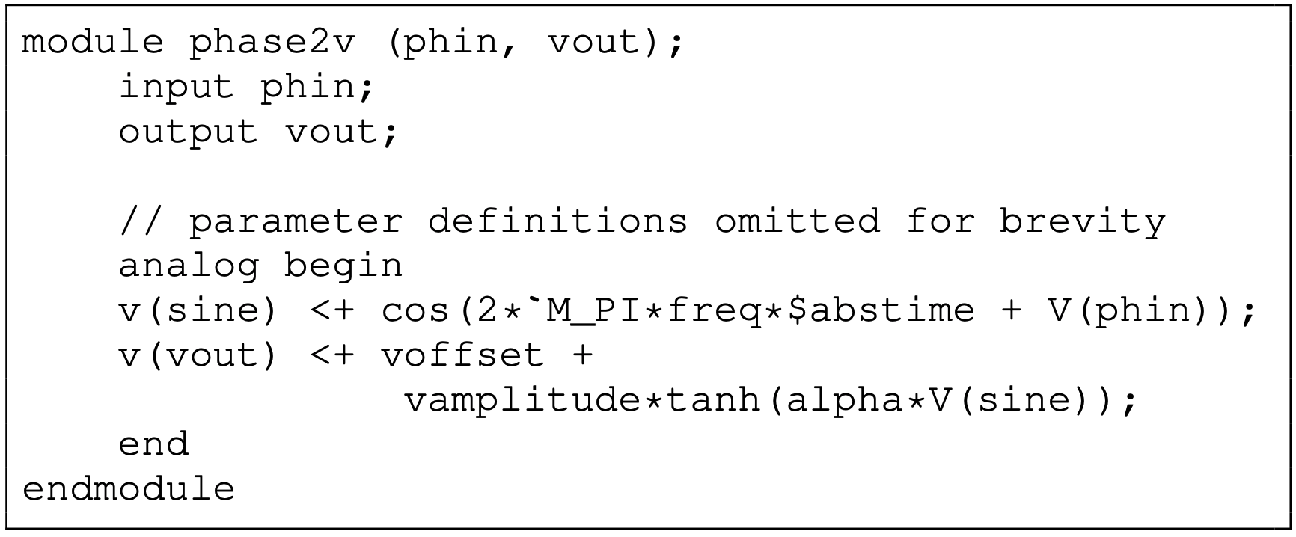
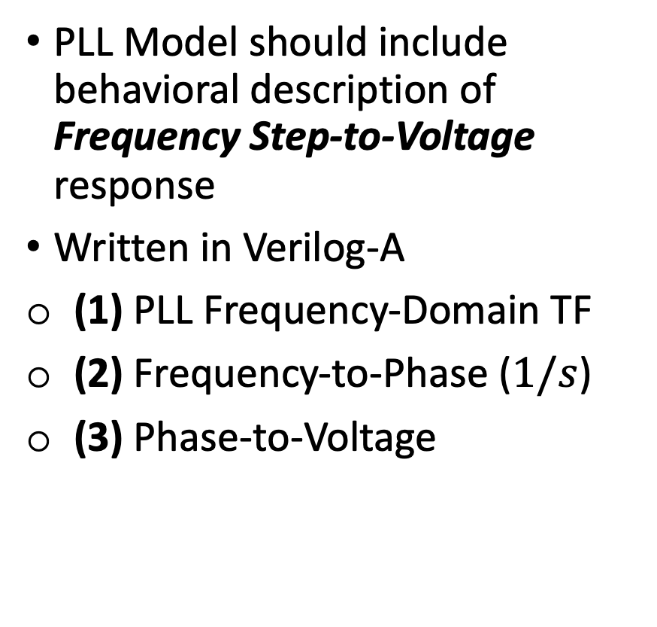
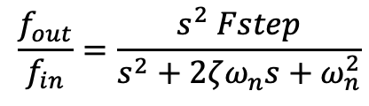
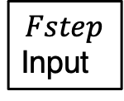

PLL Model
PLL Model
PLL Model should include behavioral description of Frequency Step-to-Voltage response
Written in Verilog-A
(1) PLL Frequency-Domain TF
(2) Frequency-to-Phase ($1/s$)
(3) Phase-to-Voltage
$$Fstep$$
Input
$$1/s$$
P2V
Clock
Output
(1)
$$\frac{f_{out}}{f_{in}}=\frac{s^{2} Fstep}{s^{2}+2ζω_{n}s+ω_{n}^{2}}$$
(2)
(3)

Slide 6
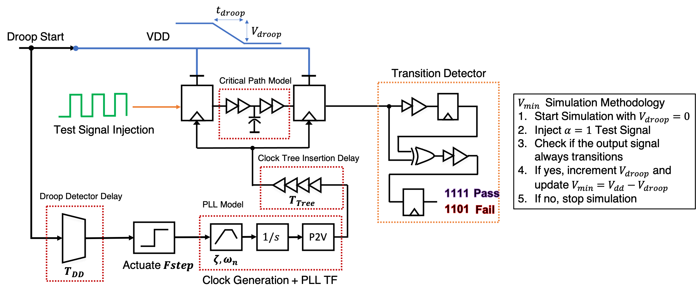
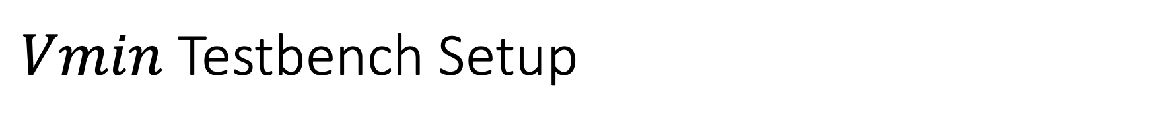
$Vmin$ Testbench Setup
Design Parameters {$Fstep$, $T_{DD}+T_{Tree}$, $ζ$,$ω_{n}$} $⇒$ System Performance $Vmin$

Slide 7
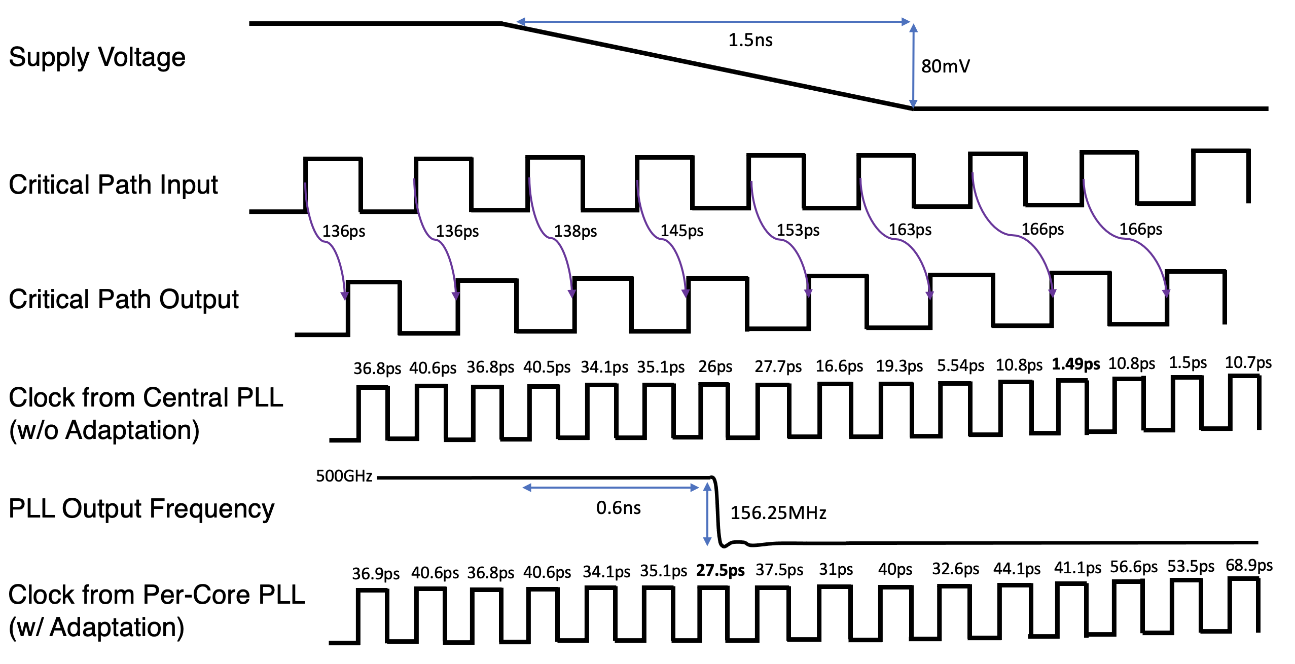
Model Validation
Comparison with Baseline Architecture: Central PLL w/o Adaptation
< Timing Diagram with Annotated Critical Path Slack >

Slide 8
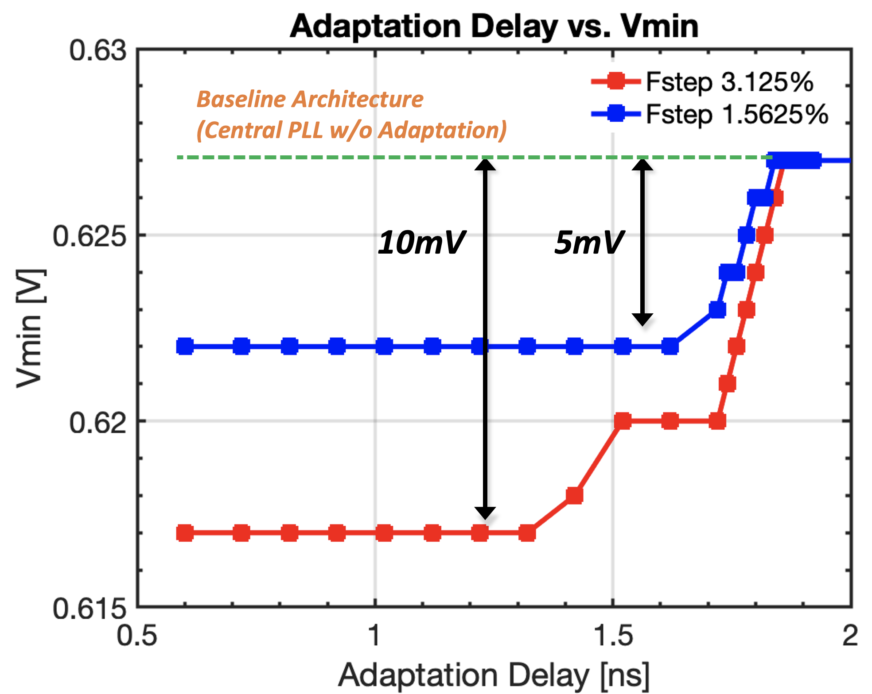
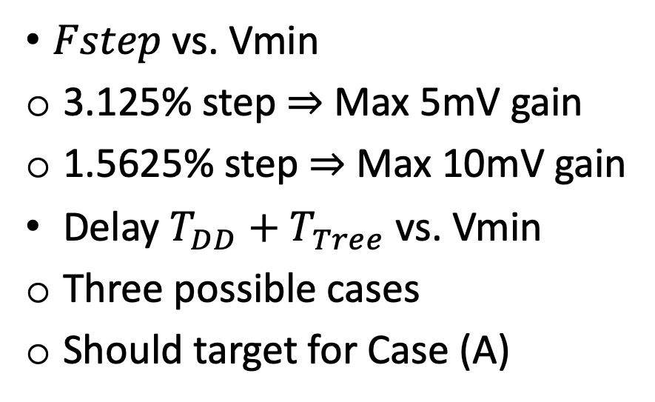

Effect of $Fstep$, Adaptation Delay
$Fstep$ vs. Vmin
3.125% step $⇒$ Max 5mV gain
1.5625% step $⇒$ Max 10mV gain
Delay $T_{DD}+T_{Tree}$ vs. Vmin
Three possible cases
Should target for Case (A)
cf., Fstep 3.125% for small droops [IBM JSSC 2018]
Case (A)
Case (B)
Case (C)

Slide 9
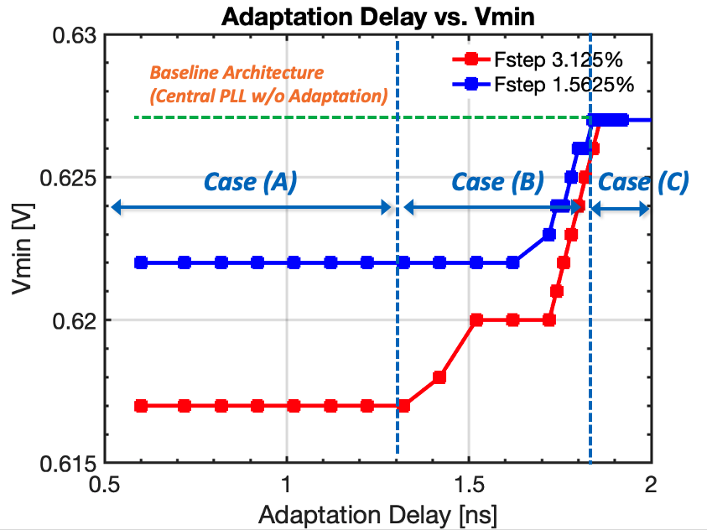
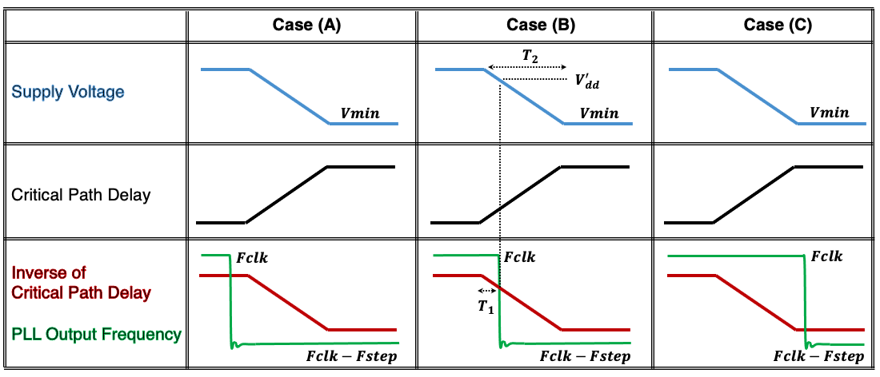

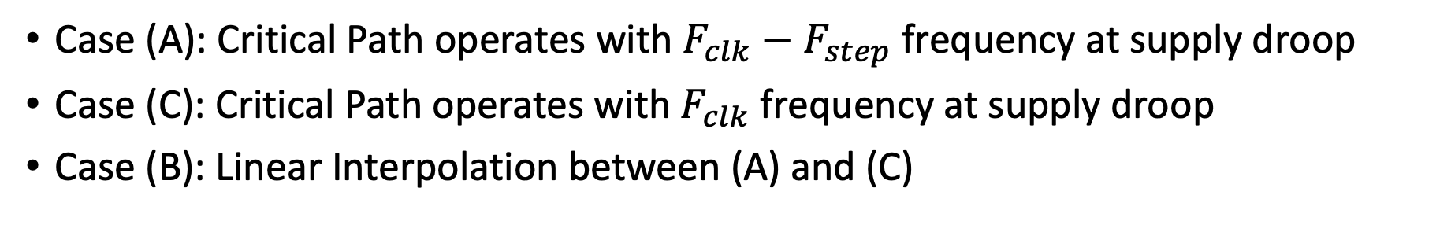
Understanding Adaptation Delay vs. $Vmin$
Case (A): Critical Path operates with $F_{clk}−F_{step}$ frequency at supply droop
Case (C): Critical Path operates with $F_{clk}$ frequency at supply droop
Case (B): Linear Interpolation between (A) and (C)

Slide 10
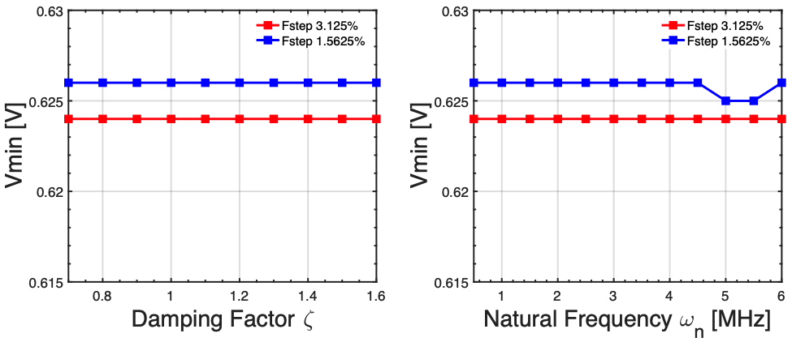
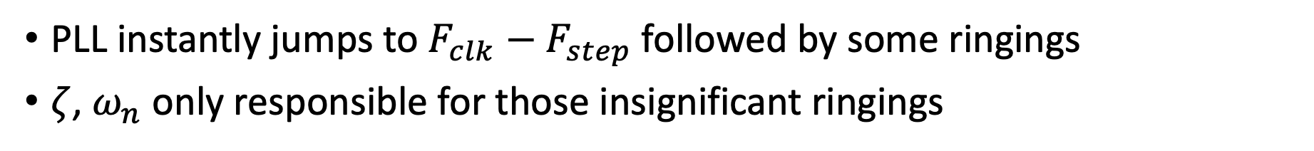
Effect of PLL Parameters
PLL instantly jumps to $F_{clk}−F_{step}$followed by some ringings
$ζ$, $ω_{n}$ only responsible for those insignificant ringings

Slide 11
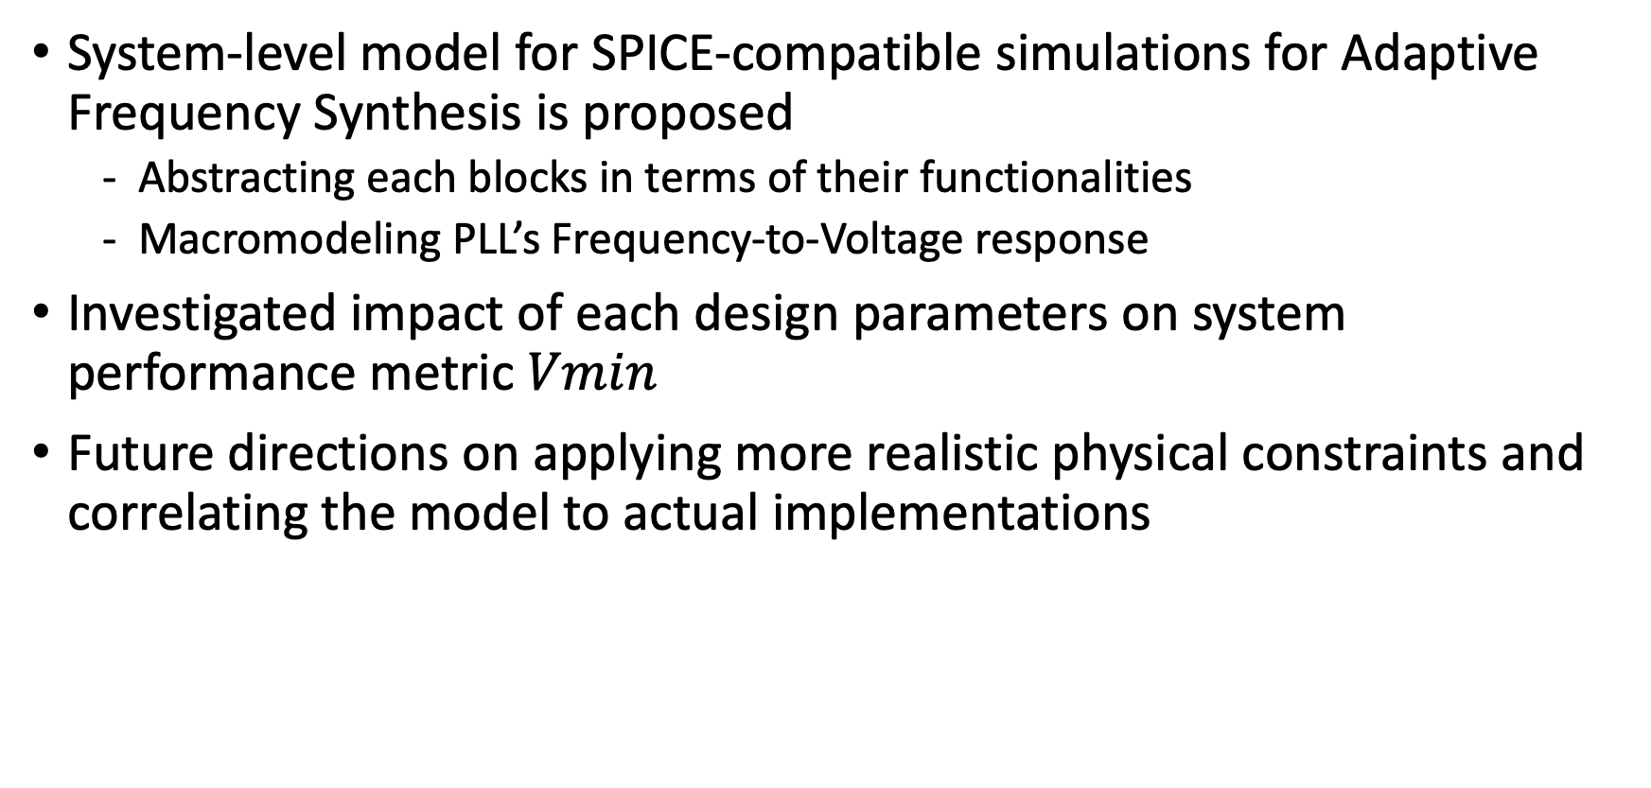
Summary
System-level model for SPICE-compatible simulations for Adaptive Frequency Synthesis is proposed
Abstracting each blocks in terms of their functionalities
Macromodeling PLL’s Frequency-to-Voltage response
Investigated impact of each design parameters on system performance metric $Vmin$
Future directions on applying more realistic physical constraints and correlating the model to actual implementations

