Slide 1
Classifying Hand written alphabets Using Topological Data Analysis
Nicolas mazzei
Shubham pal
K Sunil Joshi
Abhinav
Meng li
Wang yang li
TEAM F

Slide 2
Contents
Introduction
How TDA is different from classical ML Algorithms?
Algorithms used: Persistent Homology and Betti Numbers
Scanning and filtration methods
Tests/Experiments
Interpreting results

Slide 3
Introduction
In this project we tried to classify hand written alphabets using topological data analysis.
Techniques like persistent homology, betti numbers and filtration were mainly used for the implementation.
The data is collected and labelled manually for 26 English alphabets and fed as a consolidated csv file as input.

Slide 4
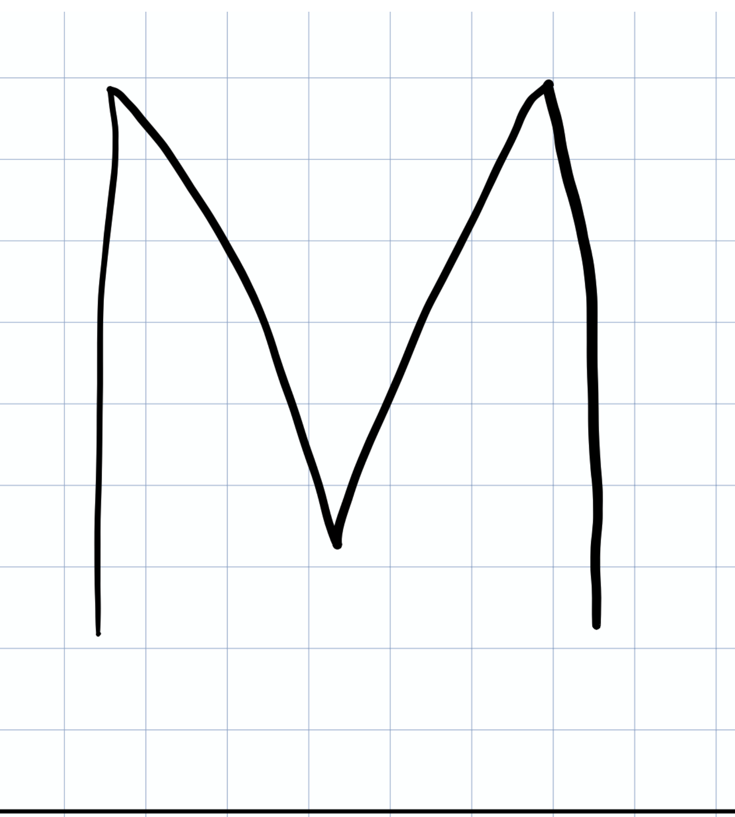
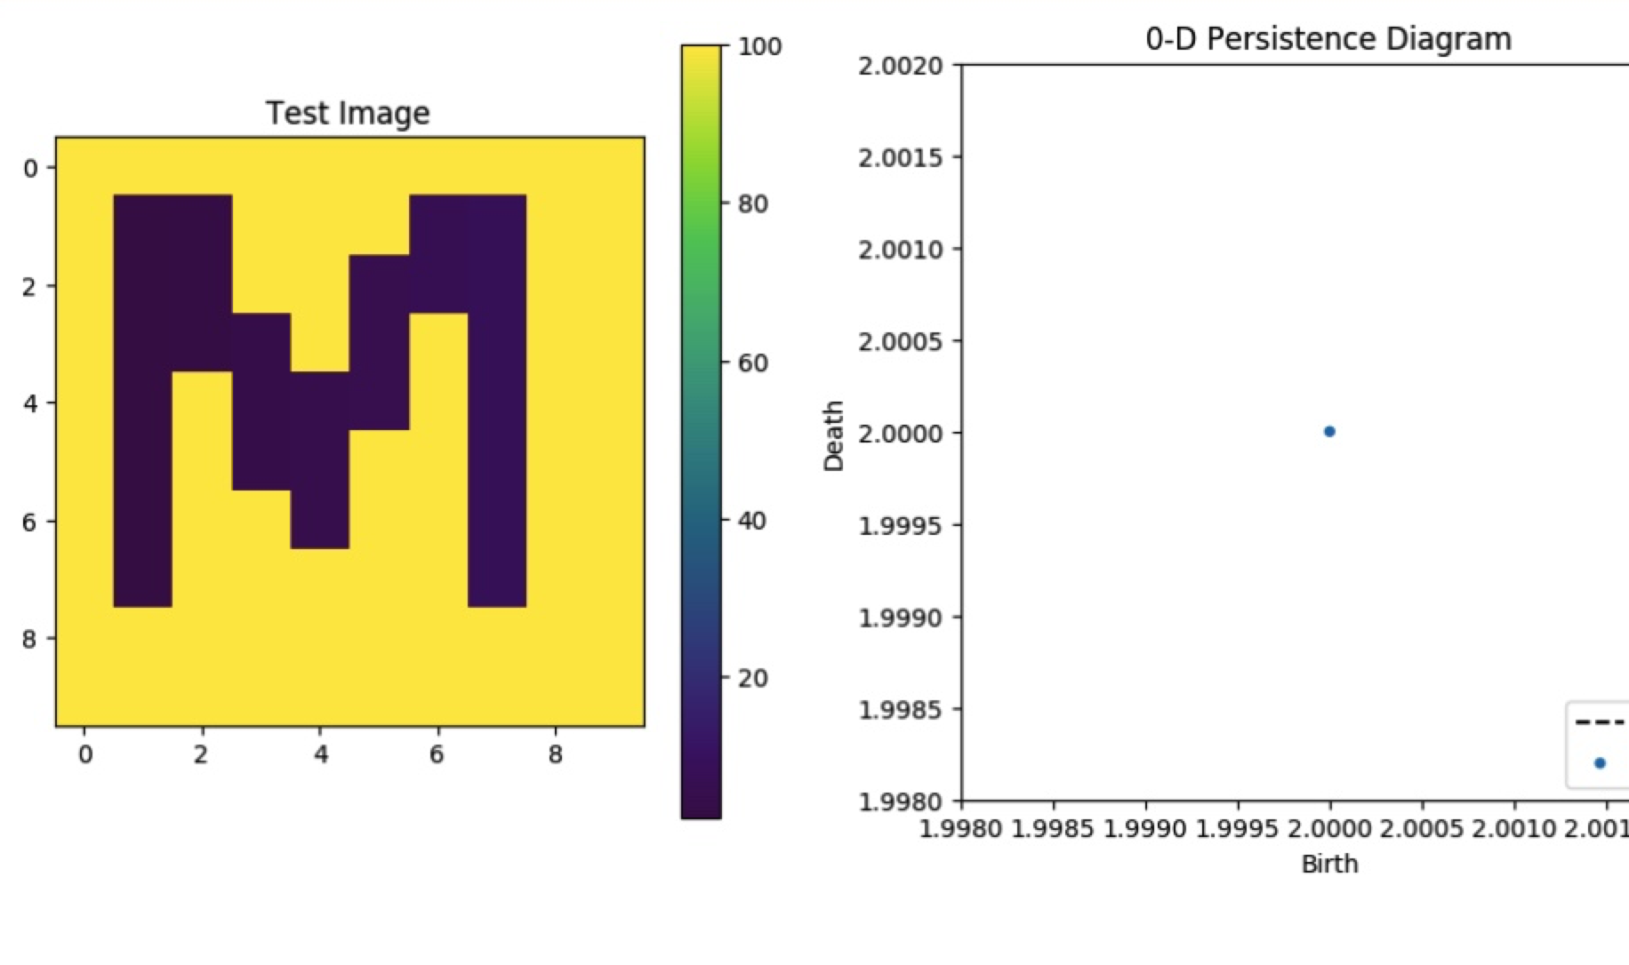
Input data
Low Star Image Filtration and Its 0 dimensional homology

Slide 5
How TDA is different from classical ML Algorithms?
Classification is supervised algorithm in classical machine learning where the task is to predict the class labels.
Here the class labels to predict would be one of the 26 alphabets .
Topological Data Analysis techniques like persistent homology , betti numbers are used to classify the letters where the dataset collected is read as point cloud.
From point cloud 0 and 1 dimensional homologies for each letter are calculated using ripser.
Ripser is a TDA package under scikit TDA which is developed in Python.

Slide 6
.
Compared to classical ML Algorithms where a hyperplane is used to classify the datapoints, TDA uses the birth and death rates of 0 and 1 dimensional homologies of the point cloud as a classification scheme.
In TDA no hyper plane is used to classify the data compare to ML algorithms.

Slide 7
Algorithms used: Persistent Homology , and Betti Numbers
In this approach we used betti numbers, rips filtration and lower star image algorithms where the whole dataset is considered as a point cloud.
Calculate the betti numbers for the given data for the each letters where the input is fed a 0’s and 1’s and outputs as betti 0 and betti 1, depending on the scanning types.
Developed a classification vectors which is a matrix of containing weights of corresponding signatures form the datasets.
Finally, compare the unknown letter with the known letter in the dataset by making use of weight vectors for each letter.

Slide 8
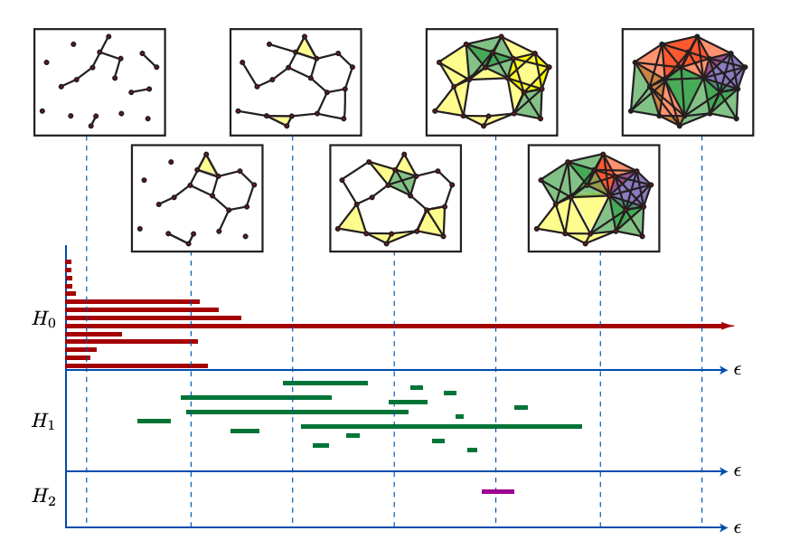
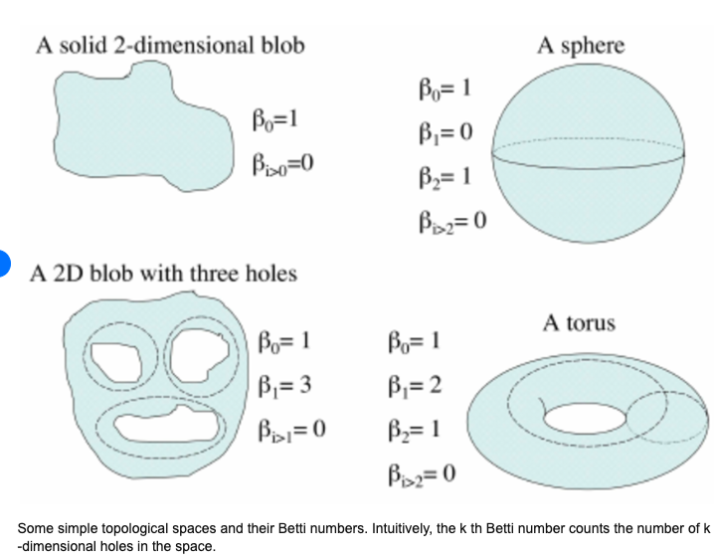
.
Persistent Homology(Barcodes) from point cloud data
Betti numbers for different shapes

Slide 9
.
Also used python’s ripser package for computing persistent homology and lower star image filtration of these sparse dataset.
The lower star represents the edge weights of maximum of two pixel values they connect.
In our dataset ‘1’ represents if a pixel is present otherwise ‘0’

Slide 10
Scanning and filtration methods
We used multiple scanning techniques as filtration methods to classify the letters.
Scanning types namely left to right , right to left , down – up and up – down.
For up down and left to right scanning we fixed scanning start as the first index.
For Down up scanning , the scanning stop is fixed to be the last index.
We set the maximum distance of the rips filtration to 100 instead of infinity which persists forever.

Slide 11
.
We also used slicing as a scanning method where we can slice the data to scan (ex. 20%, 40%.....100%).

Slide 12
Tests/Experiments
Created noise dataset by changing 0’s and 1’s.
Also generated noise data randomly .
Performed 100 test cases with noise added and calculated average classification rate.
The above step is performed three times, once for each type of noise added to the original dataset.
We found the average classification rate to be close to 60% with the noise dataset.
Further this classification rate can be improved by using optimal scanning / filtration methods.

Slide 13
Interpreting results
By making use of the scanning / filtration methods, we tried to classify the letters.
The classification rate for the unknown letter is predicted with an accuracy of 60%, which can be improved.
Overall, TDA is a great tool handle higher dimensional data which is easy to visualize and interpret the results compared to the state of art deep learning and machine learning algortihms.

Slide 14
.
THANK YOU!
Any Questions.

