Slide 1
Plug-In Diffusion and Flow-Matching Priors for Inverse Problems
Ju Sun
Computer Science & Engineering, UMN
Oct 28, 2026
SPARC Exchange

Slide 2
Inverse Problems

Slide 3
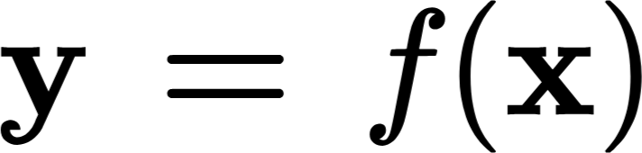


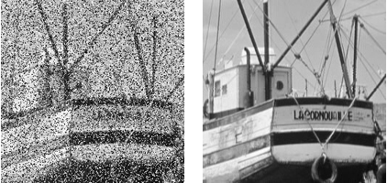
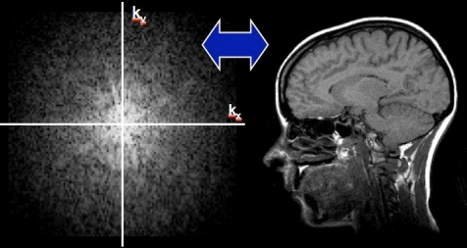


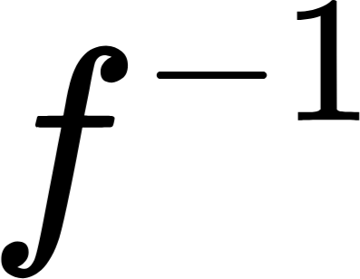
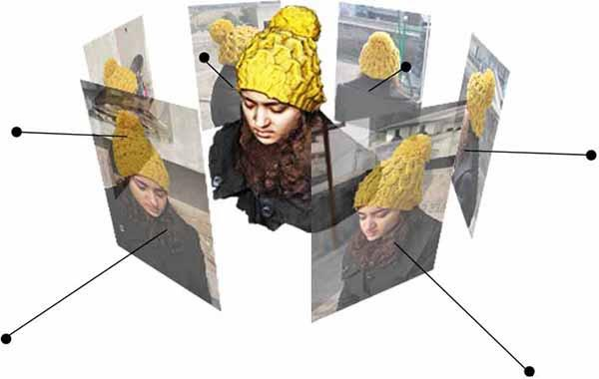
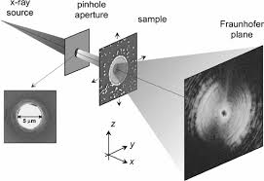
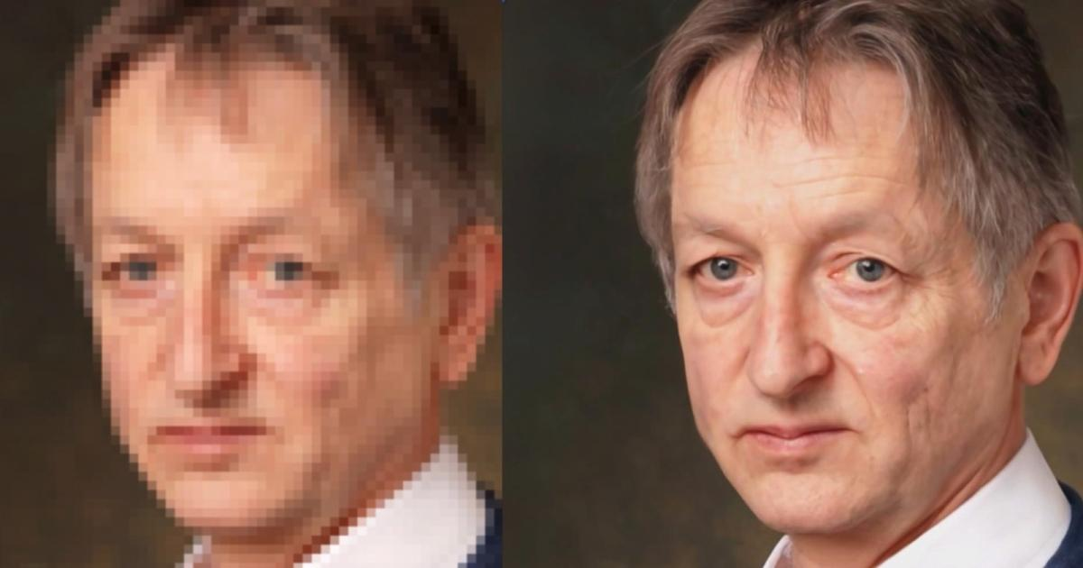
Inverse problems
Inverse problem: given , recover
Image denoising
MRI reconstruction
Image super-resolution
3D reconstruction
Coherent diffraction imaging (CDI)

Slide 4
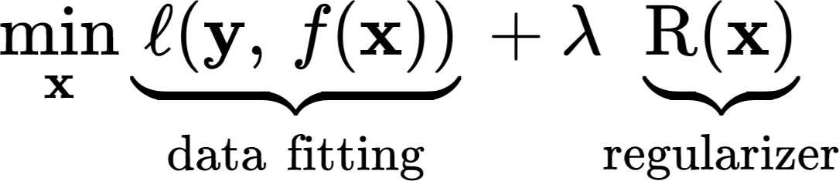


Traditional methods
Inverse problem: given , recover
RegFit
Questions
Which ? (e.g., unknown/compound noise)
Which ? (e.g., structures not amenable to math description)
Recovery quality
Computational speed

Slide 5
Deep learning has changed everything

Slide 6
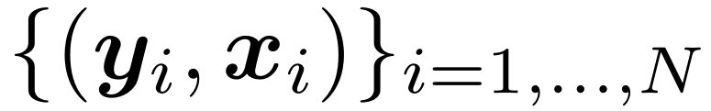
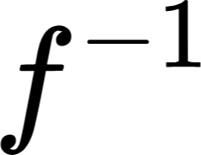
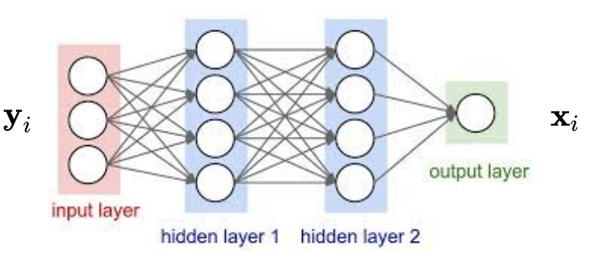

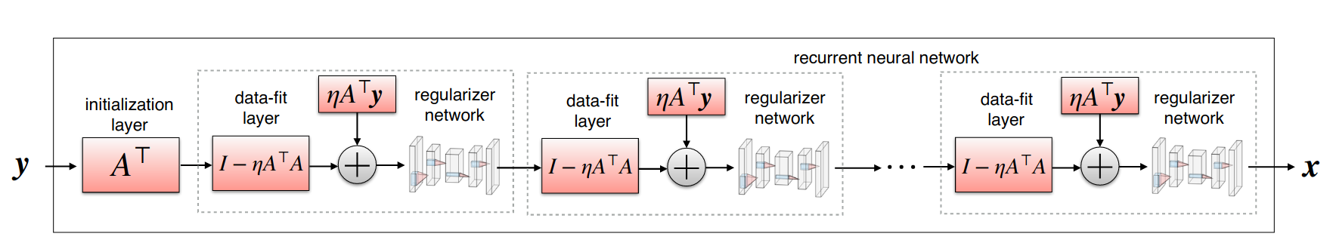
With paired datasets
Direct inversion
Algorithm unrolling
Learn from
Idea: make trainable

Slide 7
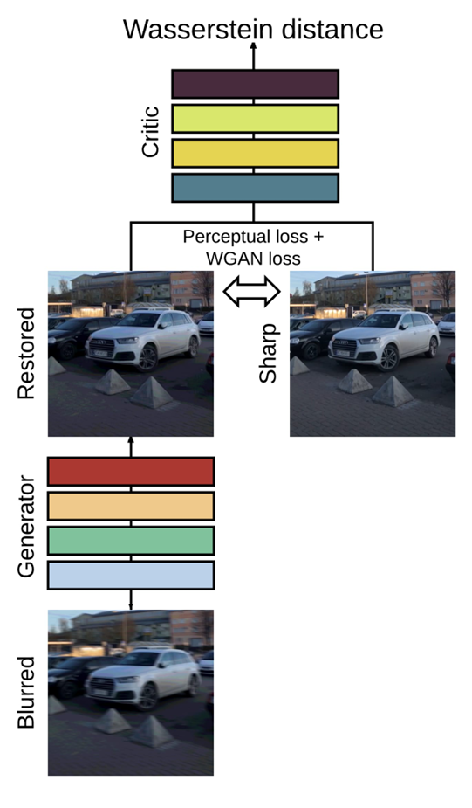
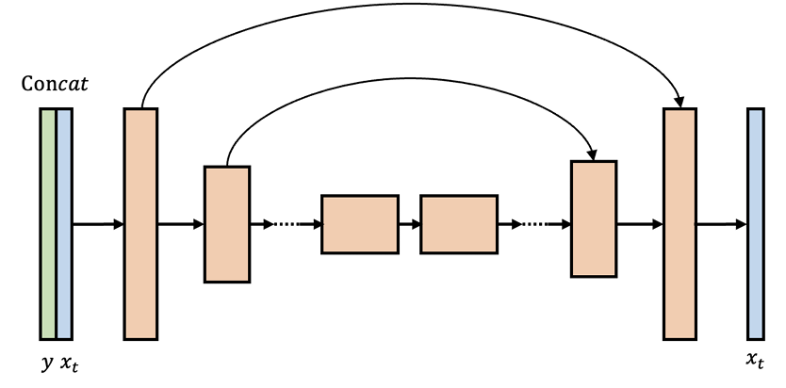

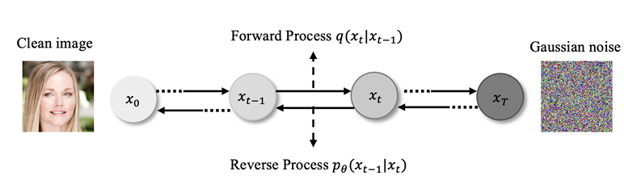
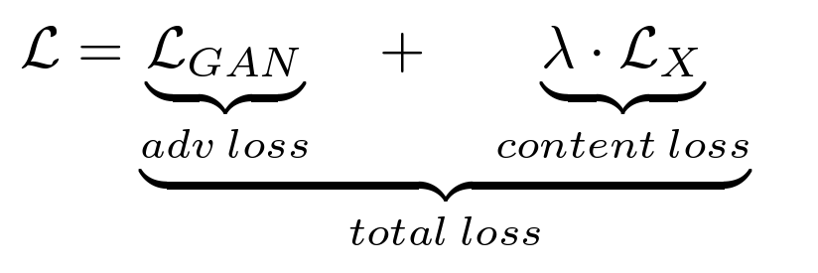

With paired datasets
Conditional generation & regularization
DeblurGAN
SR3
Image credit: https://arxiv.org/abs/2308.09388

Slide 8
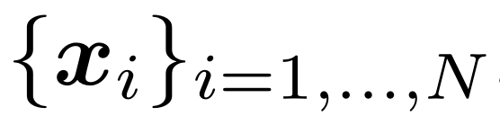
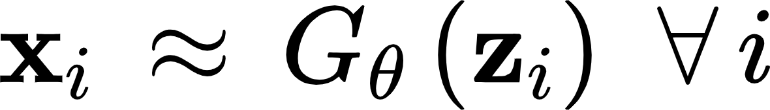
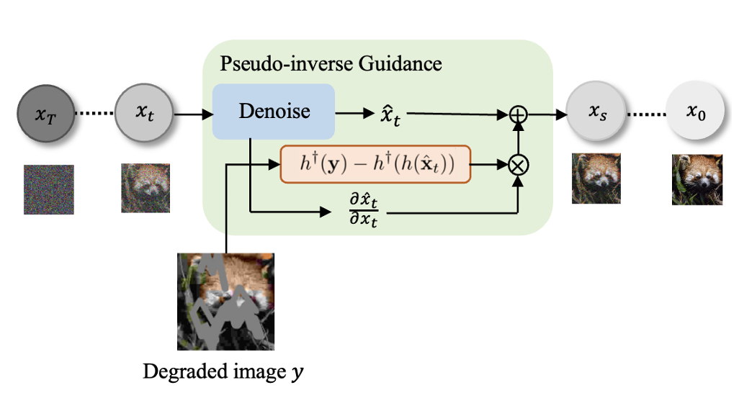
With object datasets only
Model the distribution of the objects first, and then plug in the prior
GAN Inversion
Pretraining:
Deployment:
Interleaving pretrained diffusion models (more on this later)
Image credit: https://arxiv.org/abs/2308.09388

Slide 9
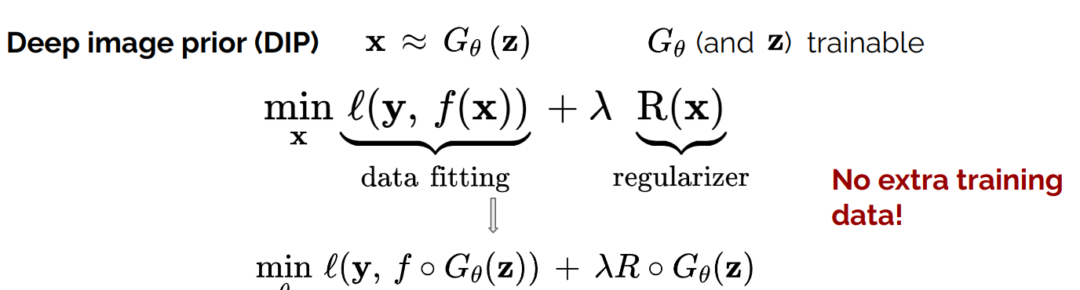
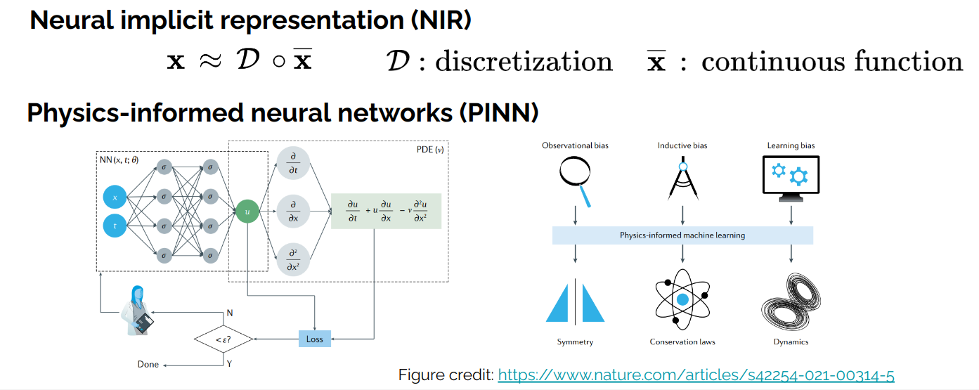
Without datasets? Single-instance methods

Slide 10
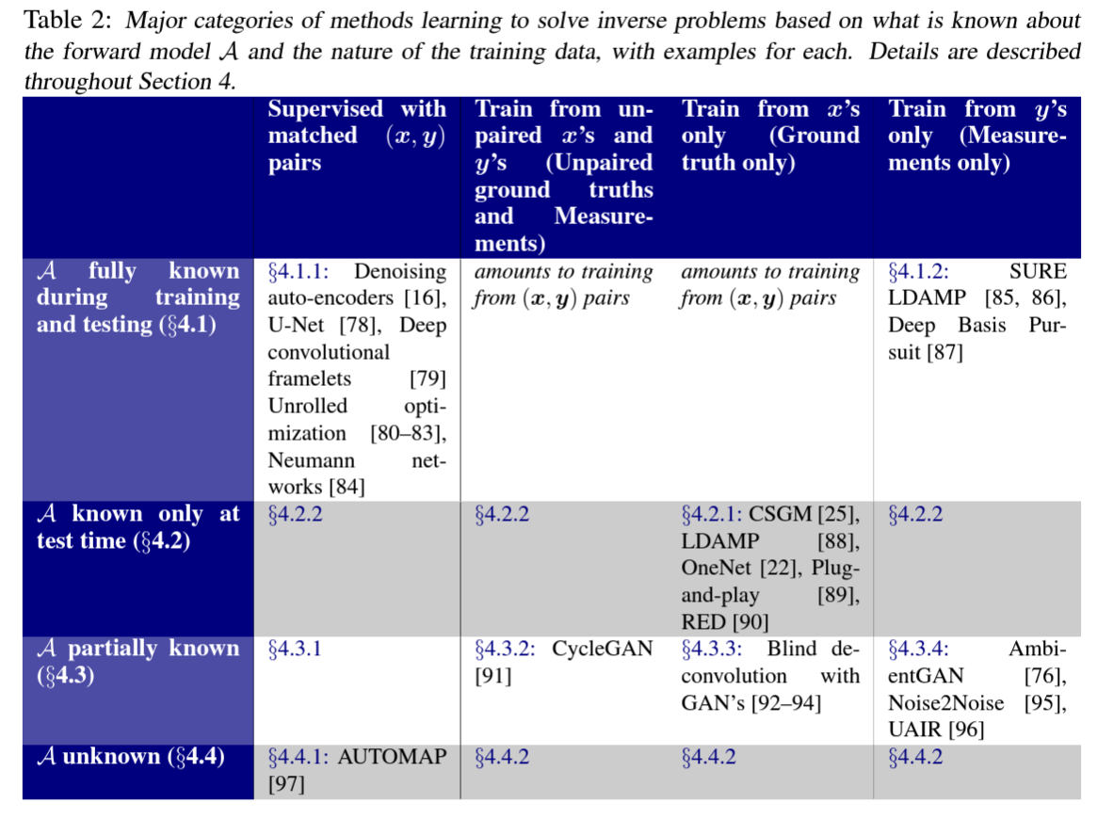
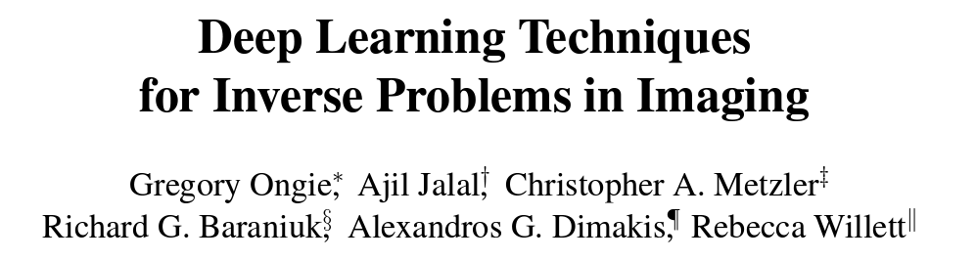
https://arxiv.org/abs/2005.06001
But focused on linear IPs

Slide 11
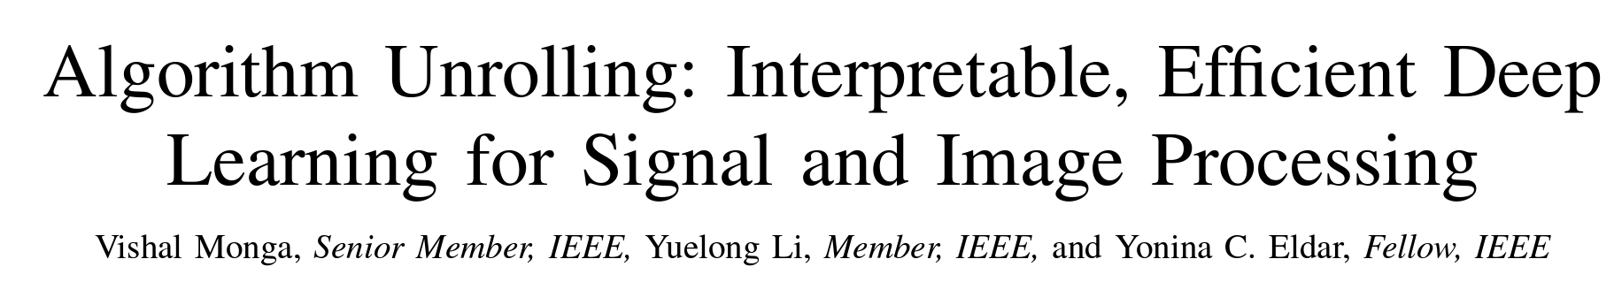
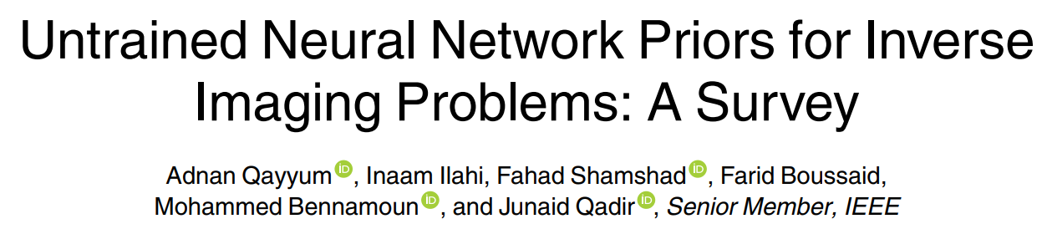
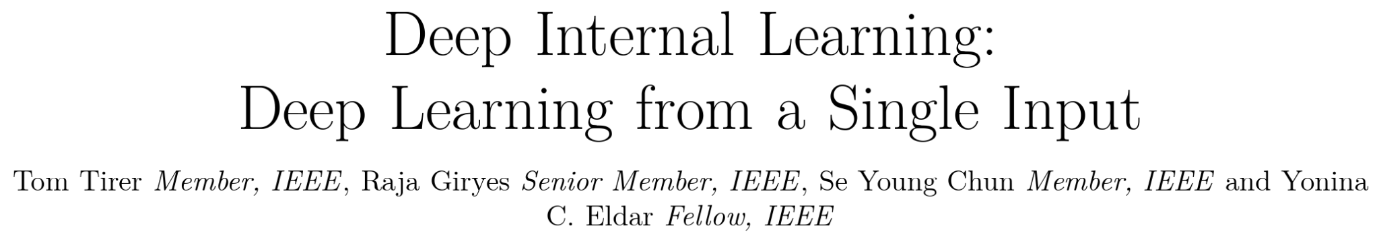
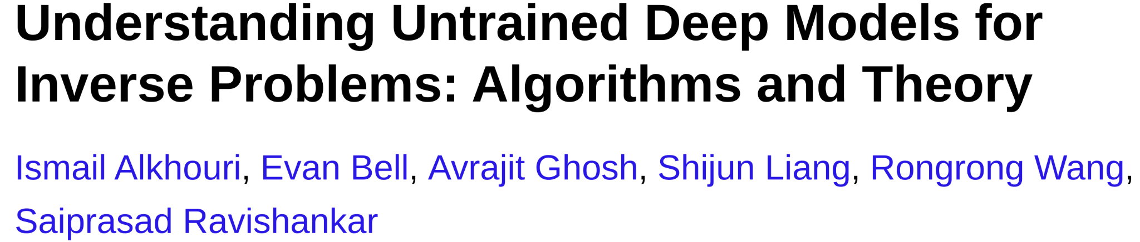
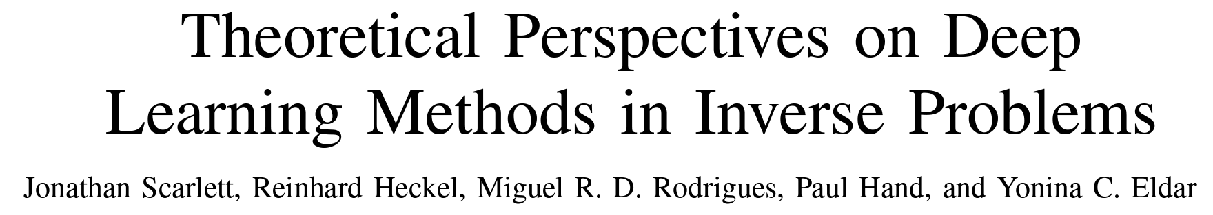
Other specialized surveys
Focused on alg. unrolling
Focused on single-instance methods
Focused on theories for linear IPs

Slide 12
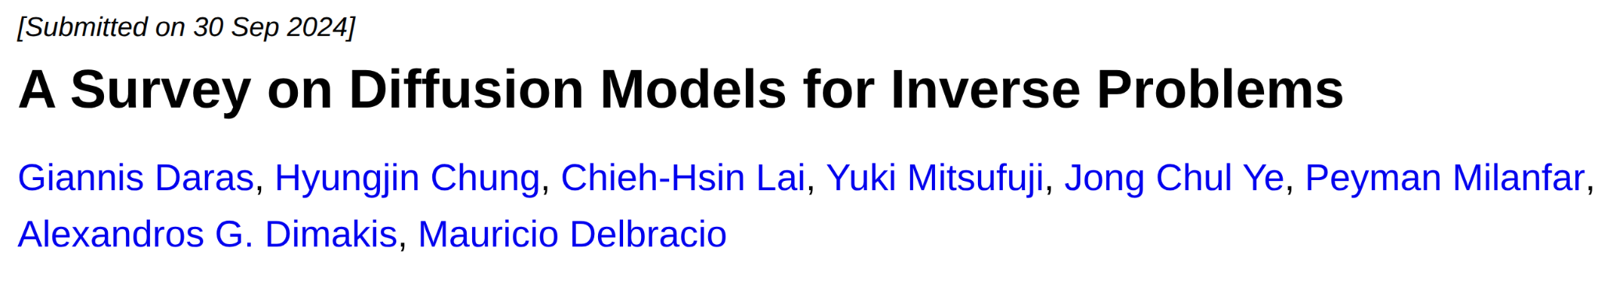
This talk:
Solving Inverse Problems (IPs)
Using Pretrained
Diffusion & Flow-Matching Models

Slide 13

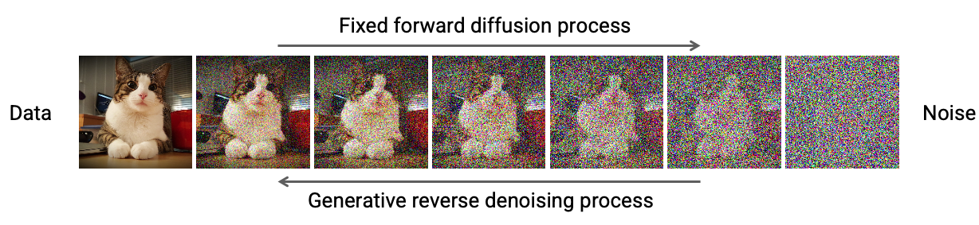
Diffusion models
Score

Slide 14
Diffusion models for inverse problems (IPs)
Supervised
Zero-shot
SR3
Image credit: https://arxiv.org/abs/2308.09388

Slide 15
Focus: IPs with pretrained diffusion models
Think of conditional score
Conditional reverse SDE

Slide 16
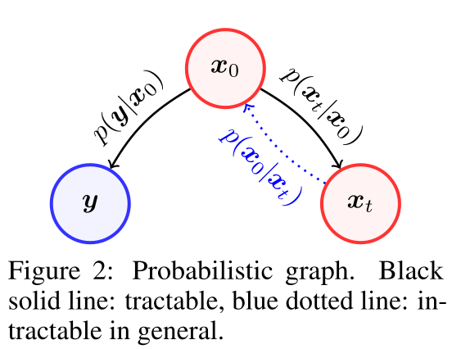
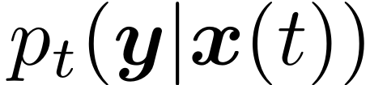
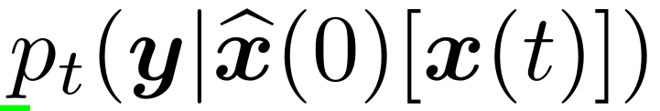
Coping with conditional score function
Learned
≅

Slide 17
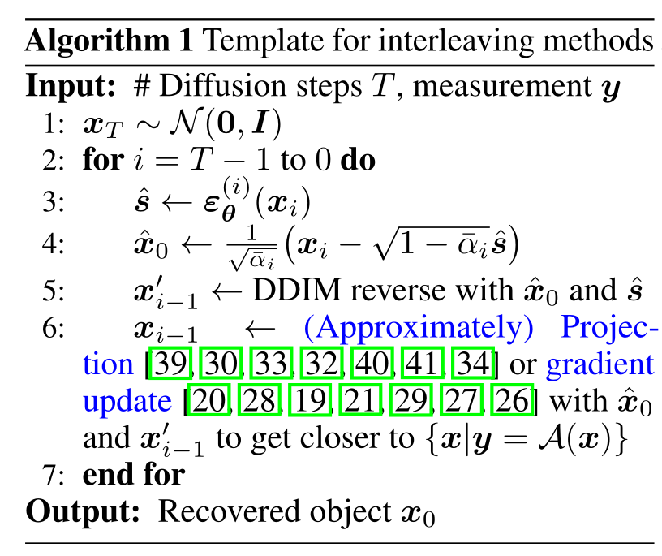
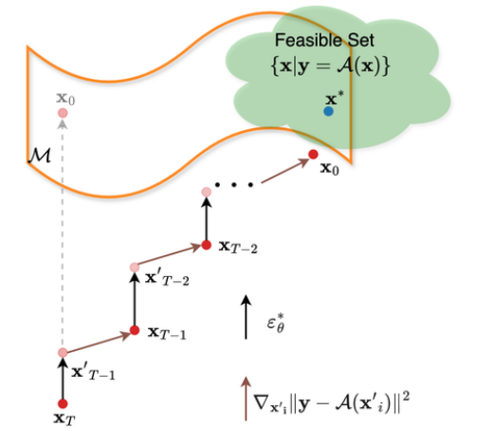
Interleaving methods: interleave >=2 iterative processes

Slide 18
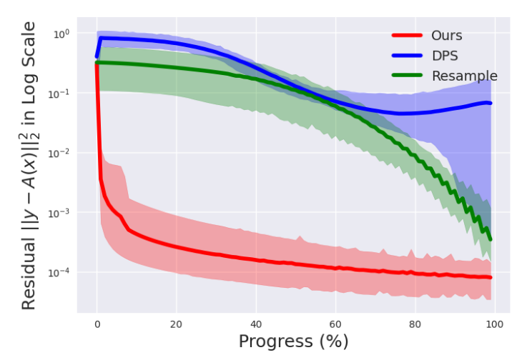
Issue I: Measurement feasibility

Slide 19
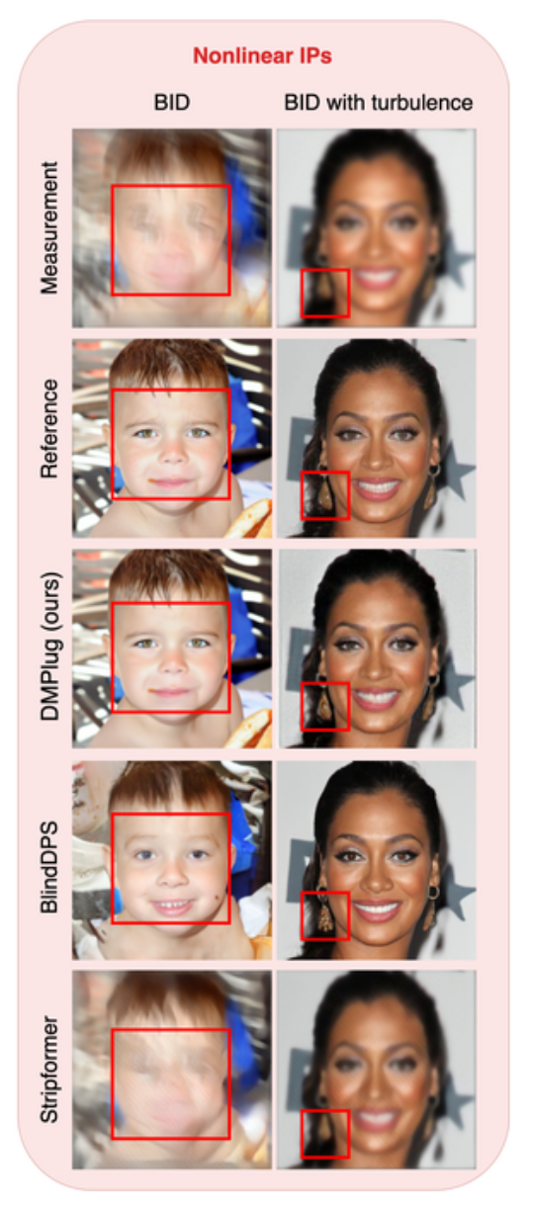
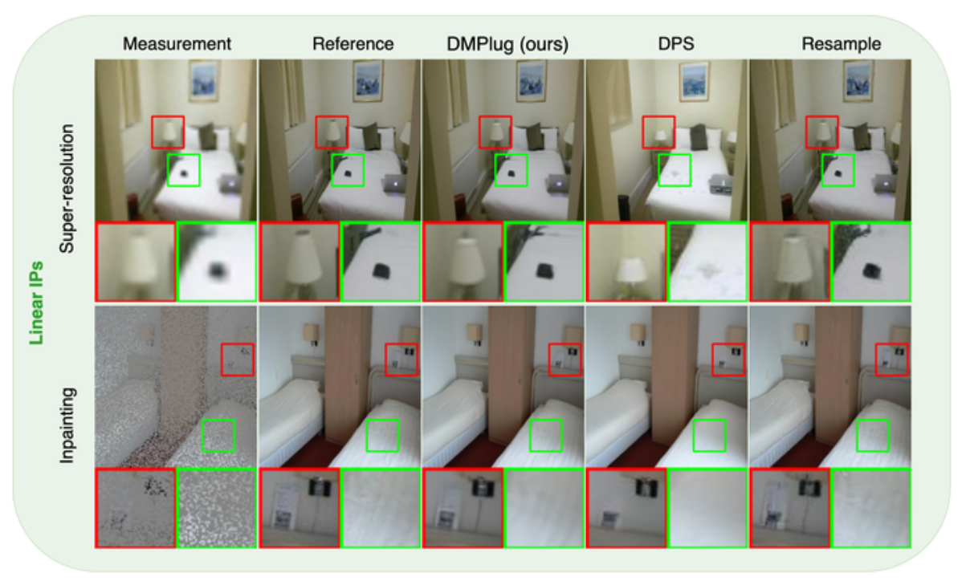
Issue II: Manifold feasibility

Slide 20
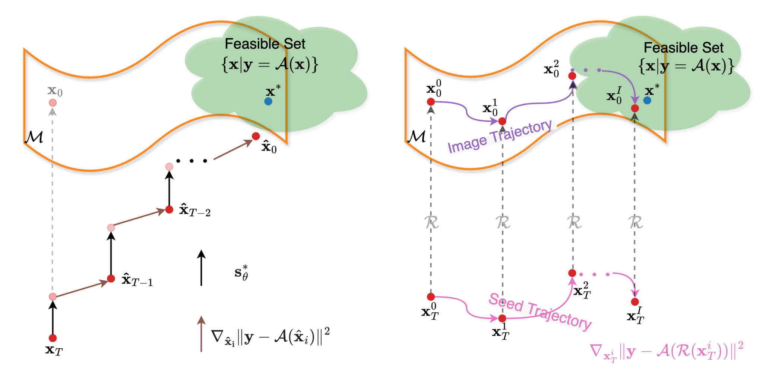
Our solution: DMPlug

Slide 21

Our solution: DMPlug
Viewing the reverse process as a function
Manifold feasibility
Measurement feasibility
Also:
Latent/seed optimization,
D-Flow

Slide 22
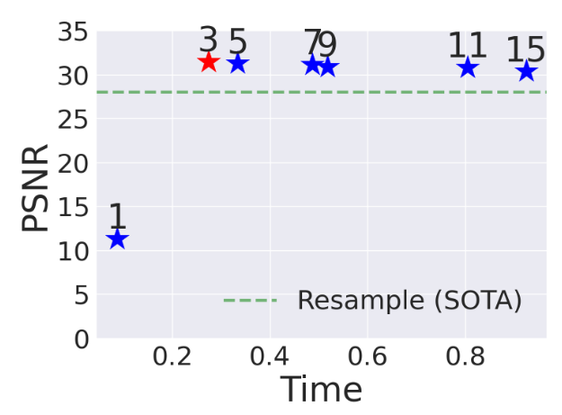
Overcoming the computational bottleneck
Issue: T blocks of DNNs involved, and we have to back-propagate through it

Slide 23
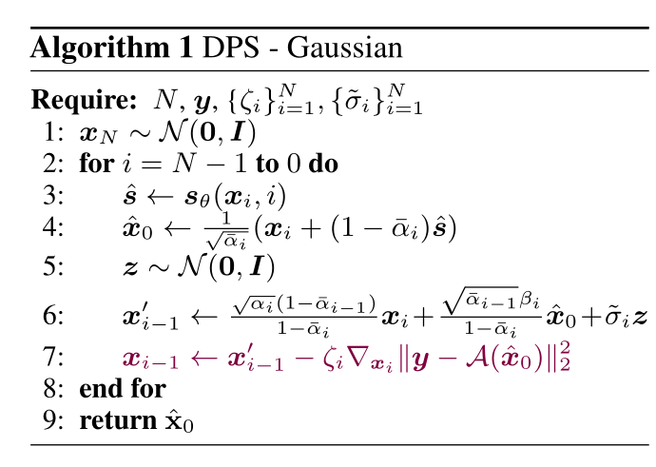
Issue III: Robustness to unknown noise
depending on noise level

Slide 24
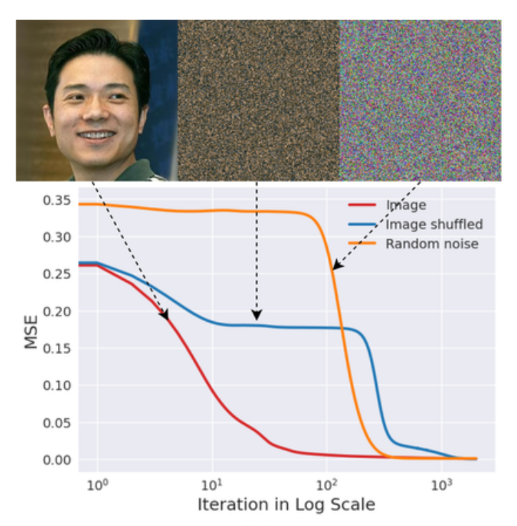
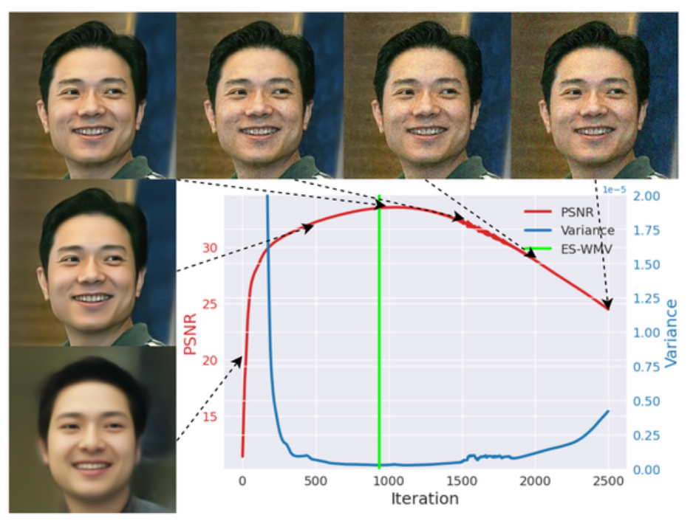
How to achieve robustness to unknown noise?
Early-learning-then-overfitting (OLTO)

Slide 25
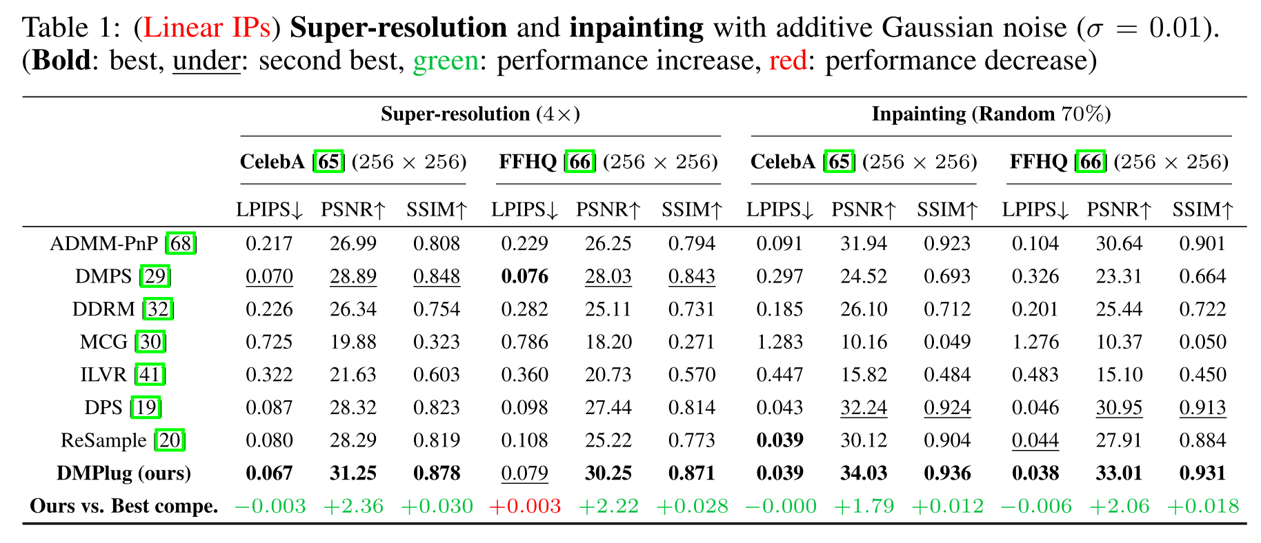
On linear IPs

Slide 26
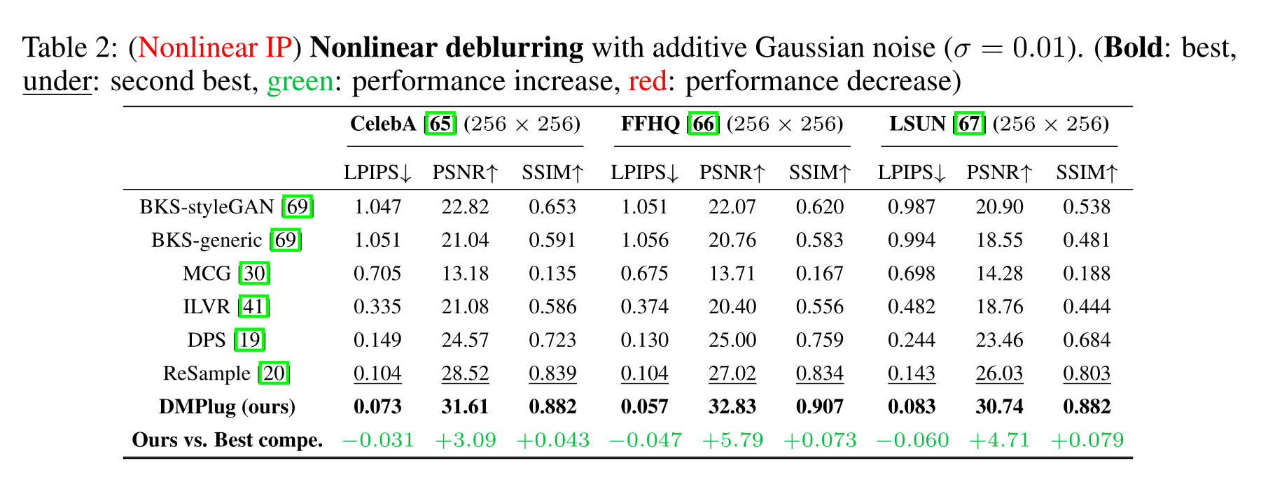
On nonlinear IPs

Slide 27
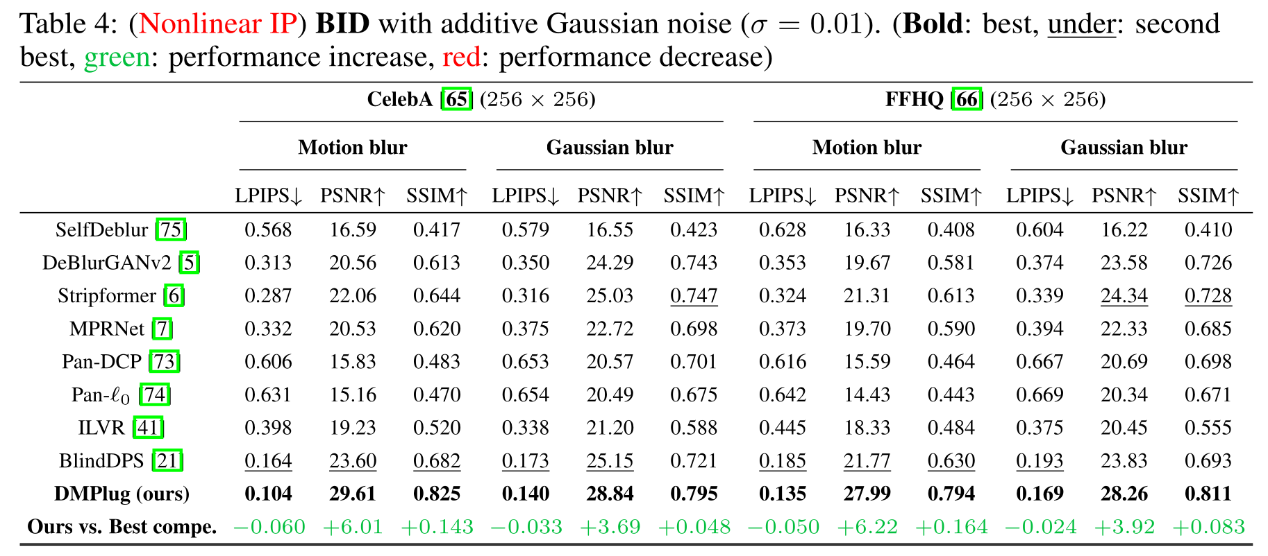
More on nonlinear IPs

Slide 28
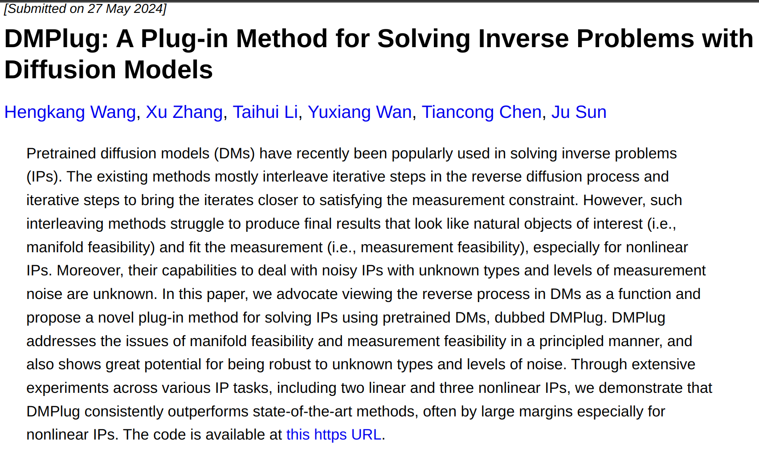
The paper (NeurIPS’24)
https://arxiv.org/abs/2405.16749

Slide 29
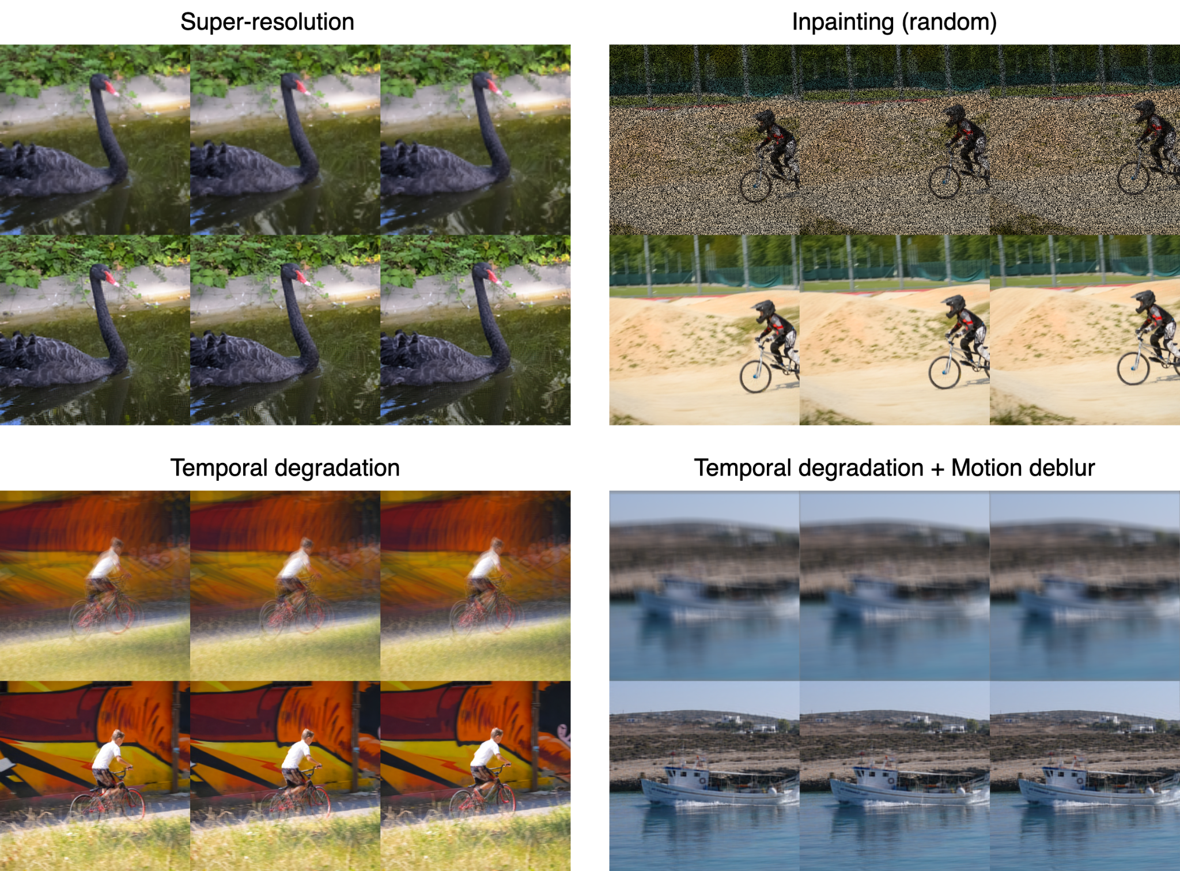
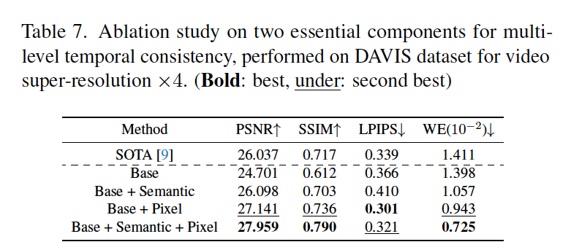
DMPlug for video restoration
Wang et al. Temporal-Consistent Video Restoration with Pre-trained Diffusion Models. AAAI 2026

Slide 30
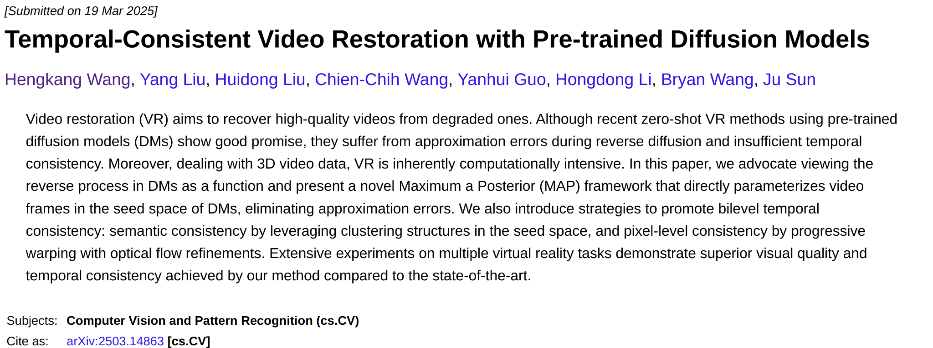
More details
https://arxiv.org/abs/2503.14863

Slide 31
This talk:
Solving Inverse Problems (IPs)
Using Pretrained
Diffusion & Flow-Matching Models

Slide 32

Recent switch to flow-matching (FM) models
NeurIPS’25 tutorial: Flow Matching for Generative Modeling
https://neurips.cc/virtual/2024/tutorial/99531
Image credit: https://github.com/facebookresearch/flow_matching

Slide 33

FM-based foundational generative models

Slide 34

Question:
Are foundation flow-based models more powerful as generative priors?

Slide 35

Surprise?
Foundation/Universal priors <<
Domain-specific, and even untrained priors

Slide 36
Is it really surprising?
Power in generation Power in constraining

Slide 37





To close the gap: warm-start
Simple distortion setting: x y
Exact flow
Approx. flow

Slide 38

Boosted performance
Gaussian Blur and Motion Blur on DIV2K 512 × 512 with additive Gaussian noise
Bold: best, under: second best; -P: prompt, -W: warm-start only

Slide 39

Boosted performance
Gaussian Deblur and Super Resolution 4X on AFHQ-Cat 256 × 256 with additive Gaussian noise
Bold: best, under: second best

Slide 40



Few-shot scientific setting

Slide 41


Results

Slide 42

More details

Slide 43
Sum up
DMPlug: a plug-in method for solving IPs with pretrained diffusion models
— principled manifold and measurement feasibility, and noise-handling
Pros and cons of foundational generative models
— powerful for generation, but not necessarily as generative priors in providing useful constraints
FMPlug: sample-based guidance for additional priors and faster search

Slide 44

Questions?
https://sun-umn.github.io/xm-plug/

