Slide 1
Project 4: Data Visualization
From noise to signal — boardroom-ready insights
E-commerce Performance
1,200 orders • ₹1,264,762 revenue • 1,189 unique customers
DecodeLabs • Project 4 — Data Visualization

Slide 2
Protect the revenue leaders and fix order leakage
Executive summary — one message, four actions
1. Protect revenue leaders
Chair and Printer are the top two revenue products.
2. Investigate revenue volatility
June 2024 is the highest month at ₹68,069.
3. Reduce order leakage
Cancelled + returned orders = 41.4% of all orders.
4. Use price + quantity to explain AOV
Correlation with order value: unit price 0.72; quantity 0.62.
DecodeLabs • Project 4 — Data Visualization

Slide 3
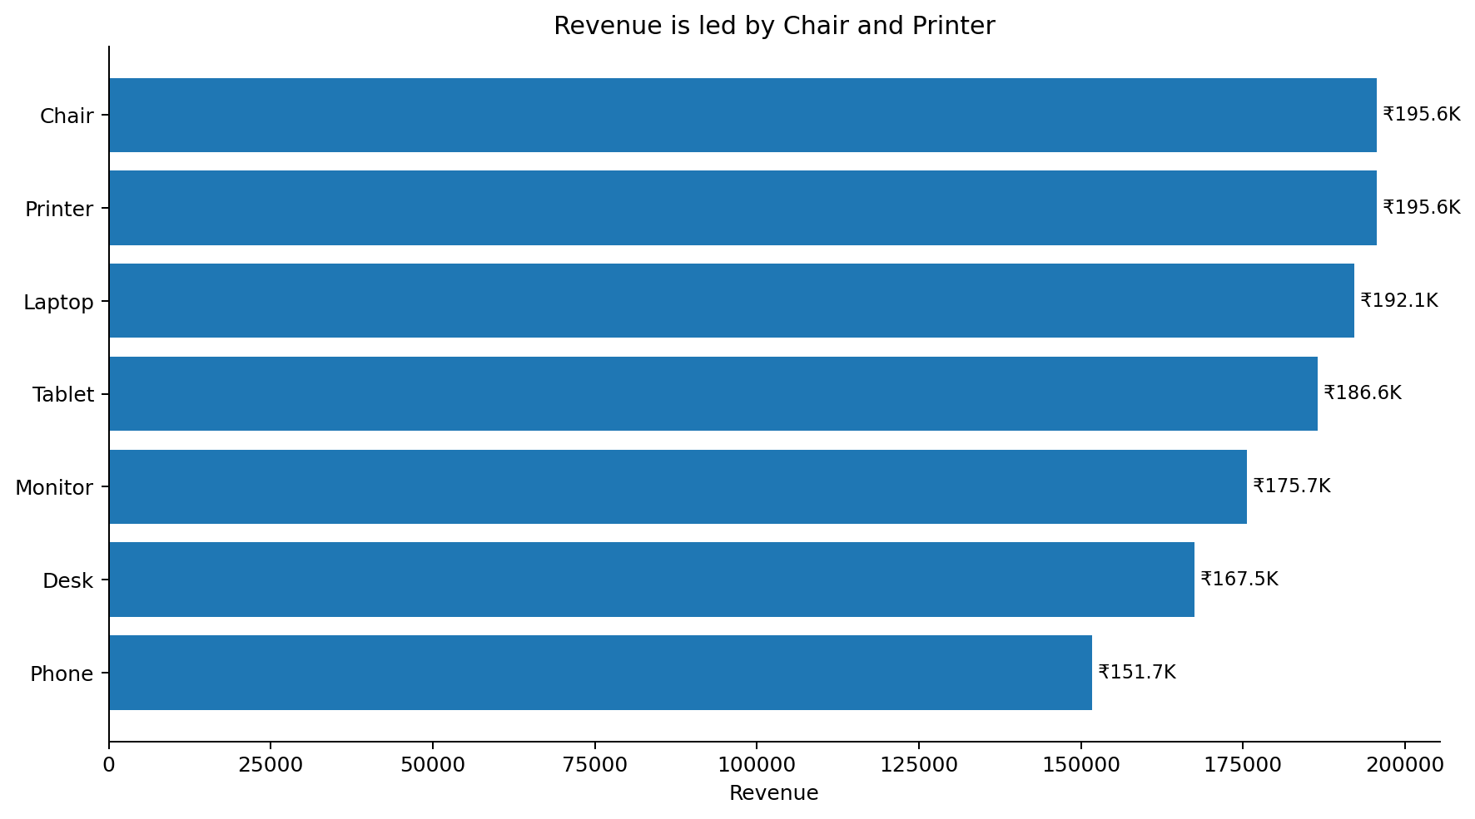
Chair and Printer lead revenue
Analytical need: compare product contribution
SO WHAT?
Prioritize availability and promotion around the two leading products. Together they contribute 30.9% of revenue.
DecodeLabs • Project 4 — Data Visualization

Slide 4
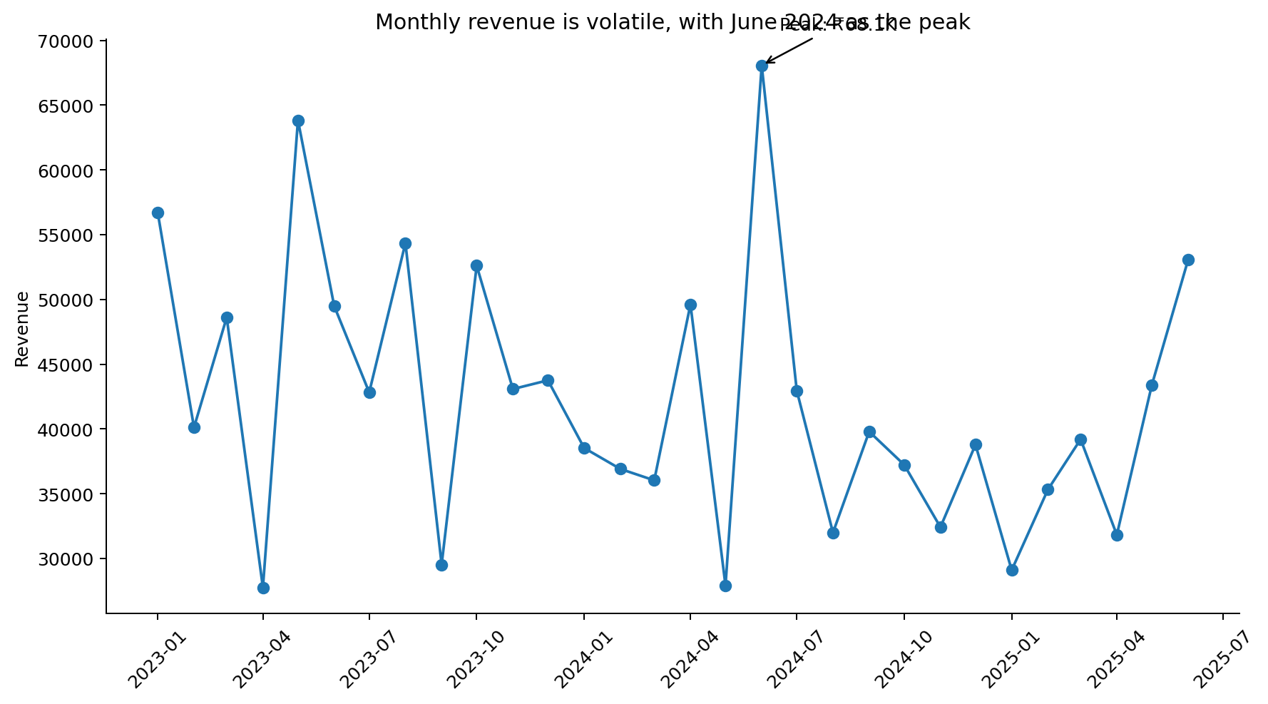
Revenue is volatile — June 2024 sets the peak
Analytical need: track movement over time
SO WHAT?
Do not plan from a simple average alone. Investigate what caused peak months and whether those drivers can be repeated.
DecodeLabs • Project 4 — Data Visualization

Slide 5
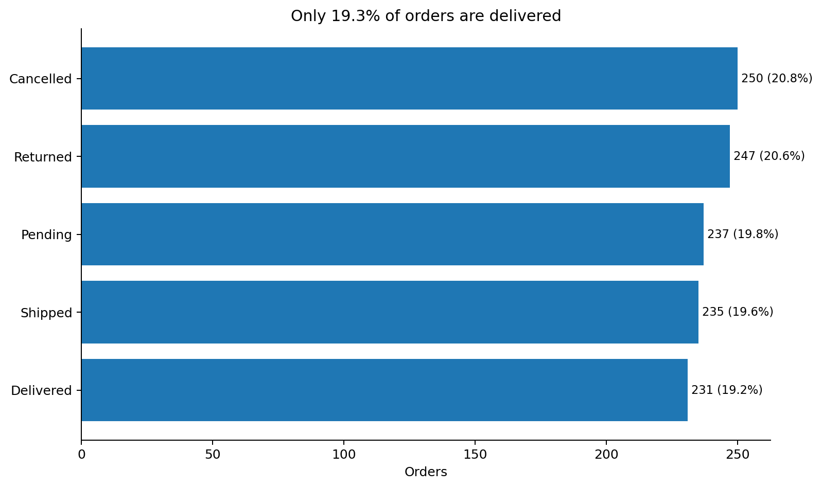
Order outcomes are the biggest operational warning
Analytical need: compare fulfillment outcomes
SO WHAT?
Only 19.2% of orders are delivered, while cancelled + returned orders represent 41.4%. Reducing leakage can improve realized revenue.
DecodeLabs • Project 4 — Data Visualization

Slide 6
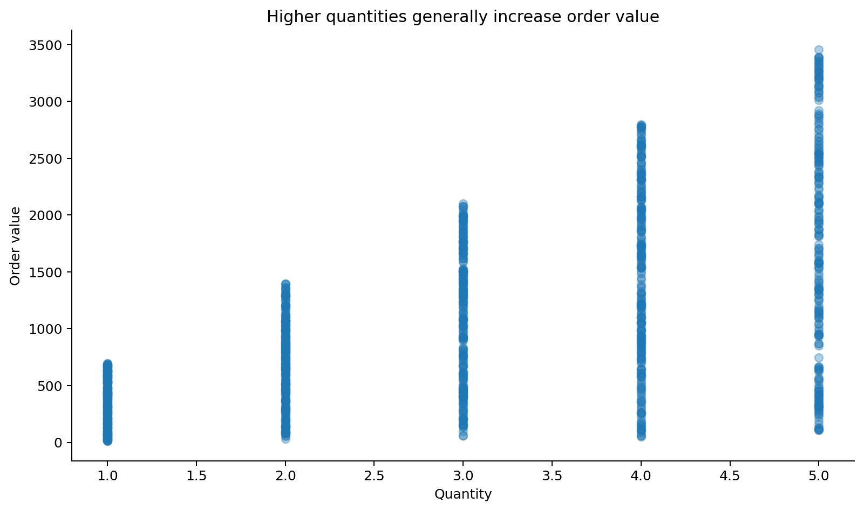
Unit price is the strongest measured revenue driver
Analytical need: explore relationships
SO WHAT?
Unit price has a 0.72 correlation with order value, stronger than quantity (0.62). Pricing and basket composition should be considered together.
DecodeLabs • Project 4 — Data Visualization

Slide 7
From pattern to action
Situation → Complication → Resolution
SITUATION
The dataset contains 1,200 orders and ₹1.26M in revenue.
COMPLICATION
Revenue varies sharply by month, and cancelled/returned orders represent 41.4% of orders.
RESOLUTION
Protect top products, diagnose peak-month drivers, and reduce order leakage before scaling growth.
DecodeLabs • Project 4 — Data Visualization

