Slide 1
Email Spam Detection: An Empirical Study of Different ML Algorithms
Team Members
SOWJANYA SUNKAVALLI 700731896
SATHYA SAI SATISH K 700731449
SAMSKRUTHI V 700711309
PRAVEEN GYARALA 700741003

Slide 2

Role/Responsibilities AND Contribution in project:
Sowjanya Sunkavalli : Worked on Naïve Bayes and Gradient boosting algorithm using dataset and provided a report with required parameter analysis.
Sathya Sai Satish K : Worked on SVM and Random Forest algorithm using dataset and provided a report with required parameter analysis.
Samskruthi Velamakanni : Worked on Decision tree and Bagging algorithm using dataset and provided a report with required parameter analysis.
Praveen Gyarala : Worked on KNN classifier and AdaBoost algorithm using dataset and provided a report with required parameter analysis.
Each person contributed 25% in the project.

Slide 3

Motivation :
With the rapid development of internet users, email spam has grown to be a significant issue today. They are being used for fraud, phishing, and unlawful and immoral behavior. Infecting your system and ours both occurs when spam emails are used to distribute harmful links.
For the spammers, it is very simple to set up a phony profile and email address. They target those people who are unaware of these scams by making themselves appear to be real persons in their spam emails. Spam emails must be found and categorized, which is a need.

Slide 4
Objectives :
The objective of this project is identifying spam using machine learning techniques. This project will discuss different machine learning algorithms and classifiers like Naive Bayes, SVM, KNN, Bagging and Boosting (Adaboost), and Ensemble Classifiers. We apply algorithms to our data sets and choose the algorithm that has the highest precision and accuracy for email spam detection.

Slide 5

Related work :
Since the usage of email has increased, there are severe problems that need to be addressed. Therefore, comparing various classification techniques is necessary because numerous studies have been done to discover the best and most appropriate classifier for spam detection.
Future Generation Computer Systems Elsevier B.V., "Scalable real-time classification of data Streams with idea drift". This study use the Naive Bayes method. Simple to use and incredibly powerful is Naive Bayes. Using Naive Bayes, you can build models very quickly and generate extremely accurate predictions.

Slide 6
Related work: continued…
Support vector machines for spam categorization by Vapnik and Drucker was published in IEEE Transactions on Neural Networks. SVM is frequently used for text classification and produces encouraging outcomes. It uses a hyperplane to split the feature set. Compared to other classifiers, boosted decision trees and SVM provide improved accuracy. SVM training is completed more quickly. SVM testing takes time and is unreliable for small datasets.
A hybrid-based approach is proposed by Wijaya and Bisri that combines Decision Tree with Logistic Regression as well as a False Negative threshold. They were successful in boosting DT's efficiency. The outcomes were compared to earlier studies. The SpamBase dataset was used for the experiment. The accuracy of the suggested method was 91.67%.

Slide 7
Problem Statement :
As a medium of communication, email has grown in importance. Around 196 billion emails are sent daily around the world, and there are projected to be 4.1 billion email accounts there in 2014. The main danger facing email users is spam.
Email spam is typically of a commercial character. Whether they are commercial or not, a lot of them are not only annoying because they steal your attention, but they can also be dangerous because they may contain links to phishing websites, malicious websites, or websites that host malware.
The project's primary goals are to detect spam emails and to optimize data storage.

Slide 8

Proposed Solution:
In the Proposed solution we trained Email Spam data set with different supervised and unsupervised machine learning models and identified the model which gives us the more accurate values in terms of classification of Spam Email by considering different model output parameters like Accuracy, Precision, Recall etc.,

Slide 9
The Classifiers which we used are:
Naïve-Bayes
SVM
Decision Tree
KNN Classifier
Gradient Boosting
AdaBoost
Bagging
Random Forest
As per our research, highest accuracy was found in Gradient Boosting Classifier.

Slide 10
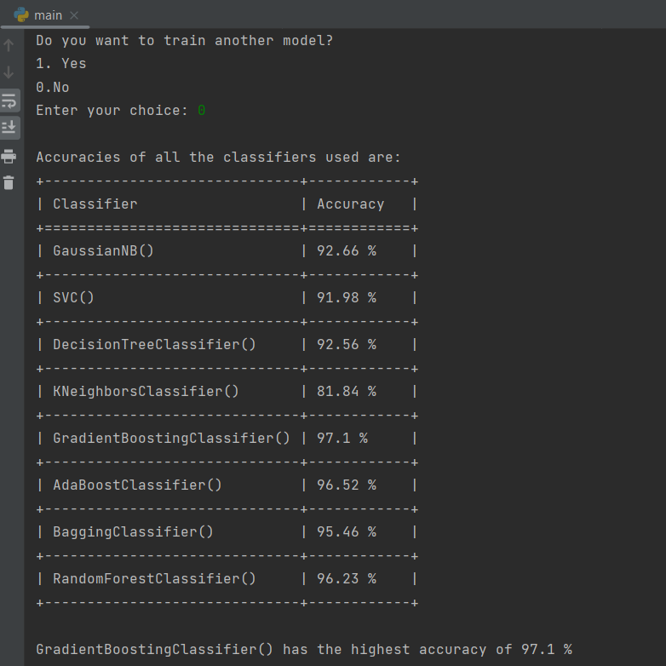
Results/Simulations

Slide 11
References
[1] “Global spam volume as percentage of total e-mail traffic from January 2014 to September 2019, by month.” https://www.statista.com/statistics/420391/spam-email-traffic-share/.
[2] T. Ouyang, S. Ray, M. Allman, and M. Rabinovich, “A large-scale empirical analysis of email spam detection through network characteristics in a stand-alone enterprise,” Elsevier, vol. 2015, pp. 101–102. [3] O. Saad, A. Darwish, and R. Faraj, “A survey of machine learning techniques for Spam filtering,” IJCSNS Int. J. Comput. Sci. Netw. Secur.
[4] K. Asif, A. Sami, S. Bharindhan, and K. Krishan, “A Comprehensive Survey for Intelligent Spam Email Detection,” IEEEXplore, 2019.
[5] “Number of e-mail users worldwide from 2017 to 2024.” [Online]. Available: https://www.statista.com/statistics/255080/number-of-e-mailusers-worldwide/.

Slide 12


Slide 13
Thank You

