Slide 1
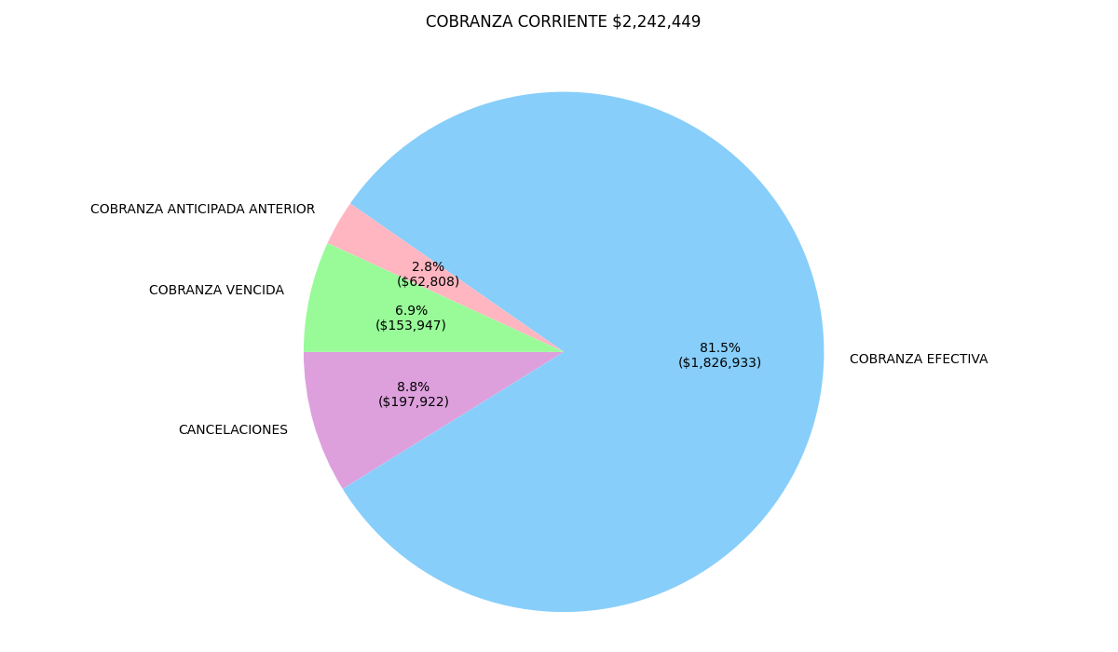
Grafica General

Slide 2
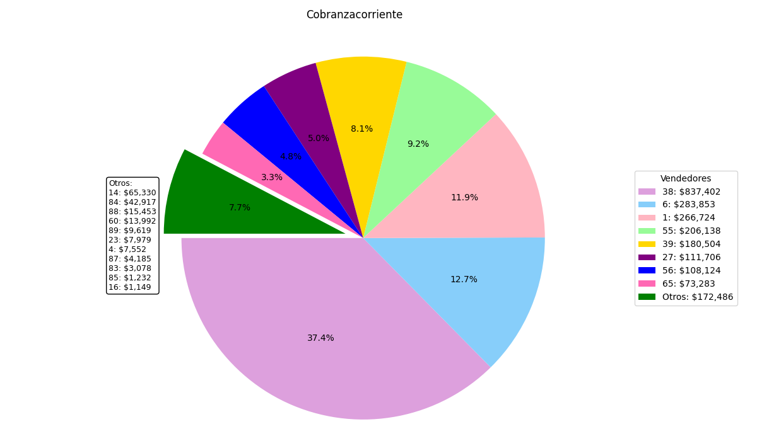
COBRANZA CORRIENTE
TOTAL $2,242,449

Slide 3
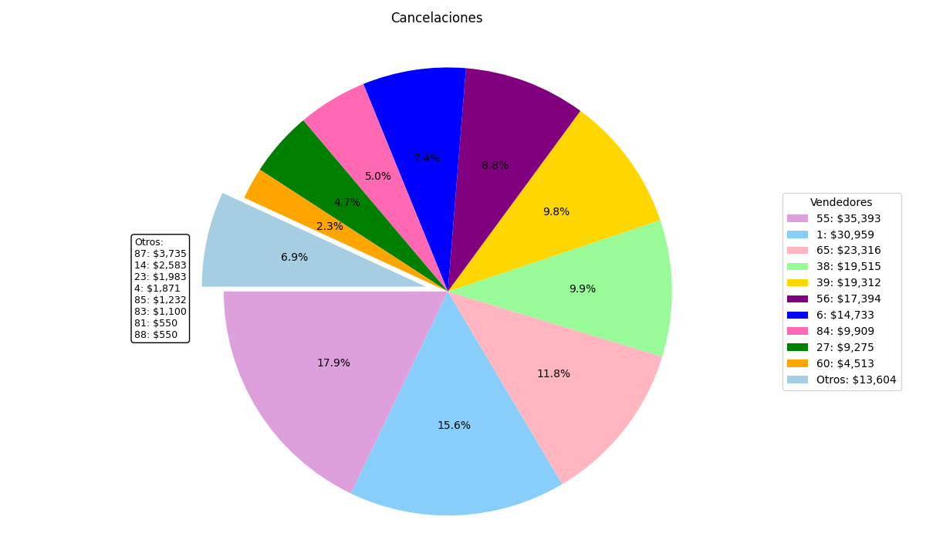
CANCELACIONES
TOTAL $197,922

Slide 4
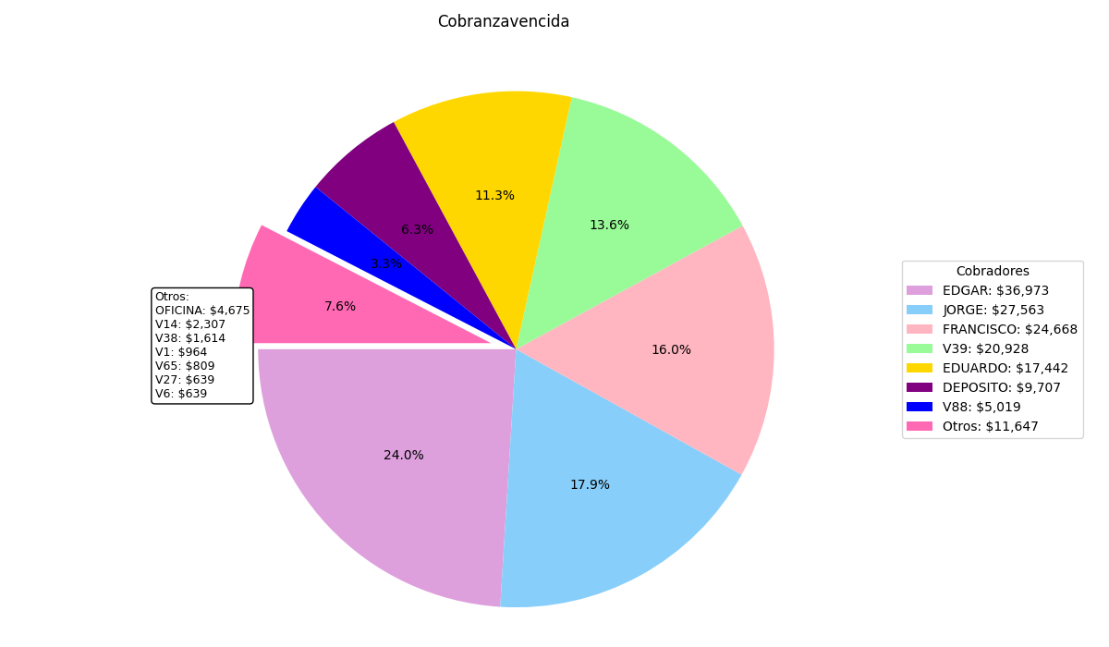
COBRANZA VENCIDA
TOTAL $153,947

Slide 5
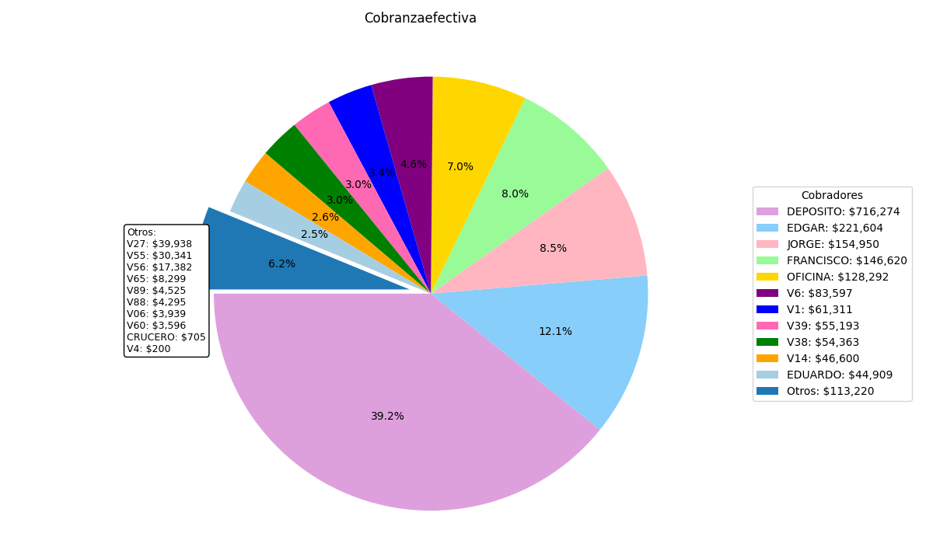
COBRANZA EFECTIVA
TOTAL $1,826,933

Slide 6
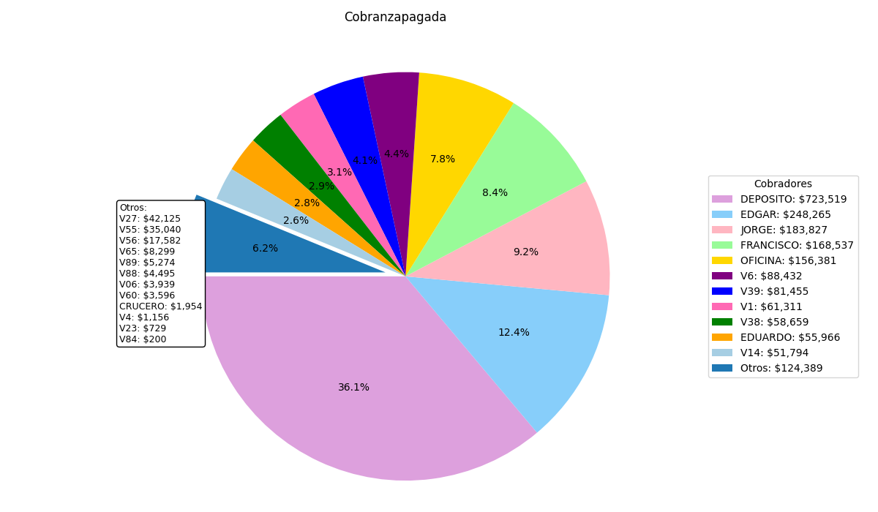
COBRANZA TOTAL
TOTAL $2,002,535

Slide 7
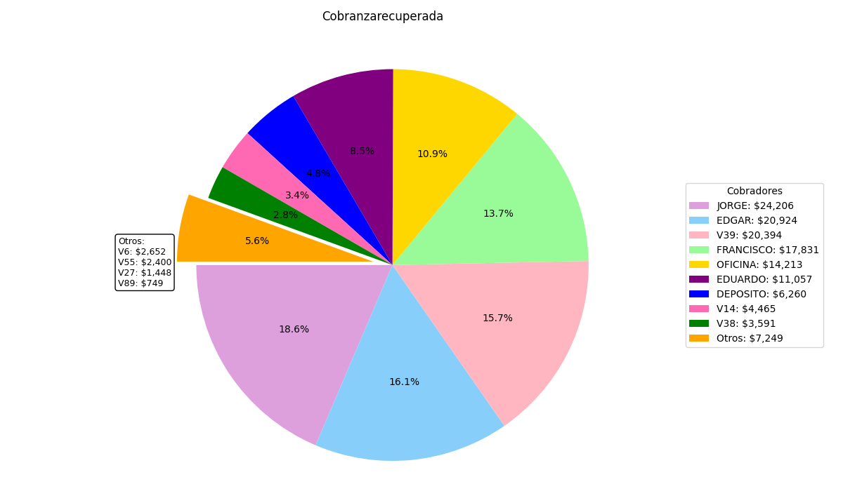
COBRANZA RECUPERADA
TOTAL $130,191

Slide 8
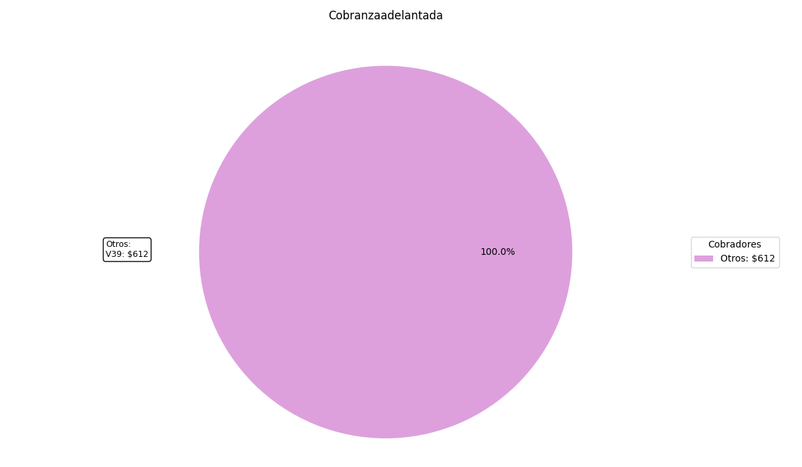
Cobranza Adelantada

Slide 9
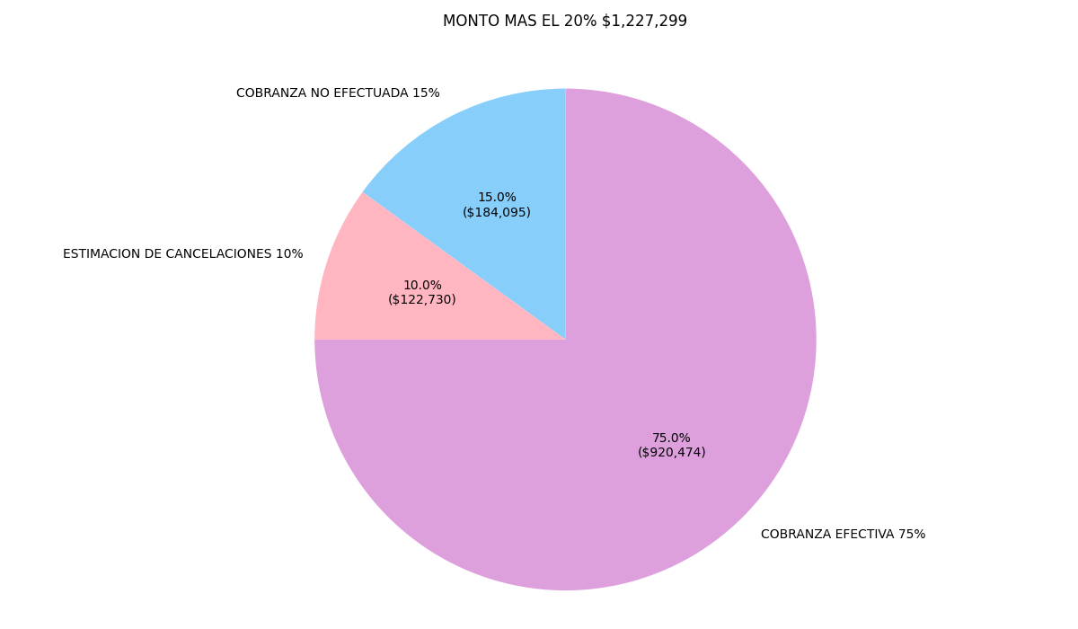
PROYECCION MES SIGUIENTE
COBRANZA CORRIENTE $1,227,299

