Slide 1
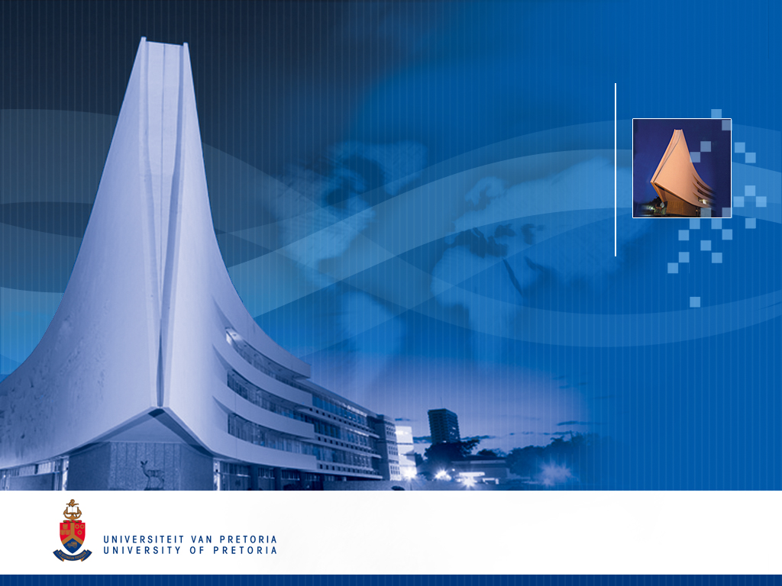


UNIVERSITY OF PRETORIA
& CSIR
Small Vessel Detection In Coastal Radar Data
M.D. Strempel
Under supervision of
Dr. P. de Villiers

Slide 2

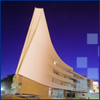

Summary
Detect small vessels and other low observables from dense clutter data

Slide 3
Summary
Detect small vessels and other low observables from dense clutter data

Slide 4
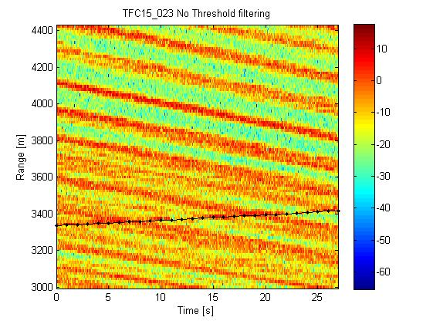
Current Methodology
Approach 1: Image processing technique
Approach 2: Time-based technique
Approach 3: Clustering technique (currently being pursued)

Slide 5
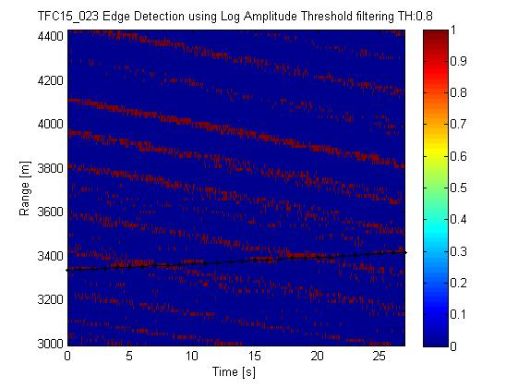
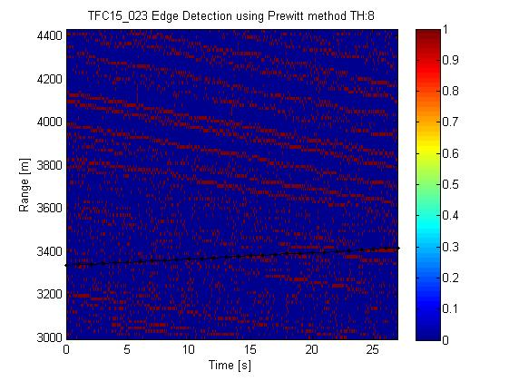
Proposed Methodology
Approach 1: Image processing technique
Use common image processing algorithms to simplify datasets.
detect and then track wave crests
Can then combine crests into groups
This can improve track quality and reduce computational complexity

Slide 6
Proposed Methodology
Approach 2: Time-based technique
Specific range bin analysis (Bin: 3010)
Do estimation in the time series domain
When sinusoidal structure collapses (estimation covariance high), there is a chance of a target – indicated by flat spot in this graph
target

Slide 7
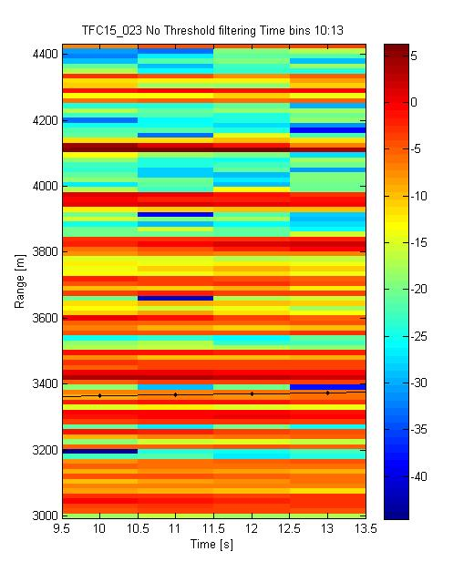
Proposed Methodology
Approach 3: Clustering technique
Specific Time bins
Bins: 10s to 13s
Track peaks above
threshold
Association on peaks
Cluster on tracks

Slide 8
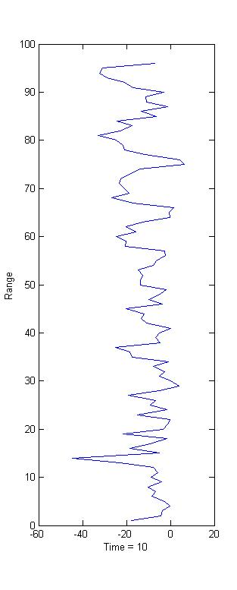
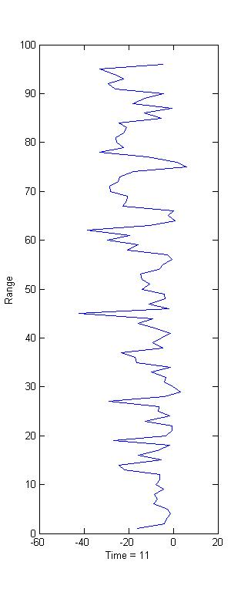
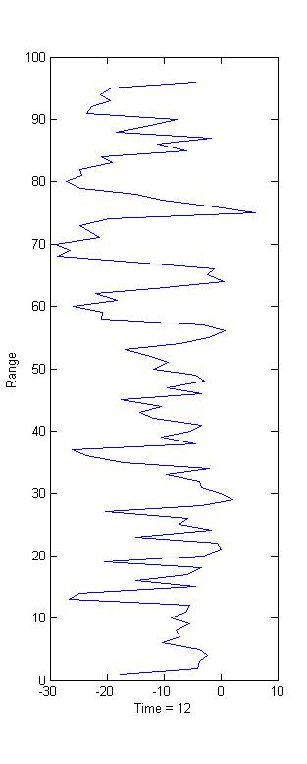
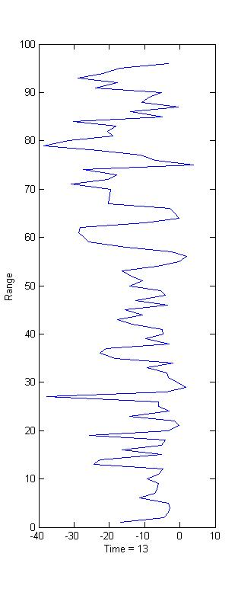
Proposed Methodology
Approach 3: Velocity clustering technique
track1
track2
Wave track
track3

Slide 9
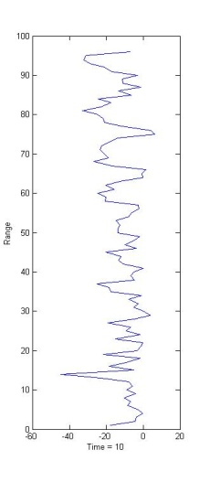
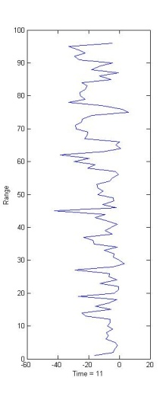
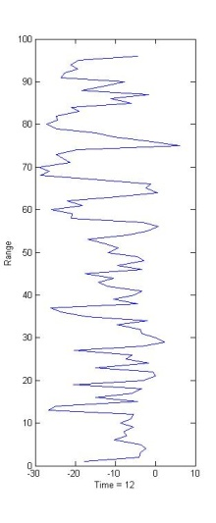
Proposed Methodology
Approach 3: Velocity clustering technique
Association techniques:
Associate on velocity
Associate based on Doppler
track1
track2
Wave track
track3

Slide 10
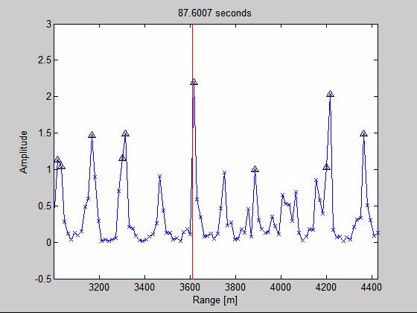
Proposed Methodology
Approach 3: Velocity clustering technique
Moving data illustration

