Slide 1
pip = package manager for python

Slide 2
y = m*x + b
OR
y = coef_ * x + intercept_

Slide 3
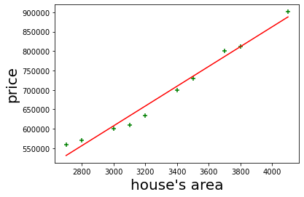
(Delta1)² + (delta2)²+…(deltaN)²
MSE = Minimum Squared Error

Slide 4
y = b + w*x
w = weight
x = [x₁, x₂, …x_{n}]

Slide 5
y = b + w₁*x₁+ w₂*x₂+…+ w_{n}*x_{n}
w = [w₁, w₂, …w_{n}] = coef_
b = bias = intercept

