Slide 1
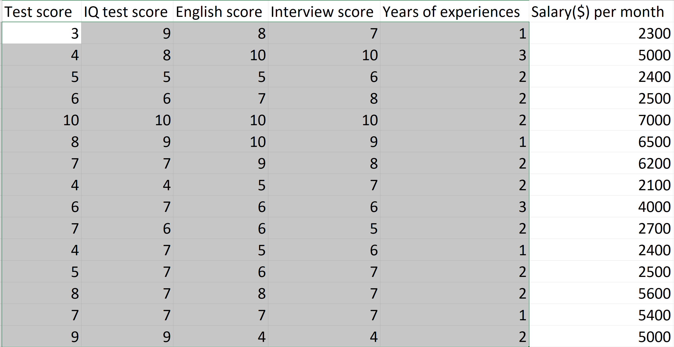
Model
Input
(features)
Output
(label)

