Slide 1
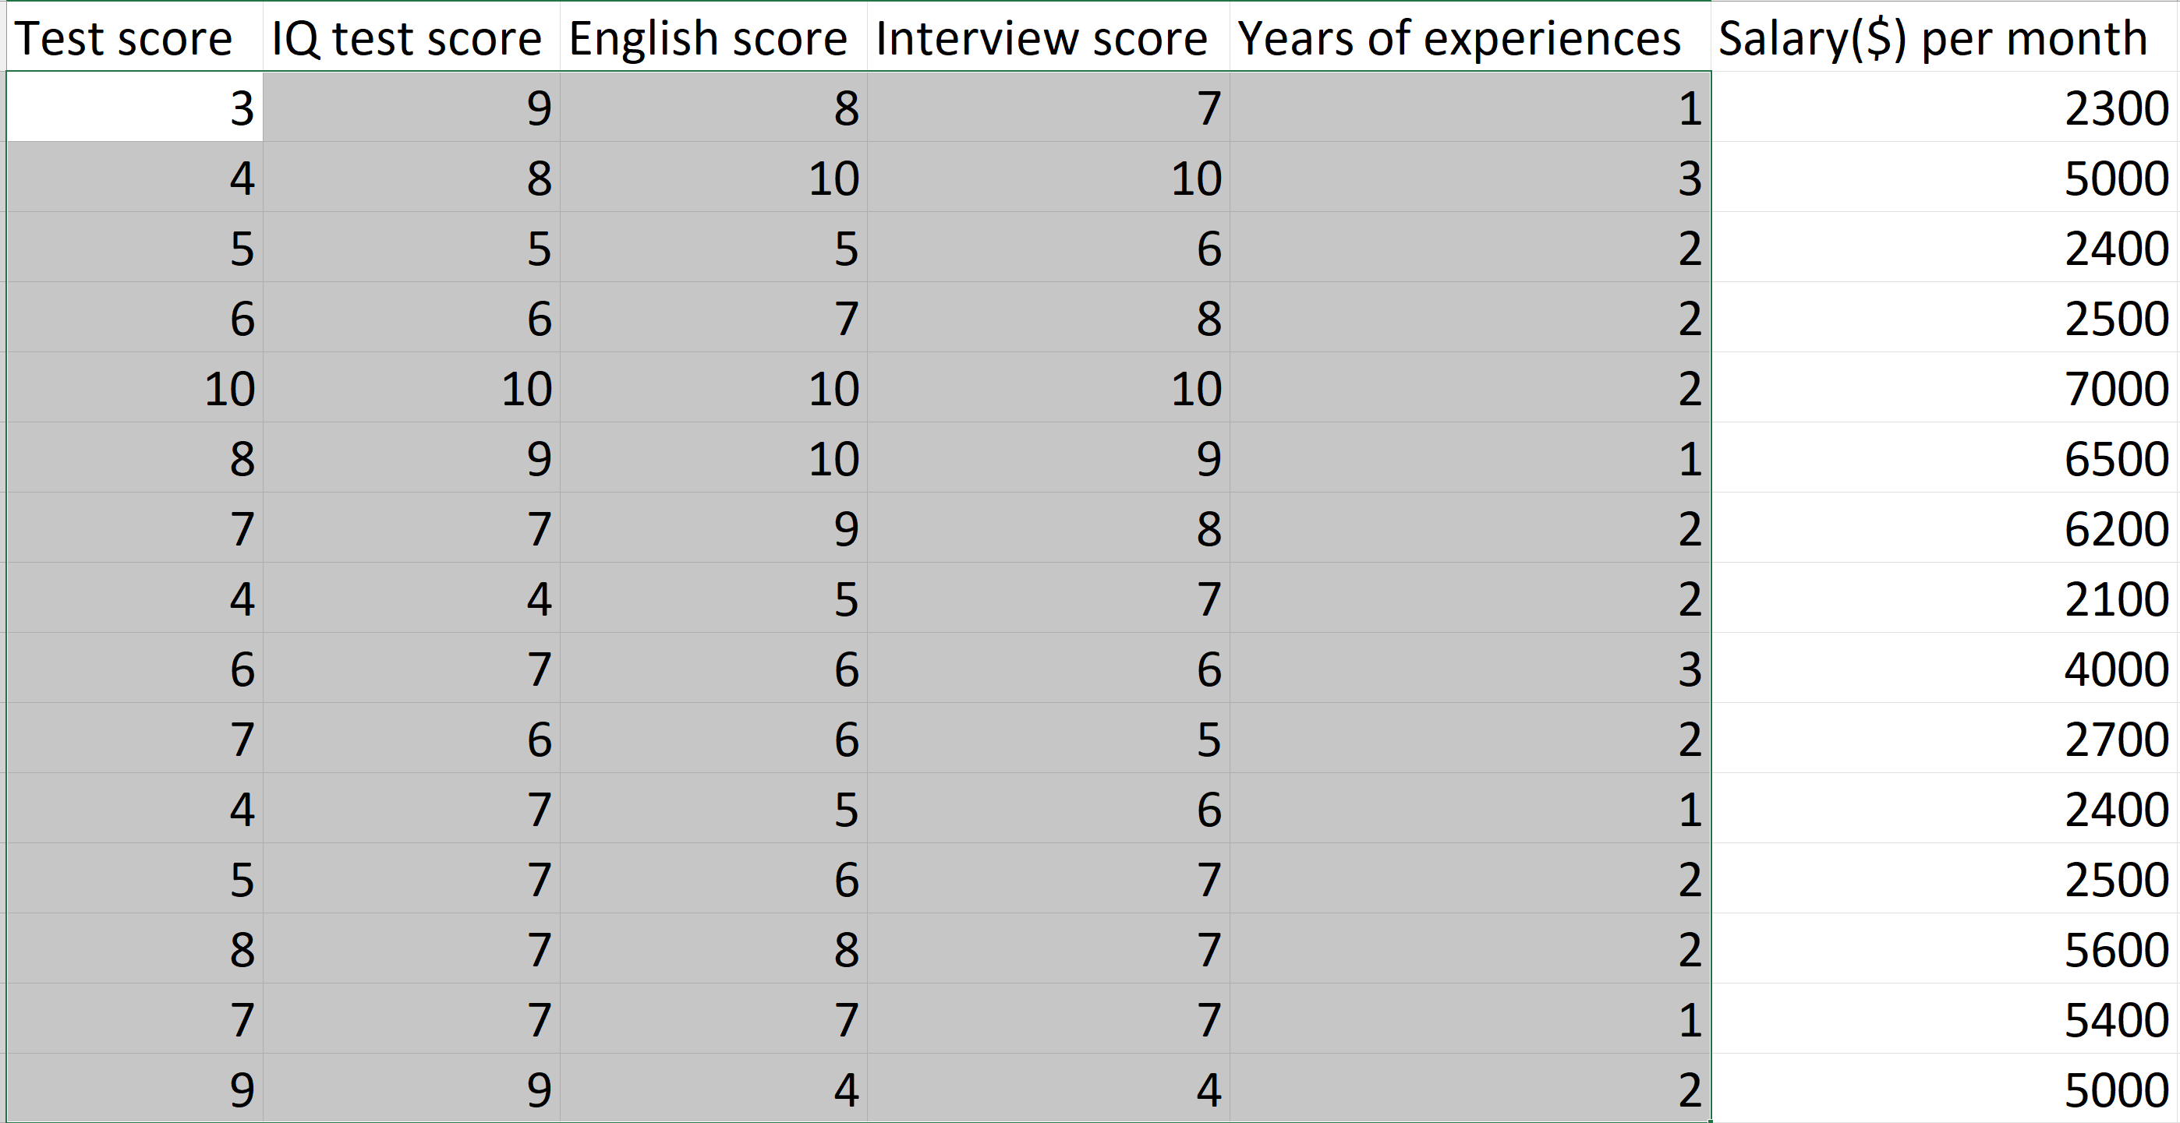
Model
Input
(features)
Output
(label)

Slide 2
Male, Female
North, West, East, South
Norminal variables
Gas, Diesel
Sedan, Hatchback, Wagon…
Categorical Variables
Bad, Good, Very Good
Ordinal variables
Low, Medium, High
One, Two, Three, Four

Slide 3
Bad
Good
Very Good
1
2
3

Slide 4
Low
Medium
Medium
High
Medium
Low
Low
High
1
2
2
3
2
1
1
3

Slide 5
mitsubishi g4 | porsche macan | renault 5 gtl | subaru trezia
1 | 0 | 0 | 0
0 | 1 | 0 | 0
0 | 0 | 1 | 0
0 | 0 | 0 | 1
mitsubishi g4
porsche macan
renault 5 gtl
subaru trezia

Slide 6
Làm việc với dữ liệu kiểu phân loại
Categorical Variables

