Slide 1
[BUG修正]数据库中数据处理、mapping结构修改

Slide 2
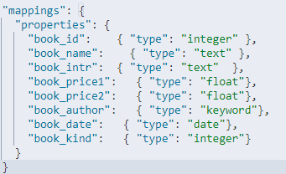
之前的一个BUG

Slide 3
改成这样
PUT /books
{
"mappings": {
"properties": {
"BookID": { "type": "integer" },
"BookName": { "type": "text" },
"BookIntr": { "type": "text" },
"BookPrice1": { "type": "float"},
"BookPrice2": { "type": "float"},
"BookAuthor": { "type": "keyword"},
"BookPress": { "type": "keyword"},
"BookDate": { "type": "date"},
"BookKind": { "type": "integer"}
}
}
}

Slide 4
由于之前的测试库数据有些问题
select book_id,book_name,book_intr,book_price1,book_price2,book_author,book_press,book_kind
,if(book_date='','1970-01-01',ltrim(book_date)) as book_date_ from books limit 10
看这条SQL

Slide 5
欢迎加入我们的QQ群
程序员在囧途教育QQ群
606976586

