Slide 1
使用etcd注册服务、web管理界面、api网关

Slide 2

初步架构
etcd
(注册中心)
gateway
api
(grpc)
spring boot (http api) spring cloud(工具集)

Slide 3
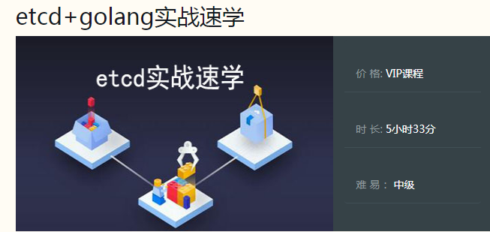
etcd
https://github.com/etcd-io/etcd
http://www.jtthink.com/course/90

Slide 4
安装Micro工具
go get github.com/micro/micro/v2

Slide 5
启动我们的服务
set MICRO_REGISTRY=etcd
set MICRO_REGISTRY_ADDRESS=localhost:2379
go run src/cmd/server.go

Slide 6
web管理界面
set MICRO_REGISTRY=etcd
set MICRO_REGISTRY_ADDRESS=localhost:2379
micro web
默认是 localhost:8082 就可以看到我们的服务

Slide 7
启动网关
set MICRO_REGISTRY=etcd
set MICRO_REGISTRY_ADDRESS=127.0.0.1:2379
set MICRO_CLIENT=grpc
set MICRO_SERVER=grpc
set MICRO_API_NAMESPACE=api.jtthink.com
micro api

Slide 8
请求
POST http://localhost:8080/user/userService/test

