Slide 1
套路篇：
支持文件上传

Slide 2
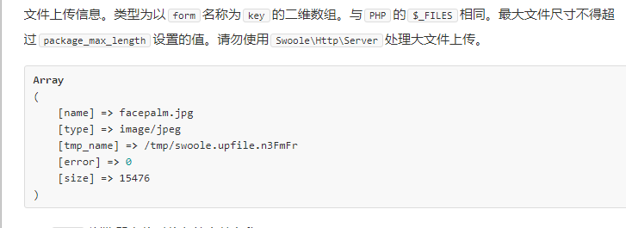
首先看文档
https://wiki.swoole.com/wiki/page/428.html

Slide 3
基本代码套路如下(前端)
<form method="post" action="/news/upload" enctype="multipart/form-data">
<input type="file" name="myjpg" autocomplete="off" />
<input type="submit" value="上传"/>
</form>

Slide 4
服务端
$request=$context->getRequest();
if ($request->files) {
$filename = basename($request->files['myfile']['name']);//取文件名
$tmpname = $request->files['myfile']['tmp_name'];
if (move_uploaded_file($tmpname, AppRoot . "/public/" . $filename)) {
return ["status" => "success"];
}
}
return ['status' =>"error"];

Slide 5
欢迎加入我们的QQ群
程序员在囧途教育QQ群
606976586

