Slide 1
Entity Matching Using Supervised Learning
Internship Presentation
Sun Min Lee
Notes:
Hello, my name is Sun Min Lee and today I'm here to talk to you about my whole internship research on entity matching using supervised learning.

Slide 2
INDEX
1. Motivation
1-1 Motivation
2. Preprocessing
2-1 Statistics on Data Sets
2-2 Creating Extending Gold Standard
2-3 Creating Feature Files
3. Evaluation
3-1 Environment
3-2 Results
4. Summary
Notes:
This is the contents of my presentation today.

Slide 3
1. Motivation
Notes:
First, I would like to talk to you about the motivation of this project.

Slide 4
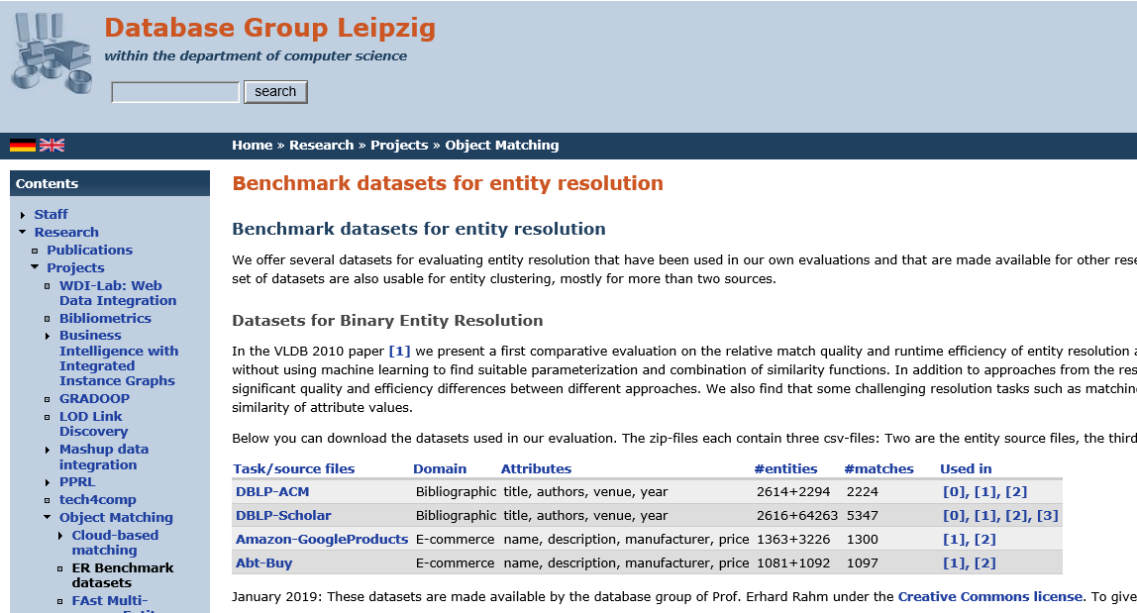
Motivation
Entity Resolution
The task of disambiguating manifestations of real-world entities in various records by linking and grouping
Structured versus unstructured
Free text and image content
Use of heterogeneous names and abbreviations
Missing, Incomplete data
Typos, Transposition, Data Errors
Source: Köpcke H, Thor A, Thomas S, Rahm E (2012) Tailoring entity resolution for matching product offers. Proc. EDBT, 545–550, http://www.datacommunitydc.org/blog/2013/08/entity-resolution-for-big-data
Notes:
It starts with what entity resolution is.
The entity resolution is the task of disambiguating manifestations of real-world entities in various records by linking and grouping.
There are problems makes the entity resolution hard which are unstructured, free text and image content, use of heterogeneous names and abbreviations, missing and incomplete data, typos, transposition and data errors.
There are different methods to solve these problems and the benchmark datasets used on that. I've collected benchmark datasets from several previous experiments, to see how it works, and what kind of data set will be good.

Slide 5
Motivation
Overview of Work
Collect
Execute
Discover
Select
Explore and Profile existing benchmark data sets for entity matching
Execute the complete matching pipeline
: create gold standard
feature creation
filtering/blocking
matching
evaluation
Try different classifiers and see how they behave for different data sets
Filter out data sets that are “good” for further experiment
Notes:
This is an overview of my work. The specific question that I'm going to be answering for the whole process is "What are 'good' data sets for further experiment.
So, first, explore and profile existing benchmark data sets for entity matching,
next execute the complete matching pipeline which is creating a gold standard, creating feature, filtering, matching, and evaluation.
Then, I tried different classifiers to see how they behave for different data sets.
Last I'd filtered out data sets that are "good" for further experiments.

Slide 6
2. Preprocessing
Collecting data sets, Profiling
Notes:
Preprocessing
I explored 7 papers and found 25 data sets that are used.

Slide 7
Statistics
Source: https://sites.google.com/site/anhaidgroup/useful-stuff/data
(21) |  | Product Data sets (4) | Books Data sets (7) | Citation (1) | Movies, Music Anime (5) | Restaurants Data sets (4)
Data Sets |  | Baby_products, Beer, Bikes, Electronics | Books: 5, Ebooks: 2 | 1 | Movies: 3, Music: 1, Anime: 1 | Restaurants: 4
Source | Entities | 4259 - 5085 Avg: 4,619 | 2,999 - 8,639 Avg: 5,016 | 3,122 | 2,961 - 55,923 Avg: 14,766‬ | 5,882 - 11,840 Avg: 8,653
 | Features | 8 - 17 | 9 - 17 | 12 | 8 - 17 | 6-25
Target | Entities | 3,000 – 10,718 Avg: 6,930 | 2998 - 14110 Avg: 7,355 | 3,881 | 3,094 – 6,913 Avg: 5,464 | 3,013-28,787 Avg: 10,230
 | Features | 8 - 13 | 10 - 17 | 15 | 8 - 13 | 6 - 16
Gold Standard | Entities (Avg) | 424 | 410 | 400 | 461 | 424
 | Positives (ratio) | 0.147 – 0.289 Avg: 0.214 | 0.1 – 0.727 Avg: 0.346 | 0.23 | 0.245 – 0.646 Avg: 0.419 | 0.202 – 0.325 Avg: 0.256
 | Negatives (ratio) | 0.711 – 0.853 Avg: 0.786 | 0.273 – 0.9 Avg: 0.654 | 0.77 | 0.354 – 0.755 Avg: 0.581 | 0.675 – 0.798 Avg:0.744
Notes:
This are the statistics of collected data sets. This table shows brief information on 21 data sets which are products, books, citations, entertainments, and places. These have around 8,000 source entities on average, around 7,200 target entities on average and average 427 entity pairs in the gold standard. Most of them have between 8 to 15 features.

Slide 8
Statistics
Size of Gold Standard in Data Sets
 |  | Anime | Baby_ products | Beer | Bikes | Books1 | Books2 | . . . | Movies5 | Music | Restaurants1 | Restaurants2 | Restaurants3 | Restaurants4
Source | Entities | 4,000 | 5,085 | 4,345 | 4,786 | 3,506 | 3,967 | … | 3,556 | 55,923 | 5,882 | 6,960 | 9,947 | 11,840
 | Features | 8 | 17 | 5 | 10 | 12 | 17 | … | 9 | 10 | 6 | 9 | 25 | 8
Target | Entities | 4,000 | 10,718 | 3,000 | 9,003 | 3,508 | 3,701 | … | 6,913 | 6,907 | 3,013 | 3,897 | 28,787 | 5,223
 | Features | 8 | 17 | 5 | 10 | 12 | 17 | … | 8 | 11 | 6 | 8 | 16 | 7
Gold Standard | Entities | 393 | 400 | 450 | 450 | 374 | 397 | … | 373 | 539 | 450 | 444 | 400 | 400
 | Positives / Negatives | 0.409 /0.594 | 0.27 /0.73 | 0.151 /0.849 | 0.289 /0.711 | 0.62 /0.38 | 0.232 /0.768 | … | 0.646 /0.354 | 0.245 /0.755 | 0.275 /0.725 | 0.202 /0.798 | 0.22 /0.78 | 0.325 /0.675
Entity Pairs of Gold Standard are always less than 1,000
Notes:
The interesting fact about these data sets is that entity pairs of the gold standard are always less than 1,000 even though some of them have more than 10,000 source entities. Because the gold standard is the main data that is used for a machine learning experiment, it's clear to say these data sets are quite small.

Slide 9
Statistics
Source: https://dbs.uni-leipzig.de/research/projects/object_matching/benchmark_datasets_for_entity_resolution
(4) |  | Abt-Buy | Amazon-GoogleProducts | DBLP-ACM | DBLP-Scholar
Source | Entities | 1,081 | 1,363 | 2,616 | 2,616
 | Features | 4 | 5 | 5 | 5
 | Lowest Density | price (0.3867) | description (0.9156) | year (0.998) | authors (0.9167)
Target | Entities | 1,092 | 3,226 | 2,294 | 64,263
 | Features | 5 | 5 | 5 | 5
 | Lowest Density | price (0.5403) | manufacturer (0.0719) | authors (0.9939) | year (0.4586)
Gold Standard | Entity Pairs | 1,097 | 1,300 | 2,224 | 5,347
Notes:
This table shows the information of 4 data sets which are found from database group Leipzig. These have around 2,000 source entities on average and a minimum of around 1,000 to a maximum of more than 60,000 target entities. They all have 4 to 5 features. As you can see on this Lowest density, the DBLP-ACM data set has only a few missing values. The existing gold standards for these data sets only have Entity pairs which means they only have positives.

Slide 10
Creating Extending Gold Standard
Creating Negative labeled Data from Positive labeled Data
 |  | Abt-Buy | Amazon-GoogleProducts | DBLP-ACM | DBLP-Scholar
Gold Standard |  | 1,097 | 1,300 | 2,224 | 5,347
Extending Gold Standard - train | Entities | 5,730 | 6,753 | 592 | 9,484
 | Positives | 876 | 1,039 | 98 | 1,580
 | Negatives | 4,854 | 5,714 | 494 | 7,904
Extending Gold Standard - test | Entities | 1,432 | 1,687 | 146 | 2,371
 | Positives | 219 | 259 | 23 | 395
 | Negatives | 1,213 | 1,428 | 123 | 1,976
Notes:
So, I've created extending the gold standard by creating negative pairs from positives. I've created 2 different files that would be used for each training and test data in machine learning. The negative pairs on these created gold standard are around 5 times positive pairs.

Slide 11
Creating Feature Files
Supported data types, similarity metrics used
Similarity metrics
String Type
Cosine Similarity, Cosine TF-IDF,
The Levenshtein distance, Overlap(Boolean)
Jaccard Index, Containment
Long String Type
Numeric Type
Absolute difference, Number equal(Boolean)
Date Type
Absolute difference of day, month, year
Notes:
Next, I've created feature files. The supported data types of feature values are string, long string, numeric, and date type. For each data type, used different similarity metrics. For string and long string type, I used cosine similarity, cosine similarity with tf-idf score, the Levenshtein distance, overlap, Jaccard index, and containment. For numeric type, absolute difference and number equal are used. For date type, I use the absolute difference of each day, month, and year.

Slide 12
Creating Feature Files
Creating Feature Files
source_id | title | … | price | category | Company_struct
1 | Peanut Shell Mila 4 Piece Crib Bedding Set |  | 159.99 | Nursery Bedding | Peanut Shell
2 | Lambs & Ivy Echo 7 Piece Bedding Set |  | 159.99 | Nursery Bedding | Lambs & Ivy
3 | Bella 6 Piece Bed Set |  | 159.99 | Nursery Bedding | Peanut Shell
target_id | title | … | SKU | price | Company_struct
1 | Maclaren Limited Edition Quest in Denim |  | 44151621 | 294.99 | Maclaren
2 | Baby Cargo Series 300 Ultra-Lightweight Stroller in Smoke |  | 43218783 | 189.99 | Baby Cargo
3 | Simmons Aluminum Tour DX Stroller |  | 17957503 | 169.99 | Simmons
… | source_id | target_id | pair_id | label | title_lev | title_jaccard | title_relaxed_jaccard | title_overlap | title_cosine_tfidf | title_containment | …
 | 1606 | 700 | 1606-700 | TRUE | 1 | 1 | 1 | 1 | 0 | 1
 | 1756 | 714 | 1756-714 | TRUE | 1 | 1 | 1 | 1 | 0 | 1
 | 1659 | 717 | 1659-717 | FALSE | 0.590164 | 0.5 | 0.5 | 0 | 0 | 0.714286
Get Types of Data
Calculate score
If Type is different
Assign (Long) String
Source: https://sites.google.com/site/anhaidgroup/useful-stuff/data Baby_product - source: babies_r_us, target: buy_buy_baby
Notes:
The method of creating feature files is first to get the feature that exists in both source and target files, second get types of each feature data. If the type of source feature and target feature are different, then assigned both to string type. Last, calculate the similarity scores using similarity metrics.

Slide 13
Creating Feature Files
Clear the feature files : delete unnecessary feature column (Empty value, Unique type)
source_id | target_id | pair_id | label | cosine_tfidf | ext_id_abs_diff | title_lev | brand_lev | weight_lev | …
1606 | 700 | 1606-700 | TRUE | 0.023648 | 1001890375 | 1 | -1 | -1
1756 | 714 | 1756-714 | TRUE | 0.023038 | 1001890428 | 1 | -1 | -1
1659 | 717 | 1659-717 | FALSE | 0.019293 | 46600563 | 0.590164 | -1 | -1
source_id | target_id | pair_id | label | cosine_tfidf | title_lev | …
1606 | 700 | 1606-700 | TRUE | 0.023648 | 1
1756 | 714 | 1756-714 | TRUE | 0.023038 | 1
1659 | 717 | 1659-717 | FALSE | 0.019293 | 0.590164
Source: features_babies_r_us_buy_buy_baby.csv
Notes:
Finally, with the created file, I've cleared unnecessary feature columns which are unique, or empty. For example, this table is the created feature file of the baby product data set. The dark column, extended id is a unique value which cannot be used for other data set. So I've deleted it. These white columns, brand, and weight all have -1 value which means the original data of this feature is empty. So I also deleted those.

Slide 14
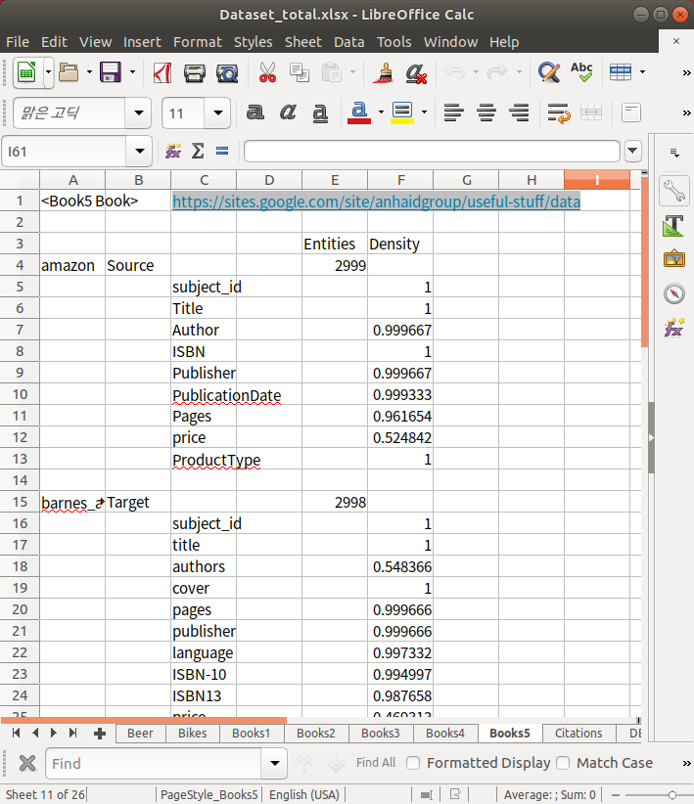
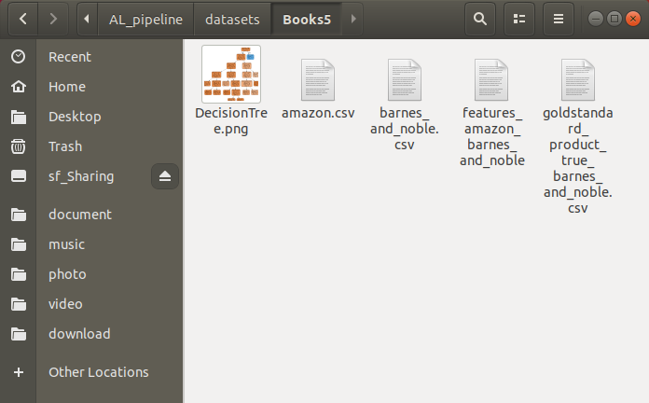
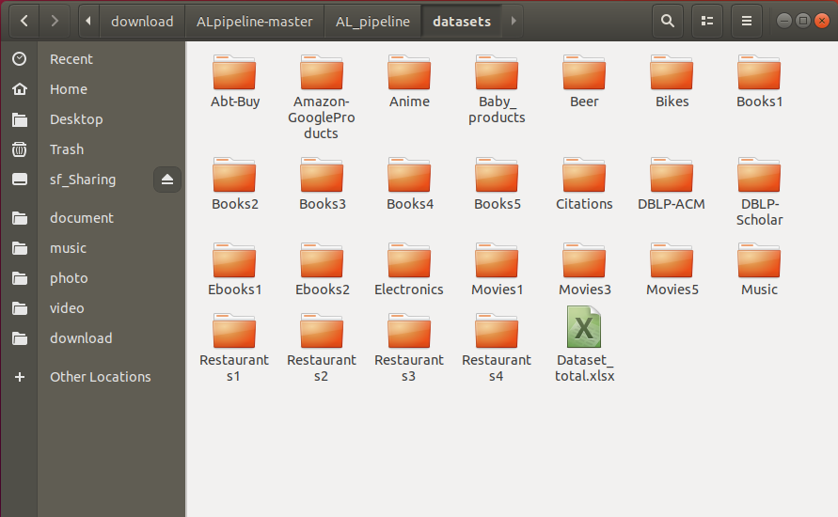
Output Materials
25 Data sets, Statistics
Notes:
These are the output materials.
I've made 25 data sets files which have the source, target, gold standard, feature files in, and statistics of those data sets.

Slide 15
3. Evaluation
Using different Classifiers – Supervised learning
Notes:
Next step is the evaluation

Slide 16

Environment
Virtual Machine: Oracle VM VirtualBox
OS : Ubuntu 18.04
Memory : 4GB
Language : Python 2.7
Machine Learning: Scikit-learn
Classifiers :
KNN: KNeighborsClassifier(2)
SVM: LinearSVC()
Decision Tree: DecisionTreeClassifier(random_state=1)
Random Forest: RandomForestClassifier(random_state=1)
Naïve Bayes: GaussianNB()
Logistic Regression: LogisticRegression(random_state=1, solver='liblinear’)
XGBoost: XGBClassifier(objective="binary:logistic", random_state=1)
Notes:
This is the environment when running machine learning. I used python and scikit-learn framework to run machine learning. These are the classifiers used for this supervised learning experiment. I used 7 classifiers which are K Nearest Neighborhood, Support vector machines, Decision Tree, Random Forest, Naive Bayes, Logistic Regression, XGBoost.
The reason for selecting these classifiers is that those are well-known classifiers and show quite high accuracy scores on binary classification.

Slide 17
Results
Average scores on 25 Data Sets : 4 (Train-Test Split), 21 (Cross-Validation)
High
Decision Tree,
Random Forest Classifier
Low
KNN, Naïve Bayes
Notes:
This graph shows the average precision, recall and f1 score of 7 classifiers on 25 data sets. Decision Tree and Random Forest classifier show the high score which is around 0.9, KNN and Naive Bayes classifiers show relatively low score which is around 0.8. All the classifiers have over 0.75 F1 score.

Slide 18
Results
F1 score of classifiers on All Data Sets
Books5
All Classifiers have low F1 score on Book5 data set
Restaurants2
Low score on KNN classifier,
High score on other classifiers
Notes:
This graph is the F1 scores of classifiers on all individual data sets. On 10 data sets, all classifiers show above 0.9 f1 score. On 14 data sets, the average F1 score of classifiers is above 0.9. The data set which has the lowest average f1 is Books2 with 0.215, and next is the baby product with 0.518. The data set which has the highest average f1 is Movies3 with 0.986, and next is Anime with 0.985 f1 scores. There are some data sets that looks interesting which is Books5, the only one has below 0.4 on all classifiers, and restaurants2, which only KNN classifier shows below 0.2 f1 scores which others have good scores.

Slide 19
Results
Scores of all Classifiers on Books5, Restaurants2 data sets
Books5 – Low score on all used classifiers
Small feature file size
6 feature columns
Restaurants2 – Only KNN shows low score
Also shown on the other data set - e.g. Restaurants1, Books3
Size of feature file affect the score of evaluation
Some classifiers have low accuracy compare to other classifiers
Notes:
So I specifically looked at these two data sets. On Books5 except for naive Bayes, all the classifiers show around 0.2 f1 score which is low compared to the other data sets. So I've looked at the decision tree of this data set and it only has a depth of 6. Compare to the other data sets the depth of this data set is not big. So I looked at the feature file and found that there are only 6 attributes. The number of attributes of the feature file is usually over 15 in other data sets, I can guess the problem of this low score is because of the small feature file. On Restaurants2 data sets only KNN shows around 0.2 f1 scores while other classifiers show even close to 1. I could find this graph on different data sets like Restaurants1 and Books3. So I can guess some classifiers have relatively poor performance. So I got the conclusion that the size of the feature file affects the score of evaluation, and some classifiers have lower accuracy compare to the other classifiers.

Slide 20
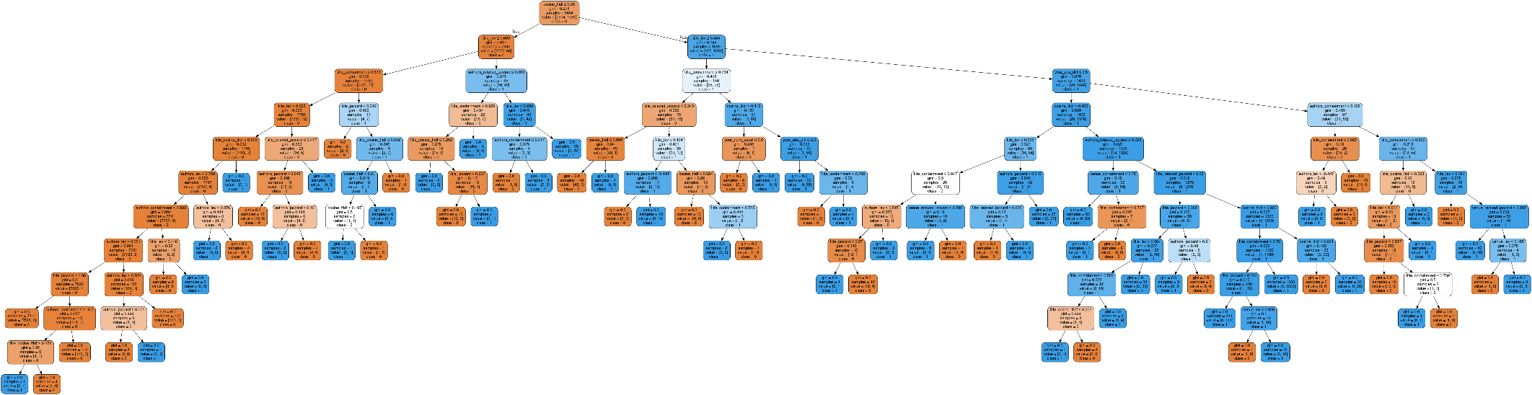
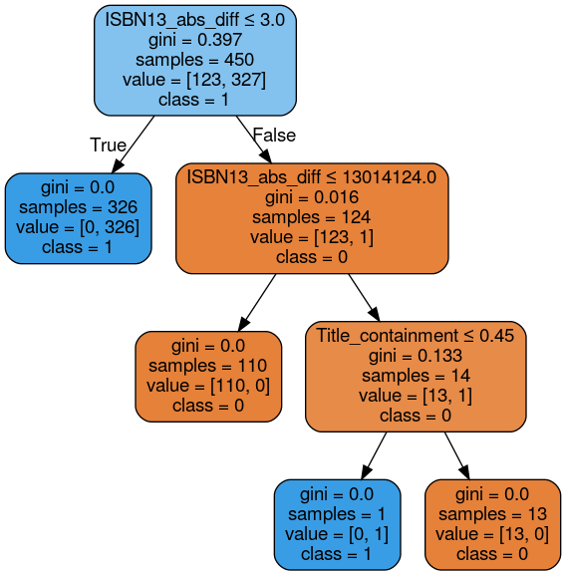
Results
Decision Tree
DBLP-Scholar
Books3
Both Data Sets have over 0.96 f1 score
DBLP-Scholar : Max Depth 12
Books3: Max Depth 3
Books3 data set is relatively easy than DBLP-Scholar data set
Notes:
There is also an interesting fact on the Decision Tree classifier. Both data sets have over 0.96 f1 score which is high. but the DBLP-Scholar data set has a depth of 12 which books3 data set only has a depth of 3. By looking at this tree model, I found that the books3 data set is relatively easy than the DBLP-Scholar data set.

Slide 21
4. Summary
.
Notes:
To summarize the results.

Slide 22
Summary
Achieve near 100% F1
Anime
Books3
Ebooks2
Movies3
Relatively low F1
Abt-Buy
Amazon-GoogleProducts
Baby_products
Books2
Notes:
I deleted classifiers with the relatively low f1 scores from the graph above. So these 4 classifiers are the one with good performance. We can see these red circled data sets which are anime, books3, ebooks2, Movies3. Those achieve near 100% f1 which is not good data sets because these already show the high accuracy score on existing classifiers. The data sets with these green circled data sets have a comparatively low f1 score which is below 0.8 on average. I think these could be good data sets for further experiments.

Slide 23
References
Konda, P., Naughton, J., Prasad, S., Krishnan, G., Deep, R., Raghavendra, V., … Zhang, H. (2016). Magellan. Proceedings of the VLDB Endowment, 9(12), 1197–1208. doi:10.14778/2994509.2994535
Mudgal, S., Li, H., Rekatsinas, T., Doan, A., Park, Y., Krishnan, G., … Raghavendra, V. (2018). Deep Learning for Entity Matching. Proceedings of the 2018 International Conference on Management of Data - SIGMOD ’18. doi:10.1145/3183713.3196926
Ebraheem, M., Thirumuruganathan, S., Joty, S., Ouzzani, M., & Tang, N. (2018). Distributed representations of tuples for entity resolution. Proceedings of the VLDB Endowment, 11(11), 1454–1467. doi:10.14778/3236187.3236198
Kasai, J., Qian, K., Gurajada, S., Li, Y., & Popa, L. (2019). Low-resource Deep Entity Resolution with Transfer and Active Learning. Proceedings of the 57th Annual Meeting of the Association for Computational Linguistics. doi:10.18653/v1/p19-1586
Thor, A., & Rahm E. (2007). MOMA - A Mapping-based Object Matching System. 3rd Biennial Conference on Innovative Data Systems Research (CIDR) January 7-10.
Köpcke, H., Thor, A., & Rahm, E. (2010). Learning-Based Approaches for Matching Web Data Entities. IEEE Internet Computing, 14(4), 23–31. doi:10.1109/mic.2010.58
Kolb, L., & Rahm, E. (2012). Parallel Entity Resolution with Dedoop. Datenbank-Spektrum, 13(1), 23–32. doi:10.1007/s13222-012-0110-x
Notes:
references

Slide 24
Thank you for listening
Internship Presentation
Notes:
Thank you!

