Slide 1


EXPLORATORY DATA ANALYSIS OF RETAIL SALES AND CUSTOMER DEMOGRAPHICS
AUTHOR: SUNNA DÍS JOHNSDÓTTIR
HYPER ISLAND

Slide 2

CONTENT
01
INTRODUCTION
02
METHODOLOGY
03
ANALYSIS RESULTS
04
RECOMMENDATIONS

Slide 3


INTRODUCTION
In this analysis, I examine a synthetic retail dataset to identify key trends in customer behavior and sales performance. The dataset spans over a period of one year. The findings aim to guide data-driven decision-making and refine my analytical skills.

Slide 4


METHODOLOGY
01
02
03
04
DATA PREPARATION
DATA CLEANING & TRANSFORMATION:
EXPLORATORY DATA ANALYSIS (EDA):
VISUALIZATION
The dataset was obtained from Kaggle as a CSV file. Imported into Python using Pandas; conducted initial data checks.
Utilized Tableau to design a dashboard displaying KPIs, sales trends, and customer demographics.
Handled missing values and duplicates to improve data quality. I converted dates to datetime format and calculated new fields like Total Revenue by combining Quantity and Price per Unit.
Analyzed data distributions and relationships using Pandas. Organized data to prepare for advanced visualization in Tableau, ensuring it was clean and ready for dashboard creation.

Slide 5
Analysis results

Slide 6

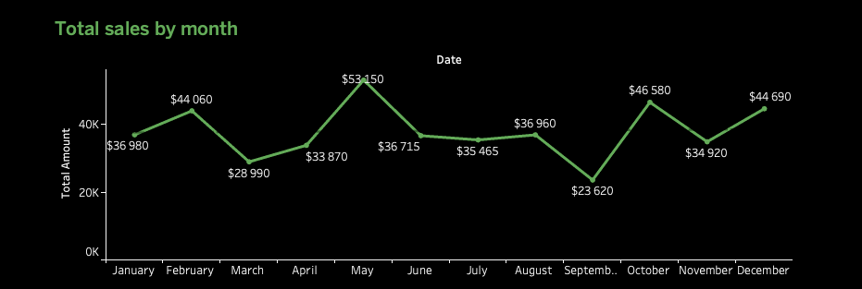
KPI’S
Highest Sales: May with $53,150, suggesting a successful sales period.
Lowest Sales: September with $23,620, reinforcing the insight from the growth rate chart.
Seasonal trends
Review marketing activities
Notes:
This slide shows key performance indicators, with total revenue at $456,000 and 2,514 orders for the year. The chart highlights monthly sales trends, with the highest sales in May at $53,150 and the lowest in September at $23,620. The fluctuations suggest variability in consumer behavior, likely influenced by seasonal trends or marketing efforts.
To understand these trends better, reviewing marketing activities and external factors, like market conditions or competitor actions, could reveal opportunities to stabilize sales and capitalize on peak periods.

Slide 7
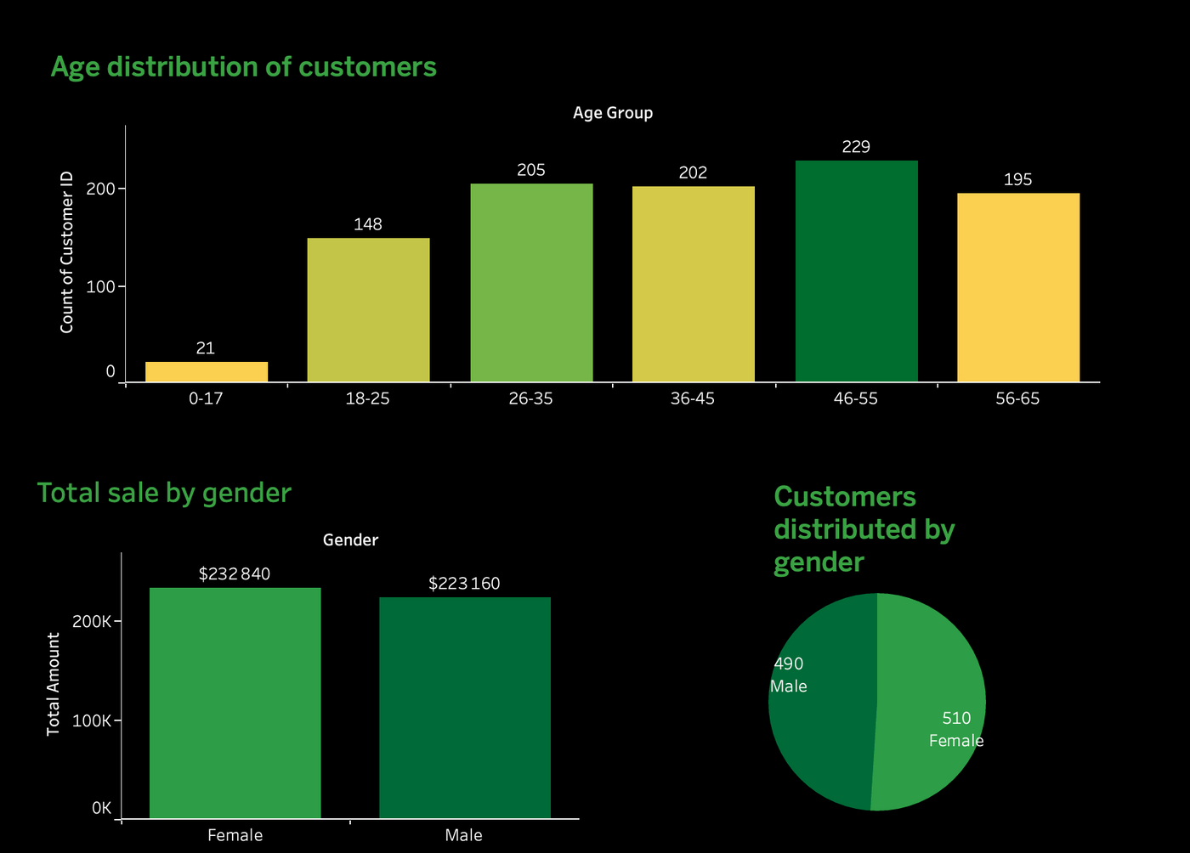
Customer Demographics
Target Age Group: Majority of customers are aged 26-55.
Balanced Revenue by Gender: Slight lead in sales from female customers.
Even Gender Split: Product appeals equally to both genders.
Notes:
The majority of customers fall within the 26-55 age range, suggesting that marketing efforts could be tailored to these age groups for maximum impact.
The revenue is relatively balanced between male and female customers, with a slight lead in sales from female customers.
The customer base is nearly evenly split between genders, indicating that the product or service appeals equally to both.

Slide 8
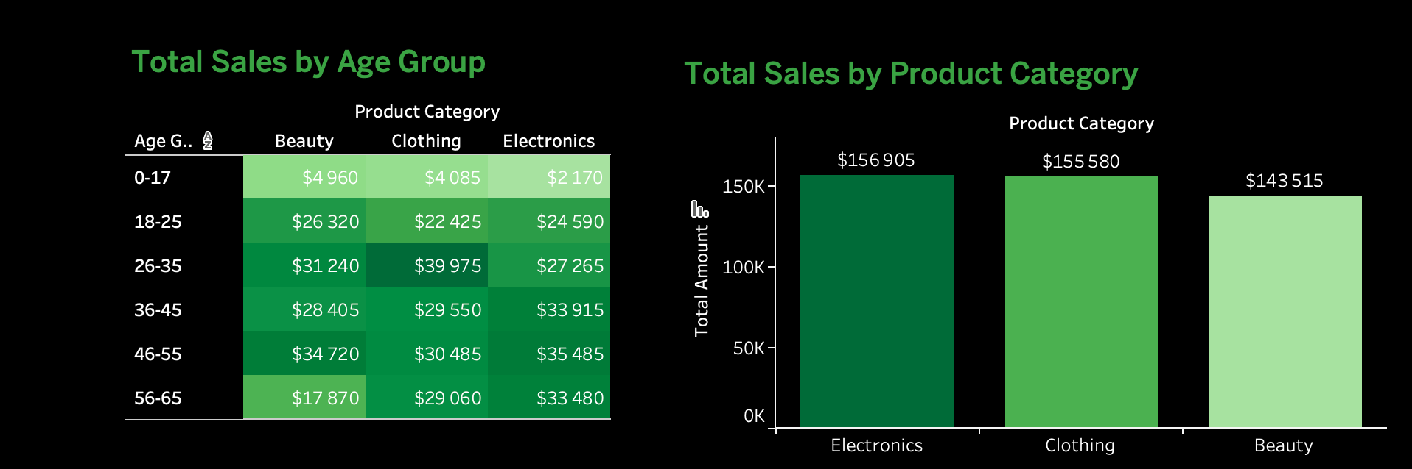
Sales by Product Category
Top Sales in Electronics: Electronics lead with $156,905 in total sales.
Peak Age for Beauty Products: Highest sales in Beauty among 46-55 year-olds.
Clothing Peak Age Group: Clothing sales highest in the 26-35 age group.
Notes:
This slide presents sales data by product category and age group.
Electronics perform strongly across all age groups, especially among 46-55 year-olds with $35,485 in sales.
Clothing shows consistent sales, peaking in the 26-35 age group at $39,975.
Beauty Products have the highest sales in the 46-55 age group with $34,720, indicating strong interest from this demographic.
Overall, Electronics lead with $156,905 in total sales, closely followed by Clothing ($155,580) and Beauty ($143,515).

Slide 9
RECOMMENDATIONS:
Focus on strategies that led to success in May and address the challenges faced in September.
Consider targeted marketing strategies focusing on the 26-55 age demographic to boost sales further.
Maintain a balanced approach to gender-targeted advertising, as both male and female customers are contributing significantly to the revenue.
Tailor marketing strategies for electronics and beauty products to target the most responsive age groups effectively.
Focus on the top-performing categories while exploring growth opportunities for those with lower sales.

