Slide 1
Geekd
Reviews and more

Slide 2
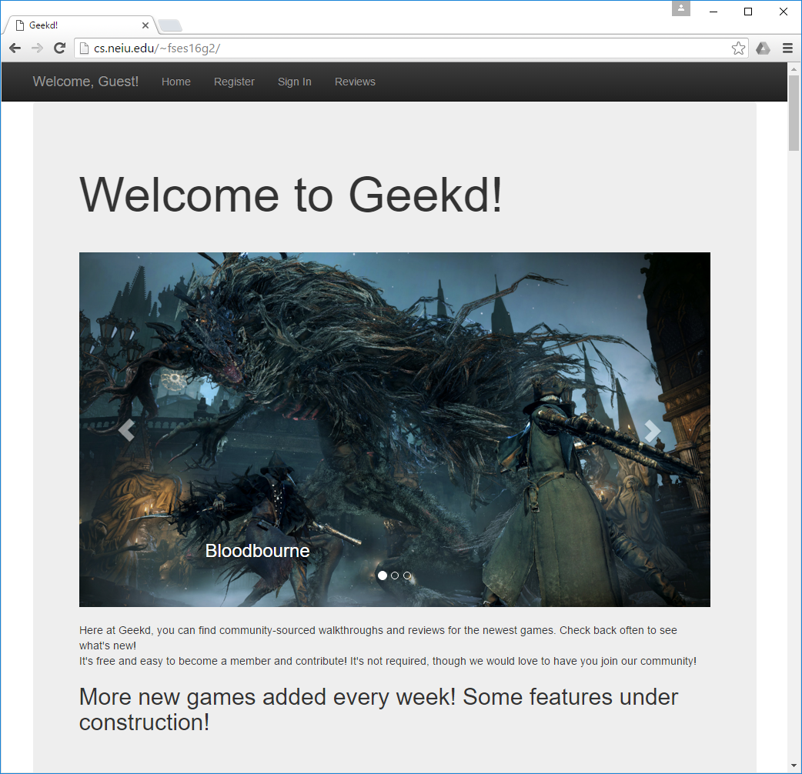
Welcome Page
Welcome page splashes with a carousel of images. Current games are displayed below.

Slide 3
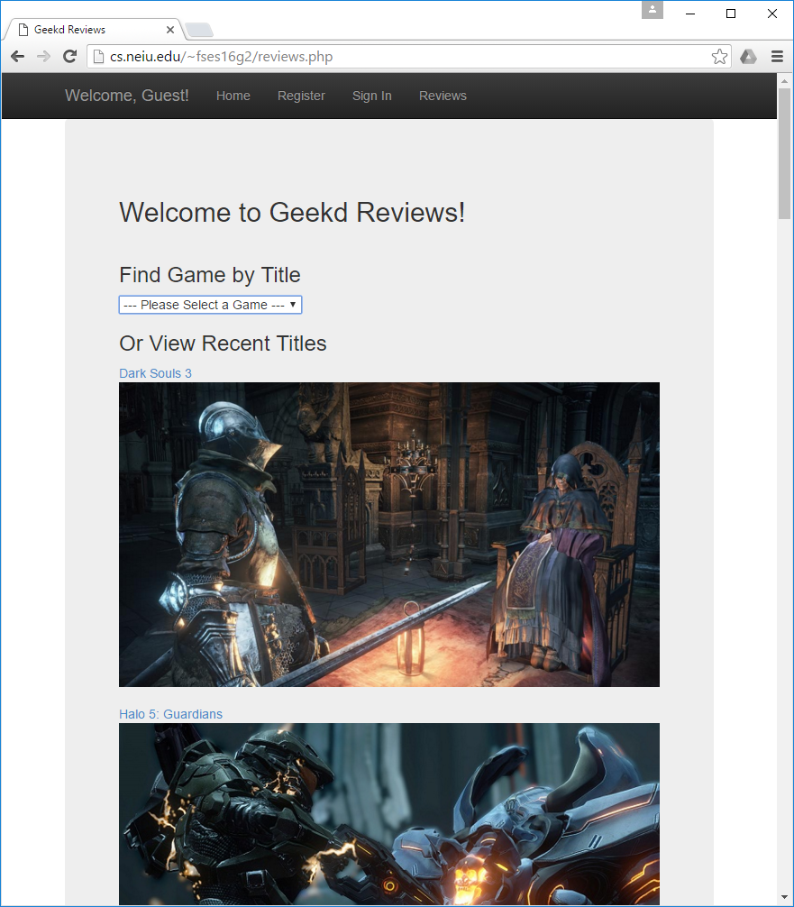
Geekd Listing
Reviews listing. Each title header and image acts as a link the the next page. The referenced is saved and passed to the next page and is populated from the database.

Slide 4
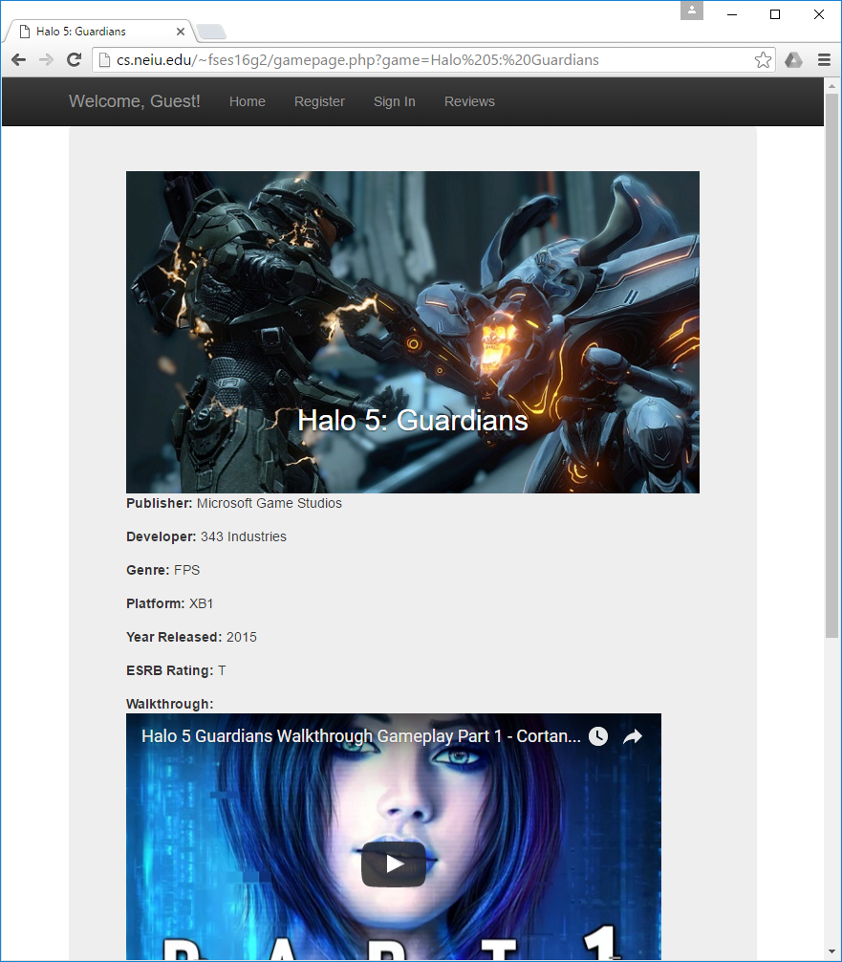
Reviews
Each game will feature a review if available. The review will be located under a walkthrough, if it is available.

Slide 5
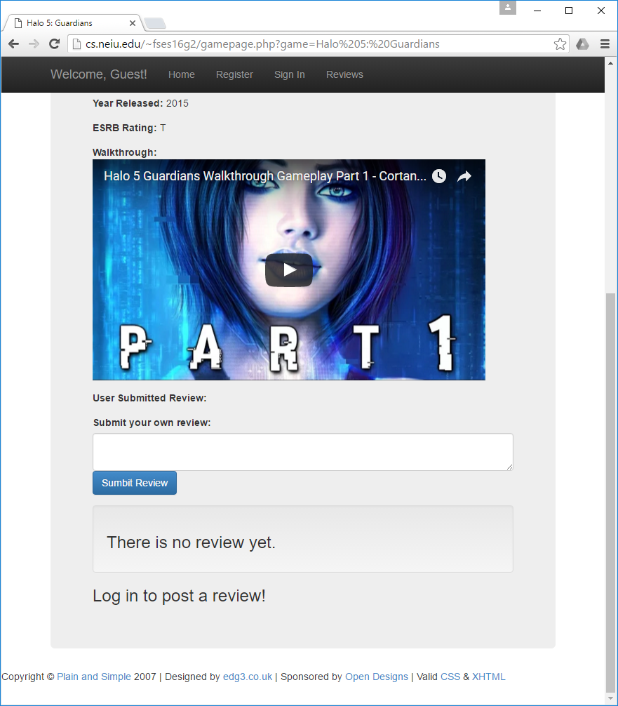
Walkthroughs
One of the preferred medias for walkthroughs are videos. Embedded videos will be provided from the appropriate mirrors.

Slide 6
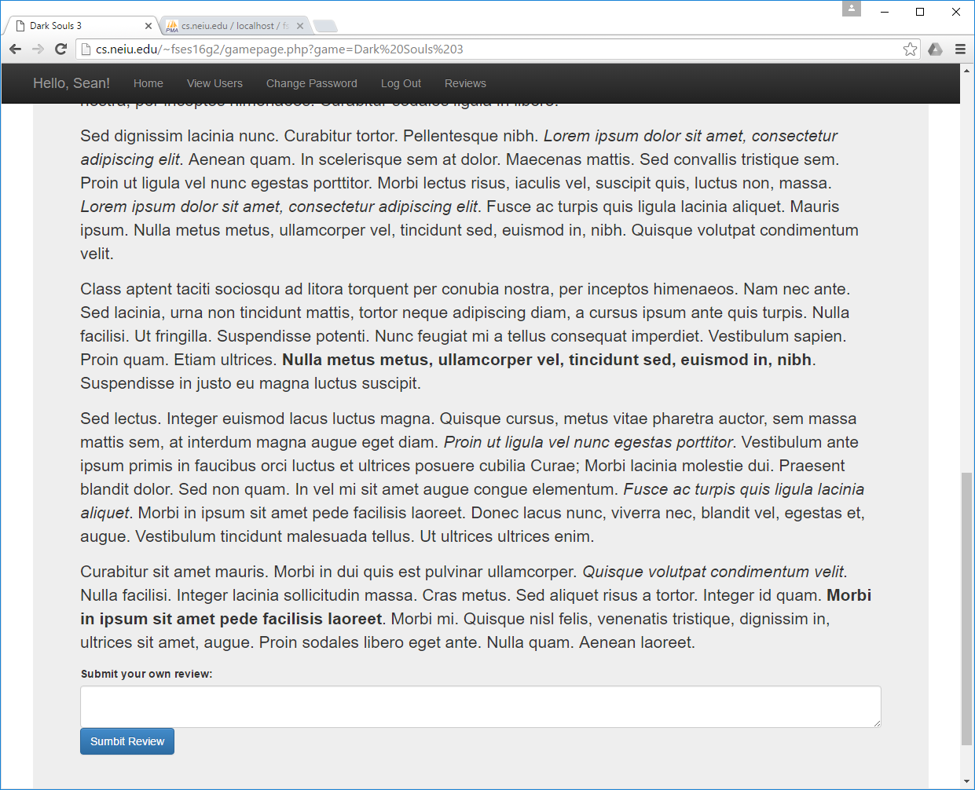
Submissions
Users will be able to submit their own reviews on the associated games page.

