Slide 1
Steady-State Diffusion, Electrostatics, Conduction and FD

Slide 2
Equations
Many 2nd order partial differential equations. For example heat flow:
At SS
dT/dt = 0
With many others for EM and other distributed problems at SS

Slide 3
Use thermal diffusion/conduction- metals as an example
In a metal two types of heat transport
Electron gas (which is dominant).
Lattice vibrations (phonons) (dominant for insulators)
Heat flow can be described by a diffusion equation (hot flows to cold).
The temperature of lattice is what we feel as “heat”, the electrons are usually in thermal equilibrium with the lattice and T_{E} = T_{l} , but not always the case.
Very useful to view heat transfer like current flow and define a thermal resistance.

Slide 4
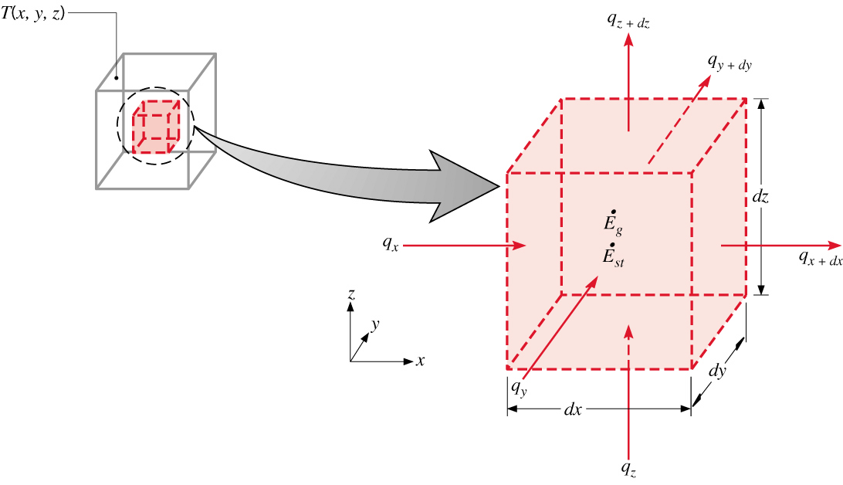
Heat Equation
The Heat Equation
A differential equation whose solution provides the temperature distribution in a
stationary medium.
Based on applying conservation of energy to a differential control volume
through which energy transfer is exclusively by conduction.
Cartesian Coordinates:
(2.13)
Heat Flow equation (PDE boundary value transient problem)
Net transfer of thermal energy into the
control volume (inflow-outflow)
Thermal energy
generation
Change in thermal
energy storage

Slide 5
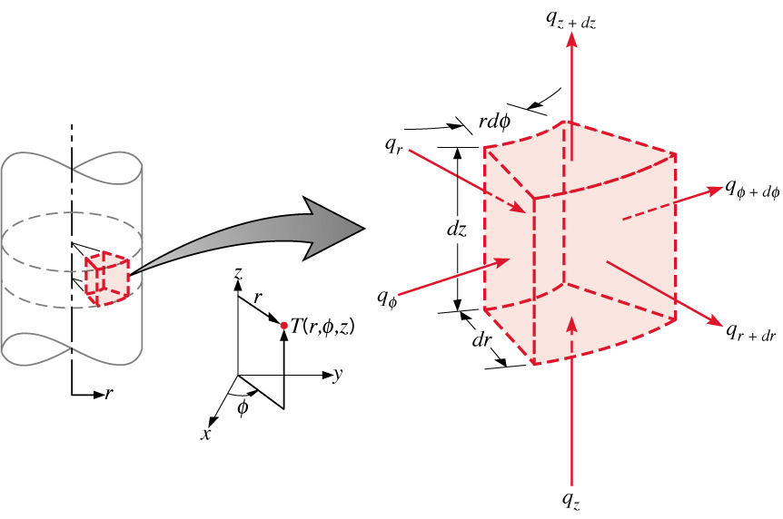
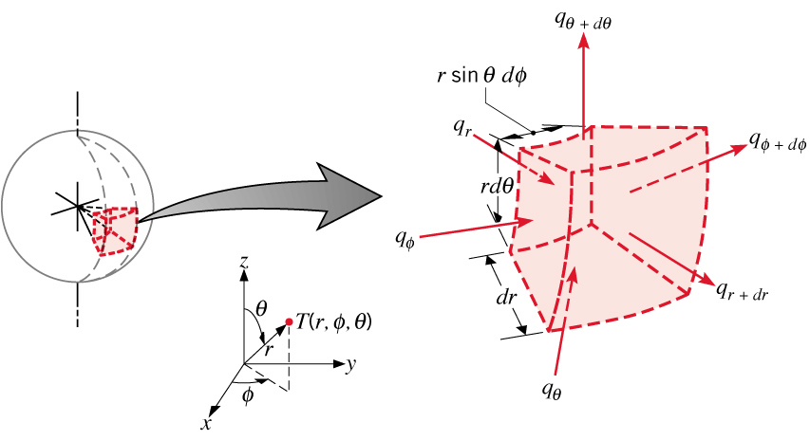
Heat Equation (Radial Systems)
Cylindrical Coordinates:
(2.20)
Spherical Coordinates:
(2.33)

Slide 6
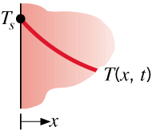
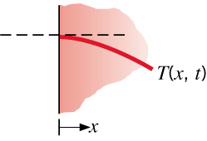
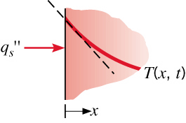
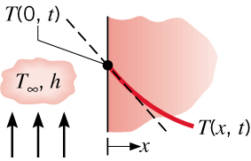
Boundary Conditions
Boundary and Initial Conditions
For transient conduction, heat equation is first order in time, requiring
specification of an initial temperature distribution:
Since heat equation is second order in space, two boundary conditions
must be specified. Some common cases:
Constant Surface Temperature:
Insulated Surface
Constant Heat Flux:
Applied Flux
Given the heat flow equation, geometry, BC’s and IC’s we can solve for T(x,y,z,t).
The BCs can be non-linear making the equation non-linear.
Convection

Slide 7
Analogy to drift (Ohms law)
Drift and Heat Flow:
Steady – State
Pure drift
Gives Poisson equation.
This is for ρ = 0 (charge/heat generation) and is the same as the heat flow equation for no heat generation.
Perfect analogy between heat flow and current flow. With T and V being a “potential” and ρ either charge or heat generation. And charge flow or heat flow as the “current”.

Slide 8
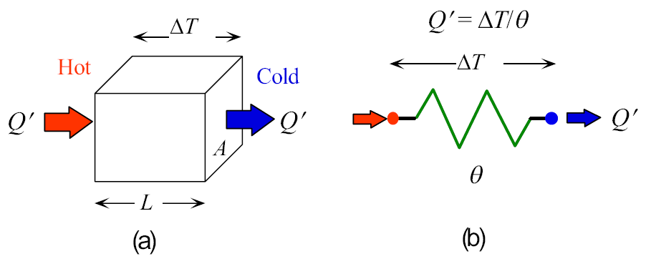
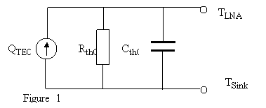
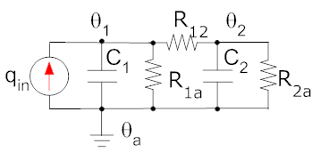
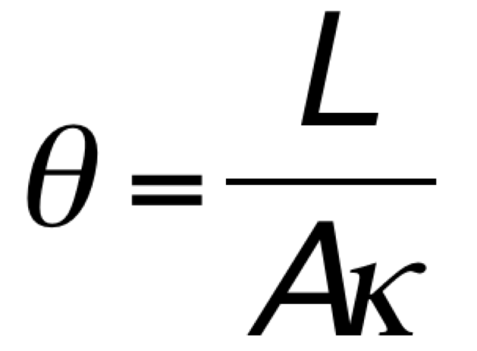
Often we use the simplest modeling approach which is to use a thermal resistance (resistivity or conductivity are used as in electrical current flow)
Devices for Spice
Packaging
To model as a circuit add thermal capacitance to ground and current sources as thermal power generation. Can get quite complicated with thermal coupling and large networks. Gross approximation of numerical solution of PDE.

Slide 9
Heat flow modeling
If we take Heat flow as an example in 3D the equation is:
This is a boundary value problem which may need to be solved for either steady-state dT/dt = 0 or for a full transient solution.
We need to change this into a numerically tractable equation.
There are many methods that have been used:
Finite Difference – will illustrate with heat flow equation in detail.
Finite Element – will illustrate with stress-strain equation a bit of detail
Finite Volume
So called “Meshless methods”
We will first look at the simplest method - Finite Difference for SS

Slide 10
Finite Difference
We will start with a simple formulation.
1D/2D
Uniform mesh
Steady-state
Essentially
Represent the physical system by a nodal network.
Use the energy balance method to obtain a finite-difference equation for each node of unknown temperature.
Solve the resulting set of algebraic equations for the unknown nodal temperatures.

Slide 11
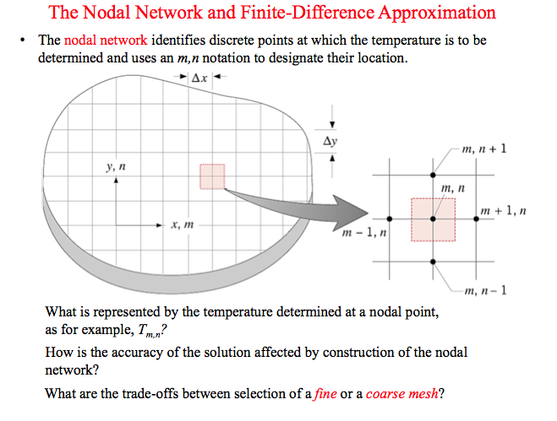

Slide 12
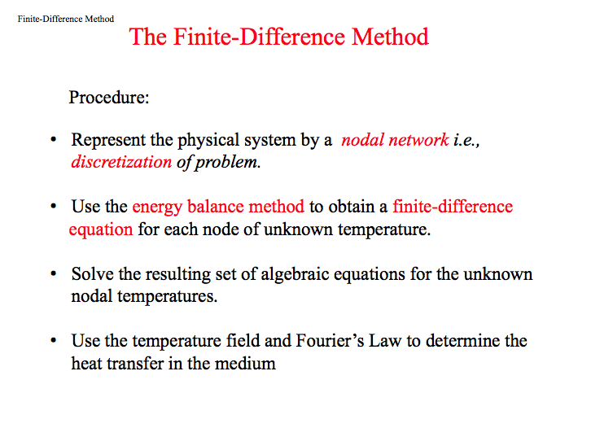

Slide 13
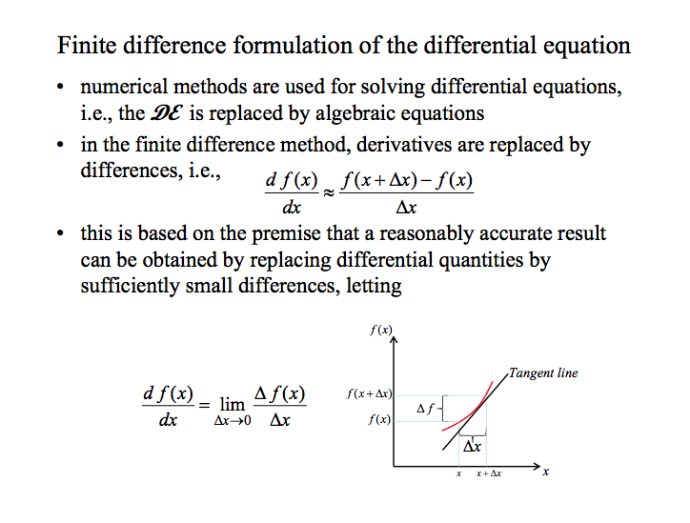

Slide 14
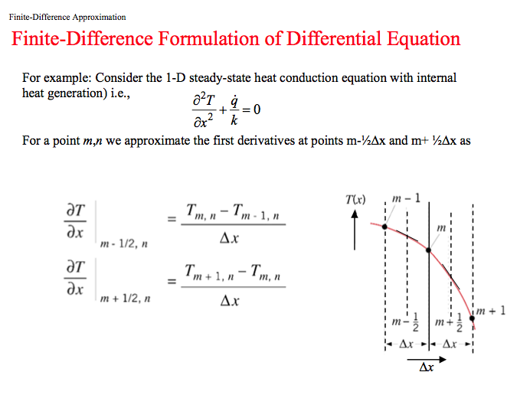

Slide 15
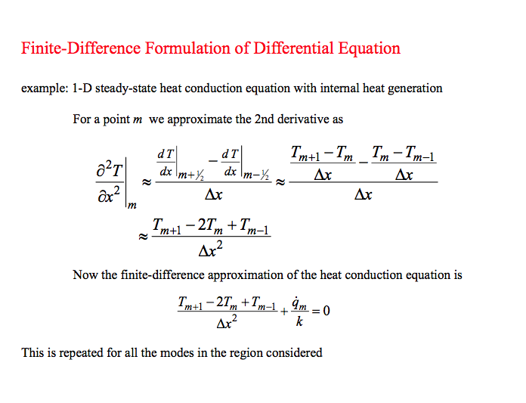

Slide 16
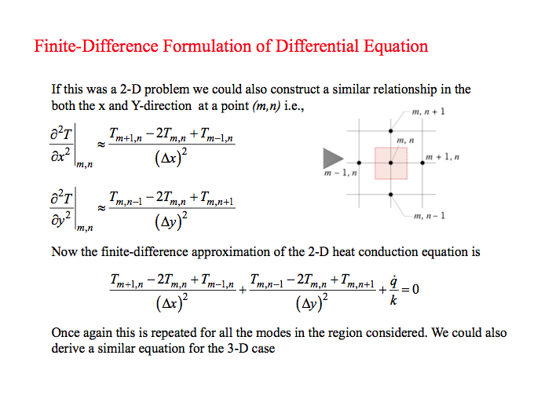

Slide 17

boundary nodes
This formula is valid for every internal node in a 2D domain.
We also have to consider nodes on boundaries. Generally two cases (although there are others):
Fixed: T_{m,n} = T_{BC}
Adiabatic (no heat flow) for example:
T_{m,n} = T_{m-1,n} – for the right side
T_{m,n} = T_{m,n+1} – for the bottom side

Slide 18
Solve by iteration
Natural method is to create a matrix of T’s
Use Δx = Δy = Δ
Solve for T(m,n) and iterate from initial guess of T.
Simply repeatedly solve for T(m,n) from previous T’s
Check for convergence
Must use special equations for boundaries
Slow and never really gets there!

Slide 19
Better: Use a set of equations
We have an equation for every node in the region:
For internal nodes we have three possible contributions:
Heat flows to neighboring nodes
Heat generated at the node
Heat flow into the thermal capacitance of the “cell”
For boundary nodes we have equations either fixing the T or setting the flow to zero.
We have m X n unknowns T_{m,n} and m X n linear equations!

Slide 20
Matrix formulation
As each Node has a unique linear equation linking T’s and BC’s around it. All the equations can be assembled into a matrix equation representing a set of N equations for N unknowns.
For steady-state (no C dT/dt term ) we would have
Where T is a vector of the unknowns (the T_{m,n}’s) , ρ a vector of generated heat and G a matrix that connects the neighboring nodes.
The matrix G is a discrete operator that is equivalent to and take the second spatial derivative.
Solution for SS case by matrix inversion

Slide 21
1D-Transient and Non-linear
If we include a thermal capacitance and use a simple example:
6 points
Fixed T’s at ends
We get matrices like these
Extension for non-linear and we have an equation such as:
With solution by explicit or implicit time integration with Newton iteration if non-linear.

Slide 22
Programing Example of Electrostatics
Exactly the same equation
Define ρ as charge
Define BC
φ(BC) = Const.
Dφ/dn = Const.
Or mixed
For inhomogeneous need permittivity ε(x,y)
As before use FD

Slide 23
Implementation Example - Electrical Conduction Modeling
Conduction modeling is very similar.
Solve Poisson equation (T or V – same equation for temperature or voltage)
Descritize region using delta x and y
2D finite difference
2D uniform mesh spacing of Δ gives equation at each point. Use i for x and j for y.
BC of 1 on left and 0 on right side of region
Get matrix equation by assembling set of equations for each point.

Slide 24
I use the Matrix Equation approach
G is very sparse
B has a few 1’s from BC on left
What about different ρ’s (σ’s) for different materials.
Anisotropic and varying.
Easier way to think of it is as 4 resistances (circuit).
Each resistor has a value given by σ(x,y) – conductivity map

Slide 25
Example for Why?
Complex structures cannot be solved using analytical techniques
Approximate methods use averaging of conductivity regions
Example of nano-structured materials

Slide 26
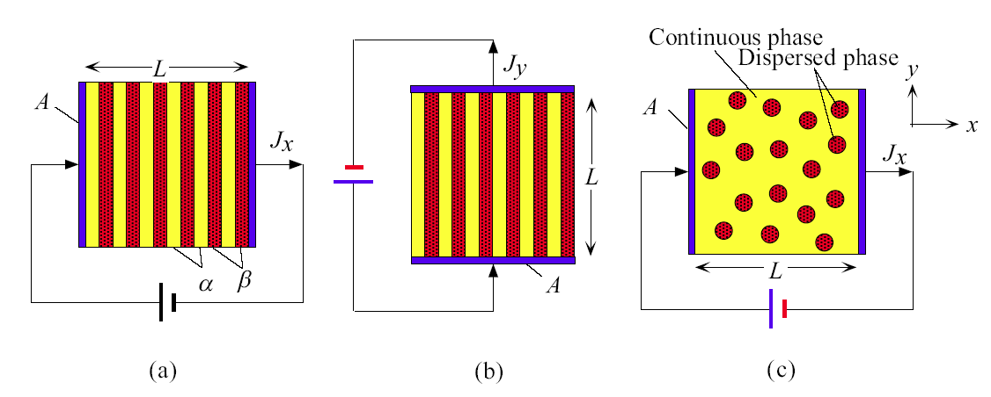
Mesoscopic Structure effects
The effective resistivity of a material with a layered structure.
Along a direction perpendicular to the layers.
Along a direction parallel to the plane of the layers.
Materials with a dispersed phase in a continuous matrix.
Structure makes life difficult
Anisotropic?
Random?
Electromagnetic (AC) effects
even more difficult.

Slide 27
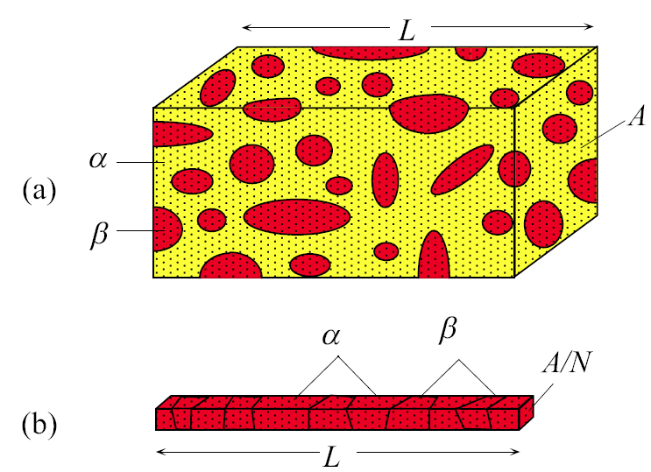
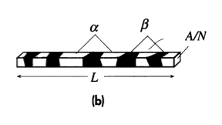
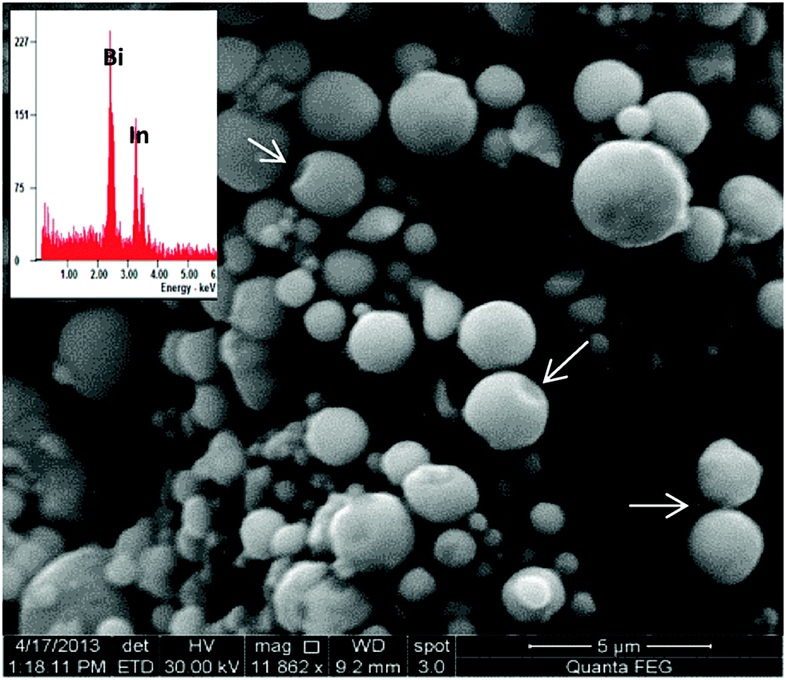
Macroscopic geometry and meso-scopic structure
Size and structure can mix to make things complicated.
Thin metal lines can have alternating phases.
Embedded nano particles?
A two-phase solid.
A thin fiber cut out from the solid.

Slide 28
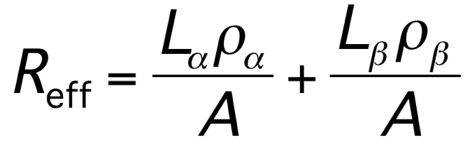
Effective Resistance of Mixtures
For a structure which results in resistors in series.
R_{eff} = effective resistance L_{α} = total length (thickness) of the α-phase layers ρ_{α} = resistivity of the α-phase layers A = cross-sectional area L_{β} = total length (thickness) of the β-phase layers ρ_{β} = resistivity of the β-phase layers

Slide 29
Resistivity-Mixture Rule
ρ_{eff} = χ_{α}ρ_{α} + χ_{β}ρ_{β}
In series!
ρ_{eff} = effective resistivity of mixture, χ_{α} = volume fraction of the α-phase, ρ_{α} = resistivity of the α-phase, χ_{β} = volume fraction of the β-phase, ρ_{β} = resistivity of the β-phase
Conductivity-Mixture Rule
σ_{eff} = χ_{α}σ_{α} + χ_{β}σ_{β}
In parallel!
σ_{eff} = effective conductivity of mixture, χ_{α} = volume fraction of the α-phase, σ_{α} = conductivity of the α-phase, χ_{β} = volume fraction of the β-phase, σ_{β} = conductivity of the β-phase

Slide 30
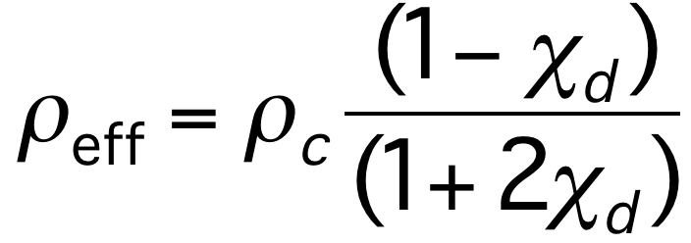
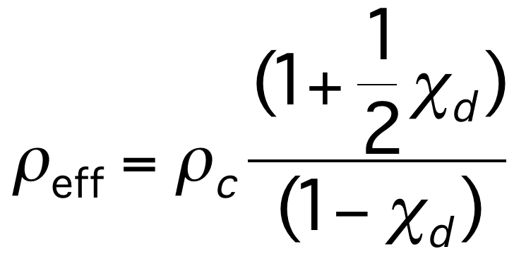
Mixture Rule (ρ_{d} > 10ρ_{c} )
Random structures are much more difficult to model.
Mixing formulas can be derived, but are of limited use.
Other transport mechanisms are sometimes present. Hopping from conductive island to conductive island is how transport in some polymers works.
We may have to do a detailed model of the transport.
Even more complicated for AC, particularly high frequencies.
ρ_{eff} = effective resistivity, ρ_{c} = resistivity of continuous phase, χ_{d} = volume fraction of dispersed phase, ρ_{d} = resistivity of dispersed phase
Mixture Rule (ρ_{d} < 0.1ρ_{c} )
ρ_{eff} = effective resistivity, ρ_{c} = resistivity of the continuous phase, χ_{d} = volume fraction of the dispersed phase, ρ_{d} = resistivity of the dispersed phase

Slide 31
Conduction Code
Creates a conductivity map cMap(i,j)
Adds random number of circular or elliptical inclusions
Random size to maximum radius
Maps nodes from (i ,j) to node number n
Creates G matrix
Assumes 1V on left side 0V on right
Top/Bottom sides insulated
Solves for V and then Ex and Ey and then Jx, Jy
Plots V, Ex, Ey, Jx, Jy

Slide 32

GetCurrents.m – Calculates Current
Inputs:
ngeo : number of geometric inclusions
Max : maximum size of inclusion
nx : length of region
ny : width of region
Acond : background conductivity
Bcond : inclusion conductivity
plot : flag to plot V, E, and J
SimType : `c’ – circular inclusions, `e’ – elliptical inclusions
Outputs:
Curr : Total currents through device

Slide 33
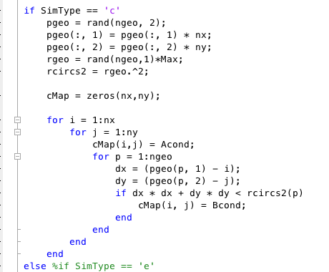
Conductivity Map
σ(x,y) (cMap) from geometry of inclusions
Use two types of inclusions:
Circles (random position, size and number)
Ellipses (random orientation and position)
Create a conductivity map to help make the G matrix
Example of circles
Random position vector of (x,y)’s
Random radius
Initialization
Explicit loop to set cMap(I,j)
Remove loops?

Slide 34
Mapping of Nodes and Equations for 2D FD
(i,j) -> n
(i-1,j) -> nxm
(i+1,j) -> nxp
(i,j-1) -> nym
(i,j+1) -> nyp
Local mapping of nodes around (i,j)
Mapping equation
Spatial region
ny
(i,j) cell has a unique unknown and is mapped to n
6
6*7
n
(i,j) -> n
j/y
2
8
V vector is nx*ny long
1
7
1
1
i/x
nx
Equation for the (i,j) -> n’th
Cell is put in the n’th line of the G matrix.
Special equations for boundary Nodes!
G Matrix size is square and nx*ny in size. Mainly 0’s

Slide 35
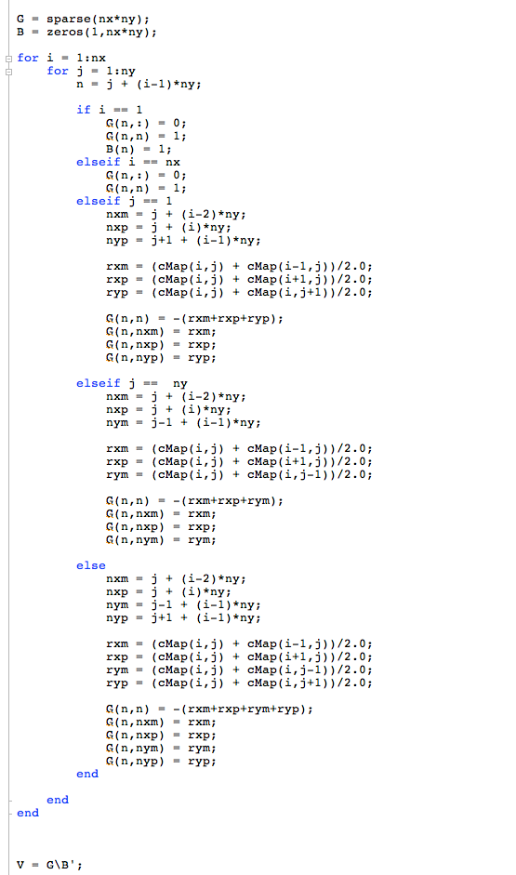
Create G matrix and B vector
Node Mapping
I did it directly. Not with stamps.
Did use the resistor concept to help define the flow.
KCL – For SS current conserved at node and ΣI = 0
Averaged σ for interface cells between two materials.
I’ve not worried about “size” (Δ) as everything sort of shakes out in the end
Node numbering is important to note. We have nx*ny nodes.
Node mapping eq.
Left Side – Set Voltage G(n,n) = 1 B(n) = 1
Right Side – Set Voltage G(n,n) = 1 B(n) = 0
Bottom Side - No Flow
Only three resistors
Top Side - No Flow
Only three resistors
6
6*7
Bulk – Four resistors
2
8
1
7
Node ordering

Slide 36
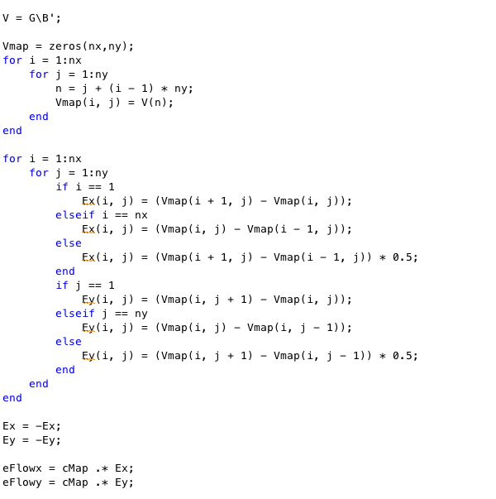

Solve and Post Process
Node Mapping
Left Side – Set Voltage G(n,n) = 1 B(n) = 1
Solve using \
Map voltages back to matrix form for plotting and taking gradient
E = grad(V) – this could be done with matlab fct grad()
J = cMap*E
Calculate total current as average of end currents (should be the same! Are they?).
Backwards node mapping
Right Side – Set Voltage G(n,n) = 1 B(n) = 0
Gradient of V
Bottom Side - No Flow
Only three resistors
Top Side - No Flow
Only three resistors
Bulk – Four resistors

Slide 37
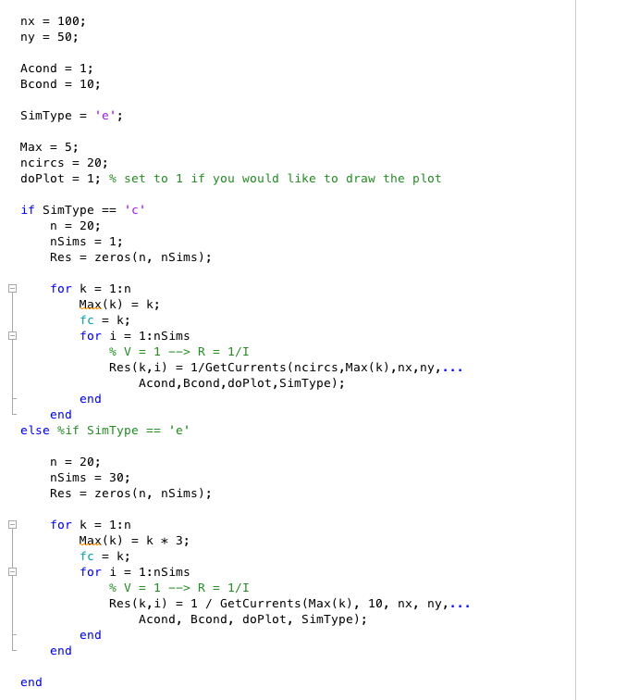
Analysis – FD + Monte Carlo
CurrentCode.m calls many GetCurrents()
Multiple runs to find out scatter (Monte Carlo) as function of different structures and parameters
Variety of radii
Stores result in in Res matrix
Plot current and scatter as function of structure and parameters

Slide 38
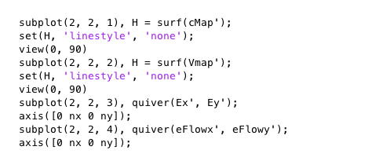
Circles -- 20 different simulations
Each simulation is shown as scene in the movie
Random circle positions
Random size up to a maximum
Plot using surf() and quiver()

Slide 39
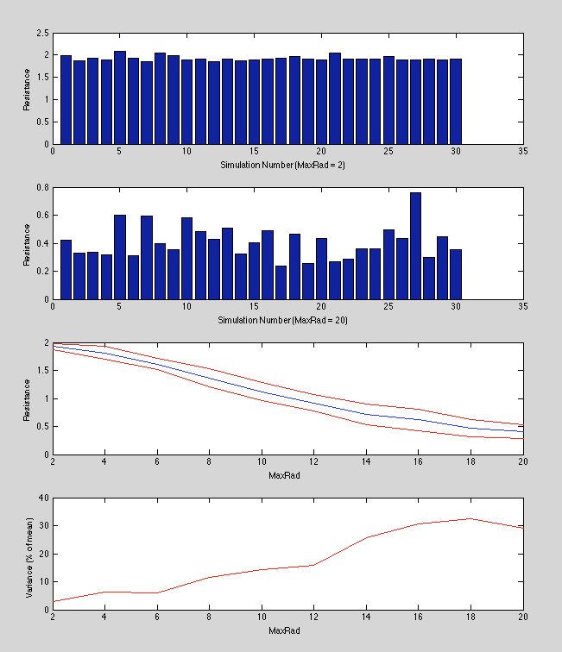
30 runs for each structure
Each structure had:
Specific max radius
20 circles
30 runs of each structure
Keep track of resistance (V/I)
Bar graphs show simulations for two structures (first and last)
First graph shows mean and std. dev of resistance as function of max radius.
Second graph shows normalized variance (% of mean).

Slide 40
Ellipse simulation
Fixed size
Random orientation and position
Variable number of objects

Slide 41
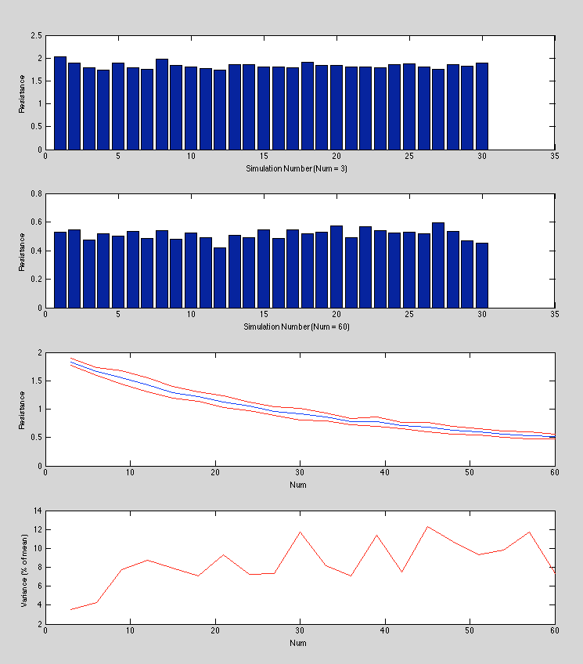
30 runs for each structure
Each structure had:
Specific size
variable number of ellipses
30 runs of each structure
Keep track of resistance (V/I)
Bar graphs show simulations for two structures (first and last)
First graph shows mean and std. dev of resistance as function of max radius.
Second graph shows normalized variance (% of mean).

Slide 42
Solution Methods
Finite Difference Summary
Good things:
Very nice simple transparent formulation
Simple meshing
Simple programming
Easy debugging
Bad Things:
Simple meshing
Difficult to do non rectangular geo
Difficult to do non-uniform meshing
Finer mesh in regions of strong heat flow are an example of what would be nice

