Slide 1

Welcome

Slide 2
Child learning System
Project Name

Slide 3
Child Learning system
Child learning system is a simple project by which any children can learn alphabet and number easily

Slide 4
Objective of the Project
EMU 8086 based System needed
Multiple option is available in the system
User friendly interface

Slide 5
Implementation & Technology Used in the Project
Assembly language
Emu 8086 compiler used to built the project
Data bus used

Slide 6
Flow chart
Start
Input any
Input 1/*
Study
decision
Input
Decision
Exit
Output

Slide 7
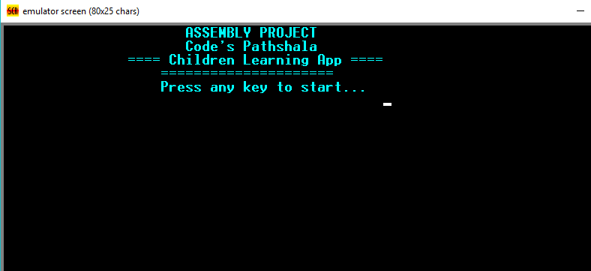
Sample output
After run the application this start page will come

Slide 8
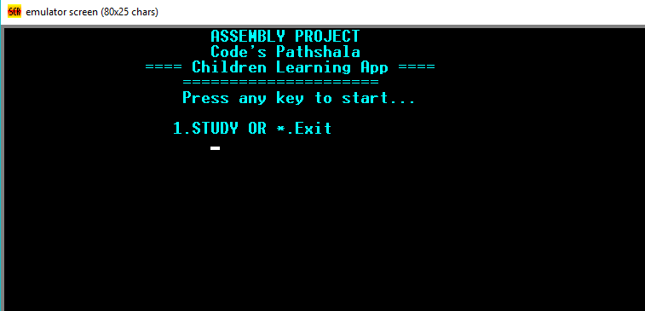
Sample output
If press any key then a menu will show.
There have two option Study and Exit

Slide 9
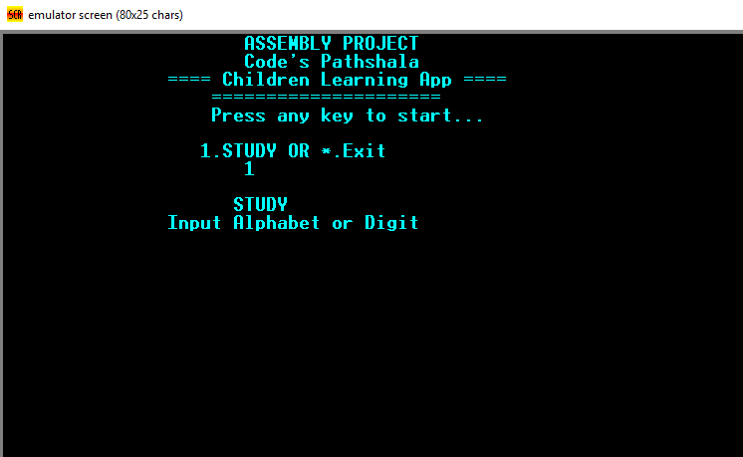
Sample output
If we press 1 the study option will select

Slide 10
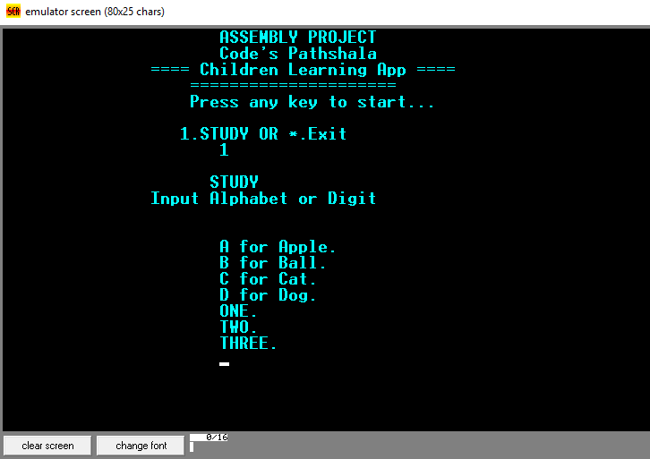
Sample output
If any alphabet or digit is selected then a word will come which is made of the entered letter

Slide 11
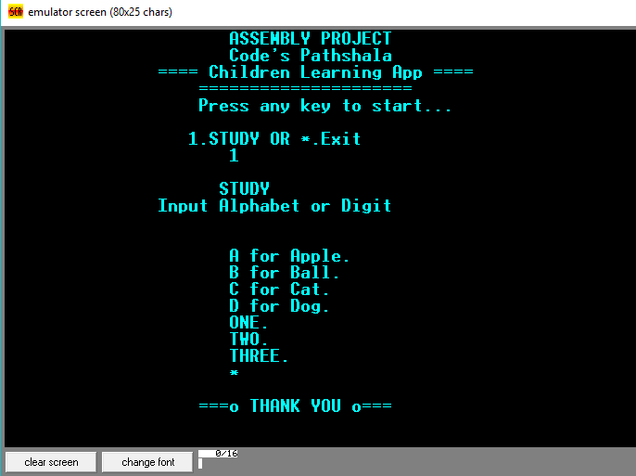
Exit
When * is pressed the program will exit

Slide 12
Find the YouTube video of this project :
https://youtu.be/egjbGw_lJpc

Slide 13
Thanks!!!!!!!!!!

