Slide 1
A Convolution Neural Network based Classification Approach for
Recognizing Mangrove family trees.
MD OSMAN GANI KHAN MASUM
ID: 152–15–5845
MD. SADEQUL ISLAM
ID: 151–15–5019
MD. TAREK HABIB
Assistant Professor
Department of CSE
Daffodil International University
Friday 3 May 2019

Slide 2
Outline
Introduction & Motivation
Problem Definition
Background
Literature review
Methodology
Findings
Recommendations
Future work and conclusions
Publication

Slide 3
Introduction & Motivation
Mangrove trees of Bangladesh and others.
Impact of Computer Vision & CNN
Our Contributions

Slide 4
Problem Definition
To:
classify and detect of valuable Mangrove trees using CNN algorithms;
distinguish between our most valuable beneficial trees from rest of them.
find a better, accurate and usable model;

Slide 5
Background
Machine Learning Framework : Tensorflow
Deep Learning Algorithm: CNN and Its Model (Inception-v3)
Python Packages and Library: Python 3, Keras, Scikit Learn.

Slide 6
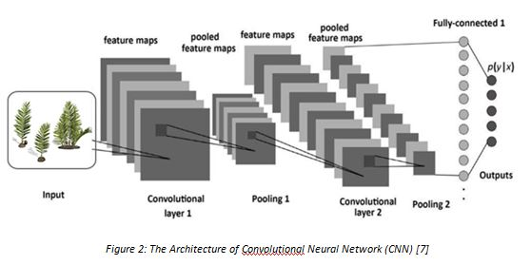
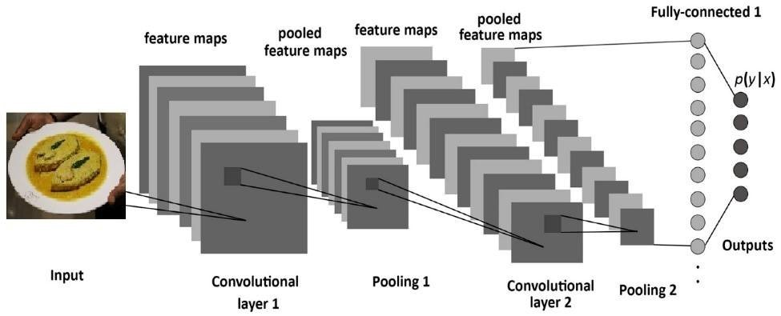
Background
Convolutional Neural Network (CNN)

Slide 7
Literature Review
Used Model: Inception-v3
Author | Title | Dataset | Accuracy
Xiaoling Xi, Cui Xu et al. | Inception-v3 for flower classification | Oxford-I7, Oxford-102 | 95% on Oxford-I7, 94% on Oxford-102
Alwyn Mathew, Jimson Mathew et al. | An Improved Transfer learning Approach for Intrusion Detection |  | 95.3%
Brady Kieffer, Morteza Babaie et al. | Convolutional Neural Networks for Histopathology Image Classification: Training vs. Using Pre-Trained Networks | Kimia Path24 | 56.98%
Xiao-Ling Xia, Cui Xu et al. | Facial expression recognition based on tensorflow platform | CK+ | 97%

Slide 8
Methodology
Tools or Instruments
2.7 GHz Intel i5 processor
4GB memory
1600MHz DDR3
64-bit Operating System
x-64 based processor

Slide 9
Methodology
Working Steps
Data
Collection
Image Pre-
processing
Inception-v3
Installation
Train & Validation
Test Model
Performance Evaluation

Slide 10
Methodology
Data Collection
Internet
Relatives and Friends

Slide 11
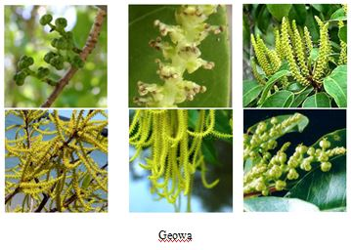
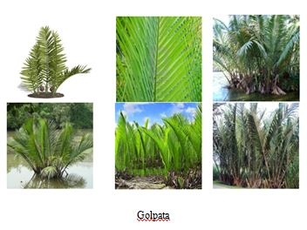
Methodology
Dataset

Slide 12
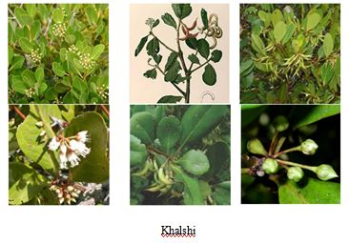
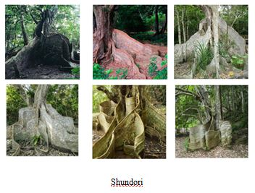
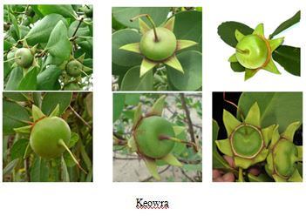
Methodology
Dataset

Slide 13
Methodology
Data Processing
Cropped image manually with OS tools
Resized image with Adobe Photoshop
Labeled image

Slide 14
Methodology
Dataset Properties
5 classes of trees
Mean value of each items is around 600 Images
300 x 300px used in Inception-v3

Slide 15
Methodology
Implementation Requirements
Model Installation
Train model

Slide 16
Findings
Model Evaluation
Experiment | Total Data | Training Data | Validation Data | Test Data
Inception V3 | 3000 | 2400 | 300 | 300

Slide 17

Findings
Test Accuracy of Inception-v3 and MobileNet-v1

Slide 18
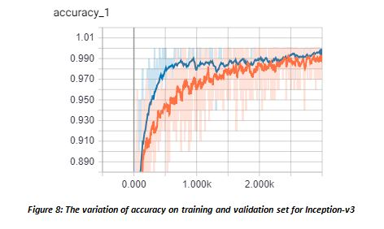
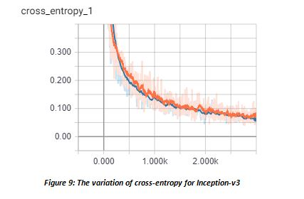
Findings
Experimental Results of Inception-v3

Slide 19
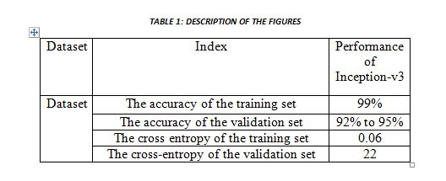
Findings
Description of The Figures

Slide 20
Future Work
Increasing dataset
Working with varieties of food items
Will implement some other CNN based models
Working with real system

Slide 21
Conclusion
First work of its kind.
We constructed the classification model only.
The result is quite satisfactory as well as encouraging.
All our works are open access and open source.
Will inspire researchers from various countries to work on their traditional items.

Slide 22


